Slide 1
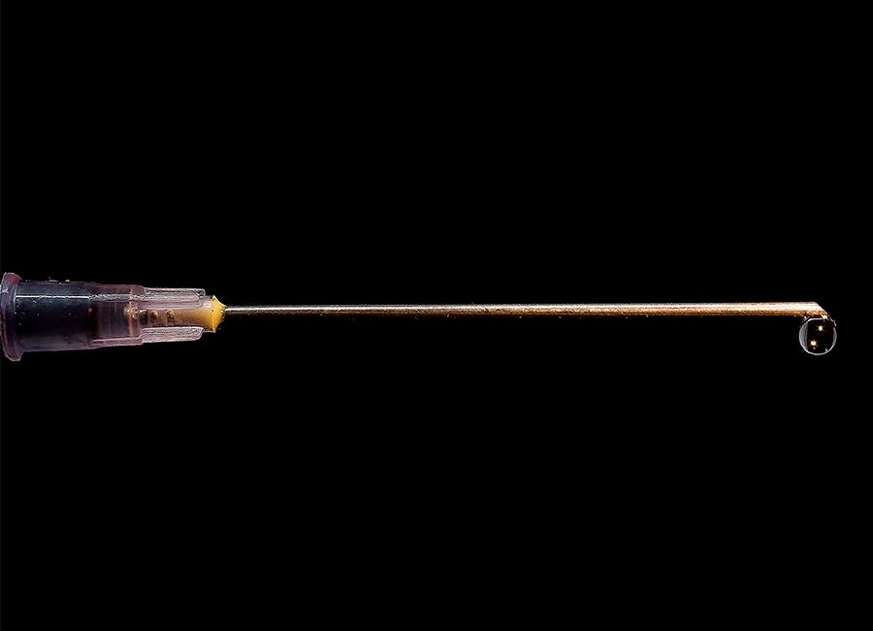
Vaccination in Jewish Law and Thought 11th January 2021 at 8pm Rabbi Dr Moshe Freedman Rabbi, New West End Synagogue Deputy Co-chair of MEAG (Moral and Ethical Advisory Group to DHSC)

Slide 2
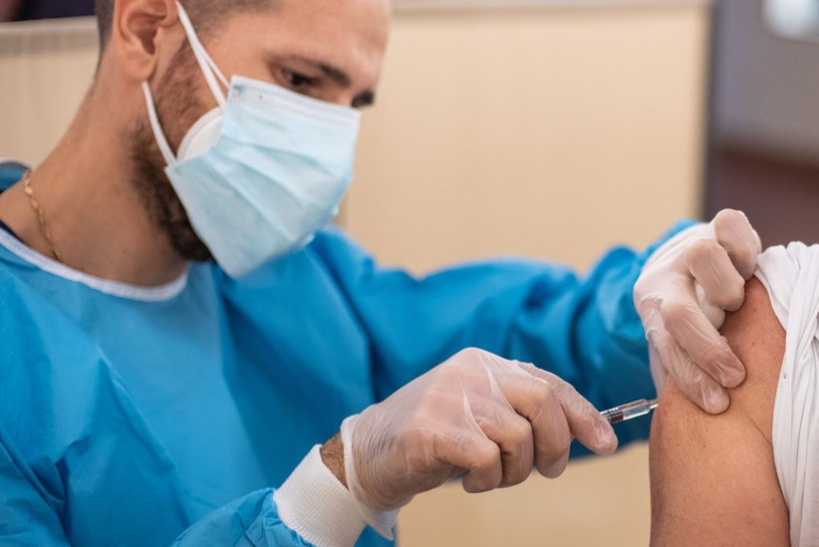
PART 1: Introduction
How do Infections Spread?
How do Vaccines work?
PART 2: History of Vaccines
PART 3: Contemporary Issues
The Imperative to Remove Danger and Protect Life
Dina d’Malchusa Dina
What goes into a Vaccine?
But Rabbi, I have faith that God will protect me!
PART 4: Ethical Issues
Herd Immunity
The Anti-Vaxxer Movement
Compulsory or Encouraged Vaccination
PART 5: Conclusion

Slide 3
Introduction

Slide 4
How do Infections Spread?

Slide 5
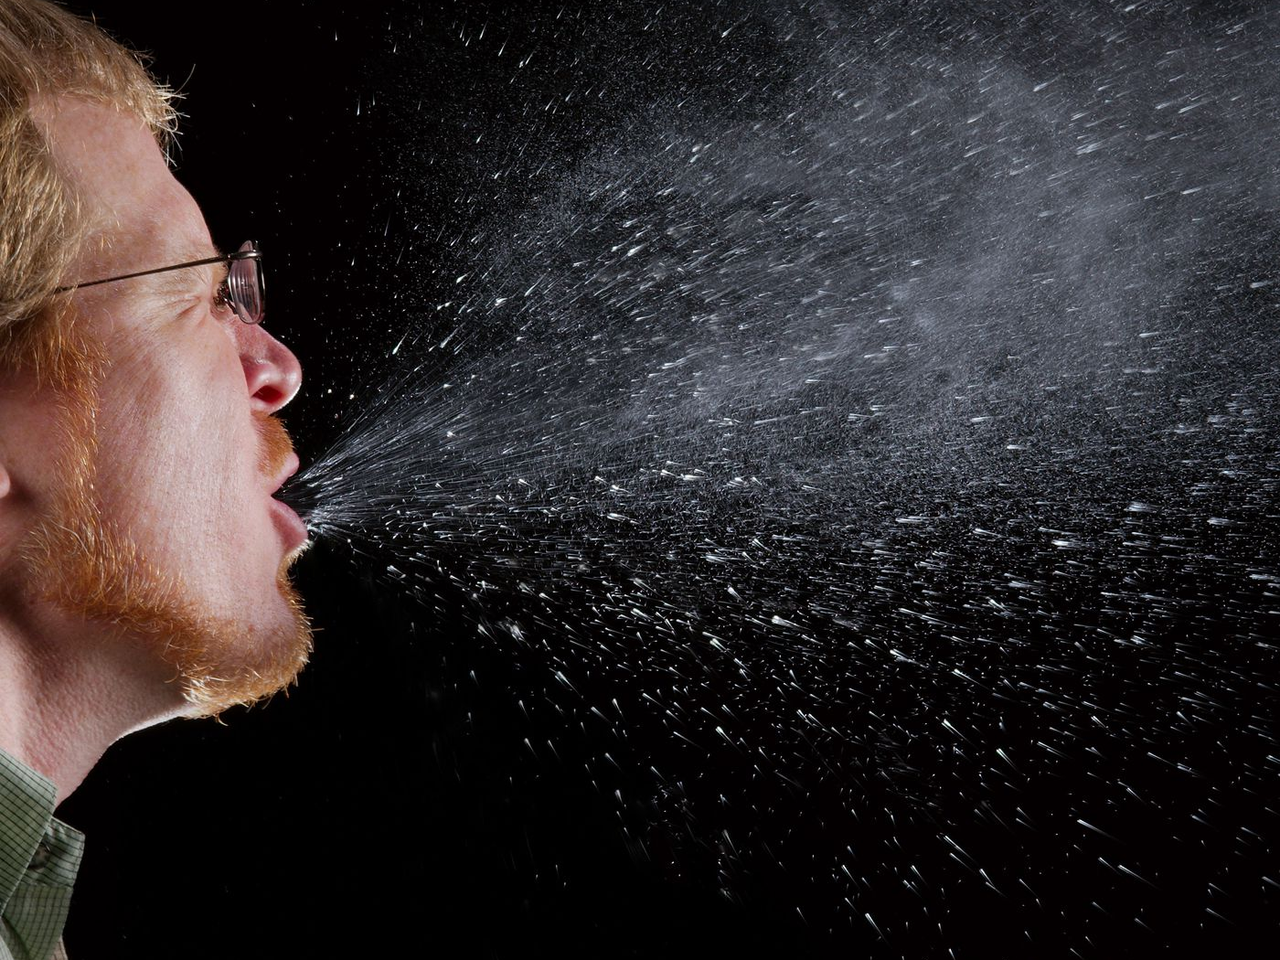

Slide 6
Antigen (such as virus)
Binding site

Slide 12
Antibody such as B Lymphocyte
Protein receptors
Antigen

Slide 21
How do Vaccines Work?

Slide 22
Live-attenuated vaccines
zzzz
Active virus
Attenuated virus
Measles, mumps, rubella (MMR combined vaccine)
Rotavirus
Smallpox
Chickenpox
Yellow fever

Slide 23
Inactivated vaccines
Active virus
Inactivated virus
Hepatitis A
Flu (shot only)
Polio (shot only)
Rabies

Slide 24
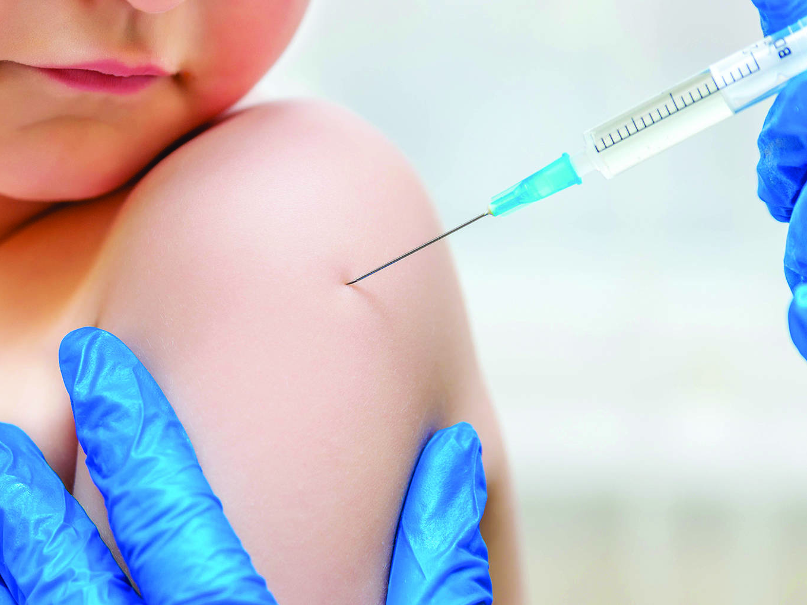

Slide 26
The body’s immune system reacts, produces antibodies and activates T-cells to destroy cells with the spike protein

Slide 32
Viral Vector Vaccines
Harmless adenovirus which causes the common cold in monkeys
Active virus
Adenovirus containing gene coding
S protein from SARS-COV-2

Slide 33
mRNA Vaccines
The body’s immune system reacts, produces antibodies and activates T-cells to destroy cells with the spike protein

Slide 34
mRNA Vaccines
Active virus
mRNA

Slide 35
mRNA Vaccines
Human cell
Some cells absorb the RNA
The mRNA instructs the cells to produce the SARS-CoV-2 spike protein
The body’s immune system reacts, produces antibodies and activates T-cells to destroy cells with the spike protein

Slide 36
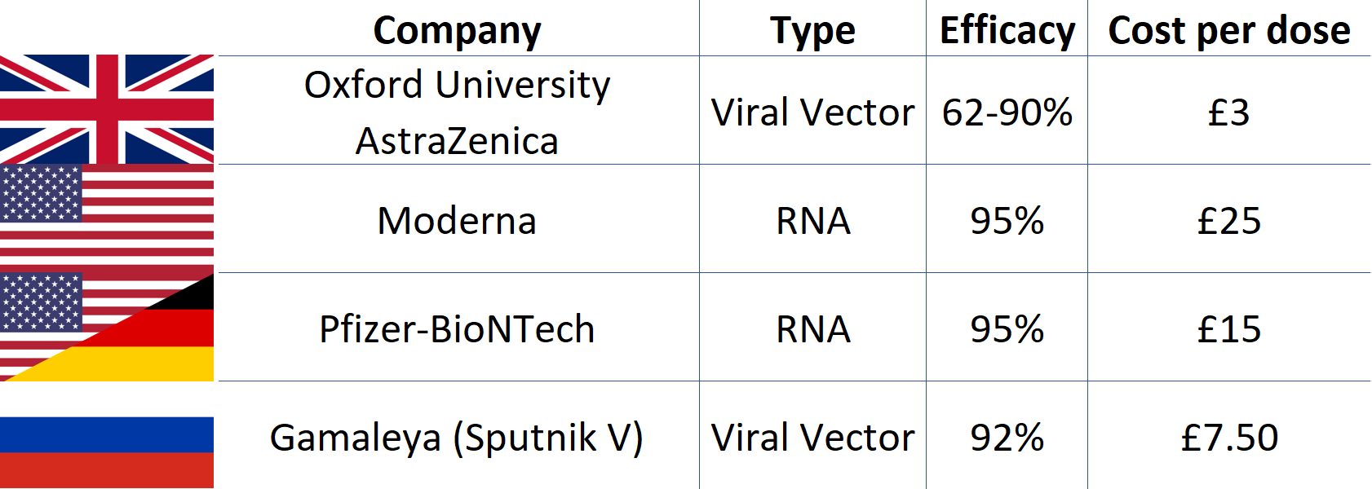
Current SARS-CoV-2 Vaccines

Slide 37
History of Vaccinations

Slide 38
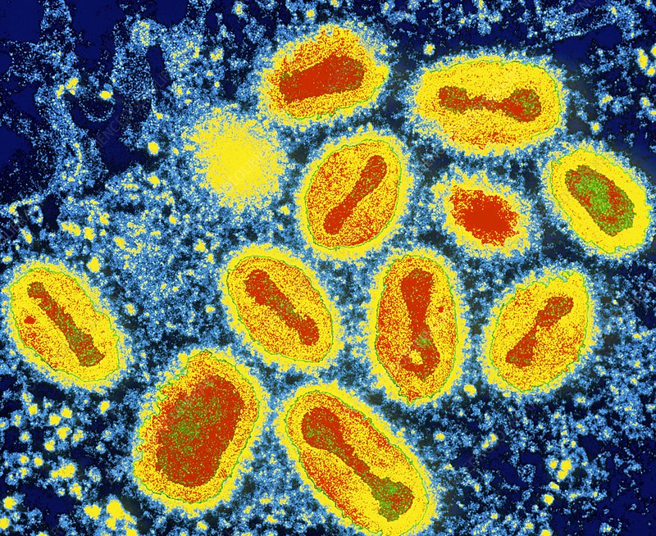
Smallpox was an infectious disease caused by one of two virus variants, Variola major and Variola minor.

Slide 39
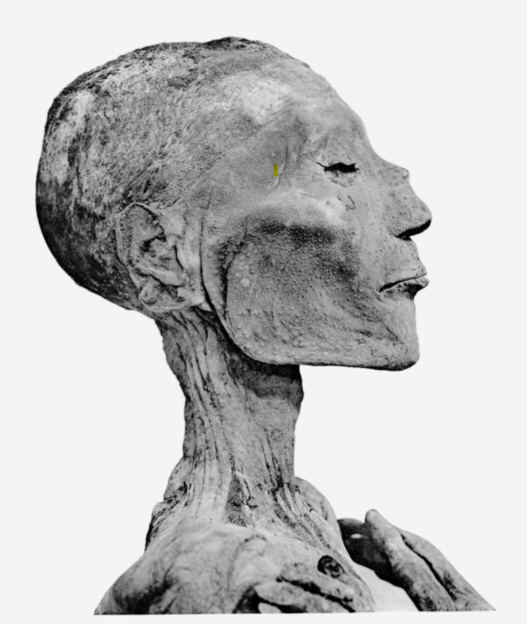
Ramses V is believed to be the first known victim of smallpox after examining the pustules found on his cheeks.
Notes:
Based on a smallpox-like rash found on three mummies, it is thought to at least date back to the Egyptian Empire, around the 3rd century BCE.

Slide 40
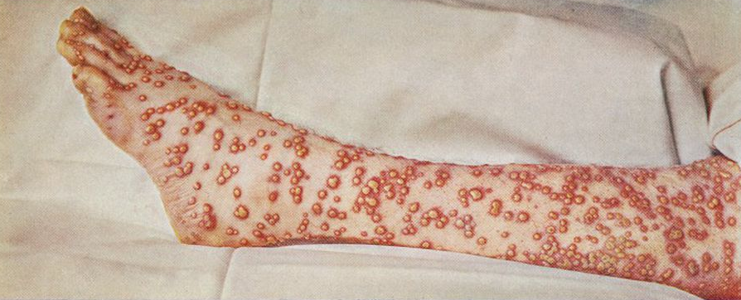
The earliest written description of a disease that clearly resembles smallpox appeared in China in the 4th century CE while early written descriptions also appeared in India in the 7th century and in Asia Minor in the 10th century.

Slide 41
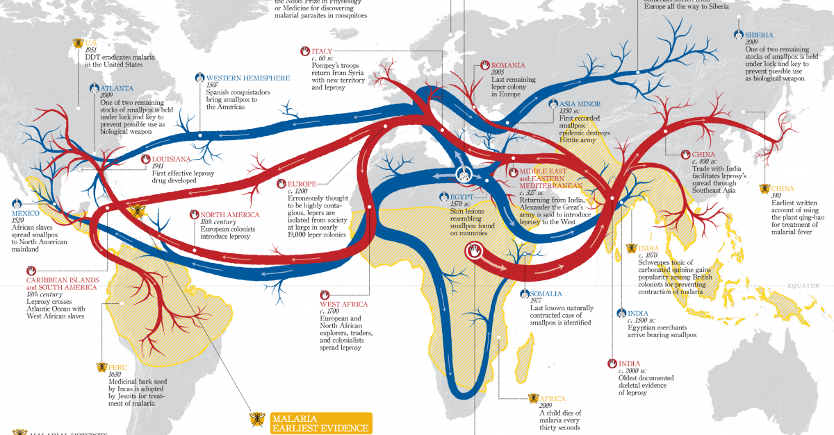
Smallpox likely started in farming communities even earlier, perhaps as much as 10,000 years ago. The global spread of smallpox can be traced to the growth and spread of civilizations, exploration, and expanding trade routes over the centuries.

Slide 42
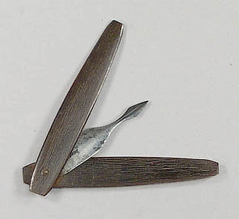
Notes:
One of the first methods for controlling the spread of smallpox was the use of variolation. Named after the virus that causes smallpox (variola virus), variolation is the process by which material from smallpox sores (pustules) was given to people who had never had smallpox. This was done either by scratching the material into the arm or inhaling it through the nose. With both types of variolation, people usually went on to develop the symptoms associated with smallpox, such as fever and a rash. However, fewer people died from variolation than if they had acquired smallpox naturally.

Slide 43
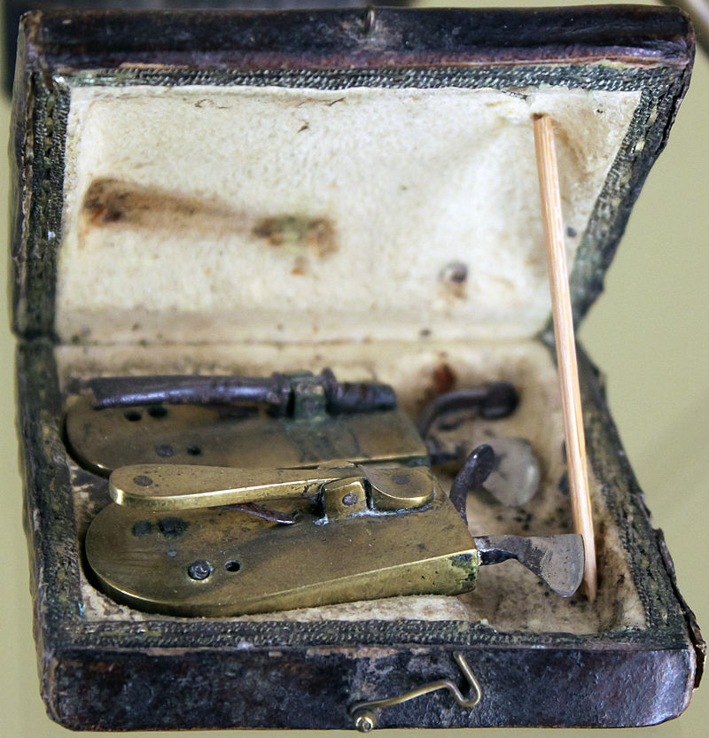
Variolation was usually carried out by Barber-Surgeons, who had performed procedures such as bloodletting (left) since the Middle Ages.

Slide 44
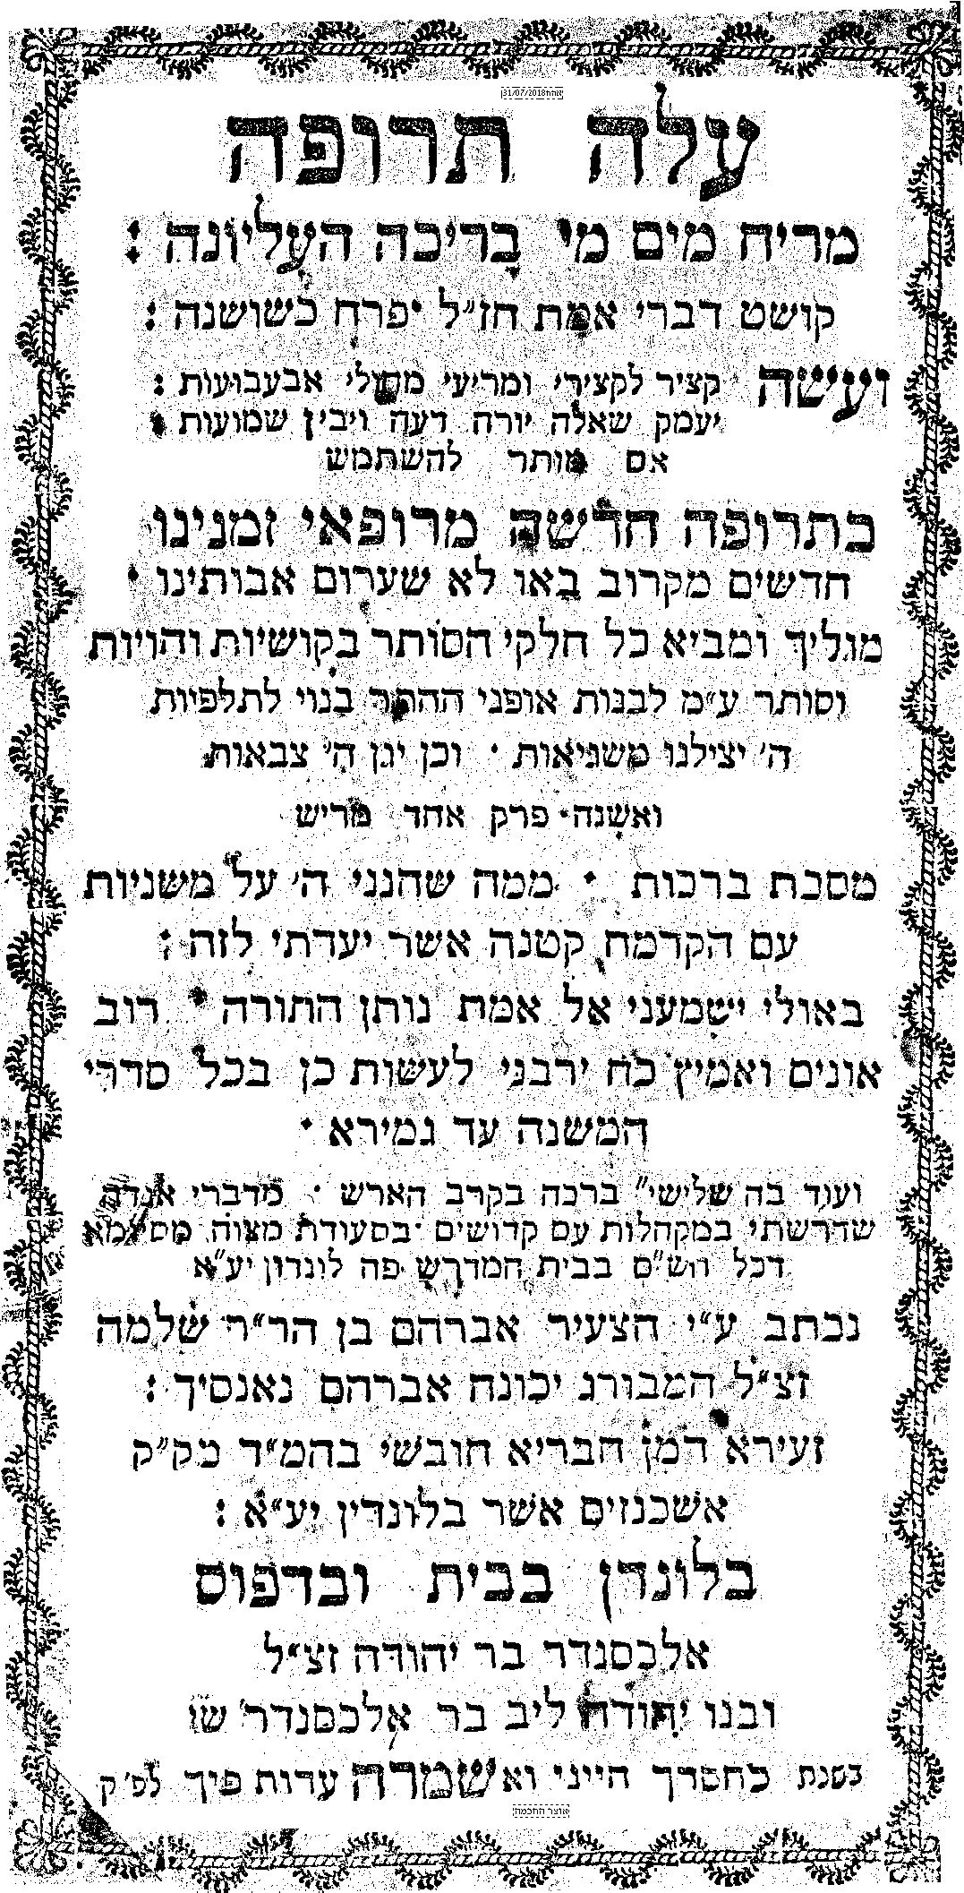
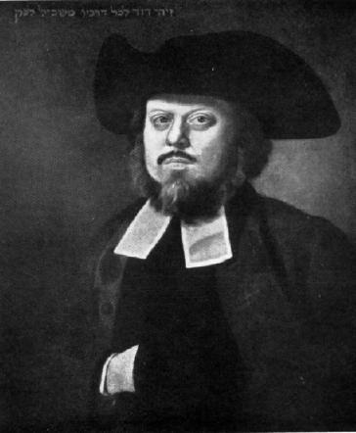
Rabbi Avraham ben Shlomo Hamburger who originated in Nancy in the Duchy of Lorraine, was a scholar and Dayan in the Hambro Synagogue in London under the leadership of Chief Rabbi David Tevele Schiff (pictured).
Notes:
In 1785 he published a small pamphlet entitled “Aleh Terufah,” detailing the tragic loss of two of his children to smallpox. Hamburger detailed the halachic imperative to allow and encourage variolation.

Slide 45
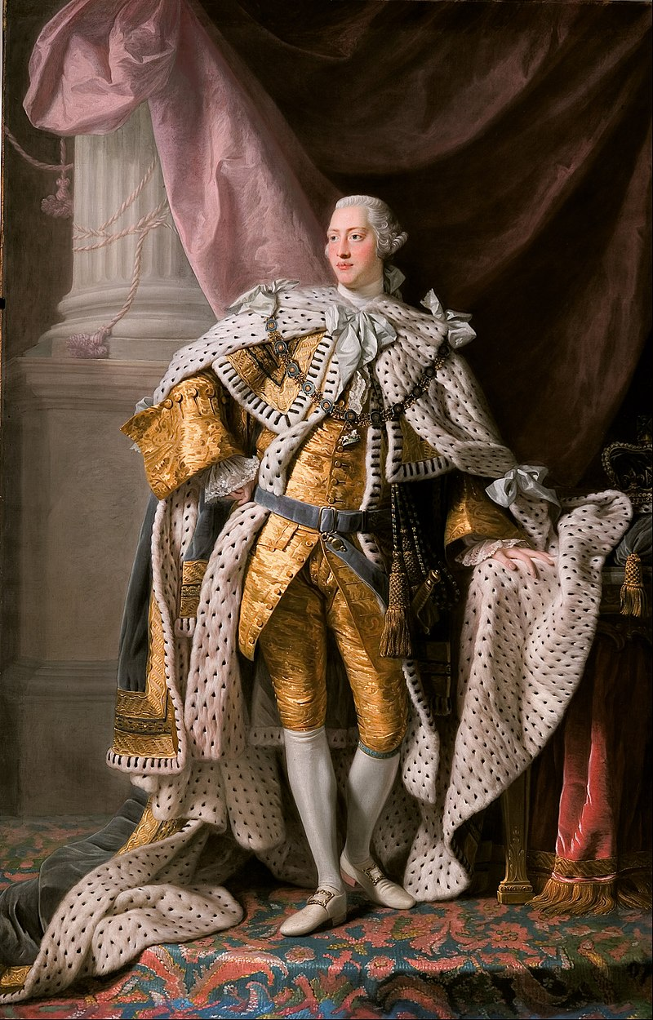
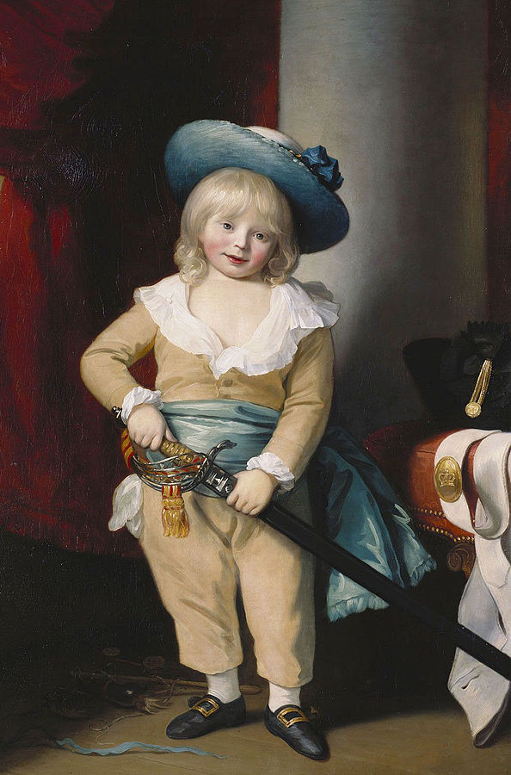
(Left) Coronation of George III (portrait by Allan Ramsay, 1762) and (right) the young Prince Octavius who died in 1783 from the variolation procedure.
Notes:
Variolation was deeply controversial. Six months after the death of his brother Prince Alfred, Prince Octavius (pictured), the thirteenth child (and eighth son) of King George III and his queen consort, Charlotte of Mecklenburg-Strelitz was inoculated with the smallpox virus. Several days later, the young boy became ill and died at the age of four. George was devastated by the loss. His later bouts of madness would involve hallucinations of his two youngest sons.
Mindful of this, Nanzig still argued that ‘the death of one in a thousand’ was no reason to reject ‘so great a benefit’ generally. His treatise has been described as a remarkably early and concise expression of the discipline of medical ethics.

Slide 46
Rabbi Yisrael Lifschitz (d. 1860) was an Ashkenazi rabbi, first in Dessau and then in the Jewish Community of Danzig. He was the author of the commentary "Tiferes Yisrael" on the Mishnah.

Slide 47
תפארת ישראל (בועז) על יומא ח:ג
ומזה נ"ל היתר לעשות אינאקולאטיאן של פאקקען, אף שא' מאלף מת ע"י האינאקולאטיאן עכ"פ שאם יתהוו בו הפאקקען הטבעיים הסכנה קרובה יותר, ולכן רשאי להכניס א"ע בסכנה רחוקה כדי להציל א"ע מסכנה קרובה.
Tiferes Yisrael (Boaz) on Yoma 8:3
From this it seems to me that permission is given to inoculate against smallpox, even though one in a thousand people die from the inoculation. Nevertheless, if one contracts smallpox naturally, the dangers are far greater.

Slide 48
וראיה ברורה לדברי ממ"ש רב"י בטור ח"מ סוף סי' תכ"ו בשם הירושלמי דחייב אדם להכניס א"ע בספק סכנה כדי להציל חבירו מודאי סכנה.
There is clear proof from the words of the Tur [Rabbi Yaakov ben Asher, d. 1340] on Choshen Mishpat 426 in the name of the Talmud Yerushalmi (Terumot 8) that one is obligated to put themselves in a situation of potential (but not definitive) danger in order to save the life of another person from certain danger.

Slide 49
והרי ברואה חבירו טובע בנהר אינו מוחלט ודאי שיטבע אם לא יציל הוא. וכי לא אפשר שינצל ממקום אחר. ואם להציל חבירו יש חיוב להכניס א"ע בספק סכנה, מכ"ש שיהיה רשות בידו להציל את גוף עצמו ע"י הכנסו א"ע לספק סכנה.
For example, someone who sees another person drowning in a river where it is uncertain that he will drown if he does not save him, and it is impossible that help will come from anywhere else. If he can save this other person, he has an obligation to put himself in a situation of potential danger. [If that is the case, then], all the more so, he is permitted to save himself from entering into a situation of potential danger.

Slide 50
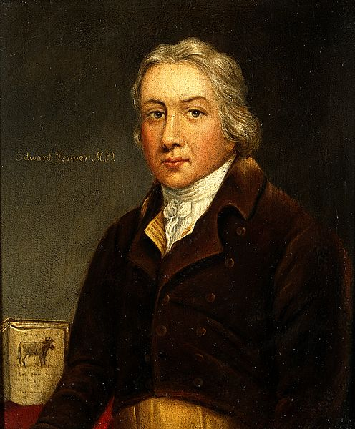
English physician and scientist Edward Jenner (1749 –1823)

Slide 51
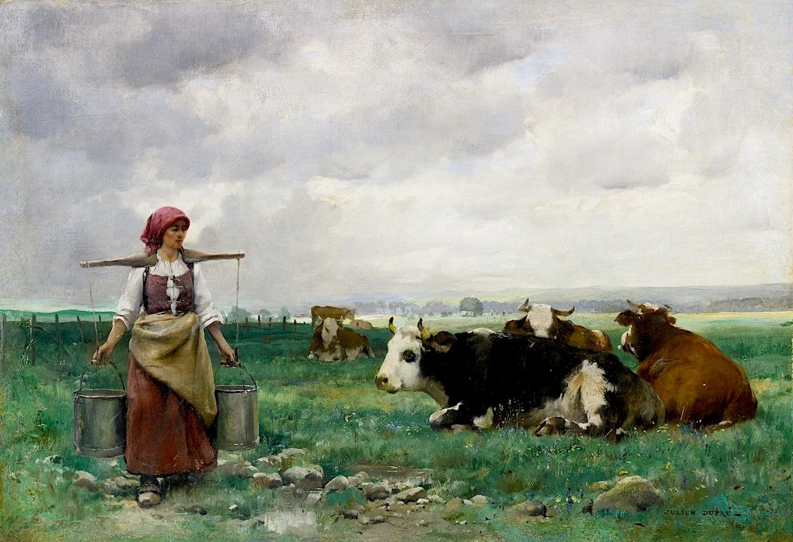
The basis for vaccination began in 1796 when Jenner observed that milkmaids who had contracted cowpox did not show any symptoms of smallpox after variolation.

Slide 52
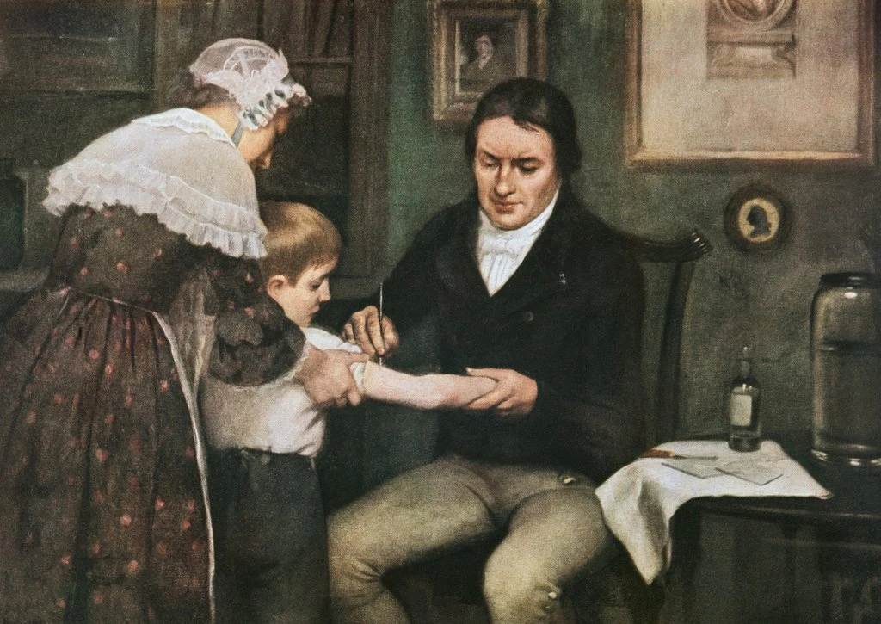
The first experiment to test this theory involved milkmaid Sarah Nelmes and James Phipps, the 9 year-old son of Jenner’s gardener. Dr. Jenner took material from a cowpox sore on Nelmes’ hand and inoculated it into Phipps’ arm. Months later, Jenner exposed Phipps a number of times to the variola virus, but Phipps never developed smallpox.
Dr. Edward Jenner performing his first vaccination against smallpox on James Phipps, May 14, 1796, oil on canvas by Ernest Board

Slide 53
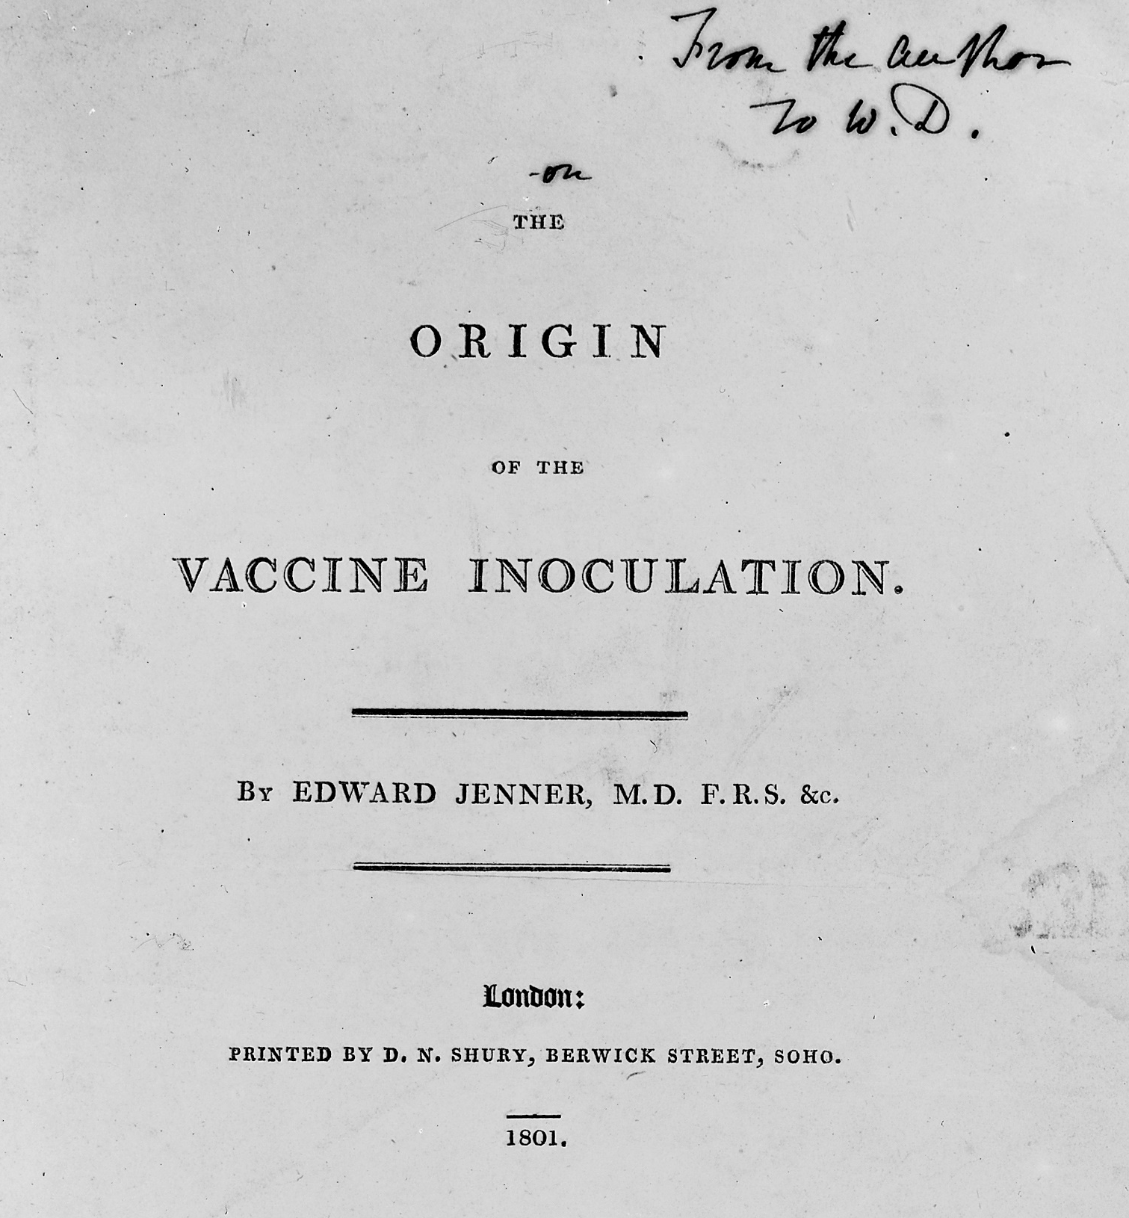
Notes:
More experiments followed, and, in 1801, Jenner published his treatise “On the Origin of the Vaccine Inoculation,” in which he summarized his discoveries and expressed hope that “the annihilation of the smallpox, the most dreadful scourge of the human species, must be the final result of this practice.”

Slide 54
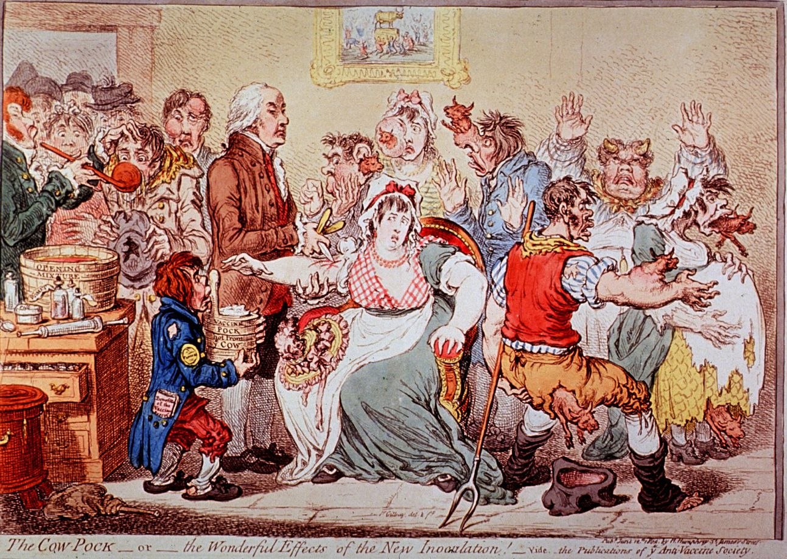
Notes:
Not everyone was convinced. This cartoon entitled “The Cow-Pock—or—the Wonderful Effects of the New Inoculation!” was published by the Anti-Vaccine Society in 1802. Drawn by British satirist James Gillray, it caricatures a scene at the Smallpox and Inoculation Hospital at St. Pancras, showing cowpox vaccine being administered to frightened young women, and cows emerging from different parts of their bodies.

Slide 55
תפארת ישראל (בועז) על אבות ג:ג
קיי"ל חסידי אוה"ע יש להן חלעה"ב [כסנהדרין ק"ה ורמב"ם פ"ח ממלכים]. והרי גם לולא פה קדוש של רז"ל שאמרו לנו כן, כבר היינו יודעים דבר זה מצד השכל, דהרי צדיק ה' בכל דרכיו וחסיד בכל מעשיו. ואנחנו רואים כמה מחסידיהן שמלבד שמכירין יוצר בראשית.
Tiferes Yisrael (Boaz) on Pirkei Avos 3:3
We have established that gentiles have a share in the world to come (Sanhedrin 105, Mishneh Torah, Laws of Kings and Wars 8). And see that even without the holy voice of the Rabbis, may their memory be blessed, who told us so - we would know this thing from the perspective of the intellect. For surely the Lord is just in all of His ways, and kind in all of His deeds.

Slide 56
ומאמינין בתה"ק שהיא אלהית, ועושין ג"ח גם לישראל, וכמה מהן שהיטיבו ביותר לכל באי עולם, כהחסיד יענער שהמציא הפאקקענאימפפונג, שעל ידה ניצולים כמה רבבות בני אדם מחולי וממיתה וממומין, ודראקא שהביא הקארטאפפעל לאייראפא, שמעכב כמה פעמים הרעב. וגוטענבערג שהמציא את הדפוס.
And we see how many of their pious ones - besides that they recognize the Author of creation, and believe that the holy Torah is divine - do kindnesses even to the Israelites. And some of them did great good to all of those that come to the world: Like the pious [Edward] Jenner, who invented the vaccine for smallpox, through which many myriads of people have been saved from disease, death and defects; and [Francis] Drake who brought the potato to Europe, which relieved famine several times; and [Johannes] Gutenberg who invented the printing press.

Slide 57
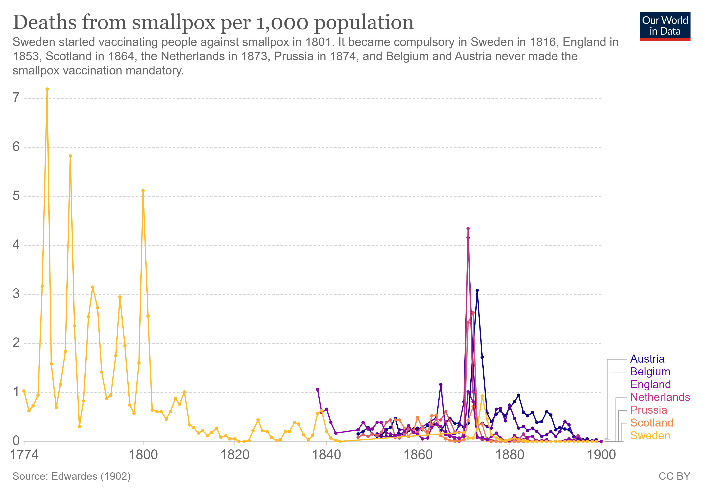

Slide 58
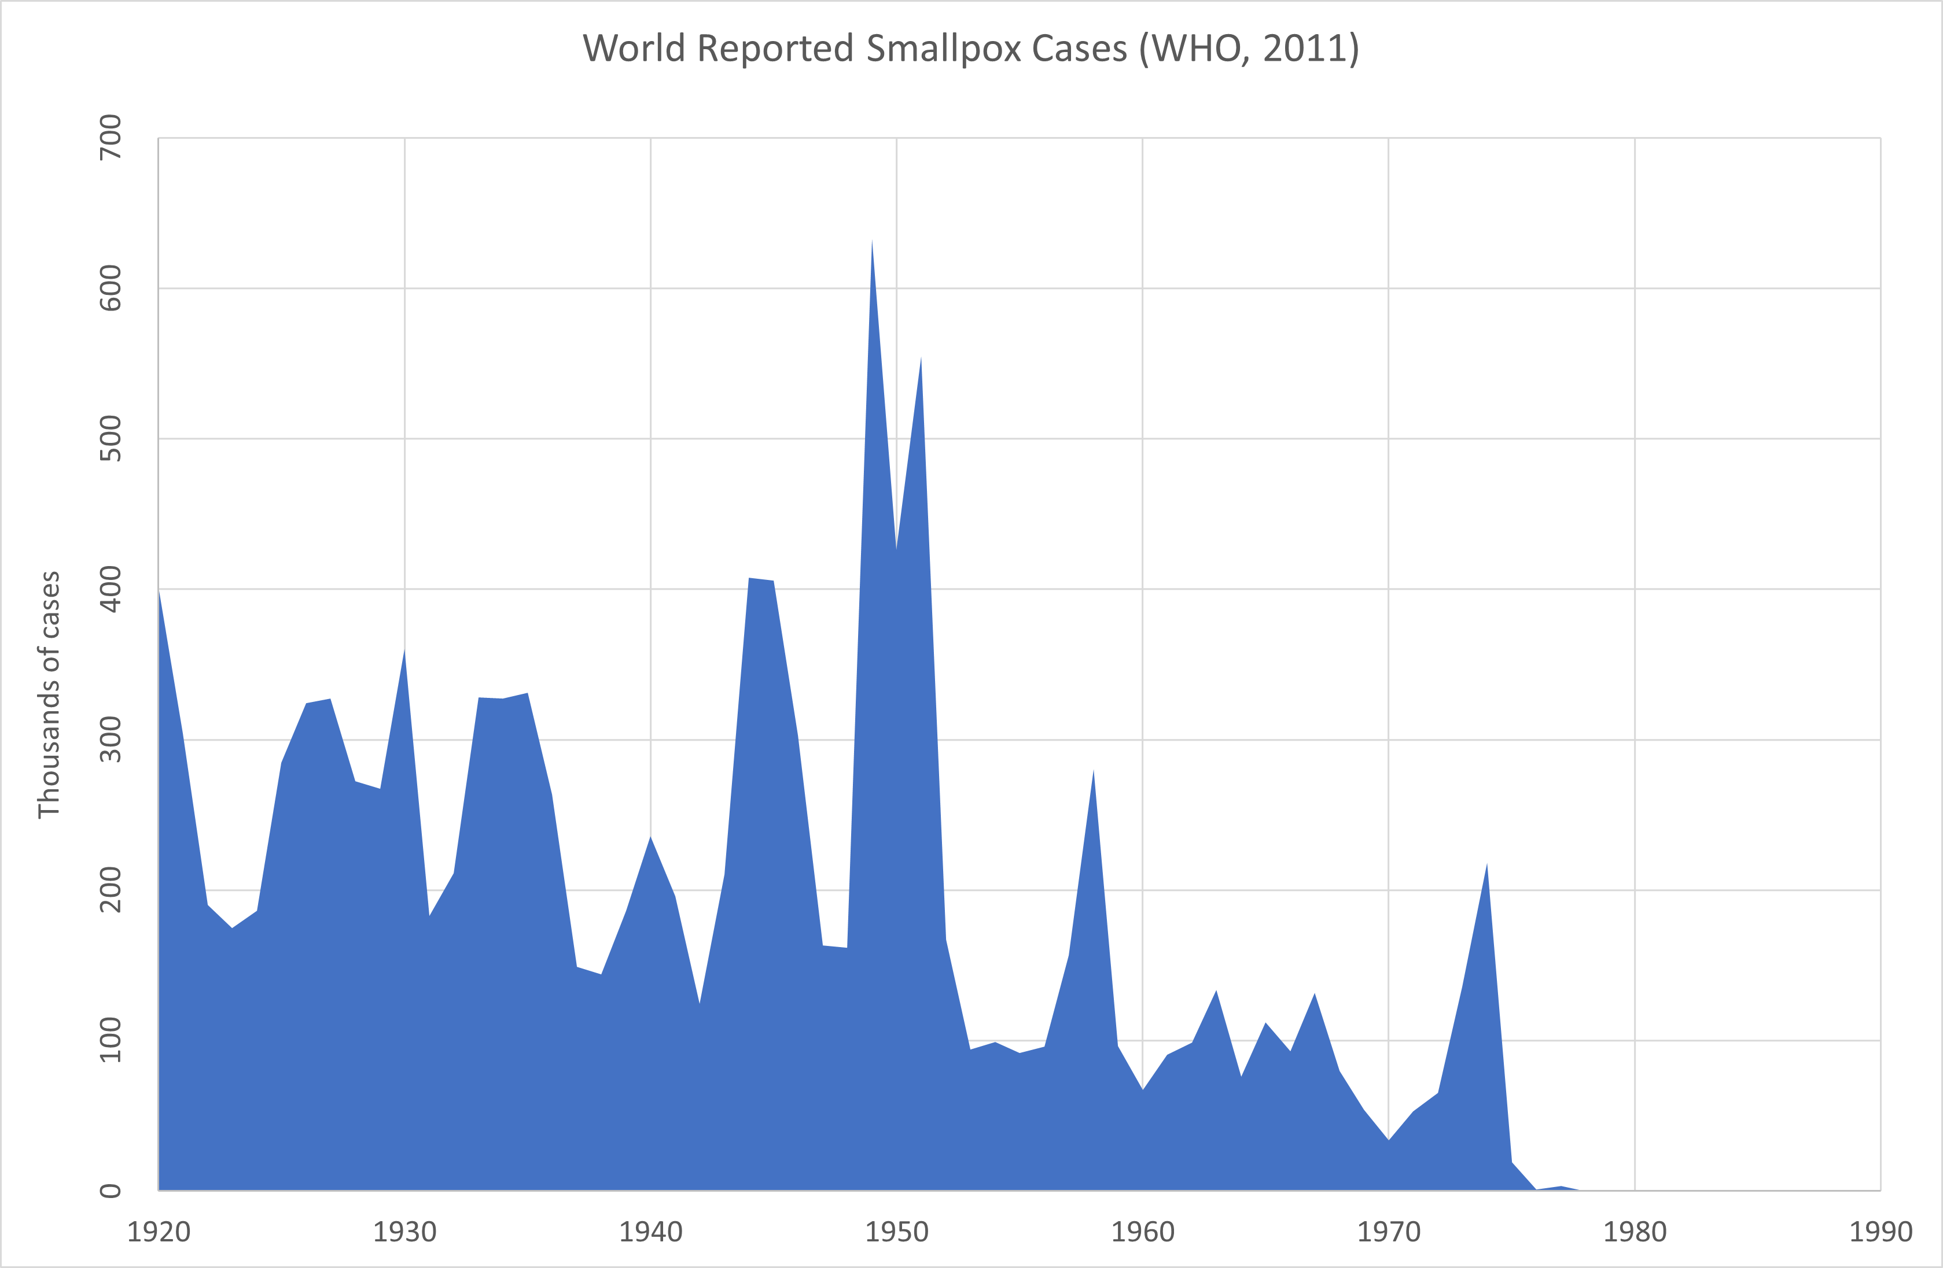

Slide 59
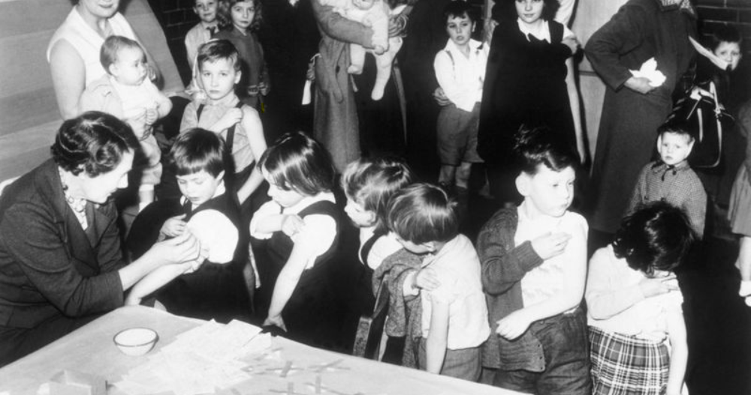
Schoolchildren in England being vaccinated against smallpox in 1962.
Notes:
In the 1960s, before the eradication program, more than half a million people died every year from the disease. But in country after country, vaccination and isolation programs lowered rates of infection until the numbers dwindled.

Slide 60
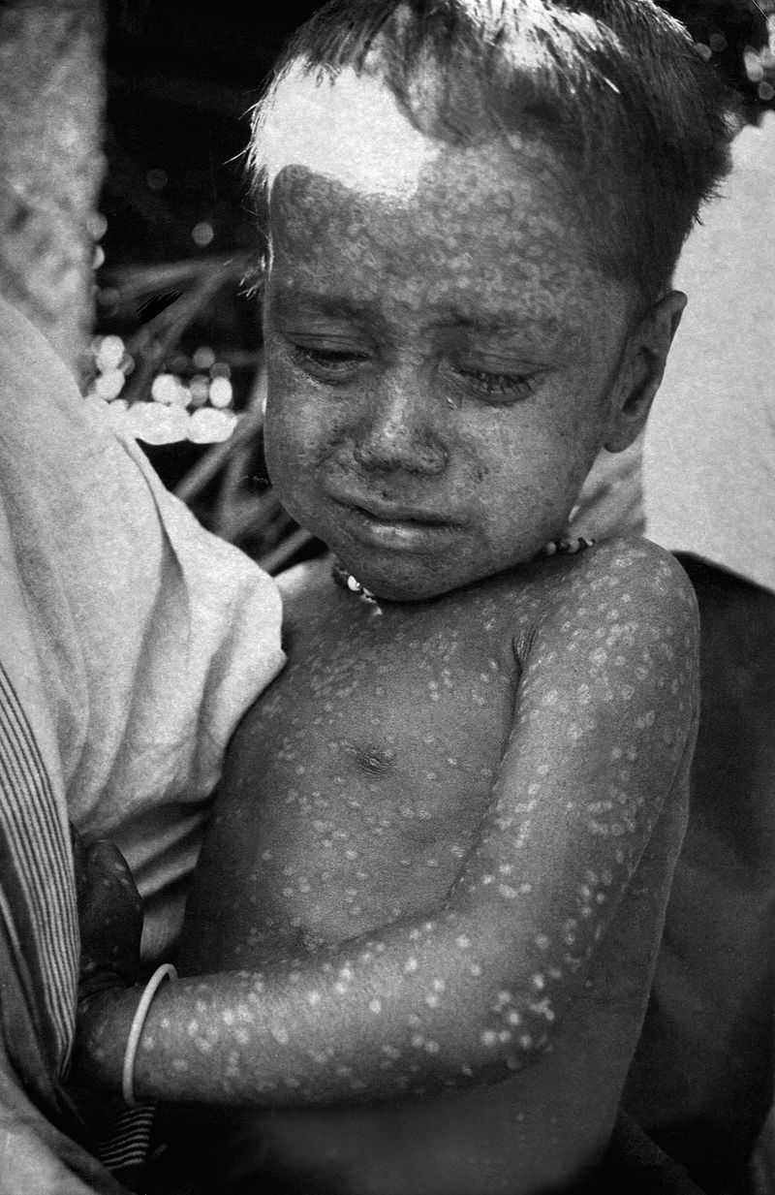
Three-year-old Rahima Banu of Bangladesh was the last person infected with naturally occurring Variola major (smallpox) in 1975.
The last naturally occurring case of Variola minor was diagnosed in October 1977, and the World Health Organization (WHO) certified the global eradication of the disease in 1980.
There was an isolated outbreak from a research facility in Birmingham Medical School in 1978 where Janet Parker, a British medical photographer, who became the last recorded person to die from smallpox.
Notes:
Banu created income for her family by posing for photos.^{[14]} In an interview in 2009, Banu said she had four children after marrying a farmer at the age of 18. She said that villagers and her in-laws treated her poorly because she had suffered from smallpox.^{[15][16]}

Slide 61
Contemporary Issues

Slide 62
The Imperative to Remove Danger and Protect Life

Slide 63
דברים פרק ד פסוק ט
רַק הִשָּׁמֶר לְךָ וּשְׁמֹר נַפְשְׁךָ מְאֹד פֶּן תִּשְׁכַּח אֶת הַדְּבָרִים אֲשֶׁר רָאוּ עֵינֶיךָ וּפֶן יָסוּרוּ מִלְּבָבְךָ כֹּל יְמֵי חַיֶּיךָ וְהוֹדַעְתָּם לְבָנֶיךָ וְלִבְנֵי בָנֶיךָ:
Devarim 4:9
But beware and watch yourself very well, lest you forget the things that your eyes saw, and lest these things depart from your heart, all the days of your life, and you shall make them known to your children and to your children's children.

Slide 64
כלי יקר דברים פרק ד פסוק ט
(ט) רק השמר לך ושמור נפשך מאד פן תשכח וגו'. השמר לך רצה לומר שמירת הגוף ולא הזכיר בו מאד כמו בשמירת הנפש אשר בשמירתה צריך האדם להזהר ביותר מבשמירת הגוף לכך אמר ושמור את נפשך מאד:
Kli Yakar (Rabbi Shlomo Ephraim Luntschitz, d. 1619)
But beware and watch yourself very well, lest you forget etc. Beware and watch yourself means looking after your body and does not mention the word “very” as it does when guarding your soul, which requires a person to take extra care, which is why it says that one should guard their soul well.

Slide 65
באר הגולה חשן משפט תכז:צ
נלע"ד הטעם שהזהירה התורה על שמירת הנפש הוא מטעם שהקב"ה ברא את העולם בחסדו להטיב להנבראים שיכירו גדולתו ולעבוד עבודתו בקיום מצותיו ותורתו ... והמסכן את עצמו כאלו מואס ברצון בוראו ואינו רוצה לא בעבודתו ולא במתן שכרו ואין לך זלזול אפקירותא יותר מזה...
Be’er HaGolah Choshen Mishpat 427:90
It appears to me that the Torah warned us to guard ourselves from harm because HaShem created the universe in His loving-kindness for the benefit of those whom He created, that they should recognise His greatness and serve Him by keeping His mitzvot and His Torah. … If one endangers himself it is as if he disdains his Creator’s wish and neither wants to serve Him nor receive His rewards. There is no greater blasphemous disdain than this. …

Slide 66
The importance of protecting others
ספר חסידים (מרגליות) סימן תרעג
לפני עור לא תתן מכשול (ויקרא י"ט י"ד) שלא ירחץ אדם שהוא מוכה שחין עם יהודי אחר אלא א"כ יודיענו שנאמר (שם שם י"ח) ואהבת לרעך כמוך וכתיב (שם שם ט"ז) ולא תעמוד על דם רעיך.
Sefer Chasidim 673
One should not put a stumbling block in front of the blind (Vayikra 19:14). Someone who is suffering from an infectious dermatological disease should not bathe in the same bathhouse with others unless they inform them, for it states (ibid. 18) “You shall love your fellow human as yourself” and (ibid. 16) “Do not stand idly by the blood of your fellow.”

Slide 67
Dina d’Malchusa Dina

Slide 68
Halakha Approaches the COVID-19 Vaccine (Tradition Online)
Rabbi Hershel Schachter argues that when the government mandates vaccination, the principle of dina de-malkhuta dina obligates it. If a democratic government ultimately legislates that a COVID-19 vaccination is safe for the general public or specific populations, people must comply with this ruling. Jews who refuse to abide by government-mandated vaccination endanger all of society and cause hillul Hashem. The recent measles outbreak in Hasidic communities in the United States with low vaccination rates and the subsequent public disgust with ultra-Orthodox Jews illustrate the potential for desecrating God’s name when Jews defy normative practice and legal requirements.

Slide 69
What goes into a Vaccine?

Slide 70
Human Cell Strains
For some vaccines, the active ingredient is grown in laboratories on cultures that contain human cells. Some viruses, such as chickenpox (varicella), grow much better in human cells. After they are grown, the viruses are purified several times to remove the cell culture material. This makes it unlikely that any human material remains in the final vaccine.
The cell strains currently used (called WI-38 and MRC-5) were started in the 1960s using lung cells taken from two aborted foetuses. The abortions were legal and agreed to by the mothers, but they were not performed for the purpose of vaccine development.
Notes:
Some people may have moral concerns about using a vaccine produced in this way. In 2005 the Vatican’s Pontifical Academy for Life issued a statement called ‘Moral reflections on vaccines prepared from cells derived from aborted human foetuses’. This statement says that they believe it is wrong to make vaccines using human cell strains derived from foetuses, and that there is a ‘moral duty to continue to fight’ against the use of such vaccines and to campaign for alternatives. However, it also states that if the population is exposed to ‘considerable dangers to their health’ through diseases such as rubella (German measles), then ‘vaccines with moral problems pertaining to them may also be used on a temporary basis’.

Slide 71
Porcine gelatine
Gelatine derived from pigs is used in some live vaccines as a stabiliser to protect live viruses against the effects of temperature. Gelatine in vaccines is highly purified and hydrolysed (broken down by water), so it is different from the natural gelatine used in foods. For example, very sensitive scientific tests have shown that no DNA from pigs can be detected in the nasal flu vaccine (Fluenz).

Slide 72
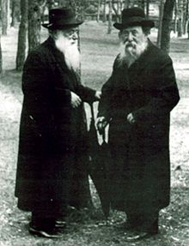
Rabbi Chaim Ozer Grodzinski (right) who was a posek in Lithuania (d. 1940) conversing with Rabbi Shimon Shkop (1939).

Slide 73
But Rabbi, I have faith that God will protect me!

Slide 74
תהלים פרק קטז פסוק ו
שֹׁמֵר פְּתָאיִם יְקֹוָק דַּלּוֹתִי וְלִי יְהוֹשִׁיעַ:
Psalms 116:6
The Lord protects the simple; when I was poor, He saved me.
Rabbi J. David Bleich, Tradition 48:2-3, p. 47
That principle reflects the notion that dangers that are both remote and also assumed by most people as a matter of course do not rise to the threshold of danger of which Halakhah takes cognizance.

Slide 75
Risks of contracting smallpox compared to variolation
1 in 1000 (0.1%) died from variolation whereas 3 in 10 (33.3%) died from smallpox contracted naturally. 500 million people died between 1880 and 1980 from smallpox. The world population in 1980 stood at 4.46 Billion people.
Risks of COVID-19
As of 11th of January 2021, 81,431 people have died in the UK from COVID-19 and 3.07 million have tested positive. That equals a 2.7% mortality rate. Given the population is 66.65 million, only 4.6% of the population have tested positive, although an estimated 5.6% of people would have tested positive for antibodies against SARS-CoV-2 on a blood test in September, suggesting they had the infection in the past.

Slide 76
Risks of vaccination
Fact or Fiction?: Vaccines are Dangerous
Dina Fine Maron, March 6, 2015 Scientific American
The overwhelming medical evidence finds that most vaccine side effects among newborns and young children are mild—swelling, redness and a small, hard lump at the site of the injection—and typically pass within a couple of days.
A far less common but serious vaccine side effect, occurring in fewer than one in a million cases, is an immediate allergic reaction that can be treated with common medications to ease itching or swelling or, in more serious cases, by administering epinephrine. Rarely, with certain vaccinations there can be other problems. … among children born in the past two decades, vaccinations will prevent more than 20 million hospitalizations and 732,000 deaths, according to U.S. Centers for Disease Control and Prevention estimates.

Slide 77
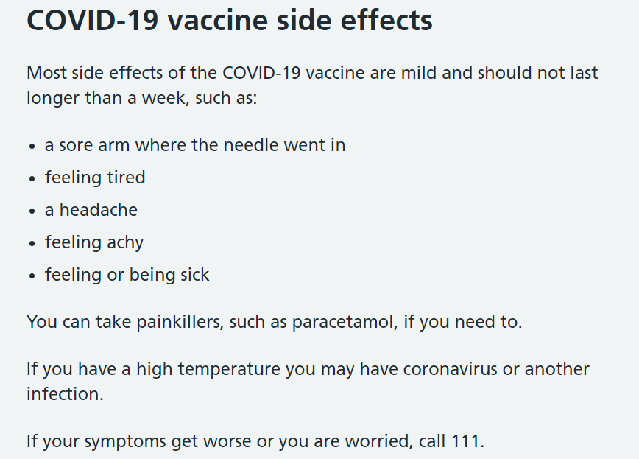
Risks of vaccination

Slide 78
Risks of vaccination

Slide 79
Risks of Receiving a New Vaccine against COVID-19
Halakha Approaches the COVID-19 Vaccine (Tradition Online)
Rabbi Hershel Schachter has stated that “if the adverse reaction risk for a given vaccine was in the range of one in 1,000,000, the concept of batla da’ato eitzel kol adam would be applied to mitigate an individual’s fear, which might have prevented him from being vaccinated.”
Delaying vaccination even one day will exact a high cost in human life. Although the daily death toll from COVID-19 is climbing in many countries, the true cost to human life of each day that the pandemic continues is immeasurable—and probably far greater than this, due to excess mortality from non-COVID-19 illness (caused by delays in medical care from fear of infection and an overburdened healthcare system), economic hardship, unemployment, and the deterioration of mental health.

Slide 80
Ethical Issues

Slide 81
Herd Immunity

Slide 82
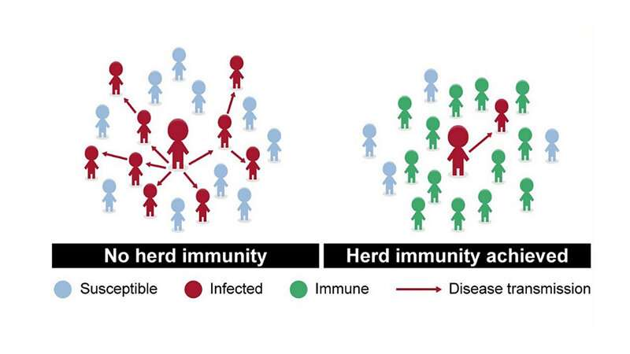

Slide 83
The Anti-Vaxxer Movement

Slide 86
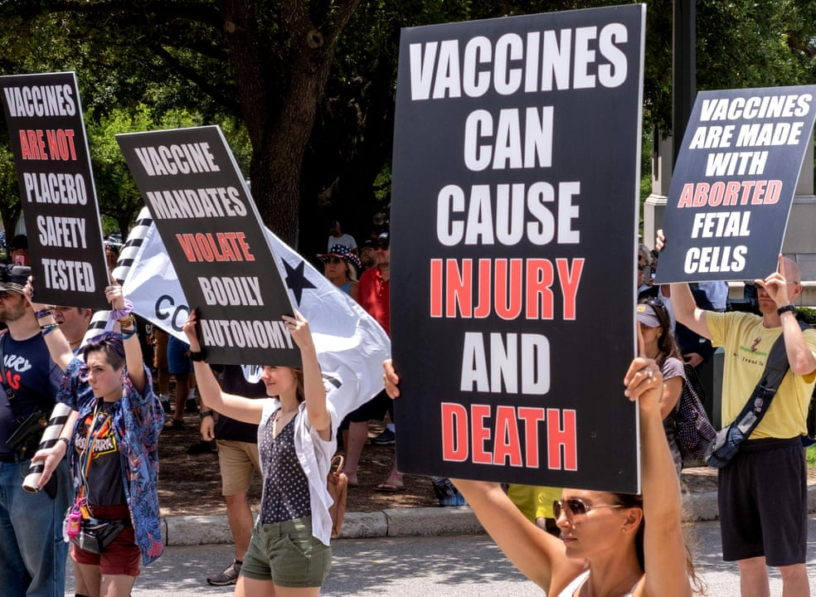

Slide 87
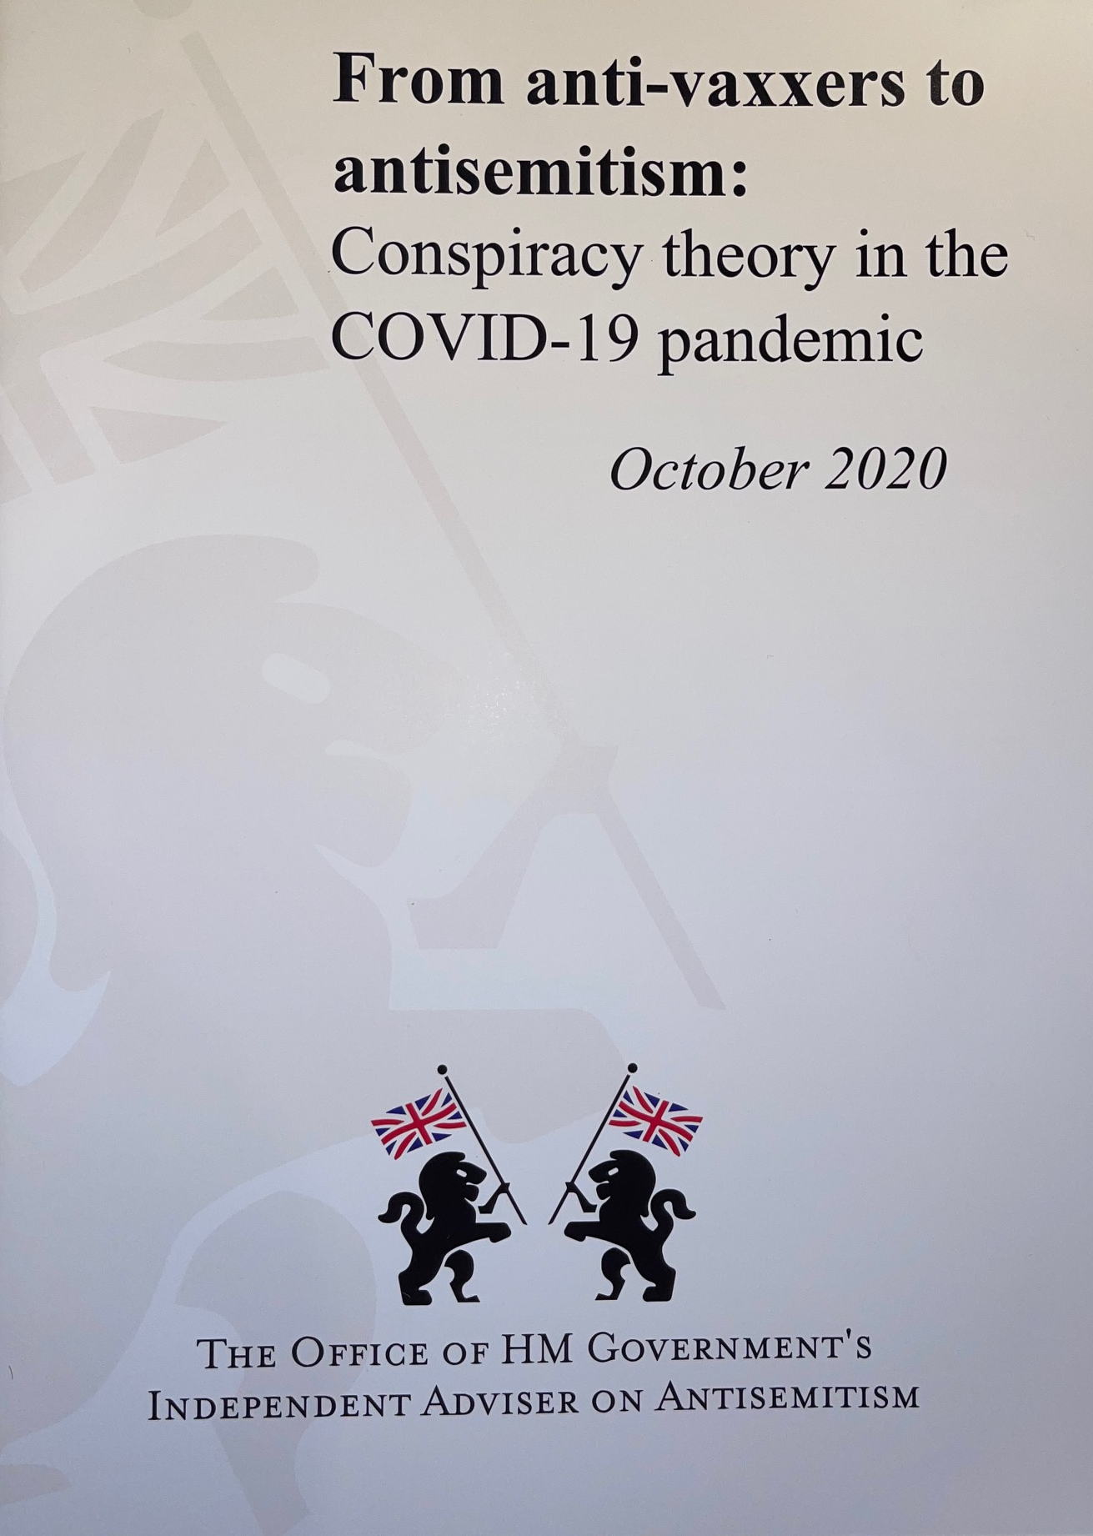

Slide 89
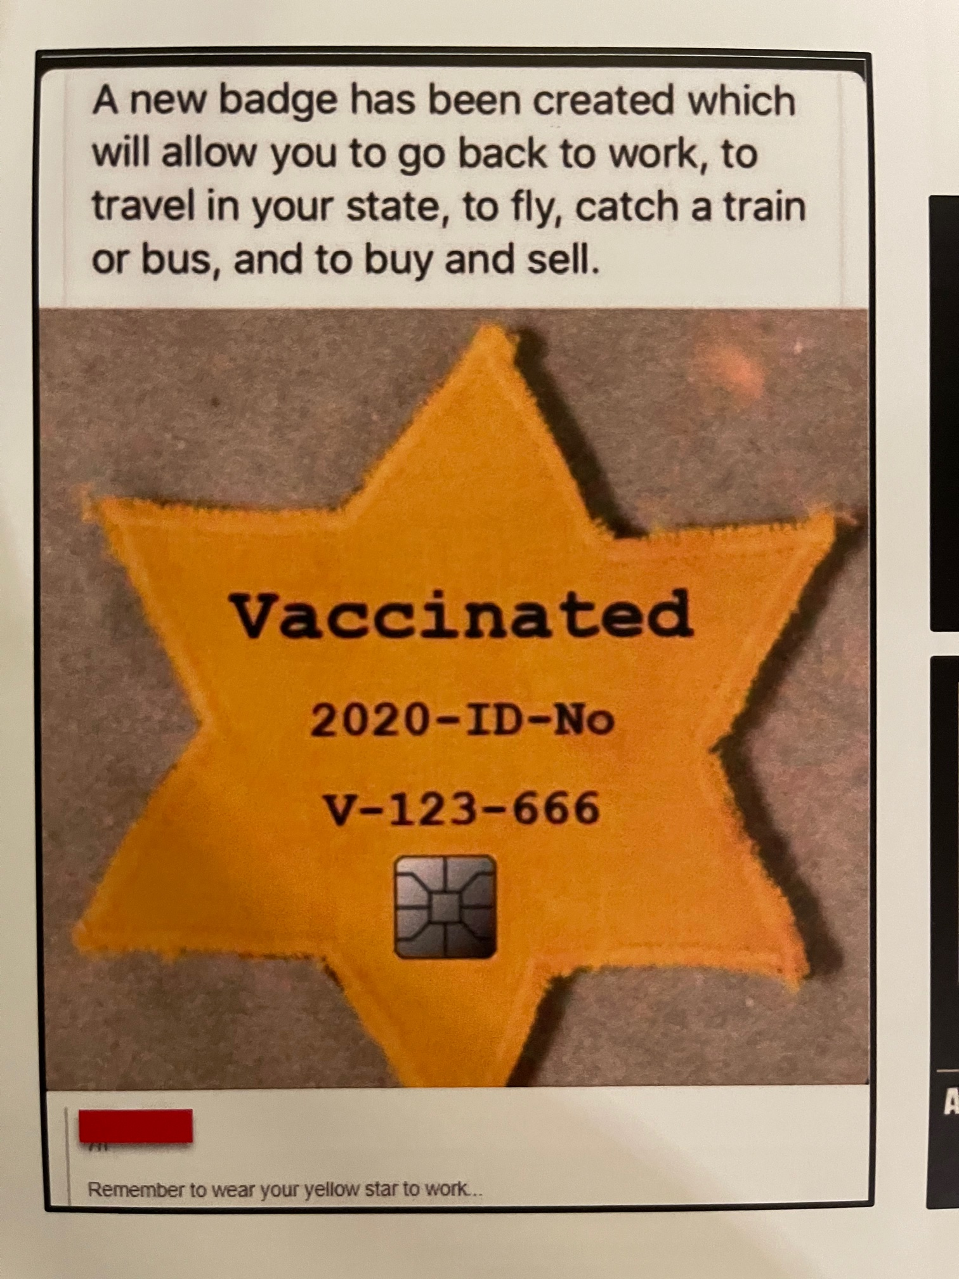

Slide 91
Compulsory or Encouraged Vaccination

Slide 92
שולחן ערוך יורה דעה סימן קטז
עוד כתבו שיש לברוח מן העיר כשדבר בעיר, ויש לצאת מן העיר בתחלת הדבר, ולא בסופו (תשובת מהרי"ל סי' ל"ה /מ"א/). וכל אלו הדברים הם משום סכנה, ושומר נפשו ירחק מהם ואסור לסמוך אנס או לסכן נפשו בכל כיוצא בזה. (ועיין בחושן משפט סימן תכ"ז).
Shulchan Aruch Yoreh Deah 116:5
They also wrote to flee from the city when a plague is in the city, and one should leave at the beginning of the plague and not at the end. And all of these things are because of the danger, and a person who guards his soul will distance himself from them and it is prohibited to rely on a miracle in all of these matters.
Rabbi Asher Weiss, citing Zivchei Tzedek Yoreh De’ah (116:41) and Tochahot Chaim (Parshat Vayetzei), writes that the contemporary equivalent of fleeing the city during a pandemic is vaccination. Be’er Heitev (O.H. 576:3) writes that people who do not flee the city during a plague are liable for their own fate.”

Slide 93
Vaccine passports

Slide 94
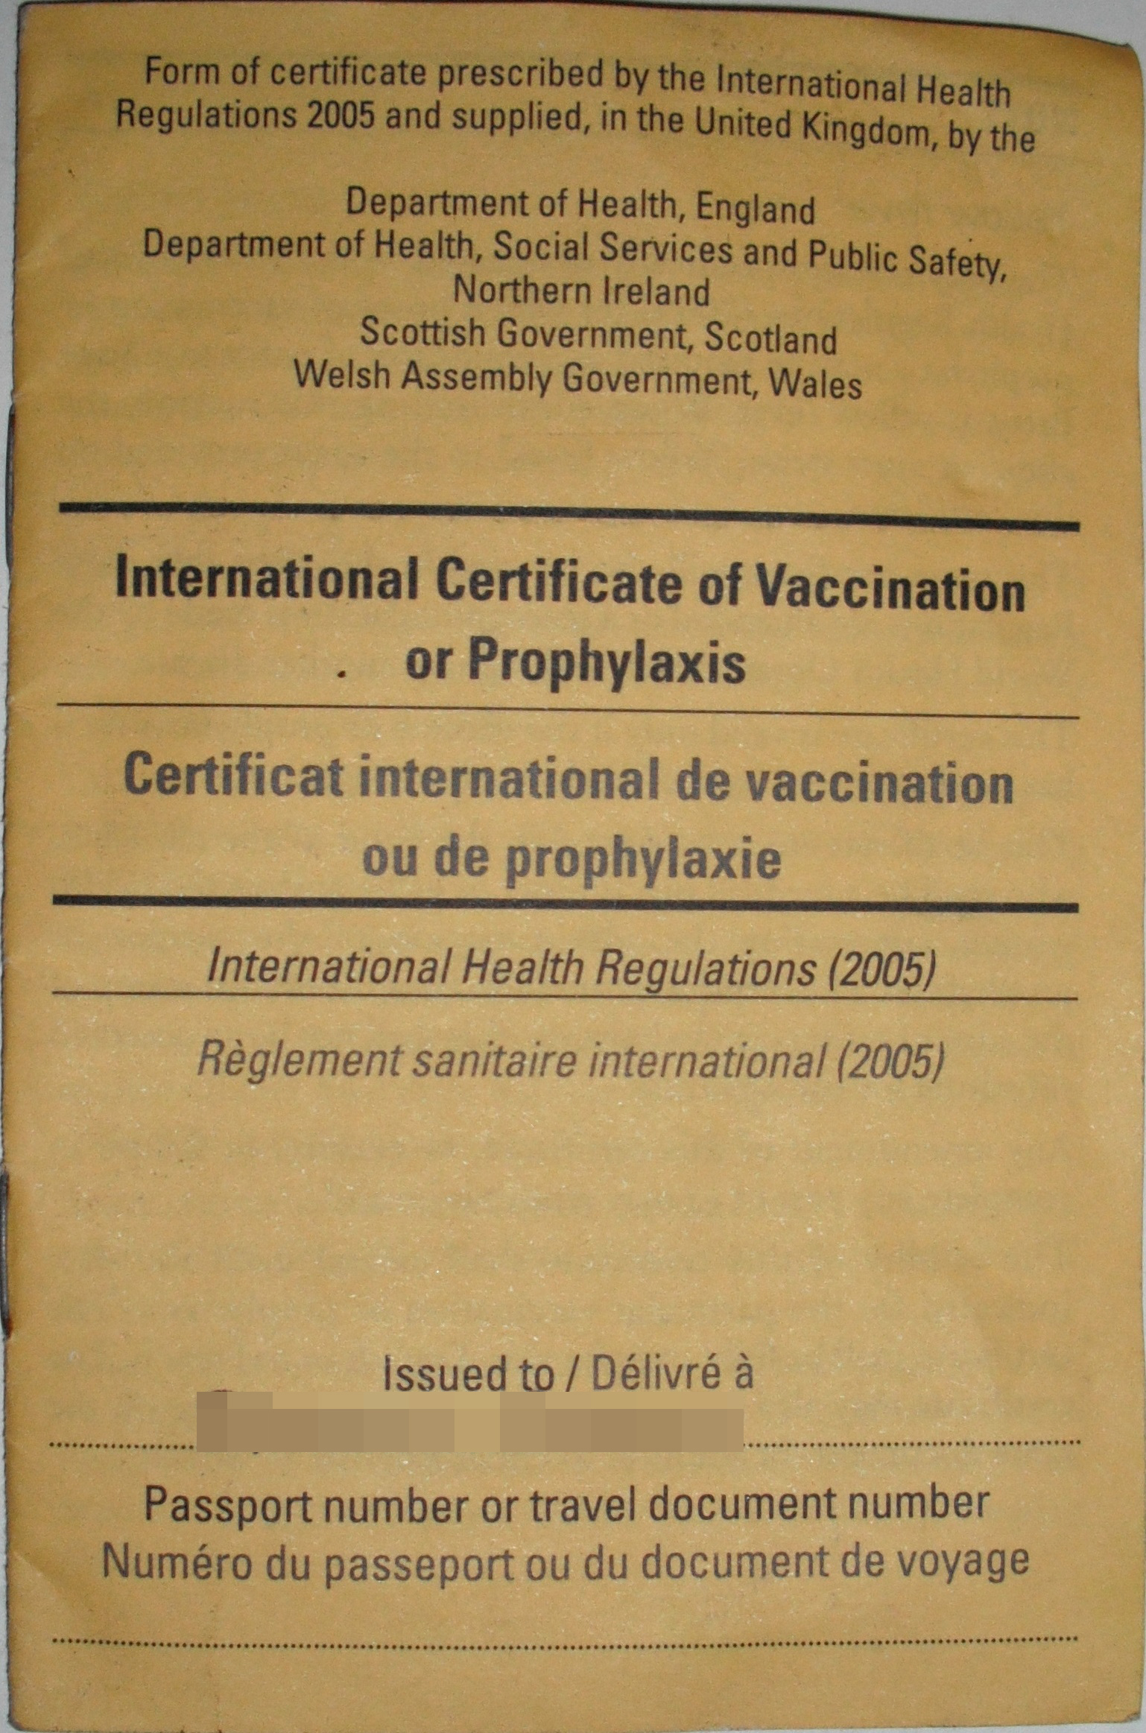

Slide 95
Vaccine nationalism

Slide 97
Conclusion

Slide 98
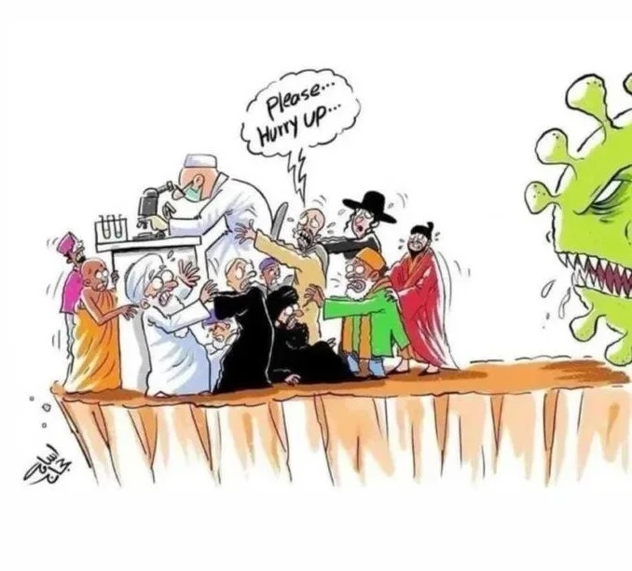

Slide 99
“
A civilisation that had space for science but not religion might achieve technological prowess. But it would not respect people in their specificity and particularity. It would quickly become inhuman and inhumane. Think of the French Revolution, Stalinist Russia and Communist China, and you need no further proof.
Rabbi Lord Jonathan Sacks זצ"ל
The Great Partnership: Science, Religion, and the Search for Meaning
”

Slide 100
Thank You
rabbi@newwestend.org.uk
07531 326289
@moshefreedman

