Slide 1
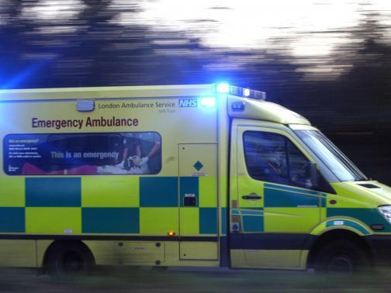
The Ethics of Triage and Vaccine Prioritisation
Judaism and Society
Rabbi Dr Moshe Freedman Rabbi, New West End Synagogue Deputy Co-chair of MEAG (Moral and Ethical Advisory Group to DHSC)

Slide 2
Overview
Introduction to Triage
The Ethical Principles of Triage
Critical Care Triage during the coronavirus epidemic
Jewish Medical Ethics of Triage
Critical Care during COVID-19
Vaccine Prioritisation
Conclusions

Slide 3
Introduction to Triage

Slide 4
tri·​age | trē-ˈäzh, ˈtrē-ˌäzh
From the French trier meaning to sort.
1a: the sorting of and allocation of treatment to patients and especially battle and disaster victims according to a system of priorities designed to maximize the number of survivors
b: the sorting of patients (as in an emergency room) according to the urgency of their need for care
2: the assigning of priority order to projects on the basis of where funds and other resources can be best used, are most needed, or are most likely to achieve success

Slide 5
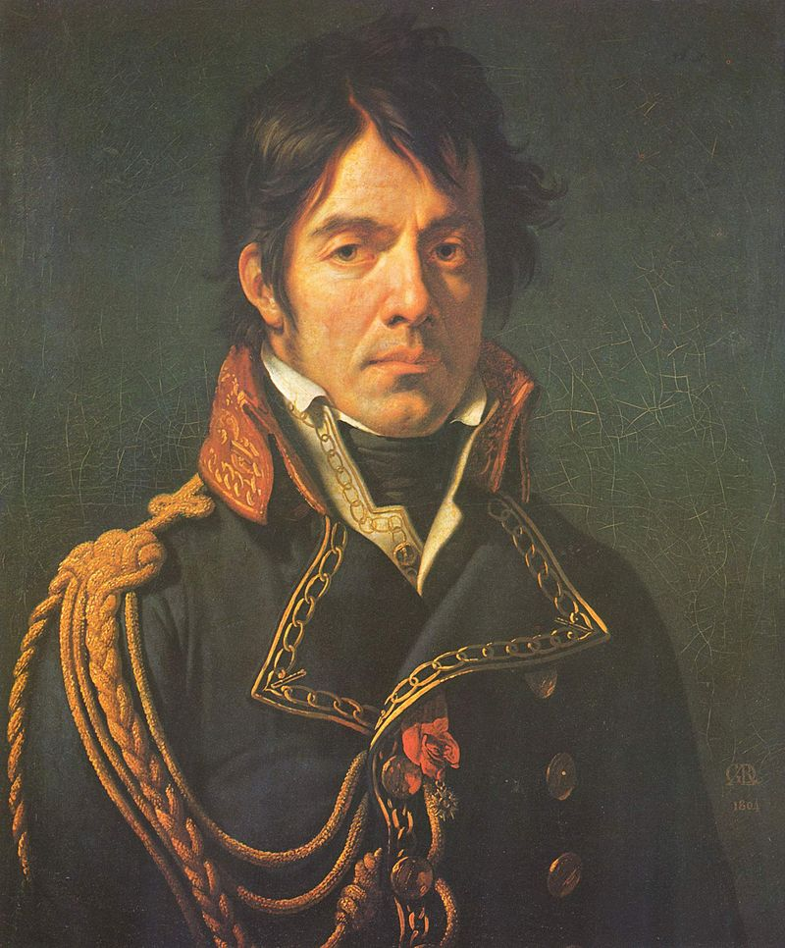
Baron Dominique Jean Larrey (1766 – 1842) was a French surgeon in Napoleon's Grande Armée and an important innovator in battlefield medicine and triage. He is often considered the first modern military surgeon.

Slide 6
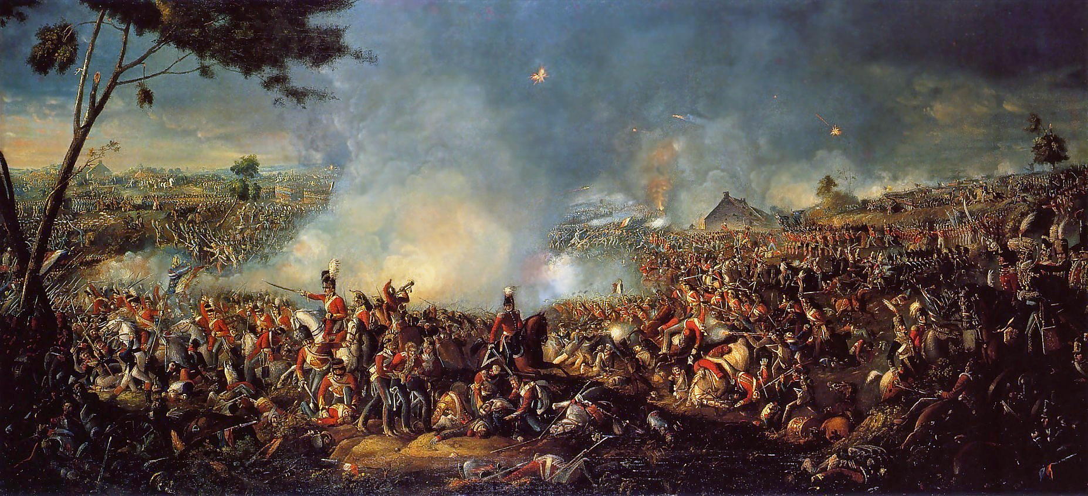
The Battle of Waterloo (18th July 1815), painted by William Sadler II

Slide 7
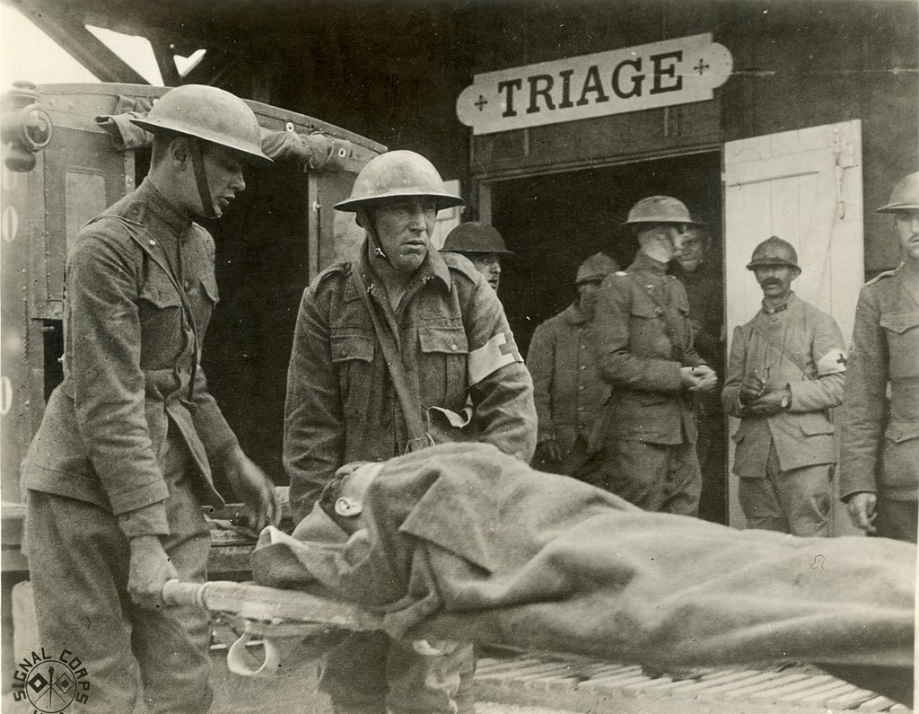
Triage station in France during World War I
Notes:
Triage was used further during World War I by French doctors treating the battlefield wounded at the aid stations behind the front. Those responsible for the removal of the wounded from a battlefield or their care afterwards would divide the victims into three categories:
Those who are likely to live, regardless of what care they receive;
Those who are unlikely to live, regardless of what care they receive;
Those for whom immediate care may make a positive difference in outcome.

Slide 8
The Ethical Principles of Triage

Slide 9
Philosophy of Ethics
NORMATIVE ETHICS
Teleological
Theory
Deontological
Theory
Ethical
Egoism
Utilitarianism
Distributive
Justice
Altruism
Kantianism /
Egalitarianism
Universalism

Slide 10
Philosophy of Ethics
NORMATIVE ETHICS
Teleological
Theory
Deontological
Theory
Ethical
Egoism
Utilitarianism
Distributive
Justice
Altruism
Kantianism /
Egalitarianism
Universalism
Normative ethics: The study of ethical behaviour. It is the branch of philosophical ethics that investigates the questions that arise regarding how one ought to act.

Slide 11
Philosophy of Ethics
NORMATIVE ETHICS
Teleological
Theory
Deontological
Theory
Ethical
Egoism
Utilitarianism
Distributive
Justice
Altruism
Kantianism /
Egalitarianism
Universalism
Teleological theory: Derived from Greek word ‘telos’ means end, teleological ethics determines the good of an act by looking to
the consequences of the decision.

Slide 12
Philosophy of Ethics
NORMATIVE ETHICS
Teleological
Theory
Deontological
Theory
Ethical
Egoism
Utilitarianism
Distributive
Justice
Altruism
Kantianism /
Egalitarianism
Universalism
Ethical egoism: An action is good if it produces result that maximizes a person’s self-interest at the expense of others. It denies that a person should help others when the person will get nothing out of it. Enlightened egoism is enlightened self interest. It considers the long range perspective of others or humanity as a whole.

Slide 13
Philosophy of Ethics
NORMATIVE ETHICS
Teleological
Theory
Deontological
Theory
Ethical
Egoism
Utilitarianism
Distributive
Justice
Altruism
Kantianism /
Egalitarianism
Universalism
Utilitarianism: States that the most ethical choice is the one that will produce the greatest good for the greatest number.

Slide 14
Philosophy of Ethics
NORMATIVE ETHICS
Teleological
Theory
Deontological
Theory
Ethical
Egoism
Utilitarianism
Distributive
Justice
Altruism
Kantianism /
Egalitarianism
Universalism
Distributive Justice: Distributive justice refers to the extent to which society's institutions ensure that benefits and burdens are distributed among society's members in ways that are fair and just. Egalitarianism is a concept within distributive justice that we all humans are equal, regardless of defining characteristics.

Slide 15
Philosophy of Ethics
NORMATIVE ETHICS
Teleological
Theory
Deontological
Theory
Ethical
Egoism
Utilitarianism
Distributive
Justice
Altruism
Kantianism /
Egalitarianism
Universalism
Altruism is the ethical doctrine that holds that the moral value of an individual's actions depend solely on the impact on other individuals, regardless of the consequences on the individual itself.

Slide 16
Philosophy of Ethics
NORMATIVE ETHICS
Teleological
Theory
Deontological
Theory
Ethical
Egoism
Utilitarianism
Distributive
Justice
Altruism
Kantianism /
Egalitarianism
Universalism
Deontological theory: Derived from Greek word ‘deon’ meaning duty. This approach to ethics believes we have a duty not to do bad, regardless of the consequences. Bribery for example, is wrong by its very nature. The ethics of an act are determined by looking at the act itself.

Slide 17
Philosophy of Ethics
NORMATIVE ETHICS
Teleological
Theory
Deontological
Theory
Ethical
Egoism
Utilitarianism
Distributive
Justice
Altruism
Kantianism /
Egalitarianism
Universalism
Kantianism: Kantian ethics are a set of universal moral principles that apply to all human beings, regardless of context or situation. Immanuel Kant, a German philosopher, calls the principles Categorical Imperatives, which are defined by their morality and level of freedom.

Slide 18
Philosophy of Ethics
NORMATIVE ETHICS
Teleological
Theory
Deontological
Theory
Ethical
Egoism
Utilitarianism
Distributive
Justice
Altruism
Kantianism /
Egalitarianism
Universalism
Universalism states that some system of ethics, or a universal ethic, applies universally, that is, for "all similarly situated individuals", regardless of culture, race, sex, religion, nationality, sexual orientation, or any other distinguishing feature.

Slide 19
Ethics in Triage
Utilitarianism versus Egalitarianism

Slide 20
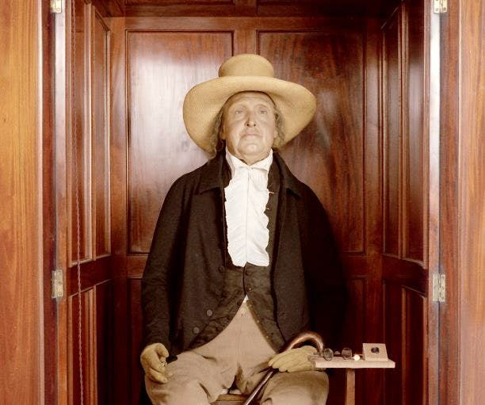
Egalitarianism versus Utilitarianism
Jeremy Bentham (1748 – 1832) was an English philosopher, jurist, and social reformer regarded as the founder of modern utilitarianism which teaches that what is right or good based on whether the consequences will be good.
Notes:
On his death in 1832, Bentham left instructions for his body to be first dissected, and then to be permanently preserved as an "auto-icon" (or self-image), which would be his memorial. This was done, and the auto-icon is now on public display in the entrance of the Student Centre at University College London (UCL). Because of his arguments in favour of the general availability of education, he has been described as the "spiritual founder" of UCL. However, he played only a limited direct part in its foundation.

Slide 21
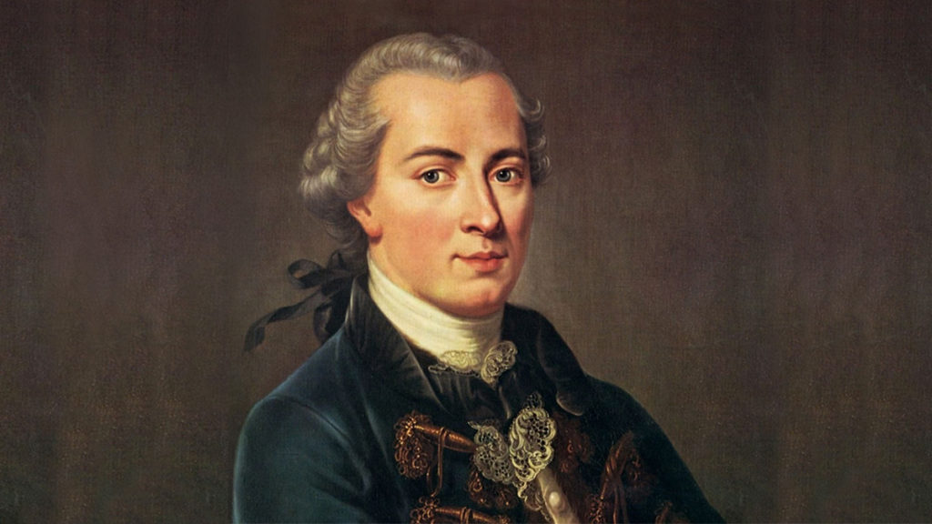
Egalitarianism versus Utilitarianism
Immanuel Kant (1724 – 1804) proposed the idea of egalitarianism theory which focuses on non-consequentially based notions of good in deciding what is right or good is based on meeting duties and obligations.

Slide 22
Egalitarianism versus Utilitarianism
Egalitarianism
Egalitarian ethics implies that everyone should be treated equally, regardless of any other determining factors or characteristics such as age, gender, or underlying medical conditions.
Treating people equally: This includes lottery and first-come-first served models. The advantage of lottery is that it is hard to corrupt and little information about the patients is needed. First-come-first served protects the existing doctor-patient relationship because other outside factors do not enter into the equation. Ethicists who take this approach believe strongly in the equality of all human beings and are reluctant to “play God”.

Slide 23
Egalitarianism versus Utilitarianism
Utilitarianism
Favouring the worst-off: This includes sickest first and youngest first. This scheme is consistent with the rule of rescue. Any plan to distribute health care services must take human nature into account if the plan is to be acceptable to society. In this regard there is a fact about the human psyche that will inevitably trump the utilitarian rationality that is implicit in cost-effectiveness analysis: people cannot stand idly by when an identified person’s life is visibly threatened if rescue measures are available. This scheme makes the most sense in a situation of temporary scarcity.

Slide 24
Egalitarianism versus Utilitarianism
Utilitarianism
Maximizing total benefits: This includes number of lives saved or life-years saved. This scheme avoids the need for judgments of social worth or quality of life.
Promoting and rewarding social usefulness: This approach favours instrumental value in the future and rewarding those who implemented important values in the past. This scheme would favour those with essential occupations such as healthcare workers, emergency personnel, or soldiers. It is vulnerable to abuse through the choice of professions prioritised and can direct scarce resources away from health needs.

Slide 25
Ethics in Triage
Deontological versus Consequential Ethics

Slide 26
Deontological versus Consequential
Deontological
Deontologists maintain that actions are in themselves moral ends. Certain features of the action itself make it right or wrong. An action that has good consequences for society, or generally maximizes life, is far less important – according to some views, not inherently important at all – than the moral properties of the action itself.
Consequential
Consequentialists, maintain that the moral rightness or wrongness of an action is determined exclusively by its consequences i.e. by the good or evil it produces. To put it differently, actions are not moral ends in themselves; they are only means to produce some moral (or immoral end). Actions that increase happiness or maximize life are defined as moral.

Slide 27
Jewish Medical Ethics of Triage

Slide 28
The Three Cardinal Sins in Judaism
תלמוד בבלי סנהדרין עד.
רוצח גופיה מנא לן סברא הוא דההוא דאתא לקמיה דרבה ואמר ליה אמר לי מרי דוראי זיל קטליה לפלניא ואי לא קטלינא לך אמר ליה לקטלוך ולא תיקטול מי יימר דדמא דידך סומק טפי דילמא דמא דהוא גברא סומק טפי.
Talmud Bavli, Sanhedrin 74a
The Gemara asks: From where do we derive this halacha, with respect to [being forced to] commit murderer? [That one must allow himself to be killed rather than commit murder?] The Gemara answers: It is based on logical reasoning that one life is not preferable to another, and therefore there is no need for a verse to teach this halakha. The Gemara relates an incident to demonstrate this: As when a certain person came before Rabbah and said to him: The lord of my place, a local official, said to me: Go kill so-and-so, and if not I will kill you, what shall I do? Rabbah said to him: It is preferable that he should kill you and you should not kill. Who is to say that your blood is redder than his, that your life is worth more than the one he wants you to kill? Perhaps that man’s blood is redder. This logical reasoning is the basis for the halacha that one may not save his own life by killing another.

Slide 29
The Two Travellers
תלמוד בבלי בבא מציעא סב.
שנים שהיו מהלכין בדרך וביד אחד מהן קיתון של מים אם שותין שניהם מתים ואם שותה אחד מהן מגיע לישוב דרש בן פטורא מוטב שישתו שניהם וימותו ואל יראה אחד מהם במיתתו של חבירו עד שבא ר' עקיבא ולימד וחי אחיך עמך חייך קודמים לחיי חבירך.
Talmud Bavli, Bava Metzia 62a
If two people were walking on a desolate path and there was a jug [kiton] of water in the possession of one of them, and the situation was such that if both drink from the jug, both will die, as there is not enough water, but if only one of them drinks, he will reach a settled area, there is a dispute as to the halakha. Ben Petura taught: It is preferable that both of them drink and die, and let neither one of them see the death of the other. This was the accepted opinion until Rabbi Akiva came and taught that the verse states: “And your brother shall live with you,” indicating that your life takes precedence over the life of the other.

Slide 30
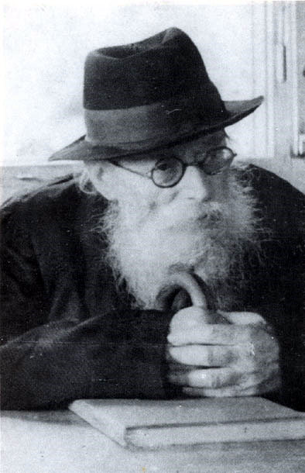
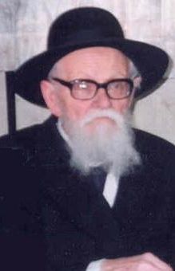
Chazon Ish versus Tzitz Eliezer
The Chazon Ish
Rabbi Avraham Yeshaya Karelitz (1878 – 1953)
The Tzitz Eliezer
Rabbi Eliezer Yehuda Waldenberg (1915 – 2006)

Slide 31
Chazon Ish versus Tzitz Eliezer
חזון איש חושן משפט בבא מציעא ליקותים כ׳ סב.
והכא טעמי' דבן פטורא דכיון דיש חיי שעה לשניהם דאם ישתו שניהם יחיו לפי שעה.
The Chazon Ish interprets the dispute as revolving around the question of whether saving two lives for a short time is preferable to saving one life for an extended period of time. Ben Petura maintains that saving two lives even for a short time is preferable; therefore they should share the water. Rebbi Akiva feels that it is more important to save the one life. Applying Rebbi Akiva’s logic to the allocation of scarce resources, it would follow that resources should preferably be used where lives can be saved as opposed to short term extension of life.

Slide 32
Chazon Ish versus Tzitz Eliezer
שו"ת ציץ אליעזר חלק ט סימן כח
ובדומה לזה מבאר העמק שאלה בשאילתא קמ"ז סק"ד דברי בן פטורא בב"מ שם דף ס"ב, דלכאורה דעתו תמוה, וכי בשביל שא"א לקיים וחי אחיך מחויב הוא להמית א"ע ח"ו ואיזו תועלת תהי' מה שיתן גם לחבירו, אלא הענין דאם ישתו שניהם עכ"פ יחיו יום או יומים גם שניהם, שלא יגיעו לישוב, ואולי עד כה יזדמן להם מים, משא"כ אם לא יתן לחבירו הרי ימות בודאי בצמא עיי"ש, וא"כ ה"ה נאמר כן בהיכא שהרפואה שלנו דל"ש דברי ר"ע דחייך קודמין ואזלינן בזה בתר דעתיה דבן פטורא, דמחויב לתתה ולחלקה בין שניהם וכנ"ל. ובכאן הוא בחלק מה עוד עדיפא מההיא דבן פטורא בב' שהיו מהלכין במדבר, דבכאן הכל הולך ובא רק בעפ"י אומדנת הרופאים הן בקביעות הסכנה לזה כן לזה והן בקביעת המדה הרפואית שעליהם לקחת, ולכן יש מקום יותר לומר בזה יחלוקו.
The Tzitz Eliezer maintains that the central issue revolves around ownership of the water. Rabbi Akiva felt that the reason one does not have to share the water is that it belongs to you. Ben Petura felt that in the context of life-saving ownership is irrelevant. The logical conclusion that follows from Rebbi Akiva’s position is that if the water belongs to a third party then it must be shared.

Slide 33
Chazon Ish versus Tzitz Eliezer
Rabbi Dr Moshe Sokol, Dean of Touro College, New York explains that the argument between the Chazon Ish and the Tzitz Eliezer is whether one takes a deontological or consequential approach to ethics.

Slide 34
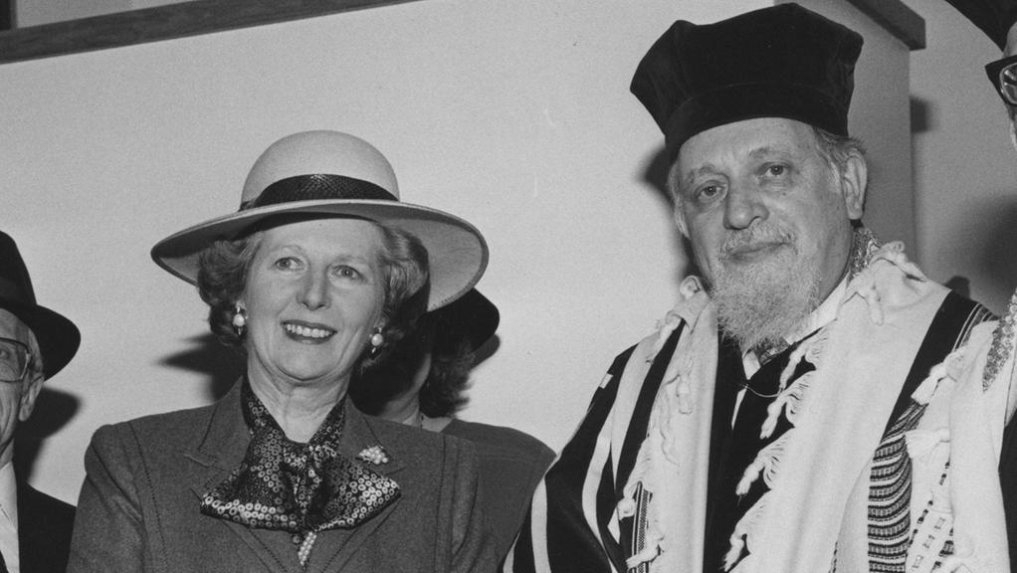
Chazon Ish versus Tzitz Eliezer
According to the Tzitz Eliezer, the reason for the requirement to extend life in every situation is that every moment of life is valuable, for there are people who justify their entire existence with a thought of repentance at the end of life. In addition, suffering has the potential to erase one’s culpability from sin.
Chief Rabbi Lord Immanuel Jakobovits
(1921 – 1999)

Slide 35
Chazon Ish versus Tzitz Eliezer
“
Immanuel Jakobovits, Journal of Rabbi p. 143
The first and most cardinal principle, in the Jewish approach to medicine is the teaching that the value of every human life is infinite and beyond measure… Since human life is of infinitive worth, any fraction of it is of equally infinite value, so that seventy years rate the same as any part of them, whether one year or one hour or a split second.
”
According to this position, a utilitarian perspective cannot be used when deciding which life to save.

Slide 36
Chazon Ish versus Tzitz Eliezer
Professor David Shatz, professor of philosophy at Yeshiva University explains Rebbi Akiva’s position based on the “least change principle.” Rebbi Akiva does not mandate sharing the water, because in a situation where someone must die the most appropriate action is to do nothing. According to Shatz, the reason inaction is preferable to action is that:
“
David Shatz, As Thyself: The Limits of Altruism in Jewish Ethics
…in dire situations when someone will die no matter what, we look at matters in terms of God’s providential control.
”
In other words, he accepts Ramsey’s contention that man should not play God with human lives. Shatz’s “least change principle” is also consistent with the allocation principle of random selection.

Slide 37
The Mishnah in Horayot 13a
OFFENCE ALERT!

Slide 38
The Mishnah in Horayot 13a
תלמוד בבלי הוריות יג.
מתני׳ האיש קודם לאשה להחיות ולהשב אבדה והאשה קודמת לאיש לכסות ולהוציא מבית השבי בזמן ששניהם עומדים בקלקלה האיש קודם לאשה:
Talmud Bavli Horayos 13a
MISHNA: A man precedes a woman when there is uncertainty with regard to which of them to rescue or to return a lost item to first. And the woman precedes the man with regard to which of them to provide with a garment first, because her humiliation is great, or to release from captivity first, due to the concern that she will be raped. When they are both subject to degradation, the release of the man precedes the release of the woman.

Slide 39
The Mishnah in Horayot 13a
תלמוד בבלי הוריות יג.
מתני׳ כהן קודם ללוי לוי לישראל ישראל לממזר וממזר לנתין ונתין לגר וגר לעבד משוחרר אימתי בזמן שכולם שוים אבל אם היה ממזר תלמיד חכם וכהן גדול עם הארץ ממזר תלמיד חכם קודם לכהן גדול עם הארץ:
Talmud Bavli Horayos 13a
MISHNA: A priest precedes a Levite. A Levite precedes an Israelite. An Israelite precedes a son born from an incestuous or adulterous relationship [mamzer], and a mamzer precedes a Gibeonite, and a Gibeonite precedes a convert, and a convert precedes an emancipated slave. When do these halachot of precedence take effect? In circumstances when they are all equal in terms of wisdom. But if there were a mamzer who is a Torah scholar and a High Priest who is an ignoramus, a mamzer who is a Torah scholar precedes a High Priest who is an ignoramus, as Torah wisdom surpasses all else.

Slide 40
The Mishnah in Horayot 13a

Slide 41
The Mishnah in Horayot 13a
פירוש המשנה לרמב"ם מסכת הוריות פרק ג משנה ז
כבר ידעת שהמצוות כולן מחויבות לזכרים, ולנקיבות מקצתן, כמו שהתבאר בקידושין, והרי הוא מקודש ממנה, ולפיכך קודם להחיות.
Commentary of the Rambam on Horayos 13a
It is well known that the commandments are incumbent on men in their entirety, whereas women are only obligated to perform a fraction of them, according to what was explained in the Gemara in Kiddushin. Therefore, men who are more sanctified through them [due to the greater number they perform], should take precedence.

Slide 42
The Mishnah in Horayot 13a
Professor Alan Jotkowitz, “A man takes precedence over a woman when it comes to saving a life” The modern dilemma of triage from a halakhic and ethical perspective, Tradition 47:1, p. 55
It is not clear why “obligation in mitzvoth” would lead to preference in life-saving. One can suggest two possible explanations: since the purpose of life in this world is to do mitsvot, the fact that a man has the potential to do more mitsvot makes his life more valuable; alternatively, the fact that he is obligated in more mitsvot denotes a higher level of intrinsic sanctity. … However, this prioritization scheme is apparently upended by the conclusion of the mishna, which bases priority on level of Torah knowledge that a person has acquired.

Slide 43
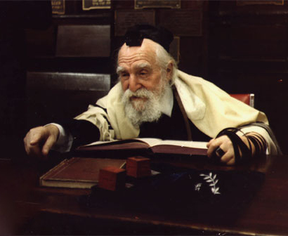
Rabbi Moshe Feinstein
Iggros Moshe
Rabbi Moshe Feinstein
(1895 – 1986)

Slide 44
Rabbi Moshe Feinstein
In one responsum, Rabbi Feinstein was asked what to do on the following scenario: Two patients simultaneously arrive at hospital, one who can only live a short time (hayyei sha’ah) even with medical intervention and who can be saved (hayyei olam). But there is only one bed available. Who should be treated, and why? He replied that the physicians should treat the patient that can be saved. He explains:
“
Iggros Moshe, Choshen Mishpat II #73
The reason is obvious: the life of someone who can be saved and live a normal life gets precedence over someone who is dying and the physician is unable to cure, but the dying patient does not have an obligation to save someone else with his life, and if he was treated first he does not have to give up his place.”
”

Slide 45
Rabbi Moshe Feinstein
Rabbi Feinstein’s prioritisation scheme is thus based heavily on a duty based approach to medical ethics as opposed to one based on human rights.
“
Immanuel Jakobovits, The Timely and the Timeless p. 128
Now in Judaism we know of no intrinsic rights. Indeed there is no word for rights in the very language of the Hebrew Bible and of the classic sources of Jewish law. In the moral vocabulary of the Jewish discipline of life we speak of human duties, not of human rights, of obligations not entitlement. The Decalogue is a list of Ten Commandments not a bill of Human Rights. In the charity legislation of the Bible, for instance, it is the rich man who is commanded to support the poor, not the poor man who has the right to demand support from the rich. In Jewish law a doctor is obligated to come to the rescue of his stricken fellow-man and to perform any operation he considers essential for the life of the patient, even if the patient refuses his consent or prefers to die. Once again, the emphasis is on the physician’s responsibility to heal, to offer service, more than on the patient’s right to be treated.
”

Slide 46
The Mishnah in Horayot 13a
Summary of how contemporary scholars approach this Mishnah
Rabbi Moshe Feinstein
In contemporary times, we effectively do not follow the prioritisation in Horayos (Iggros Moshe Choshen Mishpat II #74:1)
Rabbi Eliezer Waldenberg
Given that the prioritisation is omitted in the halachic codes (Rambam, Tur, and Shulchan Aruch) he is reluctant to accept that it applies to triage. He explains that either (i) it refers to the distribution of provisions, not saving lives, or (ii) relates to the keeping of mitzvot, which only relates to a man who actually keeps all the mitzvot. (Tzitz Eliezer 18 #1)
Rabbi Chaim Rappoport
Vehemently argues that even in modern times we must follow the prioritisation in Horayos. (Le’ela volume 51, June 2001)

Slide 47
The Mishnah in Horayot 13a
Summary of how contemporary scholars approach this Mishnah
Rabbi Professor Abraham Steinberg
These principles do not apply in modern times. (Encyclopedia Hilchatit Refu’it, IV 536-544).
Rabbi Aharon Lichtenstein
Questions whether the prioritisation is applicable today. However, he notes that “priorities due to genealogy is erased with the last sentence in that it establishes that the accomplishments of a person is more important than his genealogy” (In Quest of Your Prescence, 79)

Slide 48
Critical Care during COVID

Slide 49
British Medical Association (BMA) COVID-19 Ethics Guidance (Jan 2021)
There has always been an ethical tension in medicine between a doctor’s concern for the health and welfare of the individual patient and concern for the health of populations. In dangerous pandemics the ethical balance of all doctors and health care workers must shift towards the utilitarian objective of equitable concern for all – while maintaining respect for all as ‘ends in themselves’.
Prior to the 2009 pandemic, the Government issued an ethical framework – revised in 2017 – designed to help people think through strategic aspects of decision-making during a pandemic, as well as providing an ethical compass for clinicians. It took the form of several guiding principles which are set out briefly below.

Slide 50
Equal respect: everyone matters and everyone matters equally, but this does not mean that everyone will be treated the same
Respect: keep people as informed as possible; give people the chance to express their views on matters that affect them; respect people’s personal choices about care and treatment
Minimise the harm of the pandemic: reduce spread, minimise disruption, learn what works
Fairness: everyone matters equally. People with an equal chance of benefiting from a resource should have an equal chance of receiving it – although it is not unfair to ask people to wait if they could get the same benefit later

Slide 51
Working together: we need to support each other, take responsibility for our own behaviour and share information appropriately
Reciprocity: those who take on increased burdens should be supported in doing so
Keeping things in proportion: information communicated must be proportionate to the risks; restrictions on rights must be proportionate to the goals
Flexibility: plans must be adaptable to changing circumstances – Open and transparent decision-making: good decisions will be as inclusive, transparent and reasonable as possible. They should be rational, evidence-based, the result of a reasonable process and practical in the circumstances.

Slide 52
Professor Alan Jotkowitz’s
Triage During the COVID-19 Pandemic (Tradition Online)
Maximizing life potential can be used in triage decisions. In practice this means in a situation of limited resources, for example a dearth of respirators, resources should be given to the person who has the best chance of recovery. This means taking into account the patient’s comorbidities and functional status which all play a role in calculating the patient’s chance of survival. Cognitive and physical disability should not be used in these decisions if they do not impact on the patient’s prognosis.
“Social worth” should not be a factor, although Rabbi Eliezer Waldenberg (Tzitz Eliezer, 1915 – 2006) considered possibly making an exception for renowned Torah scholars. One can argue that healthcare workers who sacrifice themselves should have priority, certainly insofar as their future contribution to life-saving efforts, but that is a separate discussion.

Slide 53
Professor Alan Jotkowitz’s
Triage During the COVID-19 Pandemic (Tradition Online)
According to Rabbi Yechiel Yaakov Weinberg (known as the Seridei Aish, 1884–1966) one can choose to self-sacrifice and refuse the lifesaving intervention so others may receive it. However, this is by definition a personal choice and no one, including rabbis or attending physicians, should encourage a patient to make this decision.
If everything is equal regarding chance for survival, Rabbi Moshe Feinstein (1895 – 1986) prefers a random process while other halachic authorities give physicians and rescue workers leeway in decision making, according to these authorities a rational system which uses age as a criterion may be acceptable.

Slide 54
Vaccine Prioritisation

Slide 55
The Counterintuitive Nature of Vaccine Prioritisation
Phase | Priority Group
1 | Residents in care homes for older adults and their carers
2 | 80-year-olds and over and frontline health and social care workers
3 | 75-year-olds and over
4 | 70-year-olds and over and clinically extremely vulnerable individuals
5 | 65-year-olds and over
6 | 16- to 64-year-olds with serious underlying health conditions
7 | 60-year-olds and over
8 | 55-year-olds and over
9 | 50-year-olds and over

Slide 56
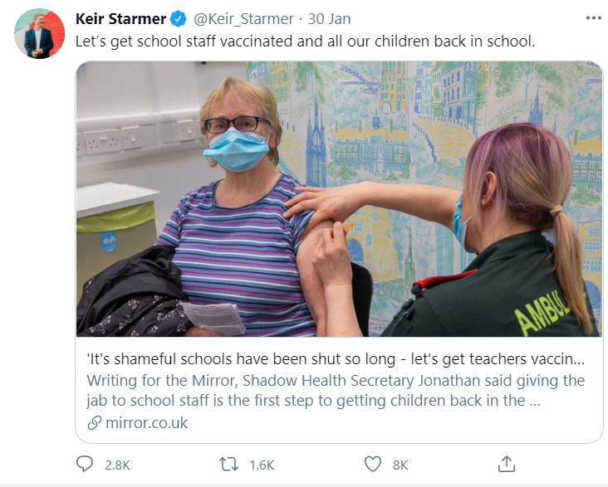
The Counterintuitive Nature of Vaccine Prioritisation

Slide 57
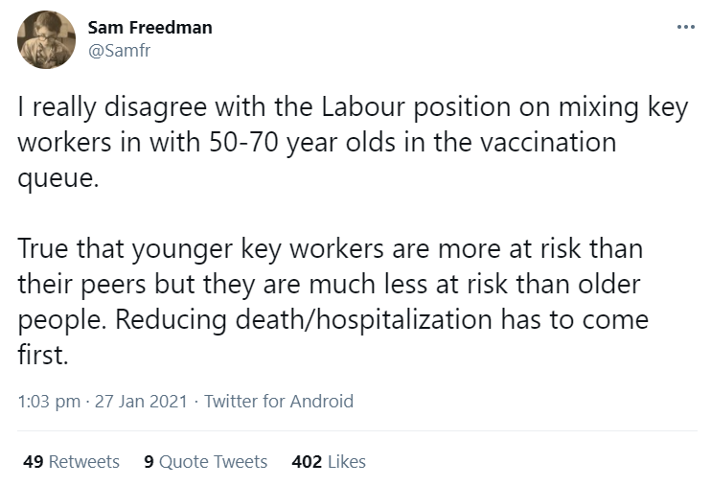
The Counterintuitive Nature of Vaccine Prioritisation

Slide 58
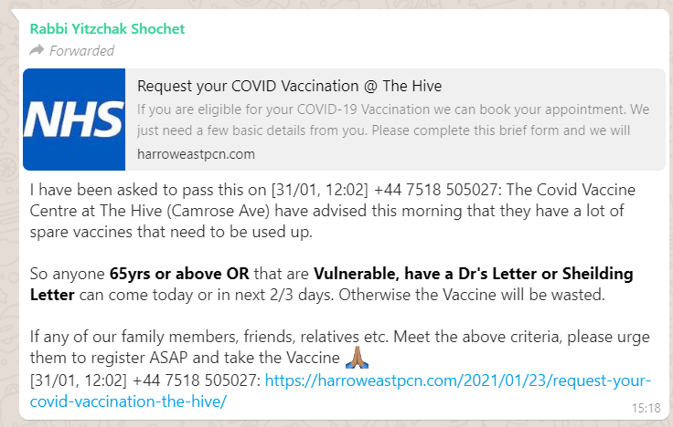
What to do with leftover doses
To waste vaccine doses that could have been given on a first come first served basis in the evening is criminal. It is a form of ethical idolatry – you’re worshipping the prioritisation system, rather than the correct ethical good.

Slide 59
Conclusions

Slide 60
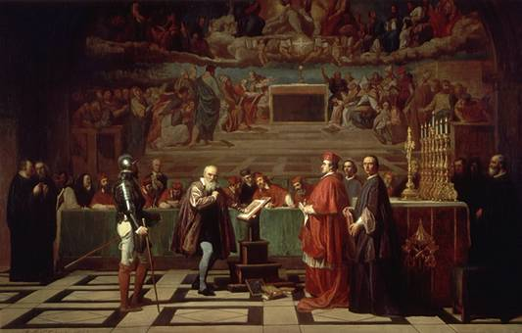
The Nature of Public Ethics
Galileo before the Holy Office, a 19th-century painting by Joseph-Nicolas Robert-Fleury
Notes:
The Galileo affair (Italian: il processo a Galileo Galilei) began around 1610^{[1]} and culminated with the trial and condemnation of Galileo Galilei by the Roman Catholic Inquisition in 1633. Galileo was prosecuted for his support of heliocentrism, the astronomical model in which the Earth and planets revolve around the Sun at the centre of the Solar System.

Slide 61
The Nature of Public Ethics
Professor Sir Jonathan Montgomery, Professor of Healthcare Law at UCL, Chair of the Oxford University Hospitals NHS Foundation Trust, Co-Chair of the Moral and Ethical Advisory Group (MEAG) to the Department of Health and Social Care

Slide 62
The Nature of Public Ethics
“
It is common for National Ethics Committees in other countries to include a significant number of theologians, but this is now rare in the United Kingdom. This is a major problem for our public ethics. For many people, theology (or at least the traditions of their faith communities) is a core source of guidance for their thinking on bioethical issues. Public bioethics needs to be sufficiently grounded in the society it serves to be recognizable by citizens; without this it cannot expect to command respect.
Professor Sir Jonathan Montgomery, “Public Ethics and Faith” (2014), Theology , 117 (5) 342 - 348
”

Slide 63
Thank You
rabbi@newwestend.org.uk
07531 326289
@moshefreedman

