Slide 1
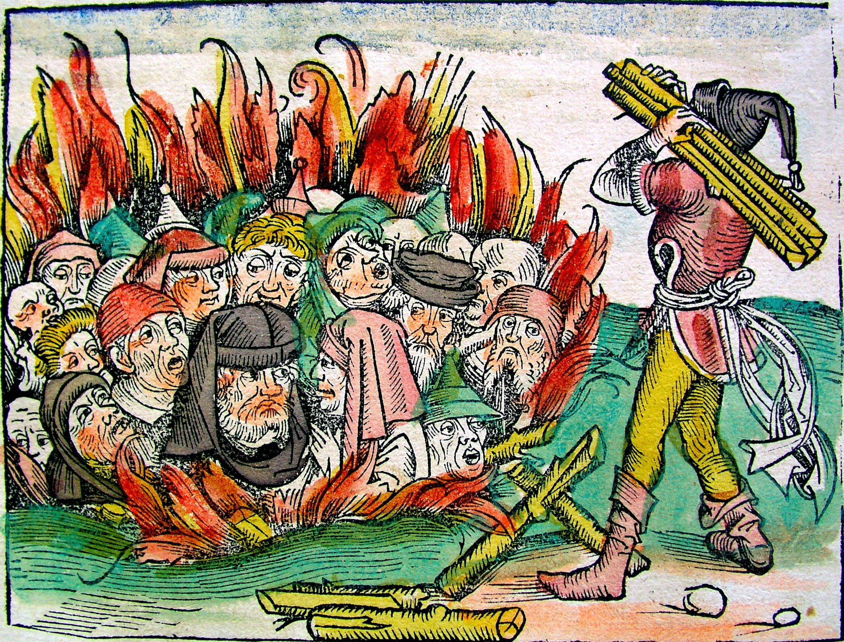
The Black Death, Smallpox and Cholera: The Jewish Response to Plagues
Judaism and Society
Rabbi Dr Moshe Freedman Rabbi, New West End Synagogue Deputy Co-chair of MEAG (Moral and Ethical Advisory Group to DHSC)

Slide 2
Overview
Plagues in the Torah
Plagues in Nach
The Rabbinic Response to Plagues
Plagues in Jewish History
Prayers, Amulets, and Segulot (charm)
The Shvartzeh Chassunah

Slide 3
Plagues in the Torah

Slide 4
The Ten Plagues

Slide 5
The Ten Plagues
שמות ז:ד-ה
וְלֹֽא־יִשְׁמַ֤ע אֲלֵכֶם֙ פַּרְעֹ֔ה וְנָתַתִּ֥י אֶת־יָדִ֖י בְּמִצְרָ֑יִם וְהוֹצֵאתִ֨י אֶת־צִבְאֹתַ֜י אֶת־עַמִּ֤י בְנֵֽי־יִשְׂרָאֵל֙ מֵאֶ֣רֶץ מִצְרַ֔יִם בִּשְׁפָטִ֖ים גְּדֹלִֽים׃ וְיָדְע֤וּ מִצְרַ֙יִם֙ כִּֽי־אֲנִ֣י יְהוָ֔ה בִּנְטֹתִ֥י אֶת־יָדִ֖י עַל־מִצְרָ֑יִם וְהוֹצֵאתִ֥י אֶת־בְּנֵֽי־יִשְׂרָאֵ֖ל מִתּוֹכָֽם׃
Exodus 7:4-5
When Pharaoh does not heed you, I will lay My hand upon Egypt and deliver My ranks, My people the Israelites, from the land of Egypt with great judgements. And the Egyptians shall know that I am the Lord, when I stretch out My hand over Egypt and bring out the Israelites from their midst.”

Slide 6
The Ten Plagues
מלבים על שמות ז:ה
וידעו מצרים. ר"ל ומצרים יסתפקו עדיין ביכולת האל וירדפו אחריהם, עד שיוכו על הים שא' ידעו מצרים כי אני ה' כמ"ש ואכבדה בפרעה ובכל חילו וידעו מצרים כי אני ה', וזה יהיה בנטותי את ידי שנטית היד מציין שאינו פוסק מלהכות מכה אחר מכה ...
Malbim on Exodus 7:5
And the Egyptians shall know. Meaning, they will continue to doubt God's omnipotence, they will charge in pursuit of the Israelites, to be struck at the sea. Whereupon the Egyptians will know that I am the Lord, as it is written, “I will be honoured through Pharaoh, and all his host; and the Egyptians will know that I am the Lord.” This will take place when I stretch out My hand, signifying that the Egyptians will be afflicted plague
upon plague. …

Slide 7
The Ten Plagues
שמות יד:יח
וְאַתָּ֞ה הָרֵ֣ם אֶֽת־מַטְּךָ֗ וּנְטֵ֧ה אֶת־יָדְךָ֛ עַל־הַיָּ֖ם וּבְקָעֵ֑הוּ וְיָבֹ֧אוּ בְנֵֽי־יִשְׂרָאֵ֛ל בְּת֥וֹךְ הַיָּ֖ם בַּיַּבָּשָֽׁה׃ וַאֲנִ֗י הִנְנִ֤י מְחַזֵּק֙ אֶת־לֵ֣ב מִצְרַ֔יִם וְיָבֹ֖אוּ אַחֲרֵיהֶ֑ם וְאִכָּבְדָ֤ה בְּפַרְעֹה֙ וּבְכָל־חֵיל֔וֹ בְּרִכְבּ֖וֹ וּבְפָרָשָֽׁיו׃ וְיָדְע֥וּ מִצְרַ֖יִם כִּי־אֲנִ֣י יְהוָ֑ה בְּהִכָּבְדִ֣י בְּפַרְעֹ֔ה בְּרִכְבּ֖וֹ וּבְפָרָשָֽׁיו׃
Exodus 14:16-18
And you raise your staff and stretch out your hand over the sea and split it, and the children of Israel shall come in the midst of the sea on dry land. And I, behold! I shall harden the hearts of the Egyptians, and they will come after you, and I will be glorified through Pharaoh, and through all his force, through his chariots, and through his horsemen. And the Egyptians shall know that I am the Lord, when I will be glorified through Pharaoh, through his chariots, and through his horsemen.

Slide 8
The Golden Calf

Slide 9
The Golden Calf
שמות לב:לא-לה
וַיָּ֧שָׁב מֹשֶׁ֛ה אֶל־יְהוָ֖ה וַיֹּאמַ֑ר אָ֣נָּ֗א חָטָ֞א הָעָ֤ם הַזֶּה֙ חֲטָאָ֣ה גְדֹלָ֔ה וַיַּֽעֲשׂ֥וּ לָהֶ֖ם אֱלֹהֵ֥י זָהָֽב׃ וְעַתָּ֖ה אִם־תִּשָּׂ֣א חַטָּאתָ֑ם וְאִם־אַ֕יִן מְחֵ֣נִי נָ֔א מִֽסִּפְרְךָ֖ אֲשֶׁ֥ר כָּתָֽבְתָּ׃ וַיֹּ֥אמֶר יְהוָ֖ה אֶל־מֹשֶׁ֑ה מִ֚י אֲשֶׁ֣ר חָֽטָא־לִ֔י אֶמְחֶ֖נּוּ מִסִּפְרִֽי׃ וְעַתָּ֞ה לֵ֣ךְ ׀ נְחֵ֣ה אֶת־הָעָ֗ם אֶ֤ל אֲשֶׁר־דִּבַּ֙רְתִּי֙ לָ֔ךְ הִנֵּ֥ה מַלְאָכִ֖י יֵלֵ֣ךְ לְפָנֶ֑יךָ וּבְי֣וֹם פָּקְדִ֔י וּפָקַדְתִּ֥י עֲלֵיהֶ֖ם חַטָּאתָֽם׃ וַיִּגֹּ֥ף יְהוָ֖ה אֶת־הָעָ֑ם עַ֚ל אֲשֶׁ֣ר עָשׂ֣וּ אֶת־הָעֵ֔גֶל אֲשֶׁ֥ר עָשָׂ֖ה אַהֲרֹֽן׃
Exodus 32:31-35
Moses went back to the Lord and said, “Alas, this people is guilty of a great sin in making for themselves a god of gold. Now, if You will forgive their sin [well and good]; but if not, erase me from the record which You have written!” But the Lord said to Moses, “He who has sinned against Me, him only will I erase from My record. Go now, lead the people where I told you. See, My angel shall go before you. But on the day that I shall make an accounting, I will bring them to account for their sins.” God struck the people with a plague, for what they did with the calf that Aaron made.

Slide 10
The Golden Calf
רמב"ן על שמות לב:לה
ויגוף ה' את העם לא ספר הכתוב כמה היו המתים במגפה, כאשר ספר הנהרגים ביד בני לוי, וכאשר פירש במגפה של דבר קרח (במדבר יז יד), ושל בעל פעור (שם כה ט). אולי לא מתו במגפה אחת, אבל נגפם ה' למות בלא עתם, כענין שכתוב כי אם ה' יגפנו או יומו יבא (ש''א כו י).
Ramban on Exodus 32:35
God struck the people with a plague. Scripture did not relate how many people died in the plague, as it did relate (in verse 28 above) the number of those killed by the hand of the Levites and as it specified regarding the plague of the Korah incident (Numbers 17:14) and that of Baal-Peor (ibid. 25:9). Perhaps they did not die in one plague all at once, but God struck them gradually in a way that caused them to die before their times, like the idea that is written in I Samuel 26:10, ... but Hashem will strike him, or his day will come.

Slide 11
The Golden Calf
רמב"ן על שמות לב:לה
ואולי לא חשש למנותם, כי כן לא מנה המתים בתבערה (במדבר יא א) ובקברות התאוה, שנאמר (שם יא לג) ויך ה' בעם מכה רבה מאד. אבל הנופלים על יד בני לוי פרט לכבודם, לומר שהרגו רבים בעם ולא פחדו מהם כי על ה' בטחו:
Ramban on Exodus 32:35
Or perhaps [Scripture] was not concerned about tallying [the victims] of this plague, for similarly it did not tally those who died at Taverah (Numbers 11:1) and at Kivrot HaTa’avah, regarding which it stated simply (ibid. v. 33), and Hashem struck a very mighty blow against the people. However, [Scripture] did specify the number of those who fell at the hand of the Levites, out of honour for [the Levites], i.e., to inform us that [the Levites] killed many among the people and did not fear, for they trusted in God to protect them.

Slide 12
Tzara’as

Slide 13
Tzara’as
ויקרא יג:א-ב
וַיְדַבֵּ֣ר יְהוָ֔ה אֶל־מֹשֶׁ֥ה וְאֶֽל־אַהֲרֹ֖ן לֵאמֹֽר׃ אָדָ֗ם כִּֽי־יִהְיֶ֤ה בְעוֹר־בְּשָׂרוֹ֙ שְׂאֵ֤ת אֽוֹ־סַפַּ֙חַת֙ א֣וֹ בַהֶ֔רֶת וְהָיָ֥ה בְעוֹר־בְּשָׂר֖וֹ לְנֶ֣גַע צָרָ֑עַת וְהוּבָא֙ אֶל־אַהֲרֹ֣ן הַכֹּהֵ֔ן א֛וֹ אֶל־אַחַ֥ד מִבָּנָ֖יו הַכֹּהֲנִֽים׃
Leviticus 13:1-2
The Lord spoke to Moses and Aaron, saying: When a person has on the skin of his body a swelling, a rash, or a discoloration, and it develops into a scaly affection on the skin of his body, it shall be reported to Aaron the priest or to one of his sons, the priests.

Slide 14
Tzara’as
Rabbi Shimshon Refael Hirsch on Tzaraat
In the majority of cases where the word נגע occurs, it clearly refers not to an ordinary condition of disease, but to a disease that comes as a result of a special Divine decree. A person afflicted with a נגע meaning literally “touched” by the finger of God. נגע is a weaker form of נגף, which is the root of מגפה — a sudden stroke of death. נגע is commonly translated “disease”; and we, too, have translated it this way, for lack of a fitting word.

Slide 15
Tzara’as
Rabbi Shimshon Refael Hirsch on Tzaraat
But “disease” does not properly express the idea of נגע. “Plague” is not much better, for it denotes only the suffering of the afflicted, but does not capture the meaning of נגע from the standpoint of its origin. Thus, the Gemara in Horayos 10a learns from the verse ונתתי נגע צרעת בבית וגו׳ (below, 14:34) that נגעי אדם, like נגעי בתים, are not מטמא unless they can be attributed to a special Divine decree, and not to other, pathological causes: פרט לנגעי רוחות פרט לנגעי כשפים.

Slide 16
Tzara’as
Rabbi Shimshon Refael Hirsch on Tzaraat
צרעת derives from צרע (related to זרה ,זרע, to throw away and remove; related also to סרה and to the Aramaic סרח, to rot). The term צרע denotes an inner rot that breaks out externally, whereas נגע denotes a plague that strikes from without, as a result of a special Divine decree, as we have stated. Thus, from the combined expression נגע צרעת we learn that צרעת is מטמאת only if it manifests itself as a נגע — as a special Divine decree; and a נגע is מטמא only if it is צרעת, an inner rot that breaks out and manifests itself externally on the skin.

Slide 17
Tzara’as
Rabbi Shimshon Refael Hirsch on Tzaraat
According to Toras Kohanim here, נגע also denotes something painful and objectionable, מלמד שהוא מצטער ממנו; and here it denotes additionally that its proximity disturbs other people, too — אחרים מצטערים ממנו, as the ראב״ד (ad loc.) explains: מריחה, its odour is objectionable. This last connotation is indicated perhaps by the adjacent expression והובא, he is brought: others feel a need to bring him to the כהן.

Slide 18
The Sin of the Spies

Slide 19
The Sin of the Spies
במדבר יד:לה-לז
אֲנִ֣י יְהוָה֮ דִּבַּרְתִּי֒ אִם־לֹ֣א ׀ זֹ֣את אֶֽעֱשֶׂ֗ה לְכָל־הָעֵדָ֤ה הָֽרָעָה֙ הַזֹּ֔את הַנּוֹעָדִ֖ים עָלָ֑י בַּמִּדְבָּ֥ר הַזֶּ֛ה יִתַּ֖מּוּ וְשָׁ֥ם יָמֻֽתוּ׃ וְהָ֣אֲנָשִׁ֔ים אֲשֶׁר־שָׁלַ֥ח מֹשֶׁ֖ה לָת֣וּר אֶת־הָאָ֑רֶץ וַיָּשֻׁ֗בוּ וילונו [וַיַּלִּ֤ינוּ] עָלָיו֙ אֶת־כָּל־הָ֣עֵדָ֔ה לְהוֹצִ֥יא דִבָּ֖ה עַל־הָאָֽרֶץ׃ וַיָּמֻ֙תוּ֙ הָֽאֲנָשִׁ֔ים מוֹצִאֵ֥י דִבַּת־הָאָ֖רֶץ רָעָ֑ה בַּמַּגֵּפָ֖ה לִפְנֵ֥י יְהוָֽה׃
Numbers 14:35-37
I, the Lord, have spoken if I will not do this to the entire evil congregation who have assembled against me; in this desert they will end, and there they will die. As for the men whom Moses had sent to scout the Land, who returned and caused the entire congregation to complain against him by spreading [a slanderous] report about the Land, and the men who spread an evil report about the Land died by the plague, before the Lord.

Slide 20
The Sin of the Spies
רש"י על במדבר יד:לז
במגפה לפני ה'. בְּאוֹתָהּ מִיתָה הַהֲגוּנָה לָהֶם, מִדָּה כְּנֶגֶד מִדָּה, הֵם חָטְאוּ בַּלָּשׁוֹן, וְנִשְׁתַּרְבֵּב לְשׁוֹנָם עַד טַבּוּרָם וְתוֹלָעִים יוֹצְאִים מִלְּשׁוֹנָם וּבָאִין לְתוֹךְ טַבּוּרָם, לְכָךְ נֶאֱמַר "בַּמַּגֵּפָה" וְלֹא "בְמַגֵּפָה", וְזֶהוּ לפני ה' — בְּאוֹתָהּ הָרְאוּיָה לָהֶם עַ"פִּ מִדּוֹתָיו שֶׁל הַקָּבָּ"ה שֶׁהוּא מוֹדֵד מִדָּה כְּנֶגֶד מִדָּה (סוטה ל"ה):
Rashi on Numbers 14:37
by the plague, before the Lord — by that death which was fitting for them — measure for measure. They had sinned with their tongue; therefore, their tongue grew long extending right down to their navels, and worms came from their tongue and entered their navels. This is the reason why it states, they died by “the” plague, and not בְּמַגֵּפָה by “a” plague; this, too, is the meaning of the words “before the Lord” (they died by the plague which was before the Lord) — by that plague which was fitting for them according to the methods of the Holy One, blessed be He, Who metes out “measure for measure” (Sotah 35a).

Slide 21
The Sin of the Spies
ספורנו על במדבר יד:לז
וימותו האנשים מוציאי דבת הארץ רעה במגפה באותה מגפה שאמרו הם שתקרה בארץ אוכלת יושביה והנה פעולת אויר הארץ היתה להם לזרא ומתו תכף:
Seforno on Numbers 14:37
and the men who spread an evil report about the Land died by the plague, before the Lord. From the type of pestilence which they claimed had caused the death of the people they had seen dying in the land of Canaan during their tour of exploration. (13,32) It was the kind of pollution in the air which kills almost instantly.

Slide 22
Korach

Slide 23
Korach
במדבר יז:יא-יג
וַיֹּ֨אמֶר מֹשֶׁ֜ה אֶֽל־אַהֲרֹ֗ן קַ֣ח אֶת־הַ֠מַּחְתָּה וְתֶן־עָלֶ֨יהָ אֵ֜שׁ מֵעַ֤ל הַמִּזְבֵּ֙חַ֙ וְשִׂ֣ים קְטֹ֔רֶת וְהוֹלֵ֧ךְ מְהֵרָ֛ה אֶל־הָעֵדָ֖ה וְכַפֵּ֣ר עֲלֵיהֶ֑ם כִּֽי־יָצָ֥א הַקֶּ֛צֶף מִלִּפְנֵ֥י יְהוָ֖ה הֵחֵ֥ל הַנָּֽגֶף׃ וַיִּקַּ֨ח אַהֲרֹ֜ן כַּאֲשֶׁ֣ר ׀ דִּבֶּ֣ר מֹשֶׁ֗ה וַיָּ֙רָץ֙ אֶל־תּ֣וֹך הַקָּהָ֔ל וְהִנֵּ֛ה הֵחֵ֥ל הַנֶּ֖גֶף בָּעָ֑ם וַיִּתֵּן֙ אֶֽת־הַקְּטֹ֔רֶת וַיְכַפֵּ֖ר עַל־הָעָֽם׃ וַיַּעֲמֹ֥ד בֵּֽין־הַמֵּתִ֖ים וּבֵ֣ין הַֽחַיִּ֑ים וַתֵּעָצַ֖ר הַמַּגֵּפָֽה׃
Numbers 17:11-13
11. Moses said to Aaron, “Take the censer and put fire from the altar top into it and put incense. Then take it quickly to the congregation and atone for them, for wrath has gone forth from the Lord, and the plague has begun.” 12. Aaron took [it], just as Moses had said, and he ran into the midst of the assembly, and behold, the plague had begun among the people. He placed the incense on it and atoned for the people. 13. and he stood between the dead and the living, and the plague ceased.

Slide 24
Korach
רש"י על במדבר יז:יג
ויעמד בין המתים וגו'. אָחַז אֶת הַמַּלְאָךְ וְהֶעֱמִידוֹ עַל כָּרְחוֹ, אָמַר לוֹ הַמַּלְאָךְ, הַנַּח לִי לַעֲשׂוֹת שְׁלִיחוּתִי, אָמַר לוֹ מֹשֶׁה צִוַּנִי לְעַכֵּב עַל יָדְךָ, אָמַר לוֹ אֲנִי שְׁלוּחוֹ שֶׁל מָקוֹם וְאַתָּה שְׁלוּחוֹ שֶׁל מֹשֶׁה, אָמַר לוֹ אֵין מֹשֶׁה אוֹמֵר כְּלוּם מִלִּבּוֹ אֶלָּא מִפִּי הַגְּבוּרָה,
Rashi on Numbers 17:13
and he stood between the dead [and the living] — He (Aaron) seized the Angel of Death and stopped him forcefully. The angel said to him, “Let me be, so that I may carry out my mission!” He (Aaron) answered him, “Moses has made me responsible for preventing you.” The angel replied, “I am the messenger of the Omnipresent while you are but the messenger of Moses!” Aaron retorted, “Moses does not say anything out of his own mind, but only at the command of the Almighty.

Slide 25
Korach
רש"י על במדבר יז:יג
אִם אֵין אַתָּה מַאֲמִין, הֲרֵי הַקָּבָּ"ה וּמֹשֶׁה אֶל פֶּתַח אֹהֶל מוֹעֵד, בֹּא עִמִּי וּשְׁאַל, וְזֶהוּ שֶׁנֶּאֱמַר וישב אהרן אל משה;
Rashi on Numbers 17:13
If you do not believe me, behold, the Holy One, blessed be He, and Moses are at the entrance of the appointed tent; come with me and ask them!” This is the meaning of what is stated (verse 15): And Aaron returned to Moses (together with the Angel of Death) (cf. Midrash Tanchuma, Tetzaveh 15 at end of תצוה).

Slide 26
Korach
רש"י על במדבר יז:יג
דָּ"אַ, לָמָּה בַקְּטֹרֶת? לְפִי שֶׁהָיוּ יִשְׂרָאֵל מְלִיזִים וּמְרַנְּנִים אַחַר הַקְּטֹרֶת לוֹמַר סַם הַמָּוֶת הוּא - עַל יָדוֹ מֵתוּ נָדָב וַאֲבִיהוּא, עַל יָדוֹ נִשְׂרְפוּ חֲמִשִּׁים וּמָאתַיִם אִישׁ - אָמַר הַקָּבָּ"ה, תִּרְאוּ שֶׁעוֹצֵר מַגֵּפָה הוּא וְהַחֵטְא הוּא הַמֵּמִית (מכילתא שמות י"ז):
Rashi on Numbers 17:13
Another explanation is: For what reason was the plague stopped by means of the incense? Because the Israelites were disparaging and denigrating the incense, saying, “It is a deadly poison as Nadav and Avihu died as a result of it. Two hundred and fifty men were burnt because of it!” Therefore the Holy One, blessed be He, said, You will see that it is also a means for restraining the plague, and it is only sin that brings death” (Mekhilta d'Rabbi Yishmael 17:5:3 on Exodus 17:5).

Slide 27
The Fiery Serpents

Slide 28
The Fiery Serpents
במדבר כא:ד-ט
וַיִּסְע֞וּ מֵהֹ֤ר הָהָר֙ דֶּ֣רֶךְ יַם־ס֔וּף לִסְבֹ֖ב אֶת־אֶ֣רֶץ אֱד֑וֹם וַתִּקְצַ֥ר נֶֽפֶשׁ־הָעָ֖ם בַּדָּֽרֶךְ׃ וַיְדַבֵּ֣ר הָעָ֗ם בֵּֽאלֹהִים֮ וּבְמֹשֶׁה֒ לָמָ֤ה הֶֽעֱלִיתֻ֙נוּ֙ מִמִּצְרַ֔יִם לָמ֖וּת בַּמִּדְבָּ֑ר כִּ֣י אֵ֥ין לֶ֙חֶם֙ וְאֵ֣ין מַ֔יִם וְנַפְשֵׁ֣נוּ קָ֔צָה בַּלֶּ֖חֶם הַקְּלֹקֵֽל׃ וַיְשַׁלַּ֨ח יְהוָ֜ה בָּעָ֗ם אֵ֚ת הַנְּחָשִׁ֣ים הַשְּׂרָפִ֔ים וַֽיְנַשְּׁכ֖וּ אֶת־הָעָ֑ם וַיָּ֥מָת עַם־רָ֖ב מִיִּשְׂרָאֵֽל׃
Numbers 21:4-9
They journeyed from Mount Hor by way of the Reed Sea to circle the land of Edom, and the people became disheartened because of the way. The people spoke against God and against Moses, “Why have you brought us up out of Egypt to die in this desert, for there is no bread and no water, and we are disgusted with this rotten bread.” The Lord sent against the people the venomous snakes, and they bit the people, and many people of Israel died.

Slide 29
The Fiery Serpents
במדבר כא:ד-ט
וַיָּבֹא֩ הָעָ֨ם אֶל־מֹשֶׁ֜ה וַיֹּאמְר֣וּ חָטָ֗אנוּ כִּֽי־דִבַּ֤רְנוּ בַֽיהוָה֙ וָבָ֔ךְ הִתְפַּלֵּל֙ אֶל־יְהוָ֔ה וְיָסֵ֥ר מֵעָלֵ֖ינוּ אֶת־הַנָּחָ֑שׁ וַיִּתְפַּלֵּ֥ל מֹשֶׁ֖ה בְּעַ֥ד הָעָֽם׃ וַיֹּ֨אמֶר יְהוָ֜ה אֶל־מֹשֶׁ֗ה עֲשֵׂ֤ה לְךָ֙ שָׂרָ֔ף וְשִׂ֥ים אֹת֖וֹ עַל־נֵ֑ס וְהָיָה֙ כָּל־הַנָּשׁ֔וּךְ וְרָאָ֥ה אֹת֖וֹ וָחָֽי׃
Numbers 21:4-9
The people came to Moses and said, “We have sinned, for we have spoken against the Lord and against you. Pray to the Lord that He remove the snakes from us.” So Moses prayed on behalf of the people. The Lord said to Moses, “Make yourself a serpent and put it on a pole and let whoever is bitten look at it and live.” Moses made a copper snake and put it on a pole, and whenever a snake bit a man, he would gaze upon the copper snake and live.

Slide 30
The Fiery Serpents
רבינו בחיי במדבר פרק כא פסוק ט
(ט) והביט אל נחש הנחשת וחי. הפך הטבע, כי הנשוך מסתכן בהביטו אל צורת הנושך, ועשאו משה מנחשת קלל שהוא מאדים דוגמת הנחשים השרפים, וכן נתרפא חזקיה במריחת דבלת תאנים על השחין, ונמתקו מי מרה באותו עץ שהיה מר, והנה זה היה נס בתוך נס.
Rabbeinu Bachaya (d. 1340) on Numbers 21:9
if he looked up to the copper snake he would live. The cure was the opposite of the natural process. If the person who had been bitten would look at the snake which bit him he would endanger himself. Moses decided to make it out of copper by his own intuition, because copper is red, and similar to the fiery snakes. So too King Chizkiyah was cured by applying dried figs to the area infected by boils (a procedure which normally intensifies the skin rash he suffered from); the bitter waters at Marah were sweetened by throwing bitter (not sweet) wood into it.

Slide 31
Plagues in Nach

Slide 32
Philistine Haemorrhoids

Slide 33
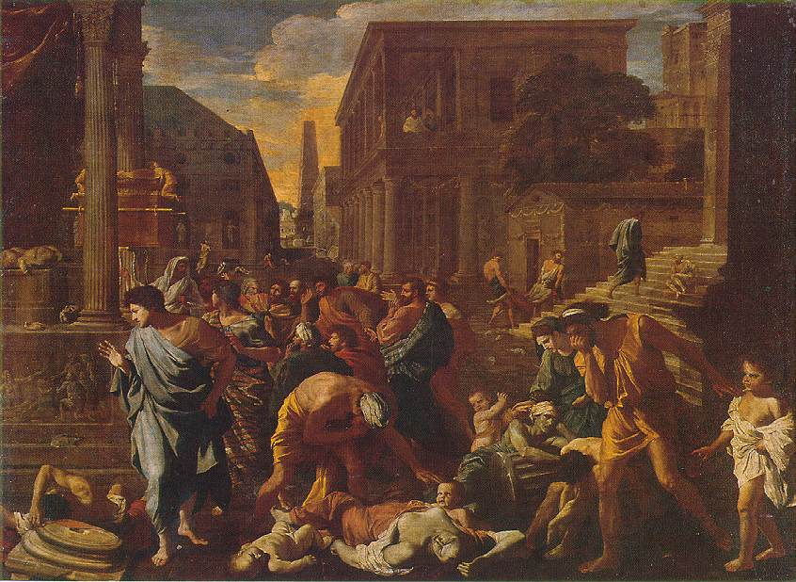
Philistine Haemorrhoids
The Plague of Ashdod 1630 by Nicolas Poussin (1594–1665). Louvre, Paris. The picture was on the front cover of the January 2018 edition of the journal Emerging Infectious Diseases.

Slide 34
Philistine Haemorrhoids
שמואל א פרק ה
(א) וּפְלִשְׁתִּים לָקְחוּ אֵת אֲרוֹן הָאֱלֹהִים וַיְבִאֻהוּ מֵאֶבֶן הָעֵזֶר אַשְׁדּוֹדָה: (ב) וַיִּקְחוּ פְלִשְׁתִּים אֶת אֲרוֹן הָאֱלֹהִים וַיָּבִיאוּ אֹתוֹ בֵּית דָּגוֹן וַיַּצִּיגוּ אֹתוֹ אֵצֶל דָּגוֹן: ... (ו) וַתִּכְבַּד יַד יְקֹוָק אֶל הָאַשְׁדּוֹדִים וַיְשִׁמֵּם וַיַּךְ אֹתָם בעפלים בַּטְּחֹרִים אֶת אַשְׁדּוֹד וְאֶת גְּבוּלֶיהָ: ... (ח) וַיִּשְׁלְחוּ וַיַּאַסְפוּ אֶת כָּל סַרְנֵי פְלִשְׁתִּים אֲלֵיהֶם וַיֹּאמְרוּ מַה נַּעֲשֶׂה לַאֲרוֹן אֱלֹהֵי יִשְׂרָאֵל וַיֹּאמְרוּ גַּת יִסֹּב אֲרוֹן אֱלֹהֵי יִשְׂרָאֵל וַיַּסֵּבּוּ אֶת אֲרוֹן אֱלֹהֵי יִשְׂרָאֵל: (ט) וַיְהִי אַחֲרֵי הֵסַבּוּ אֹתוֹ וַתְּהִי יַד יְקֹוָק בָּעִיר מְהוּמָה גְּדוֹלָה מְאֹד וַיַּךְ אֶת אַנְשֵׁי הָעִיר מִקָּטֹן וְעַד גָּדוֹל וַיִּשָּׂתְרוּ לָהֶם עפלים טְחֹרִים:
Samuel I 5:1-2, 6, 8-12
1. Now, the Philistines had taken the Ark of God, and brought it from Even Ha’ezer to Ashdod. 2. And the Philistines took the Ark of God and brought it to the house of Dagon, and set it up beside Dagon. … 6. And the hand of the Lord became heavy upon the Ashdodites, and He ravaged them, and He smote them with haemorrhoids, Ashdod and its borders. … 8. And they sent and gathered all the lords of the Philistines unto them, and they said, "What shall we do to the Ark of the God of Israel?" And they said, "Let the Ark of the God of Israel be brought around to Gat," and (thereupon), they brought the Ark of the God of Israel around to Gat. 9. And it was, after they had brought it around, that the hand of the Lord was upon the city (with) a great panic, and He smote the people of the city, both young and old, and haemorrhoids broke out in their hidden parts.

Slide 35
Philistine Haemorrhoids
שמואל א פרק ה
(י) וַיְשַׁלְּחוּ אֶת אֲרוֹן הָאֱלֹהִים עֶקְרוֹן וַיְהִי כְּבוֹא אֲרוֹן הָאֱלֹהִים עֶקְרוֹן וַיִּזְעֲקוּ הָעֶקְרֹנִים לֵאמֹר הֵסַבּוּ אֵלַי אֶת אֲרוֹן אֱלֹהֵי יִשְׂרָאֵל לַהֲמִיתֵנִי וְאֶת עַמִּי: (יא) וַיִּשְׁלְחוּ וַיַּאַסְפוּ אֶת כָּל סַרְנֵי פְלִשְׁתִּים וַיֹּאמְרוּ שַׁלְּחוּ אֶת אֲרוֹן אֱלֹהֵי יִשְׂרָאֵל וְיָשֹׁב לִמְקֹמוֹ וְלֹא יָמִית אֹתִי וְאֶת עַמִּי כִּי הָיְתָה מְהוּמַת מָוֶת בְּכָל הָעִיר כָּבְדָה מְאֹד יַד הָאֱלֹהִים שָׁם: (יב) וְהָאֲנָשִׁים אֲשֶׁר לֹא מֵתוּ הֻכּוּ בעפלים בַּטְּחֹרִים וַתַּעַל שַׁוְעַת הָעִיר הַשָּׁמָיִם:
Samuel I 5:1-2, 6, 8-12
10. And they sent away the Ark of God to Ekron, and it was that when the Ark of God came to Ekron, that the Ekronites cried out, saying, "They have brought around the Ark of the God of Israel to me to kill me and my people. 11. And they sent and gathered all the lords of the Philistines, and they said, "Send away the Ark of the God of Israel, and let it return to its place, so that it will not kill me and my people," for there was a panic of death in the entire city; the hand of God was very heavy there. 12. And the people who did not die, were smitten with haemorrhoids, and the cry of the city ascended to heaven.

Slide 36
Philistine Haemorrhoids
שמואל א פרק ו
(א) וַיְהִי אֲרוֹן יְקֹוָק בִּשְׂדֵה פְלִשְׁתִּים שִׁבְעָה חֳדָשִׁים: (ב) וַיִּקְרְאוּ פְלִשְׁתִּים לַכֹּהֲנִים וְלַקֹּסְמִים לֵאמֹר מַה נַּעֲשֶׂה לַאֲרוֹן יְקֹוָק הוֹדִעֻנוּ בַּמֶּה נְשַׁלְּחֶנּוּ לִמְקוֹמוֹ: (ג) וַיֹּאמְרוּ אִם מְשַׁלְּחִים אֶת אֲרוֹן אֱלֹהֵי יִשְׂרָאֵל אַל תְּשַׁלְּחוּ אֹתוֹ רֵיקָם כִּי הָשֵׁב תָּשִׁיבוּ לוֹ אָשָׁם אָז תֵּרָפְאוּ וְנוֹדַע לָכֶם לָמָּה לֹא תָסוּר יָדוֹ מִכֶּם:
Samuel I 6:1-5
1. And the Ark of the Lord was in the field of the Philistines seven months. 2. And the Philistines called the priests and the diviners, saying, "What shall we do to the Ark of the Lord? Let us know in what (manner) we shall send it to its place." 3. And they said, "If you send the Ark of the God of Israel, do not send it away empty, but you shall send back with it a guilt-offering. Then you will be cured, and it will be known to you, why His hand would not turn away from you.

Slide 37
Philistine Haemorrhoids
שמואל א פרק ו
(ד) וַיֹּאמְרוּ מָה הָאָשָׁם אֲשֶׁר נָשִׁיב לוֹ וַיֹּאמְרוּ מִסְפַּר סַרְנֵי פְלִשְׁתִּים חֲמִשָּׁה עפלי טְחֹרֵי זָהָב וַחֲמִשָּׁה עַכְבְּרֵי זָהָב כִּי מַגֵּפָה אַחַת לְכֻלָּם וּלְסַרְנֵיכֶם: (ה) וַעֲשִׂיתֶם צַלְמֵי עפליכם טְחֹרֵיכֶם וְצַלְמֵי עַכְבְּרֵיכֶם הַמַּשְׁחִיתִם אֶת הָאָרֶץ וּנְתַתֶּם לֵאלֹהֵי יִשְׂרָאֵל כָּבוֹד אוּלַי יָקֵל אֶת יָדוֹ מֵעֲלֵיכֶם וּמֵעַל אֱלֹהֵיכֶם וּמֵעַל אַרְצְכֶם:
Samuel I 6:1-5
4. And they said, "What is the guilt-offering which we shall send back to Him?" And they said, "The number of the lords of the Philistines: five haemorrhoids of gold and five mice of gold, for there is one plague for all of them and for your lords. 5. And you shall make the images of your haemorrhoids and the images of your rodents who destroy the land, and you shall give honour to the God of Israel. Perhaps He will lighten His hand from upon you, and from upon your god, and from upon your land.

Slide 38
Philistine Haemorrhoids
כריתות ה:
משנגנז ארון נגנז צנצנת המן וצלוחית שמן המשחה ומקלו של אהרן שקדים ופרחים וארגז ששגרו פלשתים דורון לאלהי ישראל
Babylonian Talmud Tractate Keritot 5a
When the Ark was hidden [by King Yoshiyahu], along with it was sequestered the jar of manna, and the flask of the anointing oil, and Aaron’s staff with its almonds and blossoms. And also hidden with the Ark was the chest that the Philistines sent as a gift to the God of Israel [after they captured the Ark and were stricken by several plagues].

Slide 39
Philistine Haemorrhoids
Journal of The Royal Society of Medicine, Volume 93 August 2000, p. 449
The New International Version (NIV) in its footnotes records that the Septuagint (a translation from the Hebrew to Greek done in Alexandria for Ptolemy Philadelphus) and Vulgate (a translation by St Jerome into Latin from the Septuagint) texts elaborate on the fact that Philistines were smitten with tumours as follows. In 1 Samuel 5 v6 the NIV states the Philistines were afflicted with tumours and the Septuagint and Vulgate expand this point with the words `and rats appeared in their land, and death and destruction were throughout the city' and in v 9 of the same chapter the Septuagint versions expand `He afflicted the people, both young and old with an outbreak of tumours' by specifying the site of the tumours as being `in the groin.’

Slide 40
Philistine Haemorrhoids
Βασιλειῶν Α´ - Κεφάλαιο 6:4
καὶ λέγουσι· τί τὸ τῆς βασάνου ἀποδώσομεν αὐτῇ; καὶ εἶπαν· κατ᾿ ἀριθμὸν τῶν σατραπῶν τῶν ἀλλοφύλων πέντε ἕδρας χρυσᾶς, ὅτι πταῖσμα ἐν ὑμῖν καὶ τοῖς ἄρχουσιν ὑμῶν καὶ τῷ λαῷ
Septuagint on Samuel I 6:4 [Kingdoms 1 6:4]
According to the number of the lords of the Philistines, πέντε έδρας χρυσάς five buttocks of gold, for the plague was on you, and on your rulers.

Slide 41
Philistine Haemorrhoids
Vulgate (4th Century BCE) on Samuel I 6:4
iuxta numerum provinciarum Philisthim quinque anos aureos facietis et quinque mures aureos quia plaga una fuit omnibus vobis et satrapis vestris facietisque similitudines anorum vestrorum et similitudines murium qui demoliti sunt terram et dabitis Deo Israhel gloriam si forte relevet manum suam a vobis et a diis vestris et a terra vestra Translation (King James Bible) of the Vulgate on Samuel I 6:4
According to the number of the provinces of the Philistines you shall make five golden emerods (haemorrhoids) [lit. five golden behinds], and five golden mice: for the same plague hath been upon you all, and upon your lords. And you shall make the likeness of your emerods, and the likeness of the mice, that have destroyed the land, and you shall give glory to the God of Israel: to see if he will take off his hand from you, and from your gods, and from your land.

Slide 42
Philistine Haemorrhoids
The קרי and the כתיב
שמואל א פרק ה
(ט) וַיְהִי אַחֲרֵי הֵסַבּוּ אֹתוֹ וַתְּהִי יַד יְקֹוָק בָּעִיר מְהוּמָה גְּדוֹלָה מְאֹד וַיַּךְ אֶת אַנְשֵׁי הָעִיר מִקָּטֹן וְעַד גָּדוֹל וַיִּשָּׂתְרוּ לָהֶם עפלים טְחֹרִים:
Samuel I 5:9
9. And it was, after they had brought it around, that the hand of the Lord was upon the city (with) a great panic, and He smote the people of the city, both young and old, and haemorrhoids broke out in their hidden parts.

Slide 43
Philistine Haemorrhoids
Dr. Jeremy Brown, author of the Talmudology blog
The Koren Jerusalem Bible translates the phrase as “five golden swellings,” but there is ambiguity as to the meaning in the very text of the Hebrew Bible itself. The text has the word ophalim, עפלים, but the traditional way of pronouncing this word is techorim טְּחֹרִים, which in both the Talmud and modern Hebrew means haemorrhoids.
So the different ways of translating the text is embedded in the Hebrew text itself. But one thing is certain: although they may be painful, haemorrhoids won’t kill you, but bubonic plague certainly will. And that should certainly enter into any consideration of an appropriate translation.

Slide 44
David’s Census

Slide 45
David’s Census
שמואל ב פרק כד
(א) וַיֹּסֶף אַף יְקֹוָק לַחֲרוֹת בְּיִשְׂרָאֵל וַיָּסֶת אֶת דָּוִד בָּהֶם לֵאמֹר לֵךְ מְנֵה אֶת יִשְׂרָאֵל וְאֶת יְהוּדָה: ... (י) וַיַּךְ לֵב דָּוִד אֹתוֹ אַחֲרֵי כֵן סָפַר אֶת הָעָם ס וַיֹּאמֶר דָּוִד אֶל יְקֹוָק חָטָאתִי מְאֹד אֲשֶׁר עָשִׂיתִי וְעַתָּה יְקֹוָק הַעֲבֶר נָא אֶת עֲוֹן עַבְדְּךָ כִּי נִסְכַּלְתִּי מְאֹד: (יא) וַיָּקָם דָּוִד בַּבֹּקֶר פ וּדְבַר יְקֹוָק הָיָה אֶל גָּד הַנָּבִיא חֹזֵה דָוִד לֵאמֹר: (יב) הָלוֹךְ וְדִבַּרְתָּ אֶל דָּוִד כֹּה אָמַר יְקֹוָק שָׁלֹשׁ אָנֹכִי נוֹטֵל עָלֶיךָ בְּחַר לְךָ אַחַת מֵהֶם וְאֶעֱשֶׂה לָּךְ:
Samuel II 24:1, 10-14
1. And again the anger of the Lord was kindled against Israel and He moved David against them, saying, "Go count Israel and Judah." … 10. And David's heart smote him after he had counted the people. And David said to the Lord: I have sinned greatly in what I have done; and now, 'O Lord, put aside please, the iniquity of your servant, for I was very foolish! 11. And David rose up in the morning; and the word of the Lord came to Gad the Prophet, the seer of David, saying: 12. "Go and speak to David, 'So says the Lord, "Three things I offer you, choose for yourself one of them, and I shall do it to you".

Slide 46
David’s Census
שמואל ב פרק כד
(יג) וַיָּבֹא גָד אֶל דָּוִד וַיַּגֶּד לוֹ וַיֹּאמֶר לוֹ הֲתָבוֹא לְךָ שֶׁבַע שָׁנִים רָעָב בְּאַרְצֶךָ אִם שְׁלֹשָׁה חֳדָשִׁים נֻסְךָ לִפְנֵי צָרֶיךָ וְהוּא רֹדְפֶךָ וְאִם הֱיוֹת שְׁלֹשֶׁת יָמִים דֶּבֶר בְּאַרְצֶךָ עַתָּה דַּע וּרְאֵה מָה אָשִׁיב שֹׁלְחִי דָּבָר: (יד) וַיֹּאמֶר דָּוִד אֶל גָּד צַר לִי מְאֹד נִפְּלָה נָּא בְיַד יְקֹוָק כִּי רַבִּים רחמו רַחֲמָיו וּבְיַד אָדָם אַל אֶפֹּלָה: (טו) וַיִּתֵּן יְקֹוָק דֶּבֶר בְּיִשְׂרָאֵל מֵהַבֹּקֶר וְעַד עֵת מוֹעֵד וַיָּמָת מִן הָעָם מִדָּן וְעַד בְּאֵר שֶׁבַע שִׁבְעִים אֶלֶף אִישׁ:
Samuel II 24:1, 10-14
13. And Gad came to David and he told him, and he said to him, "[Do you prefer] that seven years of famine in your land shall come upon you? or three months that you shall flee before your oppressor while he pursues you? or, that there be three days pestilence in your land? Now know and consider what I shall reply to Him that sent me. 14. And David said to Gad; "I am greatly oppressed; let us fall now into the hand of the Lord; for His mercies are great; but into the hand of man let me not fall." 15. So the Lord sent a pestilence upon Israel from the morning until the appointed time; And there died of the people from Dan to Beersheva seventy thousand men.

Slide 47
David’s Census
במדבר רבה (וילנא) פרשה יח
הוקם על כנגד מאה ברכות שבכל יום היו מתים מישראל מאה אנשים בא דוד ותקן להם מאה ברכות כיון שתקנם נתעצרה המגפה.
Midrash Numbers Rabbah 18:21
It is written, The words of David son of Yishai, and the words of the man who was established on high, the anointed one of the God of Jacob (II Samuel 23:1). The word al [על], on high, which has a numerical value of one hundred, corresponds to the one hundred daily blessings that David enacted. For it happened in David s days that every day one hundred individuals from among Israel were dying in a plague, so David came along and enacted for [the people of Israel] a requirement to recite one hundred blessings daily. As soon as he enacted [those one hundred blessings], the plague ceased.
שלחן ערוך אורח חיים מו:ג
חייב אדם לברך בכל יום מאה ברכות לפחות:
Shulchan Aruch Orach Chaim 46:3
One must bless each day at least one hundred blessings

Slide 48
Rabbinic Response to Plagues

Slide 49
The Definition of a Plague
שולחן ערוך אורח חיים סימן תקעו סעיפים א-ב
כשם שמתענים (א) ומתריעים על הגשמים כך היו מתענים על שאר הצרות; ... וכן (ב) על [ב] הדבר. איזהו דבר, עיר שיש בה ת"ק רגלי ויצאו ממנה (ג) שלשה מתים בשלשה ימים זה אחר זה, הרי זה דבר. יצאו ביום א' או בד' ימים, (ד) אין זה דבר. היו בה אלף ויצאו ממנו ששה מתים בג' ימים זה אחר זה, הרי זה דבר. יצאו ביום אחד או בארבעה ימים, אין זה דבר; וכן לפי חשבון זה;
Shulchan Aruch Orach Chaim Siman 576 Seifim 1-2
Just as one should fast (1) and sound a shofar over rain, so one should fast over other troubles. … Likewise, one should fast (2) over pestilence. As to what is considered pestilence, the ruling is as follows. When a town has five hundred active people and it has a toll of (3) three dead during three successive days, the epidemic is regarded as pestilence. If the town has this toll during one day or during four days, (4) the epidemic is not regarded as pestilence. If the town has a thousand active people and it has a toll of six dead during three successive days, the epidemic is regarded as pestilence. If it has this toll during one day or during four days, the epidemic is not regarded as pestilence. A corresponding ruling applies for other populations, in conformance with this ratio.

Slide 50
The Definition of a Plague
שולחן ערוך אורח חיים סימן תקעו סעיפים א-ב
ואין הנשים והקטנים וזקנים ששבתו ממלאכה (ה) בכלל מנין אנשי המדינה לענין זה; היה א דבר (ו) בארץ ישראל, מתענין שאר גליות עליהם (ודוקא דאיכא דבר בכולה (ז) ב ולא במקצתה) (ר"ן פ"ג דתענית). (ח) היה דבר במדינה, ושיירות הולכות ובאות ממנה למדינה אחרת, שתיהן מתענות (ט) אע"פ (י) שהן רחוקות זו מזו.
Shulchan Aruch Orach Chaim Siman 576 Seifim 1-2
Women, children and the elderly, who have ceased working, are not (5) included among the number of people of the domain who are taken into account for the purpose of this calculation. If there is pestilence (6) in the land of Israel, the other countries of the Diaspora should also fast because of them. (This applies only if there is pestilence in the entire land of Israel (7) and not only in part of it.) (…) (8) If there is pestilence in a particular domain and caravans go and come from that domain to another domain, the residents of both domains should fast, (9) although (10) they are far from one another.

Slide 51
Social Distancing
תלמוד בבלי בבא קמא ס:
ת"ר דבר בעיר כנס רגליך שנאמר ואתם לא תצאו איש מפתח ביתו עד בקר ואומר (ישעיהו כו, כ) לך עמי בא בחדריך וסגור דלתיך בעדך ואומר (דברים לב, כה) מחוץ תשכל חרב ומחדרים אימה
Talmud Bavli Bava Kamma 60b
The Sages taught: If there is plague in the city, limit the time you spend out of the house (lit. gather your feet), as it is stated in the verse: “And none of you shall go out of the opening of his house until the morning.” And it says in another verse: “Come, my people, enter into your chambers, and shut your doors behind you; hide yourself for a little moment, until the anger has passed by” (Isaiah 26:20). And it says: “Outside the sword will bereave, and in the chambers terror” (Deuteronomy 32:25).

Slide 52
Social Distancing
תלמוד בבלי בבא קמא ס:
רבא בעידן רתחא הוי סכר כוי דכתי' (ירמיהו ט, כ) כי עלה מות בחלונינו
Talmud Bavli Bava Kamma 60b
At a time when there was a plague, Rava would close the windows of his house, as it is written: “For death is come up into our windows” (Jeremiah 9:20).

Slide 53
Social Distancing
ספר חסידים (מרגליות) סימן תרעג
לפני עור לא תתן מכשול (ויקרא י"ט י"ד) שלא ירחץ אדם שהוא מוכה שחין עם יהודי אחר אלא א"כ יודיענו שנאמר (שם שם י"ח) ואהבת לרעך כמוך וכתיב (שם שם ט"ז) ולא תעמוד על דם רעיך.
Rabbi Yehudah HaChassid, Sefer Chasidim 673 (Published in 1538)
One should not put a stumbling block in front of the blind (Vayikra 19:14). Someone who is suffering from an infectious dermatological disease should not bathe in the same bathhouse with others unless they inform them, for it states (ibid. 18) “You shall love your fellow human as yourself” and (ibid. 16) “Do not stand idly by the blood of your fellow.”

Slide 54
Plagues in Jewish History

Slide 55
The Black Death

Slide 56
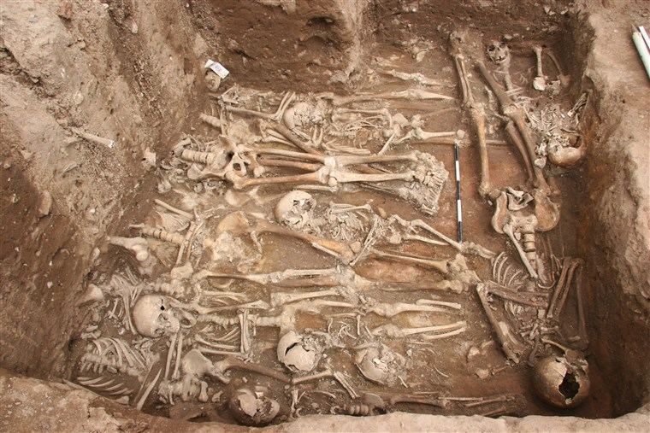
The Black Death
The mass burial site of plague victims in Ellwangen, Germany

Slide 57
The Black Death
The Black Death (also known as the Pestilence, the Great Mortality, or the Plague) was a bubonic plague pandemic occurring in Afro-Eurasia from 1346–53. It is the most fatal pandemic recorded in human history, resulting in the deaths of 75–200 million people in Eurasia and North Africa, peaking in Europe from 1347 to 1351. Bubonic plague is caused by the bacterium Yersinia pestis, but it may also cause septicaemic or pneumonic plagues. The bacterium is carried by fleas which in turn are carried on rodents and other animals.

Slide 58
The Black Death
The Jewish Encyclopaedia
During March and April, 1348, it spread through Italy, Spain, and southern France; and by May of that year it had reached southwest England. Though the Jews appear to have suffered quite as much as their Christian neighbors, a myth arose, especially in Germany, that the spread of the disease was due to a plot of the Jews to destroy Christians by poisoning the wells from which they obtained water for drinking purposes. This absurd theory had been started in 1319 in Franconia [in Germany]. On that occasion punishment had fallen upon the lepers, by whose means the Jews, it was alleged, had poisoned the wells. Two years later, in the Dauphiné [southeastern France], the same charge had been brought against the Jews.

Slide 59
The Black Death
The Jewish Encyclopaedia
In 1348, once the accusation was raised, it was spread with amazing rapidity from town to town; and official reports were sent by the mayors of various cities containing alleged confessions of Jews who had been seized under the accusation and put to torture.

Slide 60
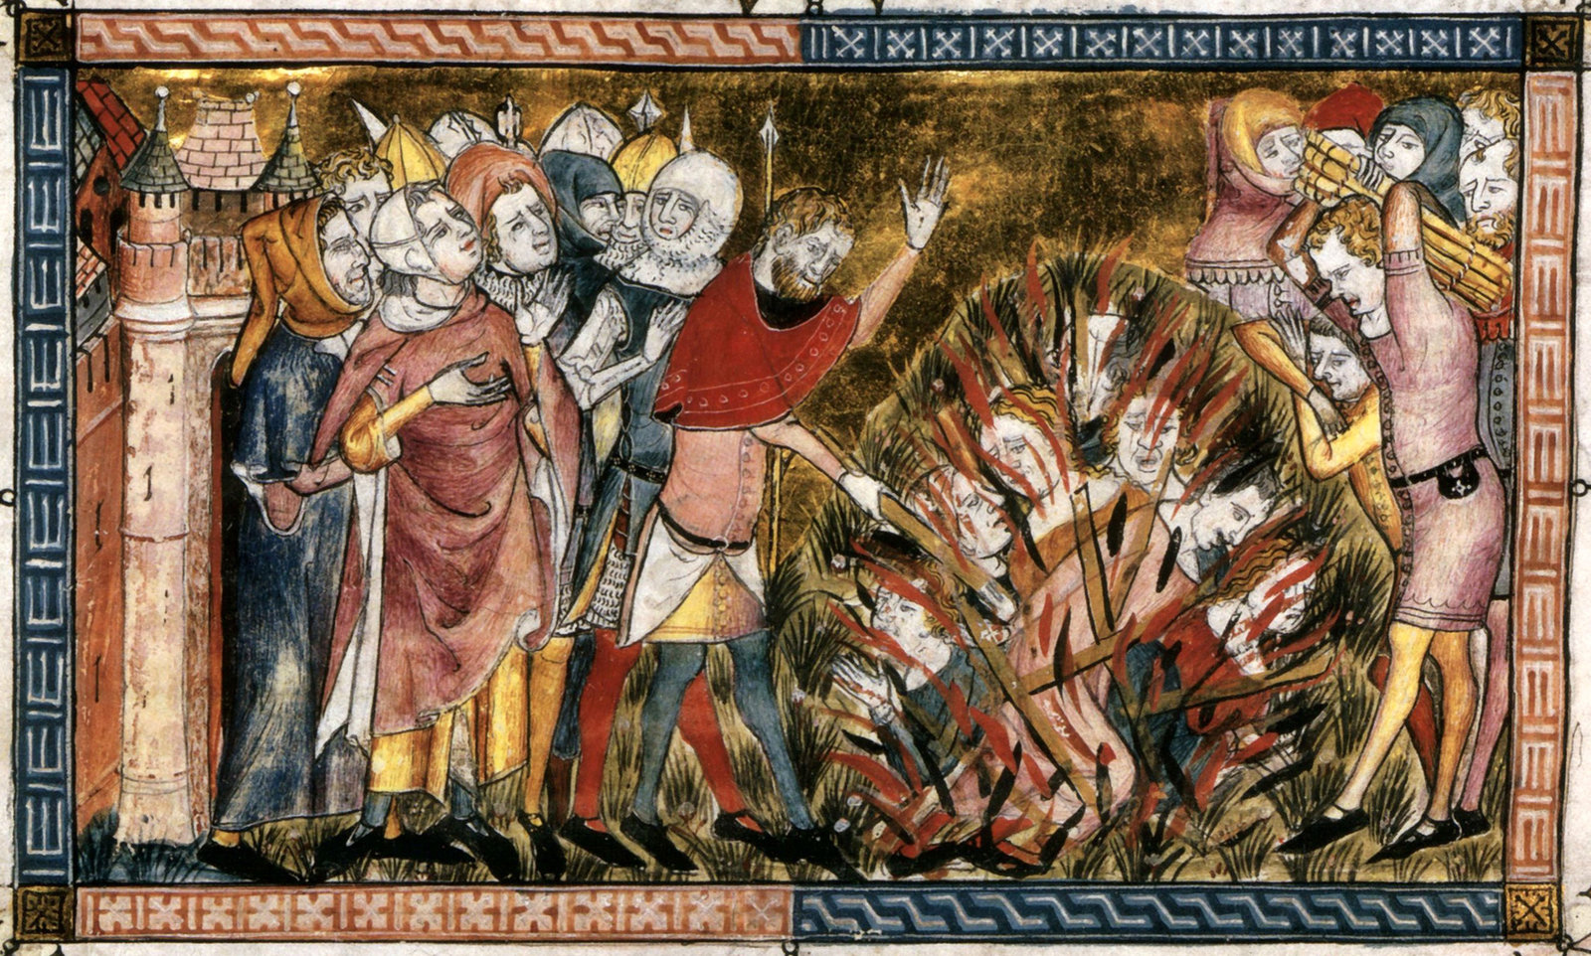
The Black Death
In this history book written in the 1340s by the French chronicler and poet Gilles li Muisis, residents of a town stricken by the plague burn Jews, who were blamed for causing the disease. From the Royal Library of Belgium

Slide 61
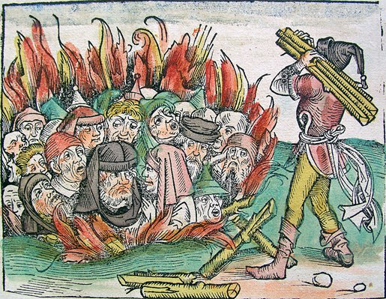
The Black Death
Depiction of Jews being burned in Germany during the Black Death, From the Liber Chronicarum, published in 1493.

Slide 62
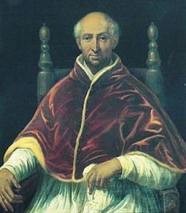
The Black Death
On the 26 September 1348 Pope Clement VI issued a decree exonerating the Jews from causing the Black Death. He tried to convince Christians that “since this pestilence is all but universal everywhere, and by a mysterious decree of God has afflicted, and continues to afflict, both Jews and many other nations throughout the diverse regions of the earth to whom a common existence with Jews is unknown (the charge) that the Jews have provided the cause or the occasion for such a crime is without plausibility.”
Pope Clement VI, 1291 - 1352

Slide 63
Smallpox

Slide 64
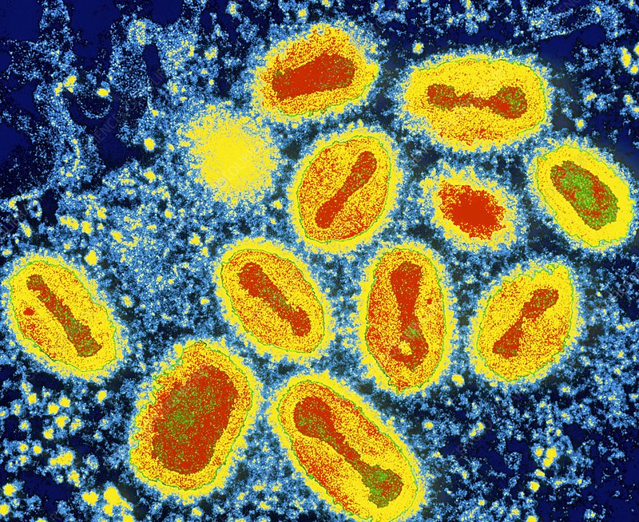
Smallpox
Smallpox was an infectious disease caused by one of two virus variants, Variola major and Variola minor.

Slide 65
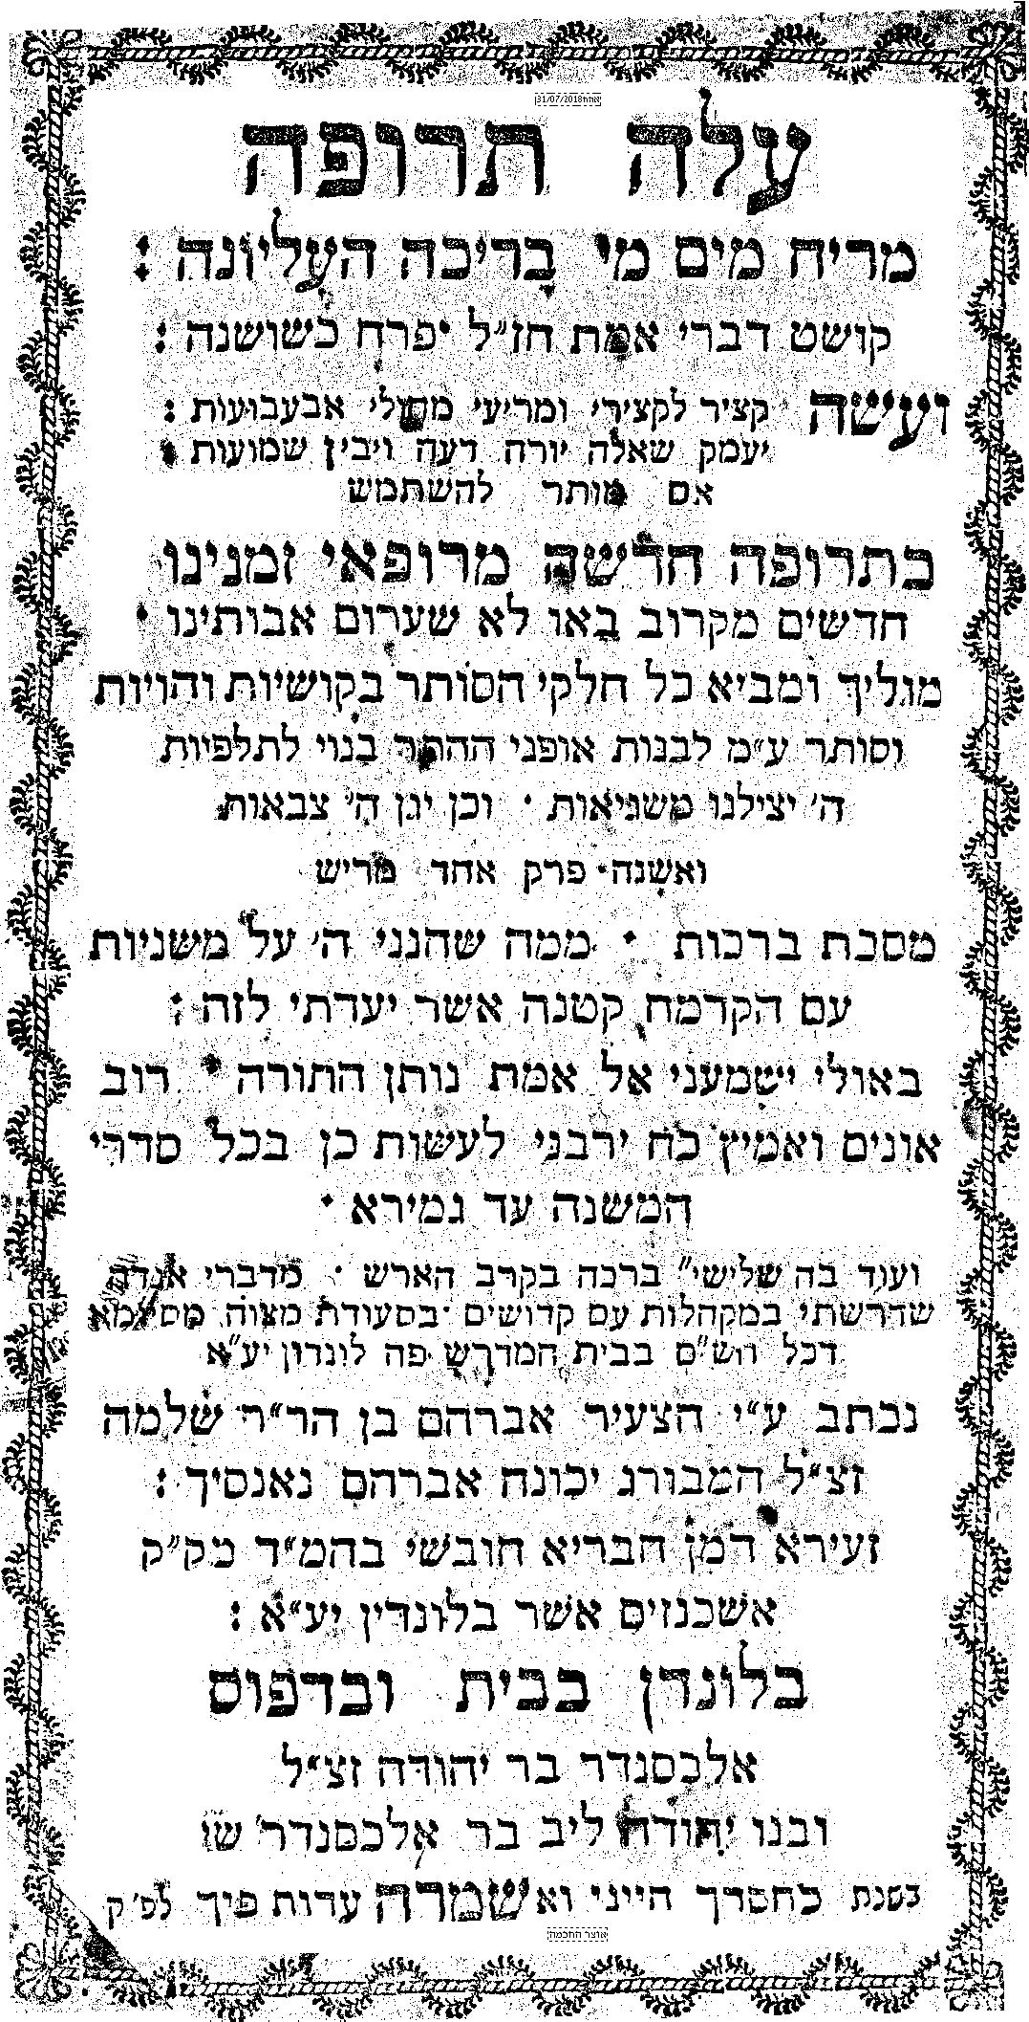
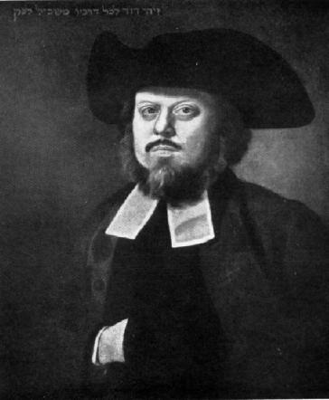
Rabbi Avraham ben Shlomo Hamburger who originated in Nancy in the Duchy of Lorraine, was a scholar and Dayan in the Hambro Synagogue in London under the leadership of Chief Rabbi David Tevele Schiff (pictured).

Slide 66
Smallpox
Rabbi Yisrael Lifschitz (d. 1860) was an Ashkenazi rabbi, first in Dessau and then in the Jewish Community of Danzig. He was the author of the commentary "Tiferes Yisrael" on the Mishnah.

Slide 67
Smallpox
תפארת ישראל (בועז) על יומא ח:ג
ומזה נ"ל היתר לעשות אינאקולאטיאן של פאקקען, אף שא' מאלף מת ע"י האינאקולאטיאן עכ"פ שאם יתהוו בו הפאקקען הטבעיים הסכנה קרובה יותר, ולכן רשאי להכניס א"ע בסכנה רחוקה כדי להציל א"ע מסכנה קרובה.
Tiferes Yisrael (Boaz) on Yoma 8:3
From this it seems to me that permission is given to inoculate against smallpox, even though one in a thousand people die from the inoculation. Nevertheless, if one contracts smallpox naturally, the dangers are far greater.

Slide 68
Smallpox
תפארת ישראל (בועז) על יומא ח:ג
ומזה נ"ל היתר לעשות אינאקולאטיאן של פאקקען, אף שא' מאלף מת ע"י האינאקולאטיאן עכ"פ שאם יתהוו בו הפאקקען הטבעיים הסכנה קרובה יותר, ולכן רשאי להכניס א"ע בסכנה רחוקה כדי להציל א"ע מסכנה קרובה.
Tiferes Yisrael (Boaz) on Yoma 8:3
From this it seems to me that permission is given to inoculate against smallpox, even though one in a thousand people die from the inoculation. Nevertheless, if one contracts smallpox naturally, the dangers are far greater.

Slide 69
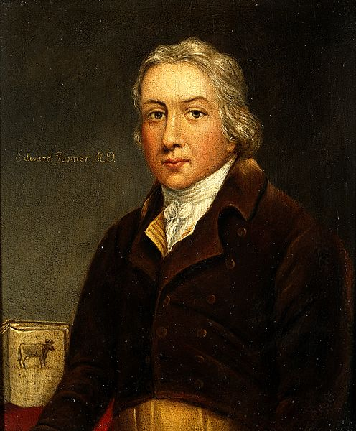
Smallpox
English physician and scientist Edward Jenner (1749 –1823)

Slide 70
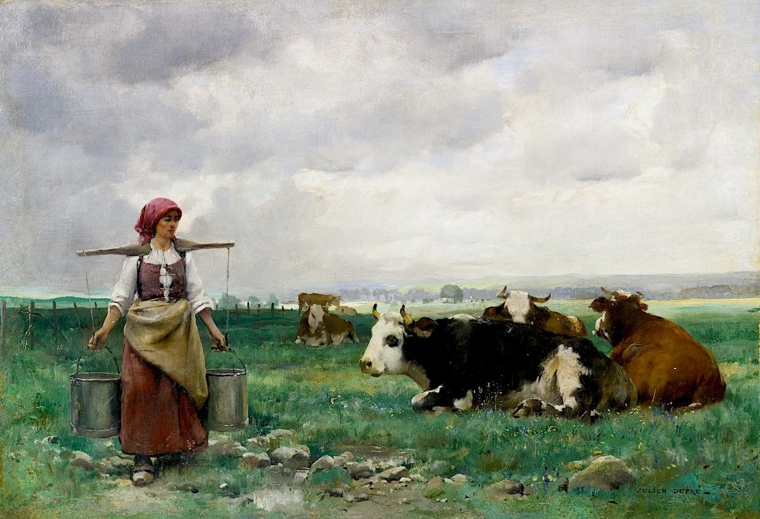
Smallpox
The basis for vaccination began in 1796 when Jenner observed that milkmaids who had contracted cowpox did not show any symptoms of smallpox after variolation.

Slide 71
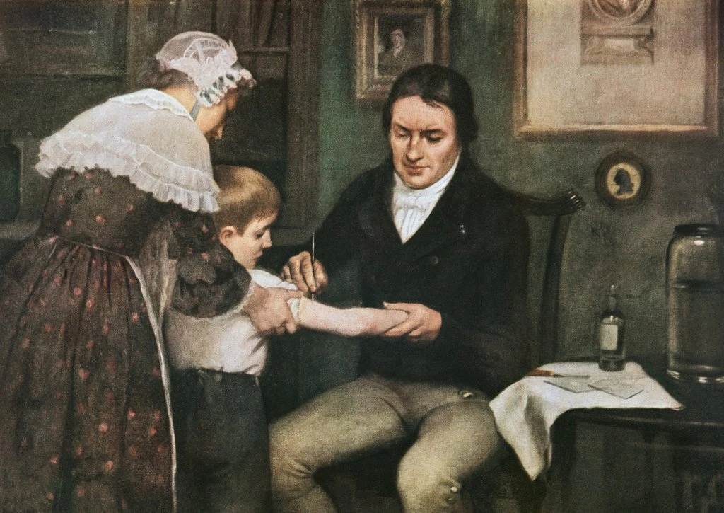
Smallpox
The first experiment to test this theory involved milkmaid Sarah Nelmes and James Phipps, the 9 year-old son of Jenner’s gardener. Dr. Jenner took material from a cowpox sore on Nelmes’ hand and inoculated it into Phipps’ arm. Months later, Jenner exposed Phipps a number of times to the variola virus, but Phipps never developed smallpox.
Dr. Edward Jenner performing his first vaccination against smallpox on James Phipps, May 14, 1796, by Ernest Board

Slide 72
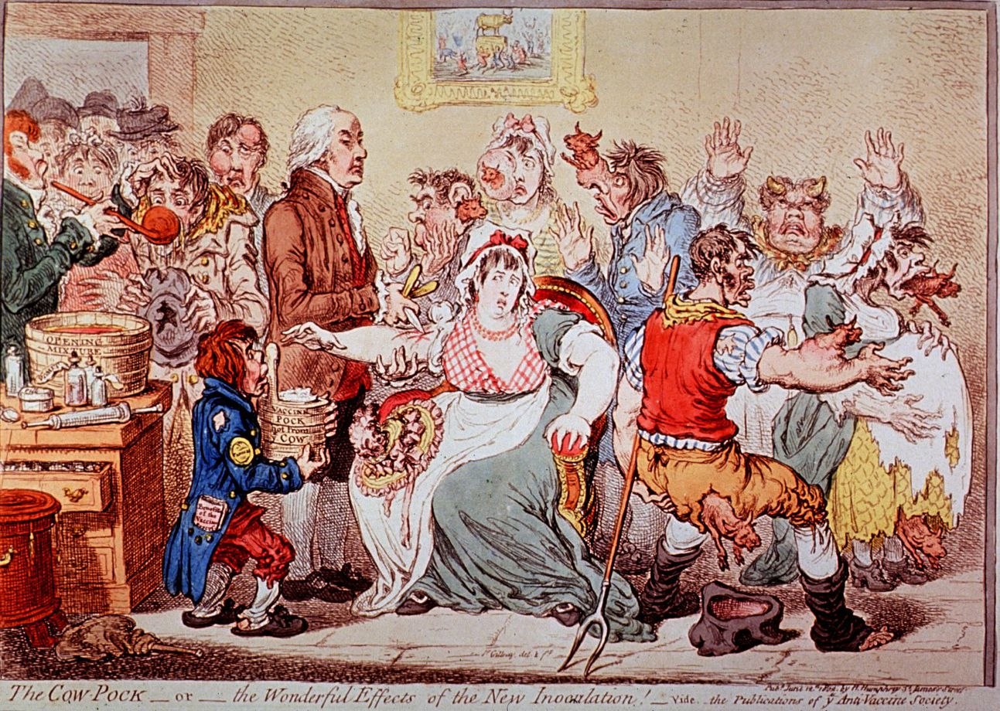
Notes:
Not everyone was convinced. This cartoon entitled “The Cow-Pock—or—the Wonderful Effects of the New Inoculation!” was published by the Anti-Vaccine Society in 1802. Drawn by British satirist James Gillray, it caricatures a scene at the Smallpox and Inoculation Hospital at St. Pancras, showing cowpox vaccine being administered to frightened young women, and cows emerging from different parts of their bodies.

Slide 73
תפארת ישראל (בועז) על אבות ג:ג
קיי"ל חסידי אוה"ע יש להן חלעה"ב [כסנהדרין ק"ה ורמב"ם פ"ח ממלכים]. והרי גם לולא פה קדוש של רז"ל שאמרו לנו כן, כבר היינו יודעים דבר זה מצד השכל, דהרי צדיק ה' בכל דרכיו וחסיד בכל מעשיו. ואנחנו רואים כמה מחסידיהן שמלבד שמכירין יוצר בראשית.
Tiferes Yisrael (Boaz) on Pirkei Avos 3:3
We have established that gentiles have a share in the world to come (Sanhedrin 105, Mishneh Torah, Laws of Kings and Wars 8). And see that even without the holy voice of the Rabbis, may their memory be blessed, who told us so - we would know this thing from the perspective of the intellect. For surely the Lord is just in all of His ways, and kind in all of His deeds.

Slide 74
ומאמינין בתה"ק שהיא אלהית, ועושין ג"ח גם לישראל, וכמה מהן שהיטיבו ביותר לכל באי עולם, כהחסיד יענער שהמציא הפאקקענאימפפונג, שעל ידה ניצולים כמה רבבות בני אדם מחולי וממיתה וממומין, ודראקא שהביא הקארטאפפעל לאייראפא, שמעכב כמה פעמים הרעב. וגוטענבערג שהמציא את הדפוס.
And we see how many of their pious ones - besides that they recognize the Author of creation, and believe that the holy Torah is divine - do kindnesses even to the Israelites. And some of them did great good to all of those that come to the world: Like the pious [Edward] Jenner, who invented the vaccine for smallpox, through which many myriads of people have been saved from disease, death and defects; and [Francis] Drake who brought the potato to Europe, which relieved famine several times; and [Johannes] Gutenberg who invented the printing press.

Slide 75
Cholera

Slide 76
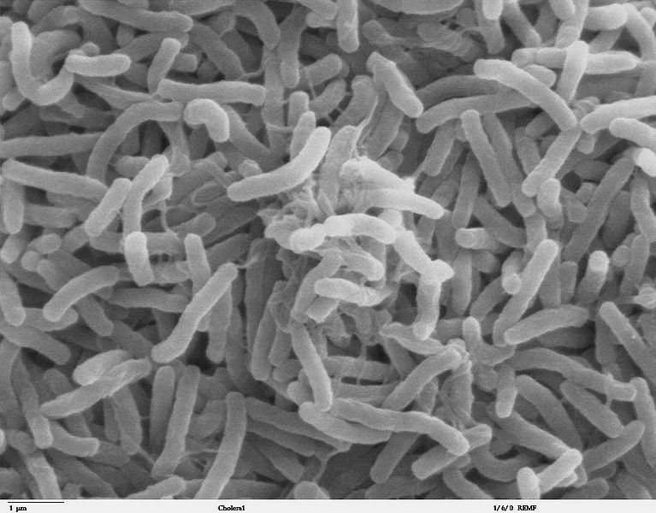
Cholera
Scanning electron microscope image of Vibrio cholerae bacteria

Slide 77
Cholera
Cholera is an infectious disease caused by a bacterium called Vibrio cholerae. The bacteria typically live in waters that are somewhat salty and warm, such as estuaries and waters along coastal areas. People contract V. cholerae after drinking liquids or eating foods contaminated with the bacteria, such as raw or undercooked shellfish.
Seven cholera pandemics have occurred in the past 200 years, with the first pandemic originating in India in 1817. Additionally, there have been many documented cholera outbreaks, such as a 1991–1994 outbreak in South America and, more recently, the 2016–2020 Yemen cholera outbreak.

Slide 78
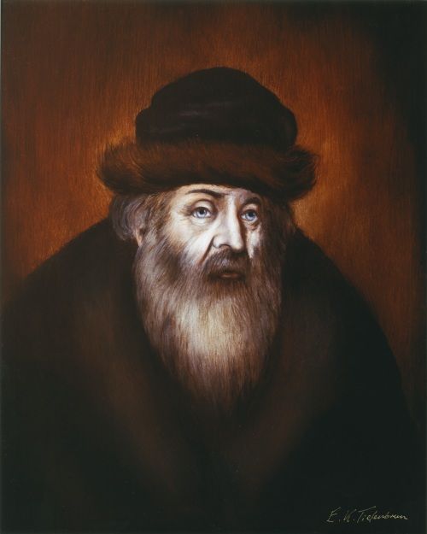
Cholera
Rabbi Akiva Eiger (1761 – 1837)‎ was an outstanding Talmudic scholar, influential halakhic authority and foremost leader of European Jewry during the early 19th century

Slide 79
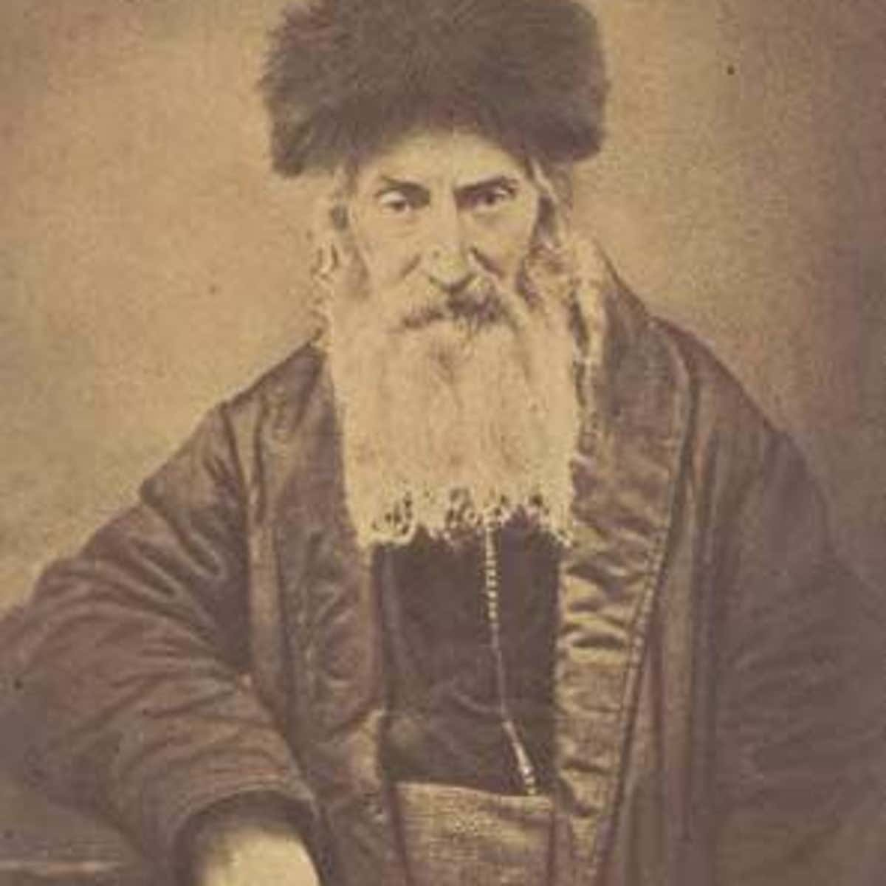
Cholera
Rabbi Eliyahu Guttmacher was about 35 years old, serving the community of Pleschen (today Pleszew, Poland) in his first rabbinic appointment when cholera hit. This was the summer of 1831, and the second of five cholera pandemics to strike during the 19th century.

Slide 80
Cholera
Letters of Rabbi Akiva Eiger 71
With the help of God, may He be blessed. Monday of the Torah reading of “Nitzavim,” 5531, Posen. To Rabbi Eliyahu Guttmacher the head of the rabbinical court of the holy community of Pleschen:
I have received your letter. Regarding prayer in the synagogue, in my view it is truly not right to congregate in a tight space. However, it is possible to pray in small groups of about 15 men starting from the first light and the same in the afternoon. After prayers in the mornings and evenings, recite some chapters of Psalms of your choice, followed by [specific petitionary prayers] and mention therein his Majesty the King, his offspring, his officers, and all who dwell in his land. Every morning and evening recite the entire passage concerning the incense. Make sure that no more than the aforementioned number of people squeeze in, perhaps by posting a policeman there.

Slide 81
Cholera
Letters of Rabbi Akiva Eiger 71
Protect yourselves from the cold; everyone should wear a flannel cloth around their waist; don’t eat bad foods, especially pickles; limit the eating of fruit and fish and the drinking of beer. Do not overeat; it is better to eat small quantities frequently. Stay clean; do not leave dirt and grime in the house. Change into clean, freshly laundered clothes several times a week. Do not be anxious; keep away from nervousness. Do not walk in the city’s air at night; in the afternoon, while the sun is shining, it is good to walk in the country to get fresh air; open windows in the morning so that air can enter the rooms. Do not leave home on an empty stomach; eat some mustard seed on an empty stomach and take some oak bark. Draw some water and wash your hands and face in the morning. Several times, drizzle some good, strong vinegar mixed with rosewater in the rooms.

Slide 82
Cholera
Letters of Rabbi Akiva Eiger 20
We provide the following guidelines given the recommendation of the physicians that gathering of large crowds for prolonged periods of time, leaving early on an empty stomach, and breathing the sharp [toxic] morning air is likely to cause cholera. Furthermore, the fumes of oil lamps. … in the synagogues are harmful to one’s health. … All synagogues, including both the men’s and women’s section, should fill to only half of their seating capacity such that every other seat is empty. To allow for equal access during the high holidays, half the congregants will attend for the two days of Rosh Hashana while the other half will attend for Yom Kippur, with the specific holiday being determined by lottery. A military guard should be posted at the synagogue entrance to maintain orderly seating. The length of the service for Rosh Hashana should not exceed five hours, each oleh to the Torah will be limited to one mi sheberakh, piyyutim should be omitted, and the cantor should not prolong the prayers with melodies or musical flourishes.

Slide 83
Cholera
Letters of Rabbi Akiva Eiger 20
We provide the following guidelines given the recommendation of the physicians that gathering of large crowds for prolonged periods of time, leaving early on an empty stomach, and breathing the sharp [toxic] morning air is likely to cause cholera. Furthermore, the fumes of oil lamps. … in the synagogues are harmful to one’s health. … All synagogues, including both the men’s and women’s section, should fill to only half of their seating capacity such that every other seat is empty. To allow for equal access during the high holidays, half the congregants will attend for the two days of Rosh Hashana while the other half will attend for Yom Kippur, with the specific holiday being determined by lottery. A military guard should be posted at the synagogue entrance to maintain orderly seating. The length of the service for Rosh Hashana should not exceed five hours, each oleh to the Torah will be limited to one mi sheberakh, piyyutim should be omitted, and the cantor should not prolong the prayers with melodies or musical flourishes.

Slide 84
Cholera
Rov in a Time of Cholera, Elli Fischer March 19, 2020
Around the same time, Rabbi Eger issued a ruling that would change Ashkenazi synagogue practice forever. The pandemic produced so many mourners that the longstanding custom of rotating the recitation of Kaddish would have left each mourner with few opportunities to recite the prayer for his deceased parents. So, for that year, Rabbi Eger allowed multiple mourners to recite Kaddish simultaneously. That one-time exception has become the norm.

Slide 85
Cholera
Rov in a Time of Cholera, Elli Fischer March 19, 2020
A small, undated manual containing prayers, practices, and charms to ward off plague and other forms of disaster was printed not long after Rabbi Guttmacher’s death in 1874. The main part of the booklet consists of an account of the bringing of the incense in the ancient Temple in Jerusalem. In Numbers 17:12-13, the High Priest Aaron burns incense to protect the living from a plague ravaging the Israelite encampment; the Talmud states that the antiplague properties of the incense were a secret that the Angel of Death told Moses before his return to humankind after receiving the Torah. Like so many other Temple rituals, once Jews could no longer perform them, recitation of descriptive passages took their place. So, as we saw in Rabbi Eger’s letter, the incense loomed large in Jewish attempts to ward off plague.

Slide 86
Cholera
Rov in a Time of Cholera, Elli Fischer March 19, 2020
This manual contains other measures for when pestilence rages. Commonsense instructions, like “cleanse every room in the house, and especially outhouses, of all muck, filth, and foul odor,” appear alongside directives to place white onions, garlic, and certain types of mushroom in every window. The manual also contains several amulets, including an “expert amulet from the rabbi, the tzaddik of Greidetz [Rabbi Guttmacher], of blessed memory.” This amulet, the reader is told, was “an amazing protection against that disease,” that is, cholera during the fourth cholera pandemic:
by the wonder of our generation, the tzaddik R. Eliyahu, of blessed memory, from Greidetz, who printed them himself in 5627 (1866-7) and sent them to every boundary of Israel, and the plague then ceased from upon Israel.

Slide 87
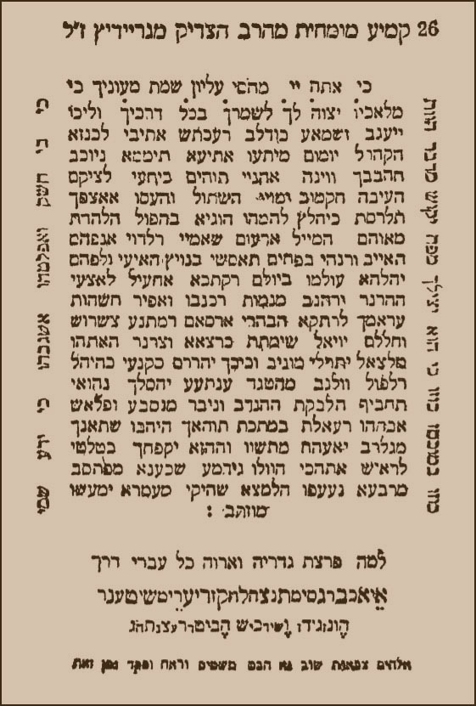
Cholera
Rabbi Guttmacher’s amulet

Slide 88
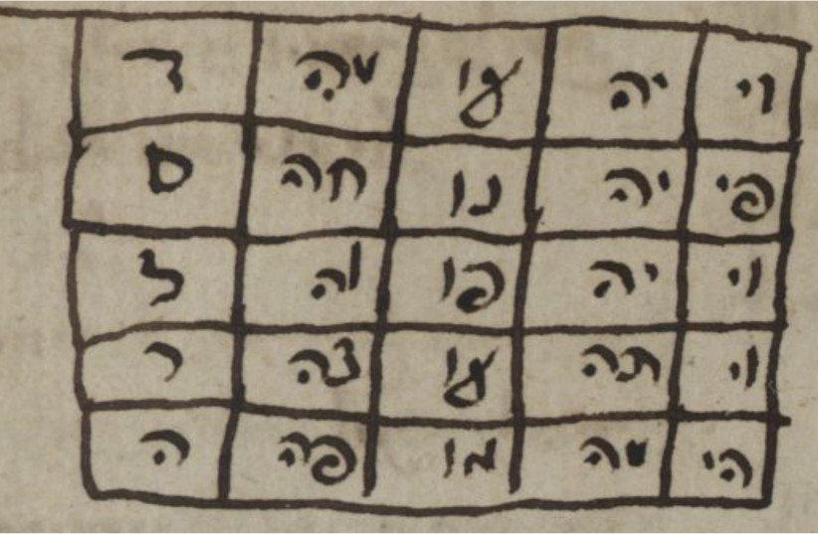
Cholera
Amulet from 'Segulot u'refuot' (Charms and Cures); this manuscript is a compendium of remedies for all sorts of ailments

Slide 89
Prayers, Amulets, and Segulot

Slide 90
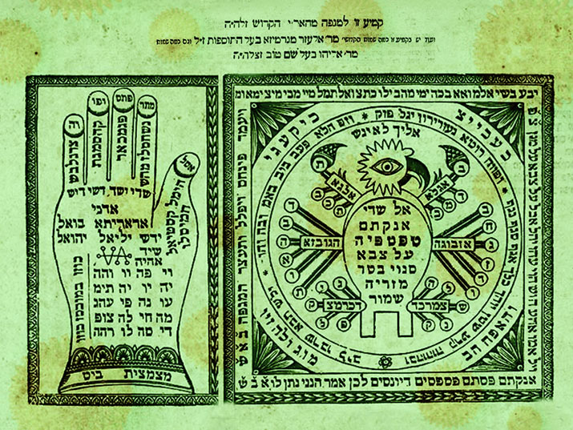
Prayers, Amulets, and Segulot
This Kemiyah appears in Shaar HaYichudim (The Gate of Unifications) by the famous Safed Kabbalist Rabbi Chaim ben Yosef Vital who was a student of Rabbi Yitzchak Luria (the Ari HaKodesh) . The Hebrew title appearing at the top reads “This amulet is for plague from the holy Ari”.

Slide 91
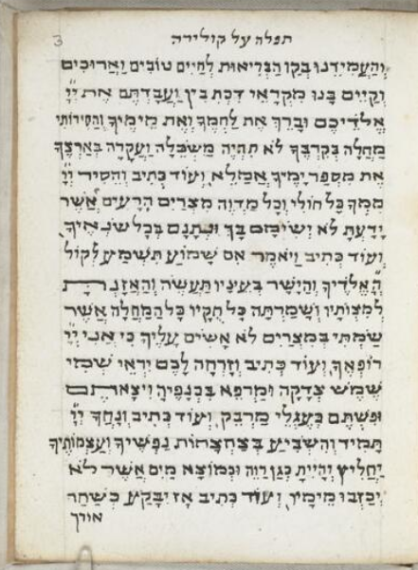
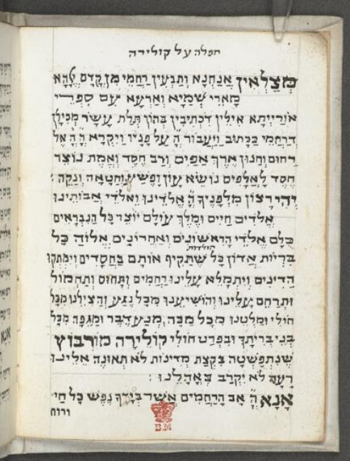
Prayers, Amulets, and Segulot
A prayer warding off the effects of cholera, 19th century Italy, the British Library

Slide 92
Prayers, Amulets, and Segulot
A prayer warding off the effects of cholera, 19th century Italy, the British Library

Slide 93
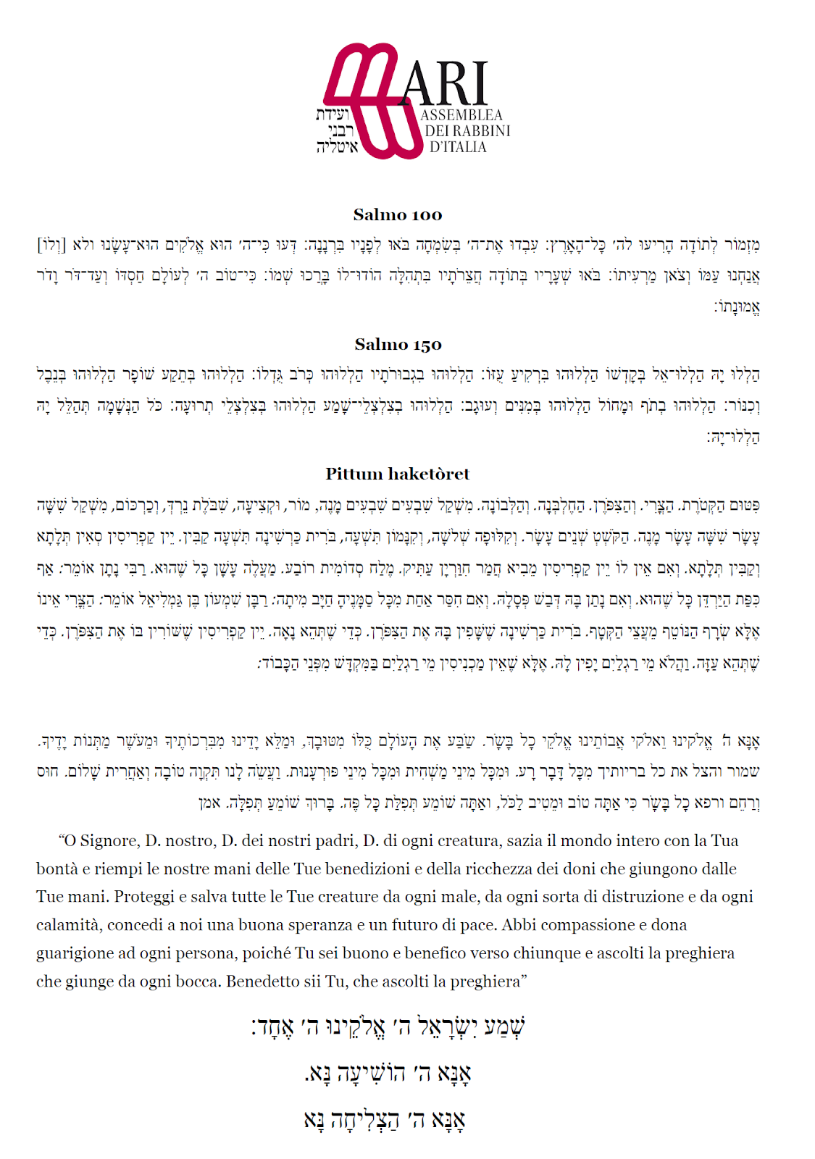
This prayer from the Assembly of Rabbis in Italy is from the current crisis. It contains Psalms 100 and 150, as well as the Pitum HaKetoret, from the Gemara in Kerisos 6a.

Slide 94
Prayers, Amulets, and Segulot
שמות פרק ל פסוק א
וְעָשִׂיתָ מִזְבֵּחַ מִקְטַר קְטֹרֶת עֲצֵי שִׁטִּים תַּעֲשֶׂה אֹתוֹ:
Exodus 30:1
You shall make an altar for bringing incense up in smoke; you shall make it out of acacia wood.
רמב"ן שמות פרק ל פסוק א
(א) ועשית מזבח מקטר קטורת - ... וזהו רז שנמסר למשה רבינו שהקטרת עוצרת המגפה (שבת פט א), כי הקטרת במדת הדין, שנאמר ישימו קטורה באפך (דברים לג י), מן וחרה אפי (שם לא יז).
Ramban on Exodus 30:1
You shall make an altar on which to bring incense up in smoke. … And this is the “secret” that was given over to Moses our Teacher by the Angel of Death: that “the burning of incense can stop a Divinely inflicted plague.” For incense relates to the Attribute of Strict Justice, as it is stated, “They shall place incense before Your Presence [אַפֶּךָ]” (Deuteronomy 33:10), the meaning of אַפֶּךָ here being related to the word אף in the verse My anger [אַפִּי] will flare (ibid. 31:17).

Slide 95
Prayers, Amulets, and Segulot
תלמוד בבלי שבת פט.
מִיָּד כׇּל אֶחָד וְאֶחָד נַעֲשָׂה לוֹ אוֹהֵב וּמָסַר לוֹ דָּבָר, שֶׁנֶּאֱמַר: ״עָלִיתָ לַמָּרוֹם שָׁבִיתָ שֶּׁבִי לָקַחְתָּ מַתָּנוֹת בָּאָדָם״ — בִּשְׂכַר שֶׁקְּרָאוּךְ ״אָדָם״, לָקַחְתָּ מַתָּנוֹת. אַף מַלְאַךְ הַמָּוֶת מָסַר לוֹ דָּבָר, שֶׁנֶּאֱמַר: ״וַיִּתֵּן אֶת הַקְּטֹרֶת וַיְכַפֵּר עַל הָעָם״, וְאוֹמֵר: ״וַיַּעֲמֹד בֵּין הַמֵּתִים וּבֵין הַחַיִּים וְגוֹ׳״ — אִי לָאו דַּאֲמַר לֵיהּ מִי הֲוָה יָדַע?
Babylonian Talmud Tractate Shabbat 98a
Immediately [after Moses had convinced the Angels that the Torah should be given to humans], each and every one of the angels became an admirer of Moses and passed something to him, as it is stated: “You ascended on high, you took a captive, you took gifts on account of man, and even among the rebellious also that the Lord God might dwell there” (Psalms 68:19). The meaning of the verse is: In reward for the fact that they called you man, you are not an angel and the Torah is applicable to you, you took gifts from the angels. And even the Angel of Death gave him something, as Moses told Aaron how to stop the plague, as it is stated: “And he placed the incense, and he atoned for the people” (Numbers 17:12). And the verse says: “And he stood between the dead and the living, and the plague was stopped” (Numbers 17:13). If it were not that the Angel of Death told him this remedy, would he have known it?

Slide 96
Prayers, Amulets, and Segulot
הרב אברהם אליעזר הירשאוויץ, אוצר כל מנהגי ישורון, סימן עו:ז "דיני הקדיש בקצרה"
חנוך בית הקברות כשלוקחין שדה לביה״ק או שמוסיפין על בית הקברות הישן, או כשבונין לו גדר חדש עושין חנוך. המנהג הזה נזכר בירושלמי (מ״ק פ״א): ומחנכין את הכוכין (משנה מ״ק פ׳׳א), וסדר החנוך כך הוא: אנשי החברה קדישא מתענין ביום זה עכ״פ עד אחר חצות היום ומרבים בסליחות בשחרית, וכשהולכים לבית הקברות אומרים הברכה אשר יצר אתכם בדין (מי שלא היה שם תוך שלשים יום) ואח״כ שיר של פגעים שהוא יושב בסתר עליון, ופ׳ קטרת ופ׳ קרח, ויאמר משה אל אהרן קח את המחתה עד המגפה נעצרה.
Rabbi Avraham Eliezer Hirshovitz, Otzar Kol Minhagei Yeshurun 76:7 (St. Louis 1918)
Finishing of a cemetery when taking a field for a cemetery or adding to an existing cemetery, or when building a new boundary to complete it. This tradition is mentioned in the Talmud Yerushalmi (Moed Katan 1): [in the section] ‘and they complete the burial chambers’ (Mishnah Moed Katan chapter 1). The order of completing or fixing is as follows: members of the chevrah kaddisha fast on that day until after chatzos (halachic midday) and increase penitential prayers during the morning service. When they go to the cemetery they say the blessing on entering the cemetery (provided they have not visited within thirty days) and afterwards שיר של פגעים (the Song of Afflictions) which is Yosheiv b’seser elyon, ‘He who dwells in the shelter of the Most High’ (Psalm 91), and the parsha of the incense, and parshas Korach [from] “And Moses said to Aharon, ‘take the fire pan’” up to “and the plague ceased” (Numbers 17:11-15).

Slide 97
Prayers, Amulets, and Segulot
Kabbalah, Magic and Science: The Cultural Universe of a Sixteenth-Century Jewish Physician by David B. Ruderman (Harvard University Press, 1988), pp. 33 - 34
On the basis of this universal construction, [Rabbi Abraham] Yagel examines the causes of the plague. He begins with the earthly cause, the emanation of poisonous vapor from the ground, which infects all living beings. People with humoral imbalance are particularly susceptible to this venomous air. The celestial cause is related to the air's condition, which is produced by changes in the stars and their conjunctions, especially that of Saturn and Mars. Yagel explains the divine cause as revenge against the enemies of the Lord "who disturb the law and break the covenant and commit transgressions that are liable to the death penalties of the rabbinic court." Only the righteous still possess the power to reverse the evil decree from bad to good.

Slide 98
Prayers, Amulets, and Segulot
Kabbalah, Magic and Science: The Cultural Universe of a Sixteenth-Century Jewish Physician by David B. Ruderman (Harvard University Press, 1988), pp. 33 - 34
After elaborating on the causes of the plague according to each world, Yagel provides a detailed prescription for resisting the disease on each respective level. On the material plane, he offers a long inventory of practical advice, ranging from proper diet, to purification of water and air, to avoidance of "overheating" through excessive sexual activity and rich foods. On the celestial level, he provides a detailed procedure for burning incense in order to bring down astral power, whereby "the higher clings to the lower and allows its spirituality to appear." …

Slide 99
Prayers, Amulets, and Segulot
Kabbalah, Magic and Science: The Cultural Universe of a Sixteenth-Century Jewish Physician by David B. Ruderman (Harvard University Press, 1988), pp. 33 - 34
On the divine level, the victim is required to ask God's forgiveness through prayer and fasting. The Thirty-sixth Psalm is deemed especially appropriate in the time of plague, and Yagel presents a line-by-line interpretation. Yet the focus of the plague tract remains the extraordinarily detailed instructions for the incense ceremony, the use of talismanic stones and metals, and the prayers and incantations accompanying the procedure. We are left again with the distinct impression that the physician armed with only Galenic medical prescriptions is no match for the virulent plague. For Yagel, the only solution is to employ methods of astral sympathetic magic once practiced by pagan idolators, though now purified and perfected by Jewish practitioners, especially the author of the Sefer haZohar. As if to highlight the pragmatic value of his handbook, Yagel appends an "order of incense" composed by the kabbalist Joseph ibn Shraga.

Slide 100
Prayers, Amulets, and Segulot
ספר סגולות ורפואות – רפאל המלאך, רבי יהודה יודל בן ישראל יצחק רוזנברג
מגפה. סגולה בשעת מגפה רחמנה לצלן. מען זאל אופהענגען א ווייסע ציבע מיט א הויבטעל קנאבעל ביי אלע פענסטער און ביי אלע טיהרען און אויף די פיער ווענט פון שטיב.
Remedies and Cures of the Angel Rafael, Rabbi Yehudah Yudel ben Yisrael Yitzchak Rosenberg (published in Novaminsk, Poland in 1914)
Plague. It is a segulah during a plague (Rachmanah litzlan). A white onion with a single clove should be hung on all windows and on all doors and on the firewall of the house.

Slide 101
Prayers, Amulets, and Segulot
ספר סגולות ורפואות – רפאל המלאך, רבי יהודה יודל בן ישראל יצחק רוזנברג
מגפה. סגולה בשעת מגפה רחמנה לצלן. פון דעם גרויסען צדיק רבי עקיבא אייגער זכר צדיק לברכה. מען זאל אלע טאג אראבשלינגען זיערנילעך גארטשיצע ניכטערען. און מען זאל אלע טאג אנטריקענען א פענעצעל ברויט ביים פייער, און דאס פענעצעל ברויט זאל מען טראגאן א גאנצען טאג ביי זיך אין קעשענע.
Remedies and Cures of the Angel Rafael, Rabbi Yehudah Yudel ben Yisrael Yitzchak Rosenberg (published in Novaminsk, Poland in 1914)
Plague. It is a segulah during a plague (Rachmanah litzlan), from the great righteous Rabbi Akiva Eiger, zt”l. Every day one should swallow nine mustard seeds on an empty stomach. And let the loaf of bread be dried by the fire every day; and let the loaf of bread be kept in his pocket all day long.

Slide 102
Prayers, Amulets, and Segulot
ספר סגולות ורפואות – רפאל המלאך, רבי יהודה יודל בן ישראל יצחק רוזנברג
מגפה. סגולה בשעת מגפה רחמנה לצלן. מען זאל עסען נאהך יעדען עסען א שטיקעל ציבעלע עדער א שטיקעל קנאבעל, כדי ער זאל לאנג שפיהרען דעם ריח פון דער ציבעלע אדער פון דעם קנאבעל.
Remedies and Cures of the Angel Rafael, Rabbi Yehudah Yudel ben Yisrael Yitzchak Rosenberg (published in Novaminsk, Poland in 1914)
Plague. It is a segulah during a plague (Rachmanah litzlan), that after each meal, eat a slice of onion and a clove of garlic, so that the taste and the smell will linger in the mouth.

Slide 103
The Shvartzeh Chassunah

Slide 104
The Shvartzeh Chassunah
הרב אברהם אליעזר הירשאוויץ, אוצר כל מנהגי ישורון, סימן מב "מגפה"
כשהיה מגפה בעיר עשו הופה עם עני יתום ויתומה עניה על חצר-מות משום סגולה או גונזין ספרים בלים ושמות הקב"ה והולכים בהמה חוגג אל בית הקברות וגונזין שם בקרקע.
Rabbi Abraham Eliezer Hershovitz, Otzar Kol Minhagei Yeshurun, 42:1 (St. Louis 1918)
Whenever there was plague in the city, a wedding was arranged between a poor orphan boy and girl and held in a cemetery as a segulah; or they would go to bury worn-out holy books containing God’s name, accompanied by a festive crowd all the way to the graveyard, where [the books] were consigned to the ground.

Slide 105
The Shvartzeh Chassunah
הרב אברהם אליעזר הירשאוויץ, אוצר כל מנהגי ישורון, סימן מב "מגפה"
הטעם משום גדול מצות צדקה והכנסת כלה שעל ידן זוכים לאריכת ימים (תד״א זוטא פ״א) ועוד הכנסת כלה עניה ויתומה עם עני יתום יש בזה הרבה מצות וכל אנשי העיר באים לשמח חתן וכלה וישכחו דאגתם ואנחתם שזו סכנה גדולה בעת ההיא ופחד המות לא יהיה עוד נגד פניהם (ראיתי בספר).
Rabbi Abraham Eliezer Hershovitz, Otzar Kol Minhagei Yeshurun, 42:1 (St. Louis 1918)
The reason is because it is a tremendous mitzvah of charity and helping a needy bride, and that through those mitzvot we would merit a long life (Tanna Devei Eliyahu Zuta 1). Furthermore, there are many mitzvot involved in helping a poor bride and groom, and the inhabitants of the town come to make the bride and groom happy, and they forget their worries and groans, for this is itself poses a great danger at this time, and fear and death will no longer be in front of them (I saw this in a book).

Slide 106
The Shvartzeh Chassunah
הרב אברהם אליעזר הירשאוויץ, אוצר כל מנהגי ישורון, סימן מב "מגפה"
גם גונזין ספרים בלים עת המגפה הטעם כדי לעורר רחמים בזה כי כמו שאנו חסים על שמות ודברים של קדושה שלא ילכו לאיבוד ולבזיון כן ירחם ד׳ עלינו ועל בנינו שלא נלכו לאיבוד ולבזיון כי גם אנו נקראים גוי קדוש ושמו משותף בשמנו.
Rabbi Abraham Eliezer Hershovitz, Otzar Kol Minhagei Yeshurun, 42:1 (St. Louis 1918)
Also the reason to bury worn-out books at the time of a plague is in order to awaken [Divine] mercy through this act, for just as we have pity on the holy names [written in the books] and other holy items, that they are not destroyed and disgraced, so too God will have mercy on us and on our children, that we should also not be destroyed or disgraced, for we are also called a “Holy Nation” and His name is partnered with our name.

Slide 107
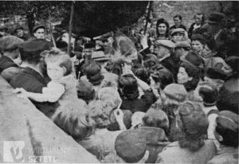
The Shvartzeh Chassunah
Wedding held in the Żelechów ghetto graveyard in 1942

Slide 108
The Shvartzeh Chassunah
שידלאווצער יזכור־בוך דף 118
אין אט דער צייט האט די חברה קדישא באשלאסן צו מאכן א ״שווארצע חתונה״ אויפן בית־עולם, וואס זאל זיין א סגולה אפצושטעלן די מגיפה. מען האט אפגעזוכט אן עלטער ארעם מיידל מיט אן ארעם יינגל, זיי פארשדכנט ,און באשטימט דעם טאג פון דער חתונה. צו דער חתונה איז געווען פארבעטן דאס גאנצע שטעטל.
Shidlovtser (Szydlowiec, Radom, Poland) Yizkor Bukh, page 118
At that time, the Hevra Kadisha decided to hold a "black wedding" at the cemetery, which would be a ‘segula’ for stopping the plague. An older poor unmarried woman was sought, together with a poor unmarried man, they were matched with one another, and the day of the wedding was set. The whole town was invited to the wedding.

Slide 109
The Shvartzeh Chassunah
שידלאווצער יזכור־בוך דף 118
מוזיקאנטן האבן געשפילט. יידן האבן געטאנצט. פארשטעלטע זיינען געריטן אויף פערד און געבלאזן אין טרומייטן. אלע האבן געטרונקען און זיך געוואונטשן ״לחיים״. ״קהלס איידעם״ האט געקראגן א פאסטן אין מרחץ צו היטן די בגדים פון די באדערם.
Shidlovtser (Szydlowiec, Radom, Poland) Yizkor Bukh, page 118
Musicians played and Jews danced. People rode on horses and blew trumpets. Everyone drank and wished each other “l’chaim.” The "community’s son-in-law" was given the job in the bathhouse to watch over the clothes of the bathers.

Slide 110
Korach
במדבר יז:יא-יג
וַיֹּ֨אמֶר מֹשֶׁ֜ה אֶֽל־אַהֲרֹ֗ן קַ֣ח אֶת־הַ֠מַּחְתָּה וְתֶן־עָלֶ֨יהָ אֵ֜שׁ מֵעַ֤ל הַמִּזְבֵּ֙חַ֙ וְשִׂ֣ים קְטֹ֔רֶת וְהוֹלֵ֧ךְ מְהֵרָ֛ה אֶל־הָעֵדָ֖ה וְכַפֵּ֣ר עֲלֵיהֶ֑ם כִּֽי־יָצָ֥א הַקֶּ֛צֶף מִלִּפְנֵ֥י יְהוָ֖ה הֵחֵ֥ל הַנָּֽגֶף׃ וַיִּקַּ֨ח אַהֲרֹ֜ן כַּאֲשֶׁ֣ר ׀ דִּבֶּ֣ר מֹשֶׁ֗ה וַיָּ֙רָץ֙ אֶל־תּ֣וֹך הַקָּהָ֔ל וְהִנֵּ֛ה הֵחֵ֥ל הַנֶּ֖גֶף בָּעָ֑ם וַיִּתֵּן֙ אֶֽת־הַקְּטֹ֔רֶת וַיְכַפֵּ֖ר עַל־הָעָֽם׃ וַיַּעֲמֹ֥ד בֵּֽין־הַמֵּתִ֖ים וּבֵ֣ין הַֽחַיִּ֑ים וַתֵּעָצַ֖ר הַמַּגֵּפָֽה׃
Numbers 17:11-13
11. Moses said to Aaron, “Take the censer and put fire from the altar top into it and put incense. Then take it quickly to the congregation and atone for them, for wrath has gone forth from the Lord, and the plague has begun.” 12. Aaron took [it], just as Moses had said, and he ran into the midst of the assembly, and behold, the plague had begun among the people. He placed the incense on it and atoned for the people. 13. and he stood between the dead and the living, and the plague ceased.

Slide 111
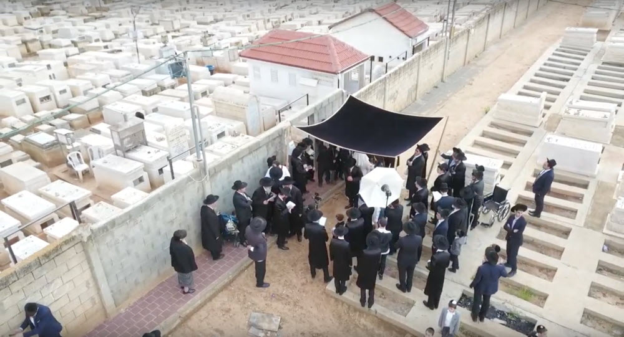
The Shvartzeh Chassunah

Slide 112
Conclusions and Questions

Slide 113
DEPRESSION, ANXIETY
AND LONLINESS:
MENTAL HEALTH IN THE
21ST CENTURY
8PM ON
SUNDAY 11TH APRIL
The Jewish view of maintaining
our mental health and how
communities can help.

Slide 114
Thank You
rabbi@newwestend.org.uk
07531 326289
@moshefreedman

