Slide 1
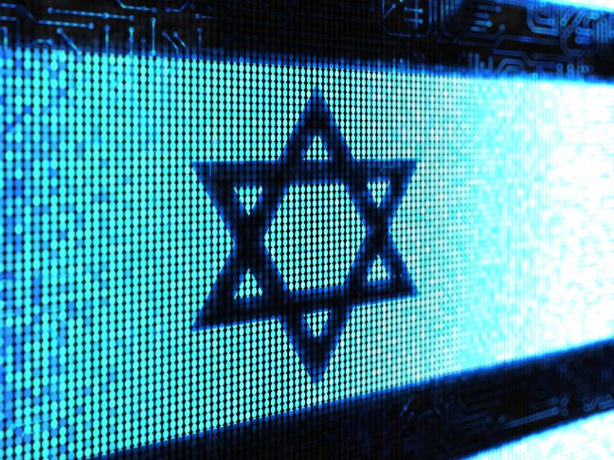
Start-up Nation: Israel's Contribution to Science and Technology
Judaism and Society
Rabbi Dr Moshe Freedman Rabbi, New West End Synagogue Deputy Co-chair of MEAG (Moral and Ethical Advisory Group to DHSC)

Slide 2
Introduction

Slide 3
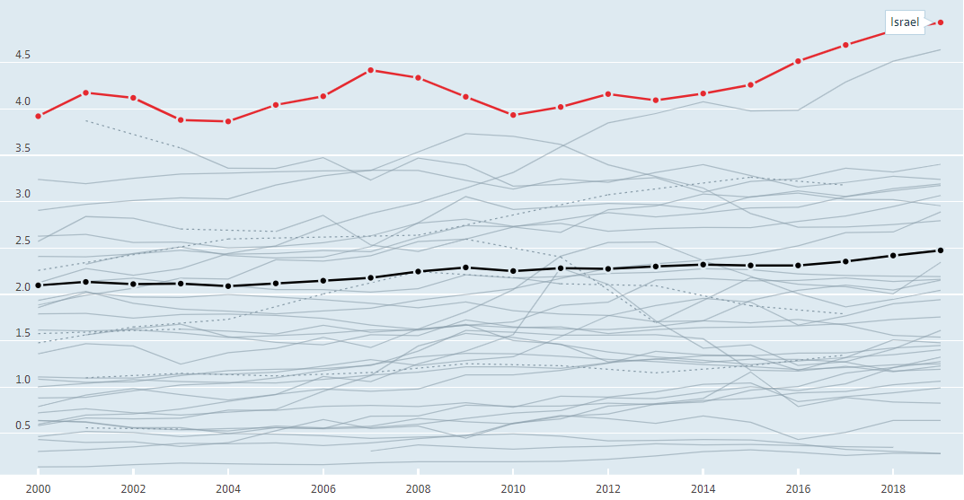
Gross domestic spending on R&D

Slide 4
The Character of Israel

Slide 5
The Military Factor

Slide 6
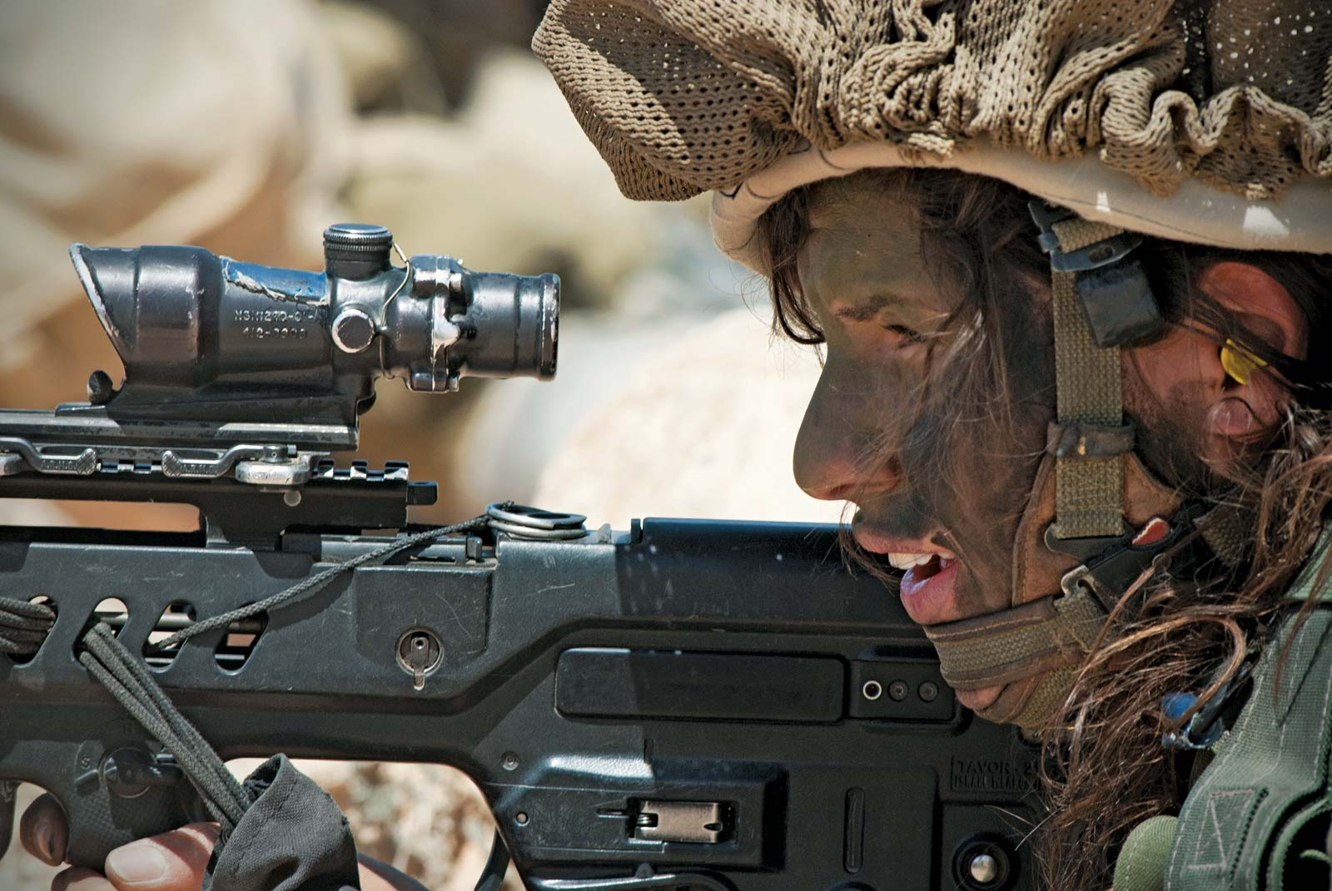
The Military Factor

Slide 7
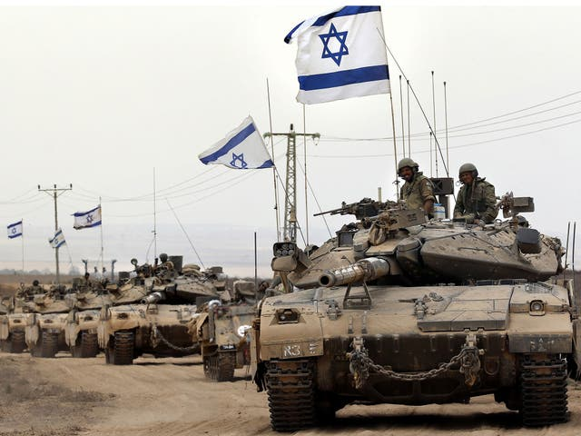
The Military Factor

Slide 8
The Military Factor
Start-up Nation, The Story of Israel's Economic Miracle, By Dan Senor, Saul Singer, 2011
For the next seven months, Farhi would be in charge of basic training for 650 soldiers, most of them fresh out of high school, plus about 120 officers, squad commanders, sergeants, and administrative staff. “The most interesting people here are the company commanders,” Farhi told us. “They are absolutely amazing people. These are kids—the company commanders are twenty three. Each of them is in charge of one hundred soldiers and twenty officers and sergeants, three vehicles. Add it up and that means a hundred and twenty rifles, machine guns, bombs, grenades, mines, whatever. Everything. Tremendous responsibility.” Company commander is also the lowest rank that must take responsibility for a territory. As Farhi put it, “If a terrorist infiltrates that area, there’s a company commander whose name is on it. Tell me how many twenty-three-year-olds elsewhere in the world live with that kind of pressure.”
Farhi illustrated a fairly typical challenge facing these twenty-three- year-olds. During an operation in the West Bank city of Nablus, one of Farhi’s companies had an injured soldier trapped in a house held by a terrorist. The company commander had three tools at his disposal: an attack dog, his soldiers, and a bulldozer. If he sent the soldiers in, there was a high risk of additional casualties. And if he sent the bulldozer to destroy the house, this would risk harming the injured soldier.

Slide 9
The Military Factor
Throughout much of the standoff, the company commander was on his own. Farhi could have tried to take charge from afar, but he knew he had to give his subordinate latitude: “There were an infinite number of dilemmas there for the commander. And there wasn’t a textbook solution.” The soldiers managed to rescue the injured soldier, but the terrorist remained inside. The commander knew that the school staff was afraid to evacuate the school, despite the danger, because they did not want to be branded “collaborators” by the terrorists. And he knew that the journalists would not leave the roof of the school, because they didn’t want to miss breaking news. The commander’s solution: empty the school using smoke grenades.
Once the students, teachers, and journalists had been safely evacuated, the commander decided it was safe to send in the bulldozer to drive the terrorist out of the adjacent building. Once the bulldozer began biting into the house, the commander unleashed the dog to neutralize the terrorist. But while the bulldozer was knocking down the house, another terrorist the Israelis didn’t know about came out of the school next door. The soldiers outside shot and killed this second terrorist. The entire operation took four hours. “This twenty-three-year-old commander was alone for most of the four hours until I got there,” Farhi told us.

Slide 10
The Military Factor
“After an event like that, the company commander goes back to the base and his soldiers look at him differently,” Farhi continued. “And he himself is different. He is on the line—responsible for the lives of a lot of people: his soldiers, Palestinian schoolchildren, journalists. Look, he didn’t conquer Eastern Europe, but he had to come up with a creative solution to a very complex situation. And he is only twenty-three years old.”
We then heard from a brigadier general about Yossi Klein, a twenty- year-old helicopter pilot in the 2006 Lebanon war. He was ordered to evacuate a wounded soldier from deep in southern Lebanon. When he piloted his chopper to the battlefield, the wounded soldier lay on a stretcher surrounded by a dense overgrowth of bushes that prevented the helicopter from landing or hovering close enough to the ground to pull the stretcher on board.

Slide 11
The Military Factor
There were no manuals on how to deal with such a situation, but if there had been, they would not have recommended what Klein did. He used the tail rotor of his helicopter like a flying lawn mower to chop down the foliage. At any point, the rotor could have broken off, sending the helicopter crashing into the ground. But Klein succeeded in trimming the bushes enough so that, by hovering close to the ground, he could pick up the wounded soldier. The soldier was rushed to the hospital in Israel and his life was saved.
Speaking of the company commanders who served under him, Farhi asked, “How many of their peers in their junior year in colleges have been tested in such a way?... How do you train and mature a twenty-year-old to shoulder such responsibility?”

Slide 12
Immigration Nation

Slide 13
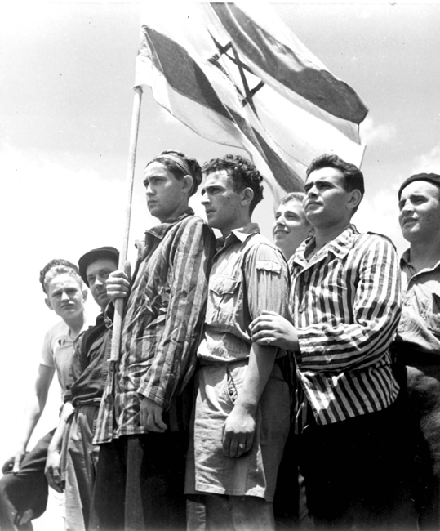
Buchenwald Concentration Camp survivors arrive in Haifa on the immigrant ship RMS Mataroa only to be arrested by the British, July 15, 1945

Slide 14
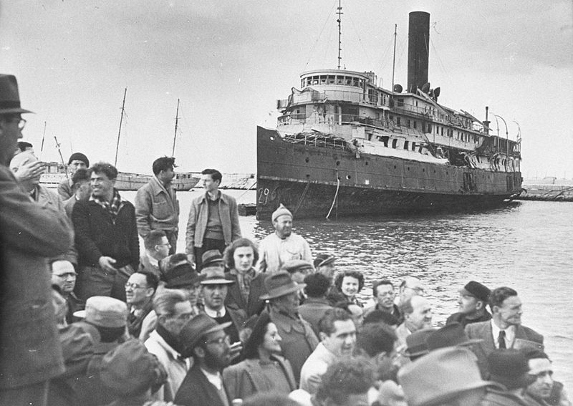
Holocaust survivors disembarking in Haifa from the Haganah ship, the Exodus.

Slide 15
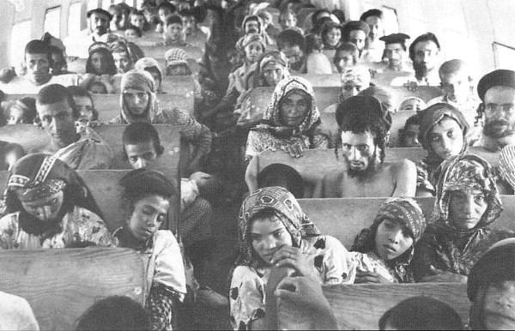
In the course of the operation "Magic Carpet" (1949-1950), the entire community of Yemenite Jews (about 49,000 in total) immigrated to Israel. Most of them had never seen an airplane before, but they believed in the Biblical prophecy: according to the Book of Isaiah (40:31), God promised to return children of Israel to Zion "on wings of eagles".

Slide 16
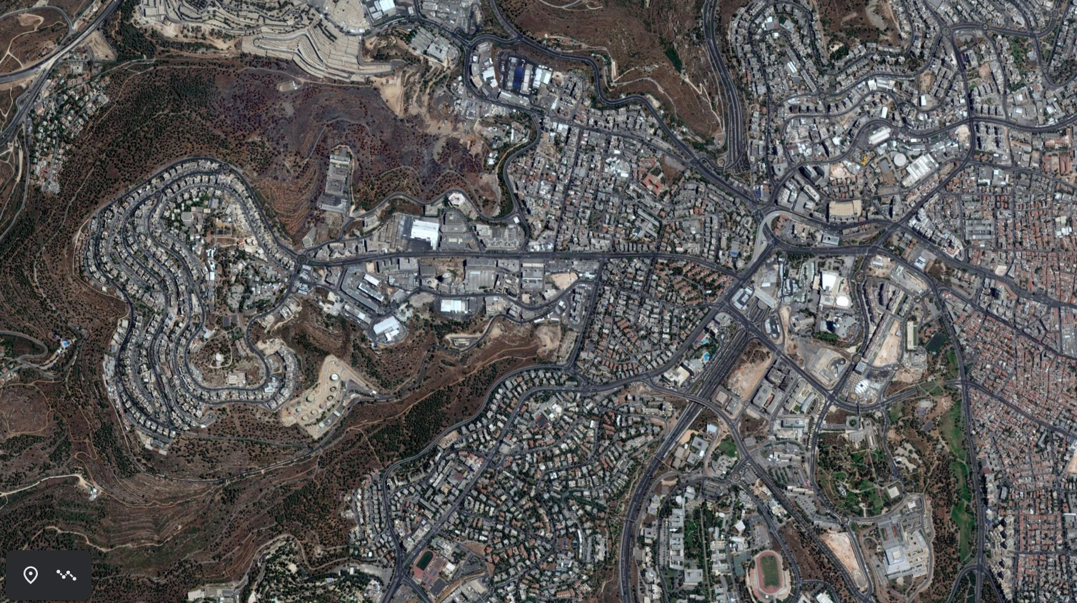
Rechov Kanfei Nesharim

Slide 17
Rechov Kanfei Nesharim
Notes:
The street was named after the operation to airlift the entire community of more than 40,000 Yemenite Jews to Israel in 1949-1950. Officially code-named "Wings of Eagles" (though colloquially referred to as "Operation Magic Carpet"), this operation was named after the Biblical description of God taking the Israelites out of Egypt and protecting them through their wanderings in the desert "on eagles' wings" (Exodus 19:4). The land on which Kanfei Nesharim Street lies was originally a dirt road leading out of Givat Shaul toward a cluster of Arab villages on the western perimeter of Jerusalem. During the Arab siege of Jerusalem, when convoys were often attacked on the Tel Aviv-Jerusalem highway, the back roads from Tel Aviv — like the one leading to Givat Shaul — became crucially important. In late 1946, the Haganah straightened and paved the road in order to use it as a landing strip. At the height of the siege, the Haganah flew in supplies, armaments, food and even soldiers on this runway.
The Kfar Shaul Mental Health Center (left) occupies the remaining buildings of the village of Deir Yassin. On 3 April 1948, the Haganah launched Operation Nachshon to capture the high ground on both sides of the Tel Aviv-Jerusalem highway. On 9 April it fought to regain Castel (at Latrun); simultaneously, the Irgun and Lehi forces attacked the Deir Yassin village at the western end of Kanfei Nesharim Street. Many of the inhabitants were killed in the attack, now known as the Deir Yassin massacre. The Israelis expelled the surviving residents and repopulated the area with Orthodox Jewish immigrants from Poland, Romania, and Slovakia; the center of the village was renamed Givat Shaul Bet.[4] Today, the remaining buildings of Deir Yassin are part of the Kfar Shaul Mental Health Center at the border between Givat Shaul Bet and Har Nof.

Slide 18
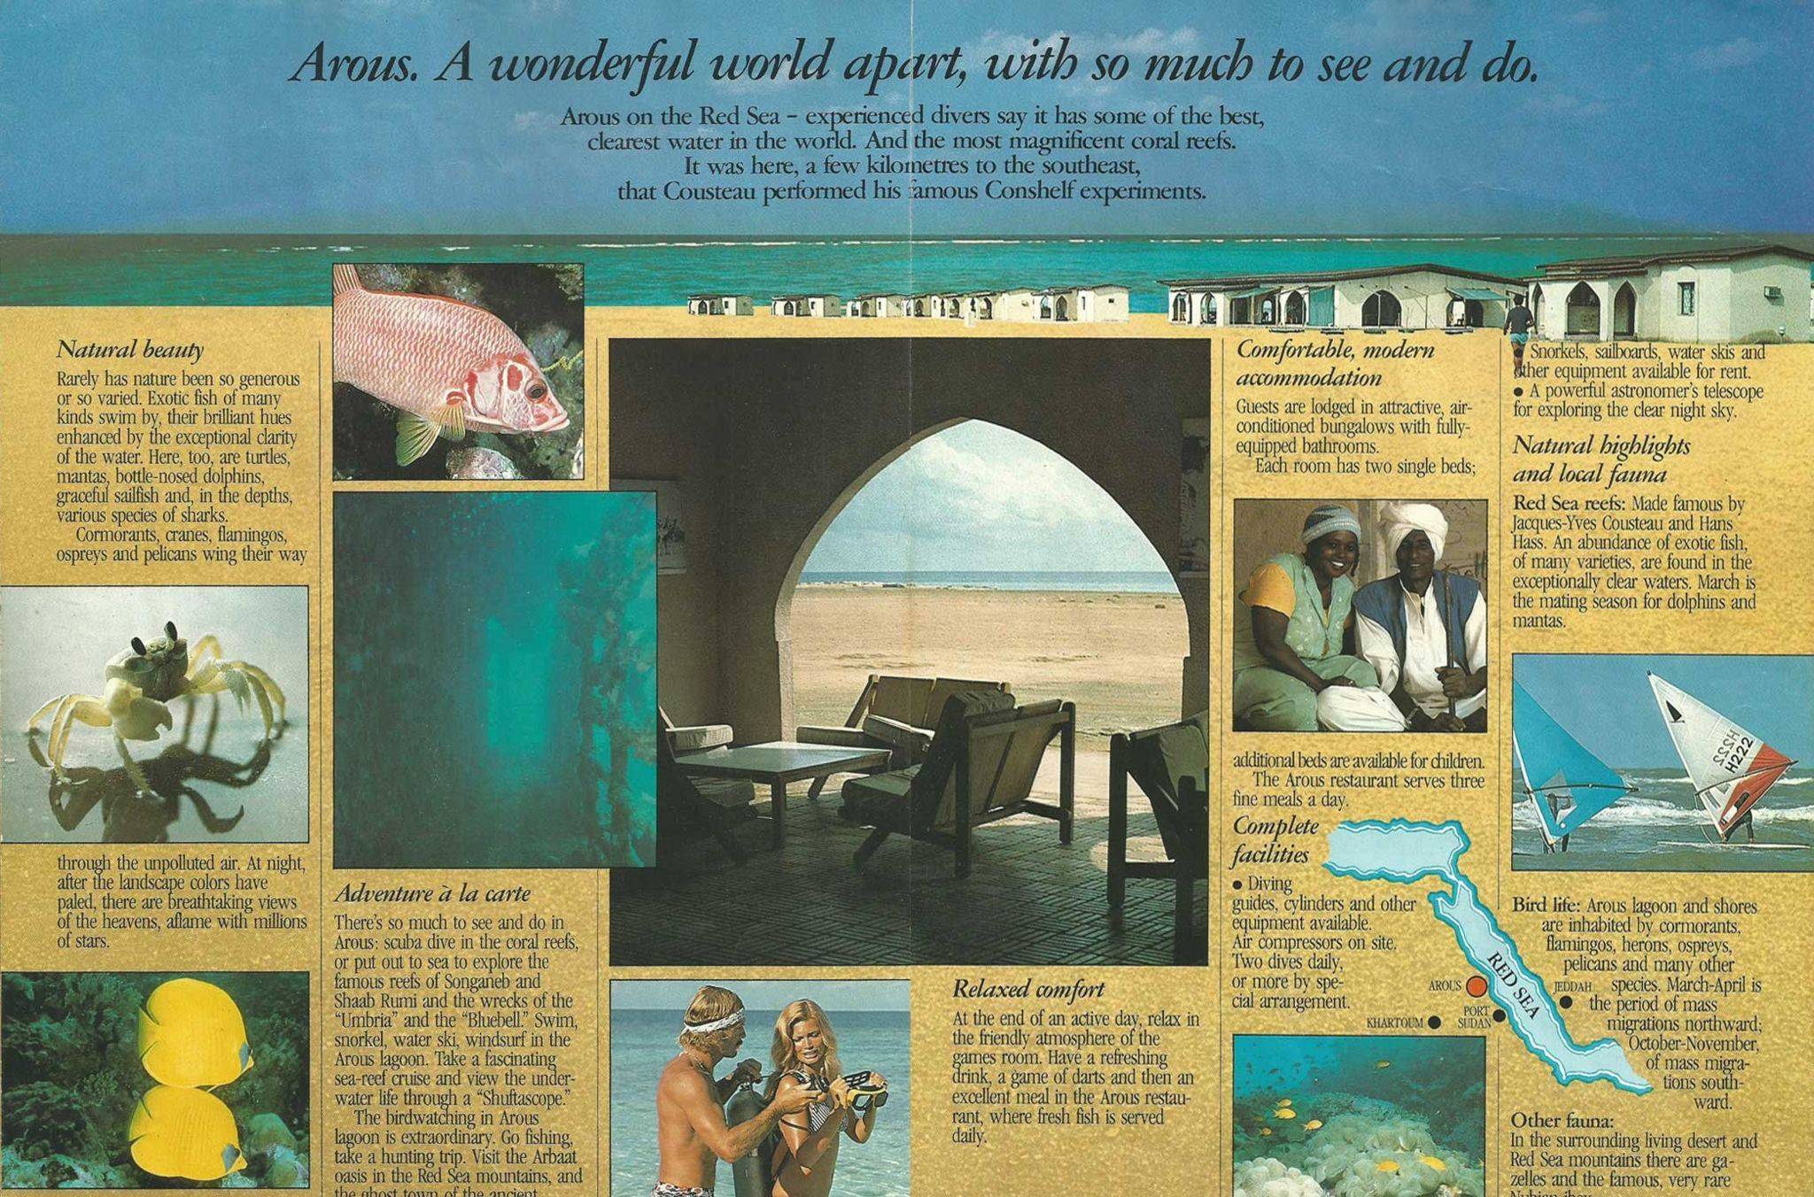
Immigration Nation
Notes:
Arous was an idyllic holiday resort in the Sudanese desert, on the shores of the Red Sea. But this glamorous destination was also a base for Israeli agents with a secret mission. The events inspired a newly released Netflix film, Red Sea Diving Resort - and the real story is in many ways more remarkable.

Slide 19
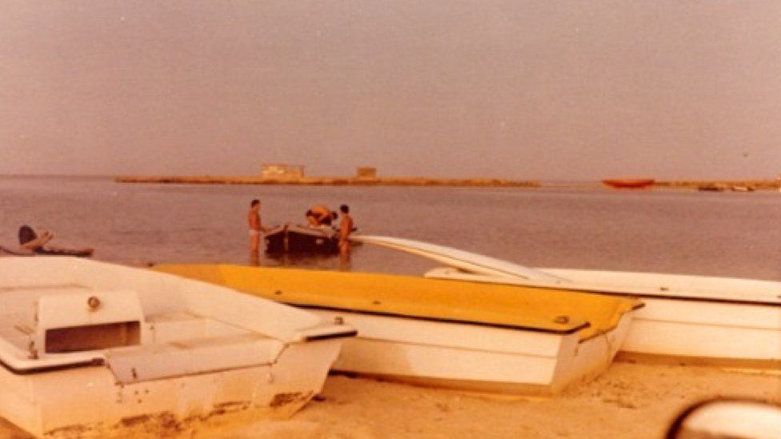
Immigration Nation
Mossad agents (background) at Arous with boats used for guests as well as for smuggling Jews
Notes:
Arous was an idyllic holiday resort in the Sudanese desert, on the shores of the Red Sea. But this glamorous destination was also a base for Israeli agents with a secret mission. The events inspired a newly released Netflix film, Red Sea Diving Resort - and the real story is in many ways more remarkable.

Slide 20
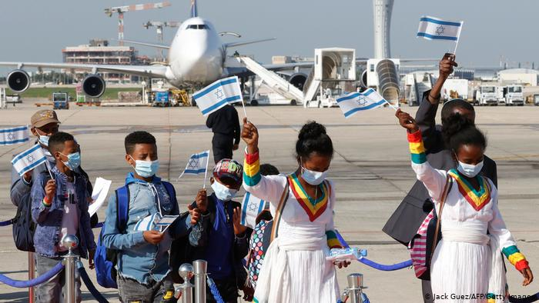
Immigration Nation
Ethiopian immigrants to Israel

Slide 21
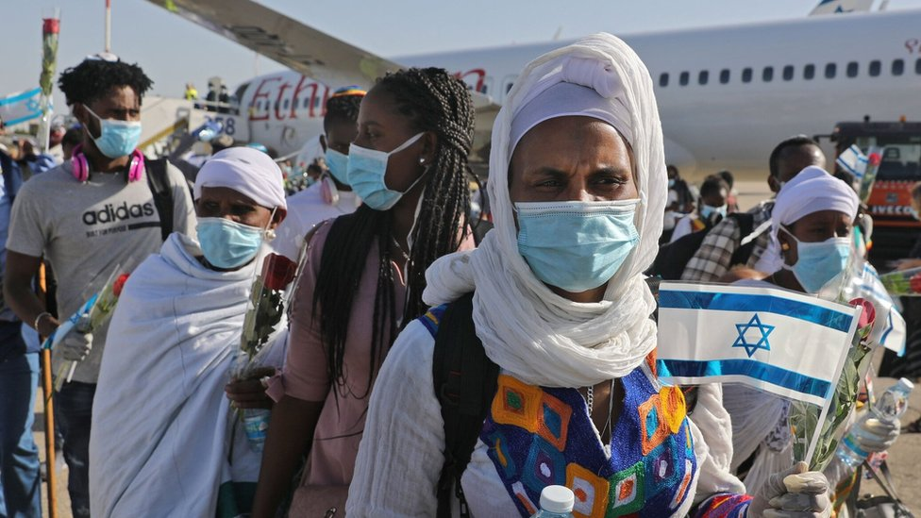
Immigration Nation
Ethiopian immigrants to Israel

Slide 22
Chutzpah

Slide 23
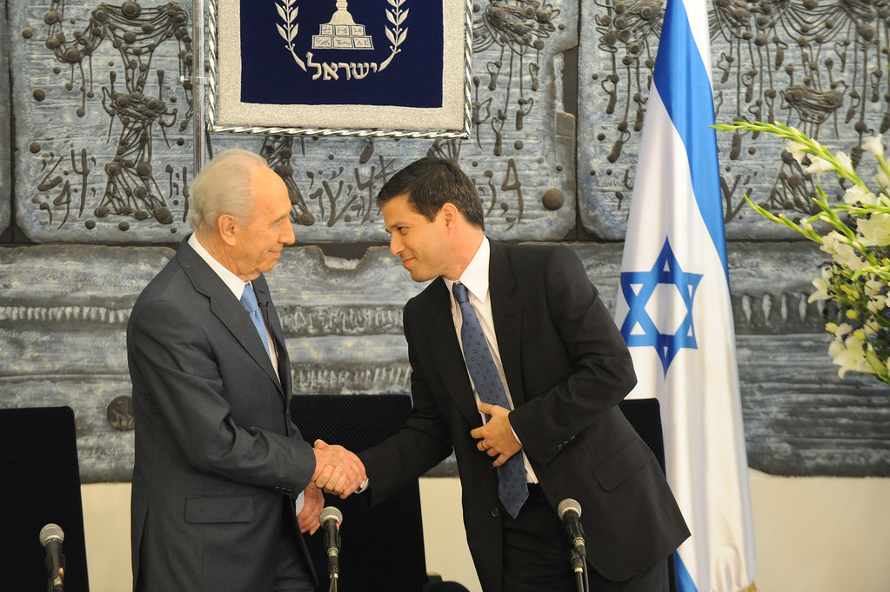
Chutzpah

Slide 24
Chutzpah

Slide 25
Chutzpah
בראשית פרק יד
(יג) וַיָּבֹא הַפָּלִיט וַיַּגֵּד לְאַבְרָם הָעִבְרִי וְהוּא שֹׁכֵן בְּאֵלֹנֵי מַמְרֵא הָאֱמֹרִי אֲחִי אֶשְׁכֹּל וַאֲחִי עָנֵר וְהֵם בַּעֲלֵי בְרִית אַבְרָם:
Genesis 14:13
And the fugitive came and he told Avram the Hebrew, and he was living in the plain of Mamre the Amorite, the brother of Eshkol and the brother of Aner, who were Abram's confederates.
בראשית רבה (וילנא) פרשה מב סימן ח
וַיַּגֵּד לְאַבְרָם הָעִבְרִי, רַבִּי יְהוּדָה וְרַבִּי נְחֶמְיָה וְרַבָּנָן, רַבִּי יְהוּדָה אוֹמֵר כָּל הָעוֹלָם כֻּלּוֹ מֵעֵבֶר אֶחָד וְהוּא מֵעֵבֶר אֶחָד.
Genesis Rabbah 42:8
and he told Avram the Hebrew – Rebbi Yehudah, Rebbi Nechemiah and the Rabbis disagree on what the meaning of this phrase means. Rebbi Yehudah says [it reflects the fact that] the entire world was on one side [of the river] and he [stood] on the other.

Slide 26
Chutzpah
ר׳ זאב וולף איינהורן, פירוש מהרז״ו על בראשית רבה פרשה מב סימן ח
מעבר אחר וכו'. כי כל בני תבל לא ידעו אז את ה' כי עבדו כולם לכוכבים ומזלות רק אברהם הכיר בורא עולם והוא לבדו היה לעבר אחד בעולם לעבוד אלהי אמת וכל בני תבל לצד אחר לצד חוץ:
Rabbi Zev Woolf Einhorn, Peirush Maharzu on Genesis Rabbah 42:8
On one side etc. – for all the abominable individuls did not yet know of God for they were all idol worshippers. It was only Abraham who recognised the Creator of the Universe, and he was the only one in the world who worshipped the One True God, and so the rest of them were on the other side.

Slide 27
Chutzpah
בראשית פרק יח פסוק כג
וַיִּגַּשׁ אַבְרָהָם וַיֹּאמַר הַאַף תִּסְפֶּה צַדִּיק עִם רָשָׁע:
Genesis 18:23
And Abraham approached and said, "Will You even destroy the righteous with the wicked?
ויגש אברהם: מצינו הגשה למלחמה (ש"ב י יג) ויגש יואב וגו', הגשה לפיוס (להלן מד יח) ויגש אליו יהודה, והגשה לתפלה (מלכים א' יח לו) ויגש אליהו הנביא, ולכל אלה נכנס אברהם, לדבר קשות, ולפיוס ולתפלה:
Rashi on Genesis 18:23
And Abraham approached and said: We find [the expression] “approaching” for war (Samuel II 10:13): “And Yoav drew forward, etc.” ; and “approaching” for placating (below 44:8): “And Yehudah approached him”; and “approaching” for prayer (Kings I 18:36):“And Eliyahu the prophet came near.” For all these, Abraham approached: to speak harshly [i.e., when he requested justice], to placate, and to pray.

Slide 28
Jewish Mindsets in Innovation

Slide 29
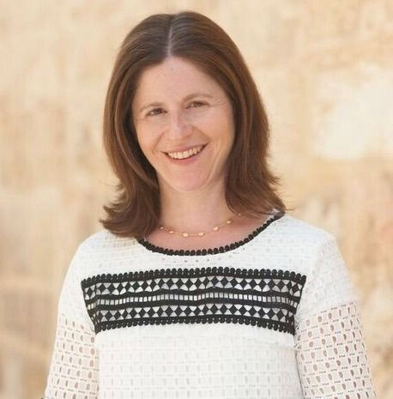
Jewish Mindsets in Innovation
Maya Bernstein is the co-founder of UpStart and co-director of Georgetown University's Institute for Transformational Leadership's Certificate in Facilitation.
She identified seven key mindsets for success in innovation:
Focus, passion and grit
Profound optimism
Listen and Collaborate
Be creative
Be patient
Failure is educative
Stay lean – experiment and learn

Slide 30
1. Focus, Passion and Grit

Slide 31
Focus, Passion and Grit
Also called a “growth mindset” coupled with a vision of how things could be or ought to be, rather than an acceptance of the now.
ויקרא כג:טו-טז
(טו) וּסְפַרְתֶּ֤ם לָכֶם֙ מִמָּחֳרַ֣ת הַשַּׁבָּ֔ת מִיּוֹם֙ הֲבִ֣יאֲכֶ֔ם אֶת־עֹ֖מֶר הַתְּנוּפָ֑ה שֶׁ֥בַע שַׁבָּת֖וֹת תְּמִימֹ֥ת תִּהְיֶֽינָה׃ (טז) עַ֣ד מִֽמָּחֳרַ֤ת הַשַּׁבָּת֙ הַשְּׁבִיעִ֔ת תִּסְפְּר֖וּ חֲמִשִּׁ֣ים י֑וֹם וְהִקְרַבְתֶּ֛ם מִנְחָ֥ה חֲדָשָׁ֖ה לַיהוָֽה׃
Leviticus 23:15-16
(15) And from the day after the Sabbath, from the day on which you bring the sheaf of the elevation offering, you shall count seven weeks; they shall be complete; (16) You shall count until the day after the seventh sabbath, fifty days; then you shall present an offering of new grain to God.

Slide 32
Focus, Passion and Grit
ויקרא פרק ב פסוק יד
וְאִם תַּקְרִיב מִנְחַת בִּכּוּרִים לַיקֹוָק אָבִיב קָלוּי בָּאֵשׁ גֶּרֶשׂ כַּרְמֶל תַּקְרִיב אֵת מִנְחַת בִּכּוּרֶיךָ:
Leviticus 2:14
When you bring a meal offering of the first grains to the Lord, you shall bring your first grain meal offering [from barley], as soon as it ripens, parched over the fire, kernels full in their husks, [ground into] coarse meal.

Slide 33
Focus, Passion and Grit
רש"י ויקרא פרק ב פסוק יד
מנחת בכורים - במנחת העומר הכתוב מדבר, שהיא באה אביב בשעת בישול התבואה, ומן השעורים היא באה. נאמר כאן אביב, ונאמר להלן (שמות ט לא) כי השעורה אביב:
Rashi on Leviticus 2:14
a meal offering of the first grains: Scripture is referring here to the מִנְחַת הָעֹמֶר, the “omer meal-offering,” which is to be offered"אָבִיב" meaning, as soon as the grain has ripened, and it comes from barley. [And how does this teach is that the minchat omer comes from barley?] For here in our verse, it says, "אָבִיב" and in an earlier verse, it says (Exodus 9:31), "כִּי הַשְּׂעֹרָה אָבִיב..." for the barley was ripened.

Slide 34
Focus, Passion and Grit
דברים פרק טז
(ט) שִׁבְעָה שָׁבֻעֹת תִּסְפָּר לָךְ מֵהָחֵל חֶרְמֵשׁ בַּקָּמָה תָּחֵל לִסְפֹּר שִׁבְעָה שָׁבֻעוֹת: (י) וְעָשִׂיתָ חַג שָׁבֻעוֹת לַיקֹוָק אֱלֹהֶיךָ מִסַּת נִדְבַת יָדְךָ אֲשֶׁר תִּתֵּן כַּאֲשֶׁר יְבָרֶכְךָ יְקֹוָק אֱלֹהֶיךָ:
Deuteronomy 16:9-10
9. You shall count seven weeks for yourself; from [the time] the sickle is first put to the standing crop, you shall begin to count seven weeks. 10. And you shall perform the Festival of Weeks to the Lord, your God, the donation you can afford to give, according to how the Lord, your God, shall bless you.

Slide 35
Focus, Passion and Grit
דברים פרק טז
(יא) וְשָׂמַחְתָּ לִפְנֵי יְקֹוָק אֱלֹהֶיךָ אַתָּה וּבִנְךָ וּבִתֶּךָ וְעַבְדְּךָ וַאֲמָתֶךָ וְהַלֵּוִי אֲשֶׁר בִּשְׁעָרֶיךָ וְהַגֵּר וְהַיָּתוֹם וְהָאַלְמָנָה אֲשֶׁר בְּקִרְבֶּךָ בַּמָּקוֹם אֲשֶׁר יִבְחַר יְקֹוָק אֱלֹהֶיךָ לְשַׁכֵּן שְׁמוֹ שָׁם: (יב) וְזָכַרְתָּ כִּי עֶבֶד הָיִיתָ בְּמִצְרָיִם וְשָׁמַרְתָּ וְעָשִׂיתָ אֶת הַחֻקִּים הָאֵלֶּה:
Deuteronomy 16:11-12
11. And you shall rejoice before the Lord, your God – you, and your son, and your daughter, and your manservant, and your maidservant, and the Levite who is within your cities, and the stranger, and the orphan, and the widow, who are among you, in the place which the Lord, your God, will choose to establish His Name therein. 12. And you shall remember that you were a slave in Egypt, and you shall keep and perform these statutes.

Slide 36
Focus, Passion and Grit
במדבר פרק כח
(כו) וּבְיוֹם הַבִּכּוּרִים בְּהַקְרִיבְכֶם מִנְחָה חֲדָשָׁה לַיקֹוָק בְּשָׁבֻעֹתֵיכֶם מִקְרָא קֹדֶשׁ יִהְיֶה לָכֶם כָּל מְלֶאכֶת עֲבֹדָה לֹא תַעֲשׂוּ: (כז) וְהִקְרַבְתֶּם עוֹלָה לְרֵיחַ נִיחֹחַ לַיקֹוָק פָּרִים בְּנֵי בָקָר שְׁנַיִם אַיִל אֶחָד שִׁבְעָה כְבָשִׂים בְּנֵי שָׁנָה: (כח) וּמִנְחָתָם סֹלֶת בְּלוּלָה בַשָּׁמֶן שְׁלֹשָׁה עֶשְׂרֹנִים לַפָּר הָאֶחָד שְׁנֵי עֶשְׂרֹנִים לָאַיִל הָאֶחָד:
Numbers 28:26-28
26. On the day of the first fruits, when you offer up a new meal offering to the Lord, on your festival of Weeks; it shall be a holy convocation for you, and you shall not perform any mundane work. 27. You shall offer up a burnt offering with a spirit of satisfaction to the Lord: two young bulls, one ram, and seven lambs in the first year. 28. Their meal offerings [shall be] fine flour mixed with oil; three tenths for each bull and two tenths for the ram.

Slide 37
Focus, Passion and Grit
רש"י במדבר פרק כח
(כו) וביום הבכורים - חג השבועות קרוי בכורי קציר חטים על שם שתי הלחם, שהם ראשונים למנחת חטים הבאים מן החדש:
Rashi on Numbers 28:26
On the day of the first fruits: The festival of Weeks [Shavuot] is called the first fruits of the wheat harvest, because of the two loaves, which were the first of the wheat offerings to be brought from the new [crop].

Slide 38
Focus, Passion and Grit
קדושת לוי, במדבר, לספירה א׳
דהנה איתא בכתבי האריז"ל על פסוק (שמות ג:יב) תעבדון את אלהים על ההר הזה, דהנה ידוע שכשהיו ישראל במצרים היו משוקעים במ"ט שערי טומאה והקדוש ברוך הוא ברוב רחמיו וחסדיו גאלם ממצרים כדי לקרבם תחת כנפי השכינה
Kedushat Levi, Numbers, For the Sefira 1
We find in the writings of the Arizal on the verse in Exodus 3:12: "You shall serve God upon this mountain." From here we know that when the Children of Israel were in Egypt they were sunk deeply in the 49 gates of impurity, and G-d, in all of his mercy and kindness, saved them from Egypt in order to bring them under the wings of the Divine presence.

Slide 39
Focus, Passion and Grit
שמות פרק ג פסוק יב
וַיֹּאמֶר כִּי אֶהְיֶה עִמָּךְ וְזֶה לְּךָ הָאוֹת כִּי אָנֹכִי שְׁלַחְתִּיךָ בְּהוֹצִיאֲךָ אֶת הָעָם מִמִּצְרַיִם תַּעַבְדוּן אֶת הָאֱלֹהִים עַל הָהָר הַזֶּה:
Exodus 3:12
And He said, "For I will be with you, and this is the sign for you that it was I Who sent you. When you take the people out of Egypt, you will worship God on this mountain."

Slide 40
Focus, Passion and Grit
קדושת לוי, במדבר, לספירה א׳
ועל זה הוצרך להם לספור ז׳ נקיים ובלא ספירת הז׳ נקיים לא היה באפשר לקרבם תחת כנפי השכינה כידוע. וזהו פירוש הפסוק תעבדון את האלהים, פירוש תעבדו נו"ן עד כאן לשונו.
Kedushat Levi, Numbers, For the Sefira 1
Based on this [their descent through the 49 gates of impurity], they needed to count a period of 7 clean weeks [for a total of 49 days], and without the counting of the 7 clean weeks, it would have been impossible for God to bring them under the wings of the Divine presence. And this is the explanation for the verse, "You shall serve God upon this mountain"; the explanation is: "You shall serve 50 [days] upon this mountain."

Slide 41
Focus, Passion and Grit
קדושת לוי, במדבר, לספירה א׳
ונמצא שהיו מצפים תמיד מתי תעבור המספר ושיגיע הקירוב ותמיד היה רצונם לכלות ימי הספירה ואם היה באפשר לכלות ימי הספירה ברגע אחד ותיכף ומיד יתחיל הקירוב אזי מה טוב ומה נעים היה להם בזה.
Kedushat Levi, Numbers, For the Sefira 1
We find that they constantly anticipated when the number would pass and when the closeness with finally come, and they constantly had a desire to complete the counting period. If it were possible to merge the counting period into one moment, hurriedly, and immediately have the closeness start -- then what good and what comfort would they have had through counting?!

Slide 42
2. Optimism and Hope

Slide 43
Optimism and Hope
God save our gracious Queen,
Long live our noble Queen,
God save the Queen!
Send her victorious,
Happy and glorious,
Long to reign over us,
God save the Queen!
O lord God arise,
Scatter our enemies,
And make them fall!
Confound their knavish tricks,
Confuse their politics,
On you our hopes we fix,
God save the Queen!

Slide 44
Optimism and Hope
Oh, say! can you see by the dawn's early light
What so proudly we hailed at the twilight's last gleaming;
Whose broad stripes and bright stars, through the perilous fight,
O'er the ramparts we watched were so gallantly streaming?
And the rocket's red glare, the bombs bursting in air,
Gave proof through the night that our flag was still there:
Oh, say! does that star-spangled banner yet wave
O'er the land of the free and the home of the brave?

Slide 45
Optimism and Hope
Arise, ye who refuse to be slaves;
With our very flesh and blood
Let us build our new Great Wall!
The peoples of China are in the most critical time,
Everybody must roar his defiance.
Arise! Arise! Arise!
Millions of hearts with one mind,
Brave the enemy's gunfire,
March on!
Brave the enemy's gunfire,
March on!
March on!
March on, on!

Slide 46
Optimism and Hope
Hasten to battle, men of Bayamo,
For the homeland looks proudly to you.
Do not fear a glorious death,
Because to die for the country is to live.
To live in chains
Is to live in dishonour and shame
Hear the clarion call,
Hasten, brave ones, to battle!
Notes:
"El Himno de Bayamo" (English: "The Bayamo Anthem", lit. 'The Hymn of Bayamo"') is the national anthem of Cuba. It was first performed in 1868, during the Battle of Bayamo [es]. Perucho Figueredo, who took part in the battle, wrote and composed the song. The melody, also called "La Bayamesa" (English: "The Bayamo Song"), was composed by Figueredo in 1867.
On October 20, 1868, the Cuban forces obtained the capitulation of the Spanish colonial authorities in Bayamo, the jubilant people surrounded Figueredo and asked him to write an anthem with the melody they were humming. Right on the saddle of his horse, Figueredo wrote the lyrics of the anthem, which was longer than the current official version. Figueredo was captured and executed by the Spanish two years later. Just before the firing squad received the Fire command, Figueredo shouted the line from his song: "Morir por la Patria es vivir" (English: "To die for one's country is to live").

Slide 47
Optimism and Hope
A lovely land is ours
With beeches green about her
Encircled by the sea
Her hills and vales are manifold
Her name, of old, is Denmark
And she is Freya's home
King Christian stood by the tall mast in smoke and mist;
his sword was hammering so hard,
that the Swedes' helmets and brains cracked.
Then sank every enemy stern and mast in smoke and mist.
"Flee," they screamed, "flee as flee can!
Who can stand up to Denmark's Christian in battle?"
Notes:
The 'royal anthem', written in 1779 by Johannes Ewald, Danish poet and playwright, is the old- est European national anthem in terms of official adoption. ... The first stanza of the anthem recalls the victory of the hero King Christian IV on Sweden in 1644, turning Denmark into a world power.

Slide 48
Optimism and Hope
To arms, to arms, ye brave!
Th'avenging sword unsheathe!
March on, march on, all hearts resolved
On liberty or death.
Oh liberty can man resign thee,
Once having felt thy gen'rous flame?
Can dungeons, bolts, and bar confine thee?
Or whips thy noble spirit tame?
Notes:
"La Marseillaise"[a] is the national anthem of France. The song was written in 1792 by Claude Joseph Rouget de Lisle in Strasbourg after the declaration of war by France against Austria, and was originally titled "Chant de guerre pour l'Armée du Rhin" ("War Song for the Army of the Rhine").
The French National Convention adopted it as the Republic's anthem in 1795. The song acquired its nickname after being sung in Paris by volunteers from Marseille marching to the capital.

Slide 49
Optimism and Hope
As long as in the heart, within,
The soul of a Jew still yearns,
And onward, towards the ends of the east,
an eye still gazes toward Zion;
Our hope is not yet lost,
The hope of two thousand years,
To be a free nation in our land,
The land of Zion and Jerusalem.
כֹּל עוֹד בַּלֵּבָב פְּנִימָה
נֶפֶשׁ יְהוּדִי הוֹמִיָּה,
וּלְפַאֲתֵי מִזְרָח קָדִימָה,
עַיִן לְצִיּוֹן צוֹפִיָּה;
עוֹד לֹא אָבְדָה תִּקְוָתֵנוּ,
הַתִּקְוָה בַּת שְׁנוֹת אַלְפַּיִם,
לִהְיוֹת עַם חָפְשִׁי בְּאַרְצֵנוּ,
אֶרֶץ צִיּוֹן וִירוּשָׁלַיִם.

Slide 50
3. Listening and Collaboration

Slide 51
Listening and Collaboration
קהלת ד:ט-י
טוֹבִ֥ים הַשְּׁנַ֖יִם מִן־הָאֶחָ֑ד אֲשֶׁ֧ר יֵשׁ־לָהֶ֛ם שָׂכָ֥ר ט֖וֹב בַּעֲמָלָֽם׃ כִּ֣י אִם־יִפֹּ֔לוּ הָאֶחָ֖ד יָקִ֣ים אֶת־חֲבֵר֑וֹ וְאִ֣יל֗וֹ הָֽאֶחָד֙ שֶׁיִּפּ֔וֹל וְאֵ֥ין שֵׁנִ֖י לַהֲקִימֽוֹ׃
Koheles 4:9-10
9. Two are better off than one, in that they have greater benefit from their efforts. 10. For should they fall, one can raise the other; but woe betide him who is alone and falls with no companion to raise him!

Slide 52
4. Creativity

Slide 53
Creativity
שמות לה:ל-לא
(ל) וַיֹּאמֶר מֹשֶׁה אֶל בְּנֵי יִשְׂרָאֵל רְאוּ קָרָא יי בְּשֵׁם בְּצַלְאֵל בֶּן אוּרִי בֶן חוּר לְמַטֵּה יְהוּדָה. (לא) וַיְמַלֵּא אֹתוֹ רוּחַ אֱלֹהִים בְּחָכְמָה בִּתְבוּנָה וּבְדַעַת וּבְכָל מְלָאכָה.
Exodus 35:30-31
(30) And Moses said unto the children of Israel: ‘See, Hashem has called by name Betzalel the son of Uri, the son of Hur, of the tribe of Yehudah. (31) And He has filled him with the spirit of God, in wisdom, in understanding, and in knowledge, and in all manner of workmanship.

Slide 54
Creativity
ברכות נה.
א"ר שמואל בר נחמני א"ר יונתן בצלאל על שם חכמתו נקרא בשעה שאמר לו הקדוש ברוך הוא למשה לך אמור לו לבצלאל עשה לי משכן ארון וכלים. הלך משה והפך ואמר לו עשה ארון וכלים ומשכן.
Berakhot 55a
Rabbi Shmuel bar Nachmani said in the name of Rabbi Yonetan: Betzalel was called because of his wisdom. In the moment that the Holy One Blessed be God said to Moses: Say to Betzalel: make for me a Mishkan, an ark, and vessels. Moses went and switched the order, and he said to him (Betzalel): make an ark, vessels, and a Mishkan.

Slide 55
Creativity
ברכות נה.
אמר לו משה רבינו מנהגו של עולם אדם בונה בית ואחר כך מכניס לתוכו כלים, ואתה אומר עשה לי ארון וכלים ומשכן. כלים שאני עושה להיכן אכניסם? שמא כך אמר לך הקב"ה עשה משכן ארון וכלים? אמר לו שמא בצל אל היית וידעת?!
Berakhot 55a
[Betzalel] said to him, our teacher, it is the custom of everyone that one builds a house, and afterwards places inside vessels, and you are saying, make for me an ark, vessels, and a Mishkan. Where do I place the vessels that I am making? Perhaps the Holy One blessed be God said to you: Make a Mishkan, an ark, and vessels? [Moses] responded: Perhaps you were in the shadow of God and you knew?!

Slide 56
Creativity
ברכות נה.
אמר רב יהודה אמר רב יודע היה בצלאל לצרף אותיות שנבראו בהן שמים וארץ כתיב הכא (שמות לה:לא) וימלא אותו רוח אלהים בחכמה ובתבונה ובדעת. וכתיב התם (משלי ג:יט) ה׳ בחכמה יסד ארץ כונן שמים בתבונה. וכתיב (משלי ג:כ) בדעתו תהומות נבקעו.
Berakhot 55a
Rav Yehuda said: Rav Said: Betzalel knew how to combine the letters that were used to create the Heavens and the Earth. It was written here (Exodus 35:31), “And He filled him with the spirit of God with Wisdom, Understanding, and Intellect.” And it was written there (Proverbs 3:19), “Hashem founded the land with Wisdom and established the Heavens with Understanding.” And it is written (Proverbs 3:20), “with his intellect, the depths were broken.”

Slide 57
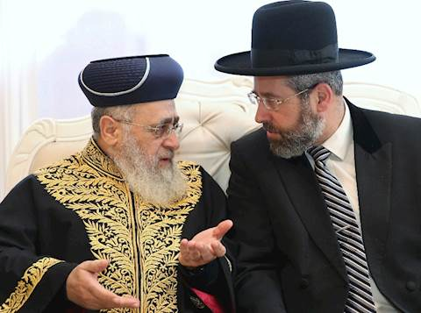
Creativity

Slide 58
Creativity
ליקוטי מוהר"ן תורה ס"ד
וְדַע, כִּי מַחֲלקֶת הִיא בְּחִינוֹת בְּרִיאַת הָעוֹלָם כִּי עִקַּר בְּרִיאַת הָעוֹלָם, עַל יְדֵי חָלָל הַפָּנוּי כַּנַּ"ל כִּי בְּלא זֶה הָיָה הַכּל אֵין סוֹף, וְלא הָיָה מָקוֹם לִבְרִיאַת הָעוֹלָם כַּנַּ"ל וְעַל כֵּן צִמְצֵם הָאוֹר לִצְדָדִין, וְנַעֲשָׂה חָלָל הַפָּנוּי וּבְתוֹכוֹ בָּרָא אֶת כָּל הַבְּרִיאָה, הַיְנוּ הַיָּמִים וְהַמִּדּוֹת, עַל יְדֵי הַדִּבּוּר כַּנַּ"ל "בִּדְבַר ה' שָׁמַיִם נַעֲשׂוּ" וְכוּ'.
Likutei Moharan I:64
Know this: that disagreement [machloket] is analogous to the creation of the world, which consisted of creating an empty space, as we have shown. For were it not so, everything would be infinitely divine [ein sof], and there would be no space left for the world. Therefore, He contracted the light to the sides, and an empty space was left in which the world could be created, with all its time and spatial dimensions, all done by the act of speech - as it is written: “By the word of God were the heavens made, etc.” [Psalms 33].

Slide 59
Creativity
ליקוטי מוהר"ן תורה ס"ד
וְכֵן הוּא בְּחִינַת הַמַּחֲלוֹקוֹת כִּי אִלּוּ הָיוּ כָּל הַתַּלְמִידֵי חֲכָמִים אֶחָד לא הָיָה מָקוֹם לִבְרִיאַת הָעוֹלָם רַק עַל יְדֵי הַמַּחֲלקֶת שֶׁבֵּינֵיהֶם, וְהֵם נֶחֱלָקִים זֶה מִזֶּה וְכָל אֶחָד מוֹשֵׁך עַצְמוֹ לְצַד אַחֵר עַל יְדֵי זֶה נַעֲשֶׂה בֵּינֵיהֶם בְּחִינוֹת חָלָל הַפָּנוּי שֶׁהוּא בְּחִינוֹת צִמְצוּם הָאוֹר לִצְדָדִין, שֶׁבּוֹ הוּא בְּרִיאַת הָעוֹלָם עַל יְדֵי הַדִּבּוּר כַּנַּ"ל כִּי כָּל הַדְּבָרִים שֶׁכָּל אֶחָד מֵהֶם מְדַבֵּר הַכּל הֵם רַק בִּשְׁבִיל בְּרִיאַת הָעוֹלָם שֶׁנַּעֲשֶׂה עַל יָדָם בְּתוֹך הֶחָלָל הַפָּנוּי שֶׁבֵּינֵיהֶם כִּי הַתַּלְמִידֵי חֲכָמִים בּוֹרְאִים אֶת הַכּל עַל יְדֵי דִּבְרֵיהֶם "וְלֵאמר לְצִיּוֹן עַמִּי אַתָּה" 'אַל תִּקְרֵי עַמִּי אֶלָּא עִמִּי, מָה אֲנָא עֲבַדִי שְׁמַיָּא וְאַרְעָא בְּמִלּוּלִי אַף אַתֶּם כֵּן'.
Likutei Moharan I:64
So too is the case with disagreement, for if all the scholars were united, there would be no creation of the world. It is only when there is disagreement between them, and they divide and each draws to one side, a space is created between them which is analogous to the empty space and the contraction of the lights, by the which the world itself was created by the act of speech, as we have shown. And all the arguments they each use are only in order to allow the world to be created by them [...] just as [God] created the heaven and the earth with words, so too can [scholars]!

Slide 60
5. Patience

Slide 61
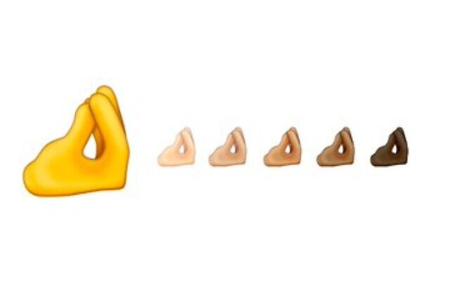
Patience
A symbol of pinched fingers — ubiquitous among Israelis saying “wait a minute” or “have patience” — has been included in the 2020 list of approved emojis.
But the non-profit Unicode Consortium, the organisation that approves new emojis, is calling the emoji showing all fingers and thumb held together in a vertical orientation the “Italian hand gesture,” or “finger purse.” Italians use the symbol to show disagreement.

Slide 62
Patience
שמות פרק א
(יא) וַיָּשִׂימוּ עָלָיו שָׂרֵי מִסִּים לְמַעַן עַנֹּתוֹ בְּסִבְלֹתָם וַיִּבֶן עָרֵי מִסְכְּנוֹת לְפַרְעֹה אֶת פִּתֹם וְאֶת רַעַמְסֵס:
Exodus 1:11
So they appointed over taskmasters over them to afflict them with their burdens, and they built store cities for Pharaoh, namely Pitom and Ra’amses.

Slide 63
Patience

Slide 64
6. Failure is Educative

Slide 65
Failure is Educative
משלי פרק כד
(טז) כִּי שֶׁבַע יִפּוֹל צַדִּיק וָקָם וּרְשָׁעִים יִכָּשְׁלוּ בְרָעָה:
Proverbs 24:16
For a righteous person can fall seven times and rise, but the wicked shall stumble upon evil.

Slide 66
Failure is Educative
פרי צדיק, נצבים א׳:א׳
אבל ישראל נופלין ועומדין וכן הוא אומר אל תשמחי אויבתי לי כי נפלתי קמתי והוא שע"י הנפילה זה עצמו יהי' סיבה לקימה ע"ד לשון חז"ל (מכות ז':) ירידה שהוא צורך עלי' שע"י הירידה יכול להיות העלי' יותר וכן הוא אומר כי שבע יפול צדיק וקם שע"י הנפילה דייקא יהיה הקימה.
Rabbi Tzadok HaKohen (d. 1900) Pri Tzadik, Nitzavim 1:1
But Israel falls and stands as it says, "Do not rejoice over me, Oh my enemy! Though I have fallen, I rise again." This is that through the act of falling this is the reason that one rises. This is the language of Chazal, "Downward motion for the sake of upward motion." That through the descent one can reach an even greater ascent. Likewise it says, "Seven times the righteous man falls and gets up." That specifically through falling, he is able to get up.

Slide 67
7. Stay Lean

Slide 68
Stay Lean
“
Successful entrepreneurs do not give up at the first sign of trouble, nor do they persevere the plane right into the ground. Instead, they possess a unique combination of perseverance and flexibility.
”
“The Lean Startup” by Eric Reis

Slide 69
Israeli Success Stories

Slide 70
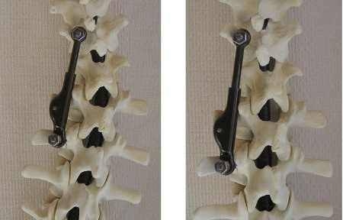
Israeli Success Stories
ApiFix system to correct severe curvature of the spine (scoliosis) minimizes risks, scar size, complications, recovery time and cost. The miniature ratchet mechanism has successfully been implanted in 15 patients so far. Limited sales of the product have begun while clinical trials are in the last stages.

Slide 71
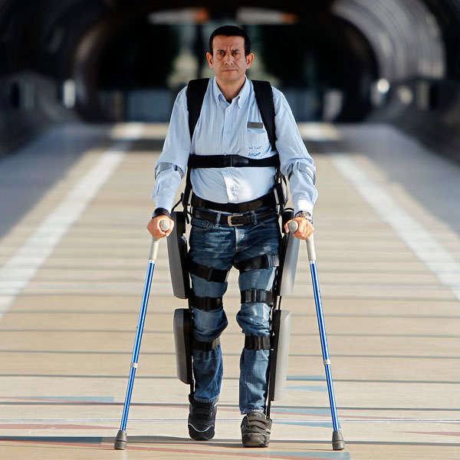
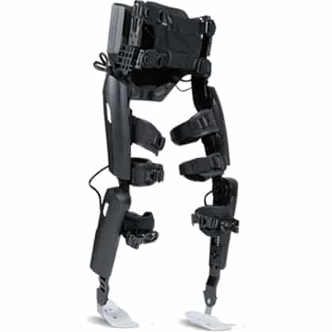
Israeli Success Stories
Argo Medical Technologies’ Rewalk robotic exoskeleton from was featured on the hit TV show “Glee” and enabled paraplegic runners in London and Tel Aviv to complete marathons. The ReWalk Rehabilitation model currently is used by patients in rehab centres from New York to Dusseldorf. ReWalk Personal, for everyday home use, is available throughout Europe and awaiting FDA clearance in the United States.

Slide 72
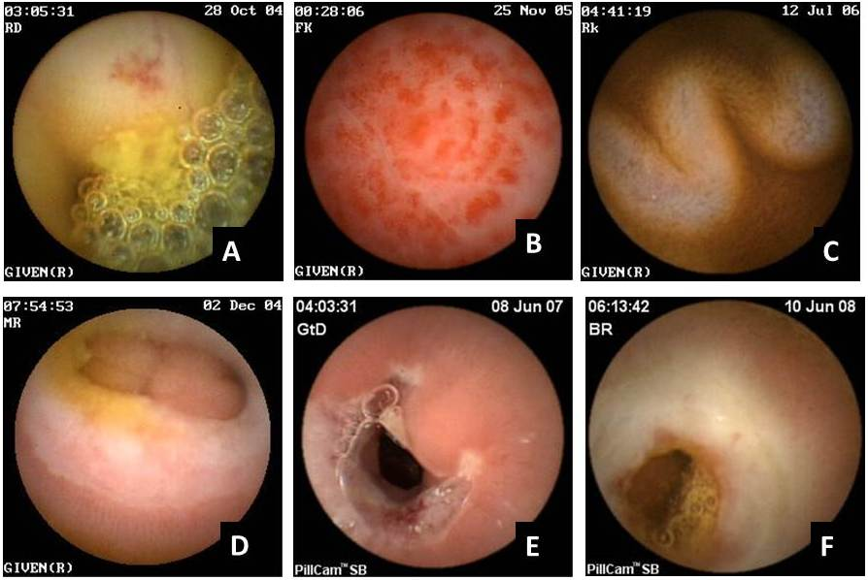
Israeli Success Stories
Israeli company Given Imaging’s technology, developed from missile defence systems, uses a battery-powered camera to take high-speed photos as it slowly winds its way through the intestinal tract over eight hours. The images are transmitted to a recording device worn around the patient’s waist and later reviewed by a doctor.

Slide 73
Israeli Success Stories
During the Jewish holiday of Rosh Hashanah 2020, Israeli researchers realized they had a solid real-world opportunity to try out a nasal spray they were developing as a COVID-19 defence. As the Jewish faith’s new year, tens of thousands would be traveling and attending synagogue and related festivals in the densely populated city of Bnei Brak—making it an ideal testing site.

Slide 74
Israeli Success Stories
Approved in Israel, Taffix, a spray created by Nasus Pharma, creates a barrier of both mechanical and chemical protection for around five hours when inhaled through the nose. It was this spray that its co-creator, Dalia Megiddo, offered to a Bnei Brak rabbi for use in the festivals.

Slide 75
Israeli Success Stories
83 people agreed to use the spray before the festivals according to instructions—reapplying every five hours until the celebrations were over. Remarkably, of the 83 people who used the nasal spray, only two people caught COVID-19; both reported forgetting to use it. Of the 160 people who were approached but chose not to use the nasal spray, 16 of them—or 10%—did contract the virus.

Slide 76
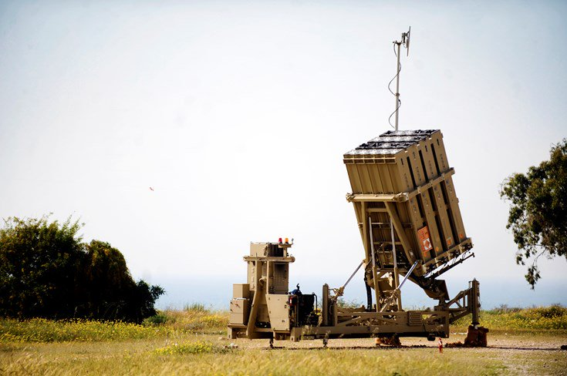
Israeli Success Stories
For many years, rockets have been launched at Israel from the Gaza Strip. As a result, an air defence system called the "Iron Dome" was deployed in southern Israel in 2011. The objective of the "Iron Dome“ is to protect Israeli civilians from the constant threat of rockets by intercepting them.

Slide 77
Israeli Success Stories
As soon as a rocket is launched by the enemy, the radar station detects and tracks its course, and then immediately launches a missile to intercept and neutralize the enemy rocket before it causes damage to civilians or property. With a range of up to 43.5 miles, it was able to intercept 692 rockets during Operation Protective Edge. In addition, in November 2012, during Operation Defensive Pillar, a record high of 421 interceptions were made in just 8 days.

Slide 78
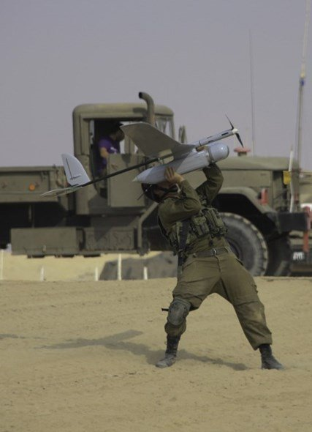
Israeli Success Stories
The “Skylark I-LE” is an unmanned aerial vehicle (UAV) which is small, light, and almost undetectable. It’s light enough to be transported by one person and can be configured to fly in less than 8 minutes. The “Skylark” can handle 3 hours of unmanned flight with a live video day and night, in any weather condition. Silent as a mouse and with the sight of a hawk, it unfolds and returns to its original form quickly.

Slide 79
Israeli Success Stories
More available at:
www.israel21c.org
www.verygoodnewsisrael.blogspot.com
www.goodnewsnetwork.org/tag/israel

Slide 80
Conclusions

Slide 81
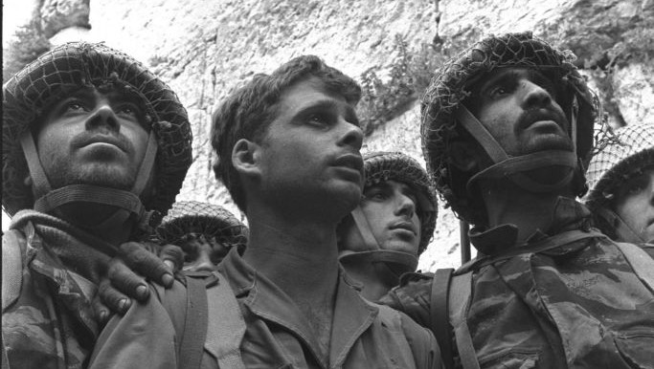
David Rubinger's famous photograph of IDF soldiers after liberating the Kotel
(the Western Wall) in June 1967

Slide 82
Conclusions
“
If the statistics are right, the Jews constitute but one quarter of one percent of the human race. It suggests a nebulous puff of star dust lost in the blaze of the Milky Way. Properly, the Jew ought hardly to be heard of, but he is heard of, has always been heard of. He is as prominent on the planet as any other people, and his importance is extravagantly out of proportion to the smallness of his bulk.
Mark Twain, September 1897

Slide 83
Conclusions
His contributions to the world’s list of great names in literature, science, art, music, finance, medicine and abstruse learning are also very out of proportion to the weakness of his numbers. He has made a marvellous fight in this world in all ages; and has done it with his hands tied behind him. He could be vain of himself and be excused for it. The Egyptians, the Babylonians and the Persians rose, filled the planet with sound and splendor, then faded to dream-stuff and passed away; the Greeks and Romans followed and made a vast noise, and they were gone; other people have sprung up and held their torch high for a time but it burned out, and they sit in twilight now, and have vanished.
Mark Twain, September 1897

Slide 84
Conclusions
The Jew saw them all, survived them all, and is now what he always was, exhibiting no decadence, no infirmities, of age, no weakening of his parts, no slowing of his energies, no dulling of his alert but aggressive mind. All things are mortal but the Jews; all other forces pass, but he remains. What is the secret of his immortality?
”
Mark Twain, September 1897

Slide 85
CUSTODIANS OF THE
WORLD: JUDAISM AND
THE ENVIRONMENT
8PM ON
SUNDAY 6TH JUNE
What does the Torah teach us about caring for our environment?
Can we still use disposables?

Slide 86
Thank You
rabbi@newwestend.org.uk
07531 326289
@moshefreedman

