Slide 1
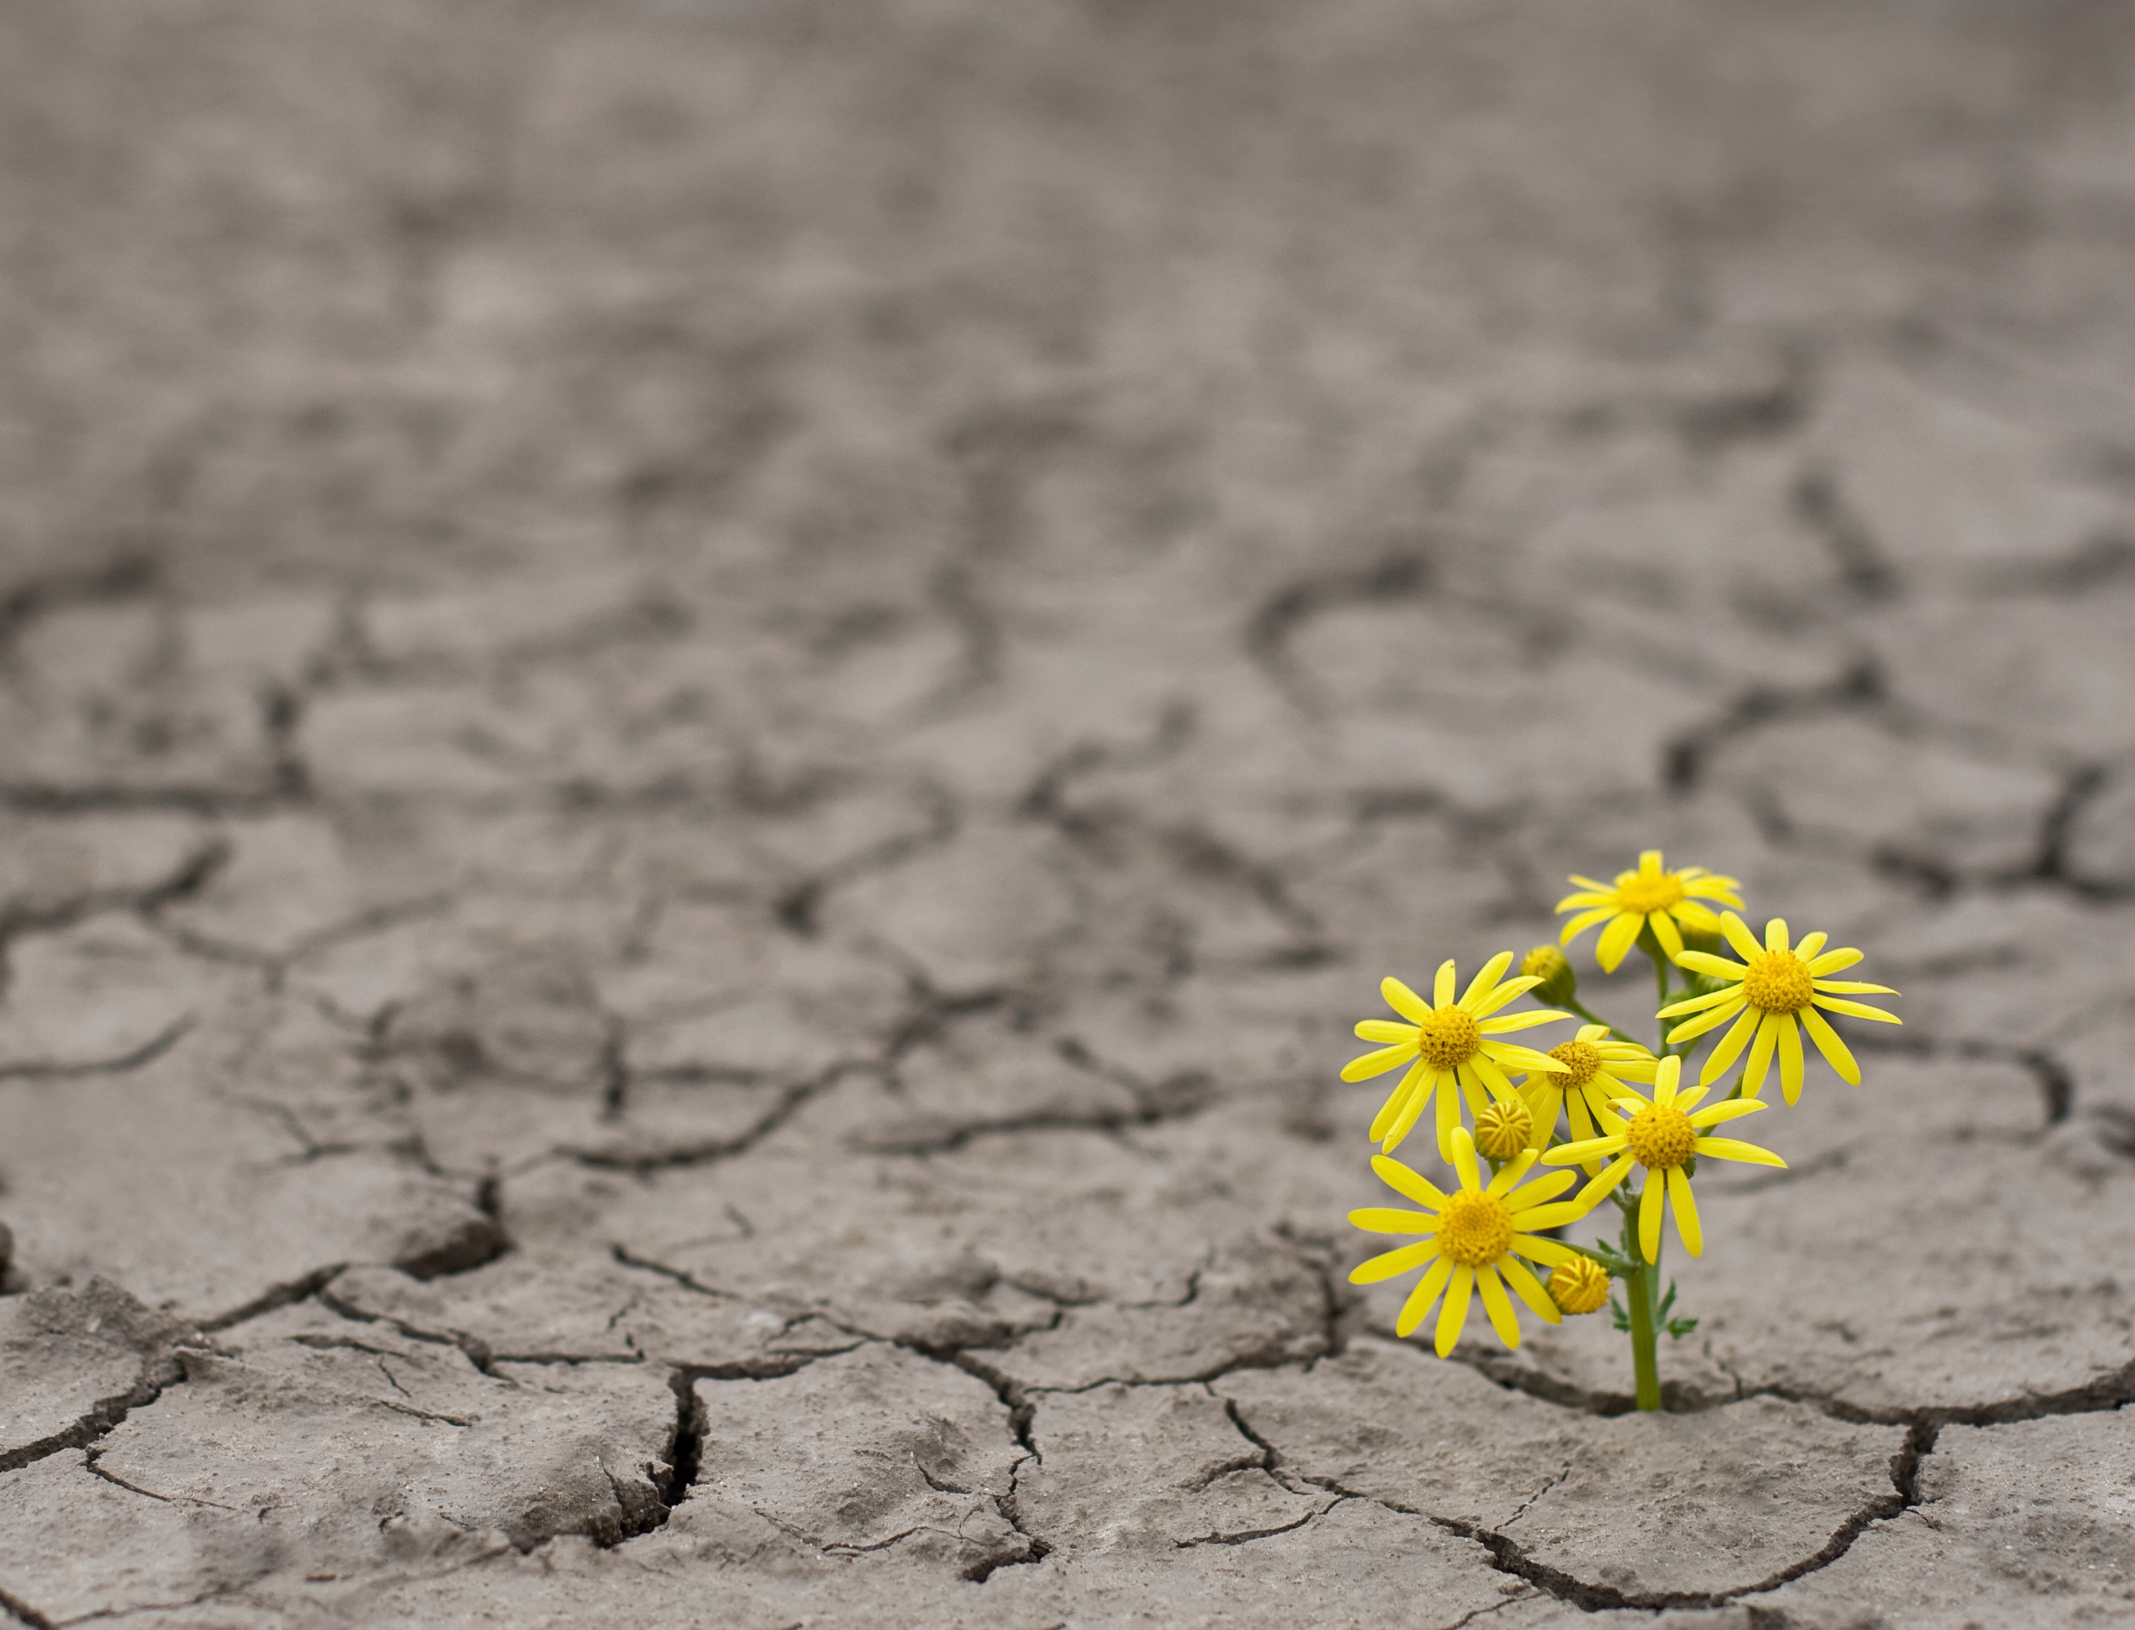
The Jewish Approach to Resilience
Judaism and Society
Rabbi Dr Moshe Freedman Rabbi, New West End Synagogue Deputy Co-chair of MEAG (Moral and Ethical Advisory Group to DHSC)

Slide 2
Summary
Jacob and the Angel
Sherri Mandel’s Road to Resilience
Adam and Eve – starting from now

Slide 3
The Road to Resilience

Slide 4
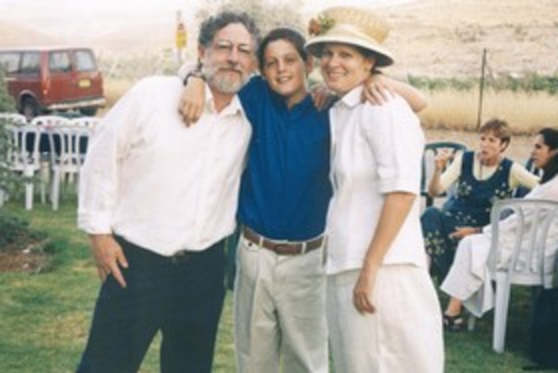

Slide 5
The Road to Resilience
Sherri Mandell, “The Road to Resilience” p. 3
The only way to absorb catastrophe is to expect to change. … Rabbi Israel Salanter, a nineteenth-century rabbi who was the leader of a Lithuanian yeshiva, said that it is harder to change one weak character trait than to learn all sixty-three tractates of the Talmud. Rabbi Salanter stressed that a person had to work on becoming a more ethical, caring person. And that work is very difficult to accomplish because most of us resist internalizing and integrating change. But you have the opportunity to grow. Not just the opportunity. The obligation. And not just the obligation. The necessity.
So know this: resilience entails change. You’re not going to bounce back to who you were. Because of your encounter with loss, you are going to bounce forward to become someone you are not yet acquainted with.

Slide 6
The Road to Resilience
Sherri Mandel’s “The Road to Resilience”
Chaos
Community
Choice
Creativity
Commemoration
Consecration
Celebration

Slide 7
Chaos

Slide 8
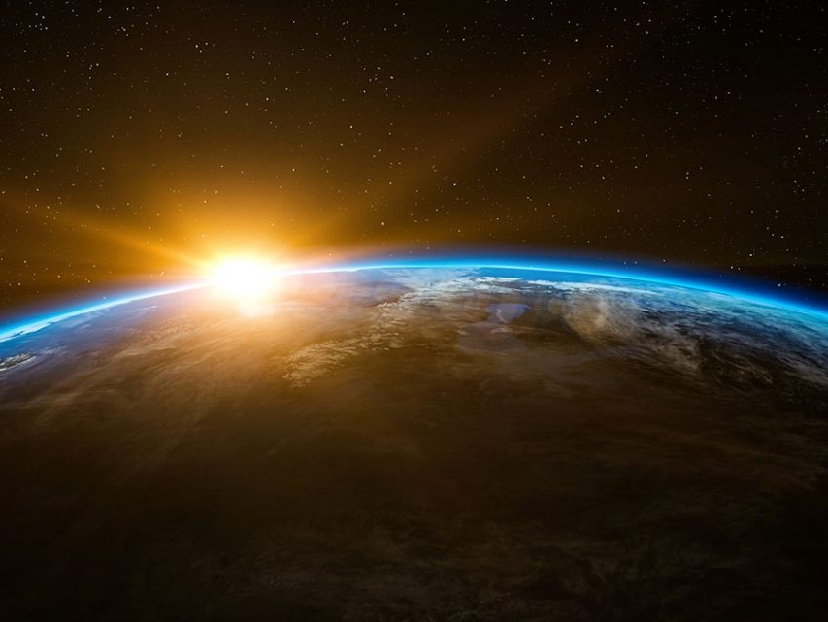
בראשית פרק א
(א) בְּרֵאשִׁית בָּרָא אֱלֹהִים אֵת הַשָּׁמַיִם וְאֵת הָאָרֶץ: (ב) וְהָאָרֶץ הָיְתָה תֹהוּ וָבֹהוּ וְחֹשֶׁךְ עַל פְּנֵי תְהוֹם וְרוּחַ אֱלֹהִים מְרַחֶפֶת עַל פְּנֵי הַמָּיִם:
Genesis 1:1-2
In the beginning of God’s creating the heavens and the earth. 2. And the earth was desolate and void, with darkness upon the surface of the deep and a breath of God hovered over the surface of the waters.

Slide 9
Chaos
Sherri Mandell, “The Road to Resilience” p. 5
When we are thrust into the desolation of chaos, we wonder how we will cope and survive. Even the word cope seems meager. We struggle. We wrestle with our pain. One bereaved mother described her experience as an earthquake. Another told me that she felt that her ego had been totally shattered. Booted from our habitual modes of comprehension and our routines, forced to find balance, we may feel totally unequipped to confront our new reality. We are alone, unsteady, trembling; the world may feel capricious, menacing, evil, and our sufferings feel arbitrary.

Slide 10
Chaos
Sherri Mandell, “The Road to Resilience” p. 5-6
But in this suffering there is divinity. When we are in pain, we may not recognize Gods presence. But even in the shock, confusion, emptiness, and desolation, God’s spirit or ruah hovers above us. Rashi compares this action to the hovering of a dove over its nest in a promise of protection. God hovers; He does not force Himself on us. But He does not abandon us.

Slide 11
Chaos
תהלים פרק קכו
(א) שִׁיר הַמַּעֲלוֹת בְּשׁוּב יְקֹוָק אֶת שִׁיבַת צִיּוֹן הָיִינוּ כְּחֹלְמִים: (ב) אָז יִמָּלֵא שְׂחוֹק פִּינוּ וּלְשׁוֹנֵנוּ רִנָּה אָז יֹאמְרוּ בַגּוֹיִם הִגְדִּיל יְקֹוָק לַעֲשׂוֹת עִם אֵלֶּה: (ג) הִגְדִּיל יְקֹוָק לַעֲשׂוֹת עִמָּנוּ הָיִינוּ שְׂמֵחִים: (ד) שׁוּבָה יְקֹוָק אֶת שבותנו שְׁבִיתֵנוּ כַּאֲפִיקִים בַּנֶּגֶב: (ה) הַזֹּרְעִים בְּדִמְעָה בְּרִנָּה יִקְצֹרוּ: (ו) הָלוֹךְ יֵלֵךְ וּבָכֹה נֹשֵׂא מֶשֶׁךְ הַזָּרַע בֹּא יָבוֹא בְרִנָּה נֹשֵׂא אֲלֻמֹּתָיו:
Psalms 126:1-6
1. A song of ascents. When the Lord returns the returnees to Zion, we shall be like dreamers. 2. Then our mouths will be filled with laughter and our tongues with songs of praise; then they will say among the nations, "The Lord has done great things with these." 3. "The Lord has done great things with us; we were happy." 4. Return, O Lord, our captivity like rivulets in arid land. 5. Those who sow with tears will reap with song. 6. He will go along weeping, carrying the valuable seeds; he will come back with song, carrying his sheaves.

Slide 12
Chaos
Sherri Mandell, “The Road to Resilience” p. 7
When it feels that the earth that supported you has been irreparably overturned, there is a promise that new seedlings will one day take root and grow. We are promised a harvest when it seems improbable, when we cannot imagine growth. And this bounty stems from an act of sowing, which is seemingly a more random process than planting. When we plant, we take a seed or seedling and carefully, even gently place it in the ground. If it’s a seedling, it’s visible. We plant in orderly rows. We know what will most likely grow - the shape, the taste, the texture. We know what to expect.
When we sow, on the other hand, we scatter seeds into the dark ground. If you haven t sown that seed, you probably don’t even know that its there. You haven’t put a marker in, written, for example, green beans and the date. You can’t witness the early signs of growth. Sowing is a process of faith. Regardless of the means of planting though, every seed has to disintegrate before it can grow into a fruit or vegetable.

Slide 13
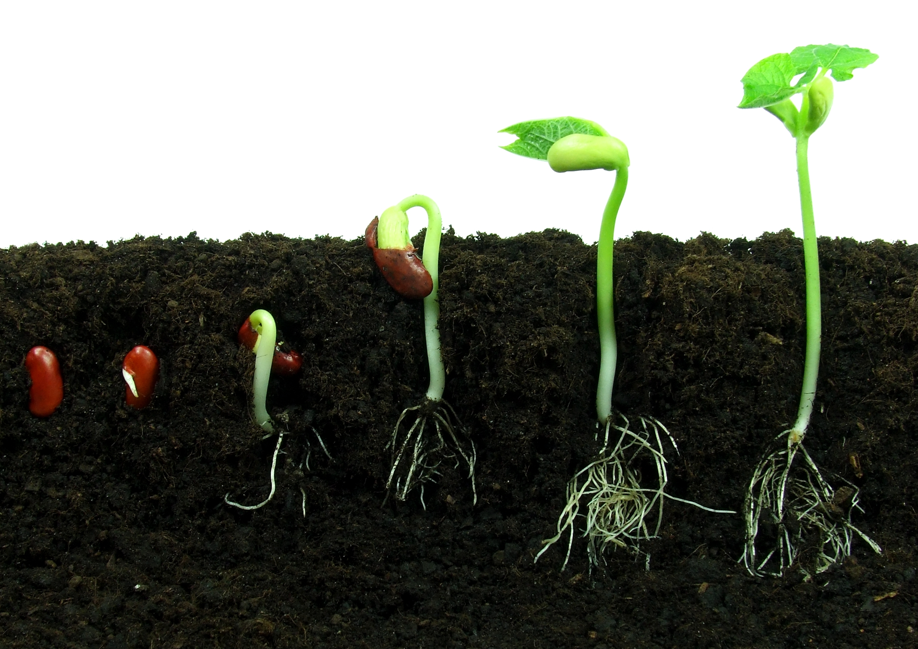
Every seed has to break apart to sprout; it has to surrender to the darkness of mystery in order to emerge. That process can feel excruciating. But it is only when the seed turns to nothing that it can, in fact, become something. Let me repeat that because it is such a stunning truth:
The seed has to turn to nothing to become something.

Slide 14
Chaos
תהלים פרק קכא
(א) שִׁיר לַמַּעֲלוֹת אֶשָּׂא עֵינַי אֶל הֶהָרִים מֵאַיִן יָבֹא עֶזְרִי:
Psalm 121:1
A song for ascents. I shall raise my eyes to the mountains, from where will my help come?
It is precisely out of the void of nothingness and chaos that our help will come. God created the Universe out of chaos, our personal emptiness and void is also the source of our greatest creativity.

Slide 15
Chaos
Sherri Mandell, “The Road to Resilience” p. 7
When it feels that the earth that supported you has been irreparably overturned, there is a promise that new seedlings will one day take root and grow. We are promised a harvest when it seems improbable, when we cannot imagine growth. And this bounty stems from an act of sowing, which is seemingly a more random process than planting. When we plant, we take a seed or seedling and carefully, even gently place it in the ground. If it’s a seedling, it’s visible. We plant in orderly rows. We know what will most likely grow - the shape, the taste, the texture. We know what to expect.
When we sow, on the other hand, we scatter seeds into the dark ground. If you haven t sown that seed, you probably don’t even know that its there. You haven’t put a marker in, written, for example, green beans and the date. You can’t witness the early signs of growth. Sowing is a process of faith. Regardless of the means of planting though, every seed has to disintegrate before it can grow into a fruit or vegetable.

Slide 16
Creativity
The Complete Hebrew – English Dictionary, Reuven Alcalay

Slide 17
Community

Slide 18
Community
תהלים פרק פט
(ג) כִּי אָמַרְתִּי עוֹלָם חֶסֶד יִבָּנֶה שָׁמַיִם תָּכִן אֱמוּנָתְךָ בָהֶם:
Psalms 89:3
For I said, “The World will it be built with kindness; as the heavens, with which You will establish Your faithfulness.”
ויקרא יט:יח
וְאָֽהַבְתָּ֥ לְרֵעֲךָ֖ כָּמ֑וֹךָ אֲנִ֖י יְהוָֽה׃
Leviticus 19:18
Love your fellow as yourself: I am God.

Slide 19
Community
תלמוד בבלי ברכות ה:
רבי חייא בר אבא חלש על לגביה ר' יוחנן א"ל חביבין עליך יסורין א"ל לא הן ולא שכרן א"ל הב לי ידך יהב ליה ידיה ואוקמיה.
Babylonian Talmud Berakhot 5b
The Gemara addresses the issue of suffering and affliction: Rabbi Yochanan’s student, Rabbi Chiya bar Abba, fell ill. Rabbi Yochanan entered to visit him, and said to him: Is your suffering dear to you? Do you desire to be ill and afflicted? Rabbi Chiya said to him: I welcome neither this suffering nor its reward, as one who welcomes this suffering with love is rewarded. Rabbi Yochanan said to him: Give me your hand. Rabbi Chiya bar Abba gave him his hand, and Rabbi Yochanan stood him up and restored him to health.

Slide 20
Community
תלמוד בבלי ברכות ה:
ר' יוחנן חלש על לגביה ר' חנינא א"ל חביבין עליך יסורין א"ל לא הן ולא שכרן א"ל הב לי ידך יהב ליה ידיה ואוקמיה.
Babylonian Talmud Berakhot 5b
Rabbi Yochanan fell ill. Rabbi Chanina entered to visit him, and said to him: Is your suffering dear to you? Rabbi Yochanan said to him: I welcome neither this suffering nor its reward. Rabbi Chanina said to him: Give me your hand. He gave him his hand, and Rabbi Chanina stood him up and restored him to health.

Slide 21
Community
תלמוד בבלי ברכות ה:
אמאי לוקים ר' יוחנן לנפשיה אמרי אין חבוש מתיר עצמו מבית האסורים.
Babylonian Talmud Berakhot 5b
The Gemara asks: Why did Rabbi Yochanan wait for Rabbi Chanina to restore him to health? If he was able to heal his student, let Rabbi Yochanan stand himself up! The Gemara answers, they say: A prisoner cannot free himself from prison, but depends on others to release him from his shackles.

Slide 22
Community
תלמוד בבלי תענית יא.
אֶלָּא יְצַעֵר אָדָם עִם הַצִּבּוּר שֶׁכֵּן מָצִינוּ בְּמֹשֶׁה רַבֵּינוּ שֶׁצִּיעֵר עַצְמוֹ עִם הַצִּבּוּר שֶׁנֶּאֱמַר וִידֵי מֹשֶׁה כְּבֵדִים וַיִּקְחוּ אֶבֶן וַיָּשִׂימוּ תַחְתָּיו וַיֵּשֶׁב עָלֶיהָ וְכִי לֹא הָיָה לוֹ לְמֹשֶׁה כַּר אֶחָד אוֹ כֶּסֶת אַחַת לֵישֵׁב עָלֶיהָ אֶלָּא כָּךְ אָמַר מֹשֶׁה הוֹאִיל וְיִשְׂרָאֵל שְׁרוּיִין בְּצַעַר אַף אֲנִי אֶהְיֶה עִמָּהֶם בְּצַעַר וְכׇל הַמְצַעֵר עַצְמוֹ עִם הַצִּבּוּר זוֹכֶה וְרוֹאֶה בְּנֶחָמַת צִבּוּר.
Babylonian Talmud Taanit 11a
The baraita continues: Rather, a person should be distressed together with the community. As we found with Moses our teacher that he was distressed together with the community, as it is stated during the war with Amalek: “But Moses’ hands were heavy; and they took a stone, and put it under him, and he sat upon it” (Exodus 17:12). But didn’t Moses have one pillow or one cushion to sit upon; why was he forced to sit on a rock? Rather, Moses said as follows: Since the Jewish people are immersed in suffering, I too will be with them in suffering, as much as I am able, although I am not participating in the fighting. The baraita adds: And anyone who is distressed together with the community will merit seeing the consolation of the community.

Slide 23
Choice

Slide 24
Choice
דברים פרק ל פסוק יט
הַעִידֹתִי בָכֶם הַיּוֹם אֶת הַשָּׁמַיִם וְאֶת הָאָרֶץ הַחַיִּים וְהַמָּוֶת נָתַתִּי לְפָנֶיךָ הַבְּרָכָה וְהַקְּלָלָה וּבָחַרְתָּ בַּחַיִּים לְמַעַן תִּחְיֶה אַתָּה וְזַרְעֶךָ:
Deuteronomy 30:19
This day, I call upon the heaven and the earth as witnesses: I have set before you life and death, the blessing and the curse. You shall choose life, so that you and your offspring will live.

Slide 25
Choice
Sherri Mandell, “The Road to Resilience” p. 42
Psychologist Albert Bandura, a professor at Stanford University who studied self-efficacy, a perceived sense of control, confirms that “a large body of research has shown that perceptions of personal control are associated with a variety of positive outcomes such as better physical and mental health psychological well-being, and lower mortality.” According to Holocaust scholar Terrence Des Pres, female prisoners in Auschwitz who chose to care for their physical appearance as much as was possible in the concentration camps had higher survival rates than those women who had given up on self-care. Obviously women in concentration camps had very little control over their lives. Yet choosing simply to wash, an act of will and defiance, signaled a firm choice to maintain ones humanity and survive.
And then there are the times when no choice will protect us. When we lose a loved one, we know that we have no control and we are not in charge. But we may learn that in relinquishing control, we experience a different sense of choice.

Slide 26
Choice
Sherri Mandell, “The Road to Resilience” p. 43
A story by the Maggid of Dubno (Rabbi Jacob Ben Zeev Kranz, born near Vilna in 1741) teaches us the secret of this process:
Once there was a prince who wanted to become a master of archery. One day he happened to be passing through a village in the midst of an archery contest. He stopped to watch the marvelous skill of the contestants. One in particular had an uncanny knack for hitting the target. The prince asked for his secret. “Oh its simple,” the man answered. “First I shoot the arrow, and wherever it lands I paint the bull’s eye around it.”
I shoot the arrow, and wherever it lands I paint the bull's eye around it. We may feel that the arrow we sent into the world has missed the target that we were aiming at. But we have the power to move the target and paint the bull’s eye around the mark our arrow has fallen on. We can extend our desire toward that for

Slide 27
Choice
שמות פרק יט פסוק יח
וְהַר סִינַי עָשַׁן כֻּלּוֹ מִפְּנֵי אֲשֶׁר יָרַד עָלָיו יְקֹוָק בָּאֵשׁ וַיַּעַל עֲשָׁנוֹ כְּעֶשֶׁן הַכִּבְשָׁן וַיֶּחֱרַד כָּל הָהָר מְאֹד:
Exodus 19:18
And the entire Mount Sinai smoked because the Lord had descended upon it in fire, and its smoke ascended like the smoke of the kiln, and the entire mountain quaked violently.
שמות פרק כד פסוק יז
וּמַרְאֵה כְּבוֹד יְקֹוָק כְּאֵשׁ אֹכֶלֶת בְּרֹאשׁ הָהָר לְעֵינֵי בְּנֵי יִשְׂרָאֵל:
Exodus 24:17
And the appearance of the glory of the Lord was like a consuming fire atop the mountain, before the eyes of the children of Israel.

Slide 28
Choice
Sherri Mandell, “The Road to Resilience” p. 45
The experience of receiving the Torah was an experience of fire, a threat of annihilation in the face of the power of God. Rabbi Samson Raphael Hirsch says, “Godliness, taking up its home down here on earth, and wishing to be found down here, always announces itself as fire.”
God isn’t only present in tranquillity. Unlike Greek philosophers such as Plato and Aristotle who perceived God in harmony and beauty, Judaism sees God as also present in chaos and catastrophe, when God communicates in what Rabbi Joseph Dov Soloveitchik calls the “covenantal” mode. Nature’s cosmic mode follows an “unalterable order and sequence,” a logic and beauty that are apparent, graspable, harmonious. The covenantal order, on the other hand, is an apocalyptic dialogue where God is present in the abyss, in the emptiness, in the tohu and vohu.

Slide 29
Creativity

Slide 30
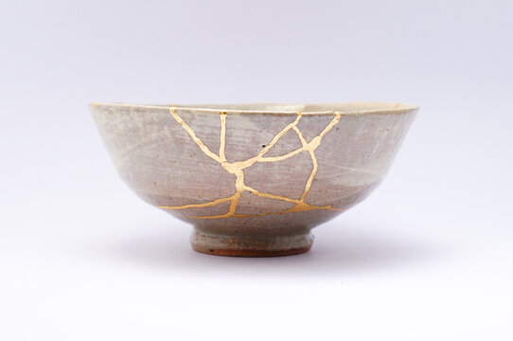
Creativity
KINTSUKUROI (Japanese meaning “to repair with gold”)
When the Japanese mend broken objects, they aggrandize the damage by filling the cracks with gold. They believe that when something's suffered damage and has a history it becomes more beautiful.

Slide 31
Creativity
The Complete Hebrew – English Dictionary, Reuven Alcalay

Slide 32
בראשית פרק א פסוק ג
וַיֹּאמֶר אֱלֹהִים יְהִי אוֹר וַיְהִי אוֹר:
Genesis 1:3
And the Lord said, “Let there be light!” And there was light.

Slide 33
Commemoration

Slide 34
Commemoration
Sherri Mandell, “The Road to Resilience” p. 63-64
In his book Zakhor: Jewish History and Jewish Memory, Jewish history Professor Yosef Yerushalmi teaches that the verb “to remember” is repeated 169 times in the Torah. In addition, the daily morning prayers conclude with six remembrances from the Jewish peoples collective history. These verses describe events that are accompanied by a biblical injunction to remember, or not to forget, such as the Exodus from Egypt, the Giving of the Torah and the sanctity of the Shabbat.
Were commanded to remember because it is so easy to forget. When things are good, we forget the challenges and heartache. In Zakhor, Yerushalmi says, “If the command to remember is absolute, there is, nonetheless, an almost desperate pathos about the biblical concern with memory, and a shrewd wisdom that knows how short and fickle human memory can be.”

Slide 35
Commemoration
Sherri Mandell, “The Road to Resilience” p. 65
The Bible abounds with verses commanding the Jewish people to remember that they were slaves in Egypt, and expecting them, as a result of that suffering, to be more compassionate, and to seek justice and equality. Rabbi Joseph Soloveitchik notes that ethics are not born in tranquility. Our pain — and others — is what allows us to internalize ethical behavior, not just intellectually, but with our entire beings, to embody such behavior, and not just admire it.
One of the powers of Camp Koby is the opportunity for children to form protective memories that nourish them. One summer day at Camp Koby, Shemaya, a seventeen-year-old counselor, told my husband and me about Tomer, a ten-year-old camper, who had become unusually agitated when a fellow camper was injured. Tomer’s father had died of injuries from a car accident, and the sight of his friend lying on the field reminded him of the terrible days of his dad’s coma. Shemaya continued to relate:

Slide 36
Commemoration
Sherri Mandell, “The Road to Resilience” p. 65
I didn’t know what to say, I felt so bad. But then I thought of something I’d learned in the counselor training. I said to him, “Can you tell me about your father? What did your father like to do?” He said, “Sailing. Playing sports, especially basketball.” I asked him, “Do you want to go play basketball with me, right now?” We went to the basketball court and started to play. Tomer said, “My father said that you put your hands on the ball like this.”
After that we went to the basketball court every night together, with Tomer coaching me the way his father had taught him. Shemaya not only gave Tomer a positive way of remembering his father - he also empowered Tomer to embody his father. Tomer was able to transmit his father’s teachings, his voice. Tomer’s memory of pain may well now be surrounded with loving memories, both of his father and of his counselor.

Slide 37
Consecration

Slide 38
Consecration
שמות פרק ג
(א) וּמֹשֶׁה הָיָה רֹעֶה אֶת צֹאן יִתְרוֹ חֹתְנוֹ כֹּהֵן מִדְיָן וַיִּנְהַג אֶת הַצֹּאן אַחַר הַמִּדְבָּר וַיָּבֹא אֶל הַר הָאֱלֹהִים חֹרֵבָה: (ב) וַיֵּרָא מַלְאַךְ יְקֹוָק אֵלָיו בְּלַבַּת אֵשׁ מִתּוֹךְ הַסְּנֶה וַיַּרְא וְהִנֵּה הַסְּנֶה בֹּעֵר בָּאֵשׁ וְהַסְּנֶה אֵינֶנּוּ אֻכָּל: (ג) וַיֹּאמֶר מֹשֶׁה אָסֻרָה נָּא וְאֶרְאֶה אֶת הַמַּרְאֶה הַגָּדֹל הַזֶּה מַדּוּעַ לֹא יִבְעַר הַסְּנֶה: ... (יד) וַיֹּאמֶר אֱלֹהִים אֶל מֹשֶׁה אֶהְיֶה אֲשֶׁר אֶהְיֶה וַיֹּאמֶר כֹּה תֹאמַר לִבְנֵי יִשְׂרָאֵל אֶהְיֶה שְׁלָחַנִי אֲלֵיכֶם:
Exodus 3:1-3, 14
1. Moses was pasturing the flocks of Jethro, his father in law, the chief of Midian, and he led the flocks after the free pastureland, and he came to the mountain of God, to Horeb. 2. An angel of the Lord appeared to him in a flame of fire from within the thorn bush, and behold, the thorn bush was burning with fire, but the thorn bush was not being consumed. 3. So Moses said, "Let me turn now and see this great spectacle why does the thorn bush not burn up?“ … 14. God said to Moses, "Ehyeh asher ehyeh (I will be what I will be)," and He said, "So shall you say to the children of Israel, 'Ehyeh (I will be) has sent me to you.'"

Slide 39
Consecration
Sherri Mandell, “The Road to Resilience” p. 76
A midrash states that, along with Moses, there were many shepherds in the area, but not one stopped to view the burning bush. None had the curiosity or courage. Perhaps
they were afraid, or distracted, or simply too involved with ordinary life. Moses turned to see, to look, to behold. And once he witnessed the burning bush, God spoke to him and
told him that he was the one who would lead the Jews out of Egypt, from their slavery. Moses was told to take off his shoes, as the priests do when they serve in the Temple, as mourners do during a shiva. He had been called into divine service, received his sacred mission.
We ourselves have become burning bushes, suffused with loss. There are losses in our life that burn forever, yet we can burn without being destroyed. Most people are oblivious to this world of burning. So many bereaved people tell me that others ask them, “You’re over it, right? I mean it’s been a few years now.”

Slide 40
Consecration
Sherri Mandell, “The Road to Resilience” p. 76
But the burning bush is a symbol of hope for Moses and for the Jewish people throughout the ages, a message of resilience. Even when we fear chat our personal loss may destroy us the burning bush tells us that we will not only endure but will discover an impassioned and urgent mission, a sense of destiny.
At the burning bush, when Moses asks what name he should use to refer to God when he returns to the Hebrew people, God says, “I will be what I will be.” This name shows that God Himself is not fixed or static but is in a process of becoming. We too are in a passage of becoming. Abraham Joshua Heschel says, “Creation, we are taught, is not an act that happened once upon a time, once and for ever. The act of bringing the world into existence is a continuous process. God called the world into being. That call goes on.”

Slide 41
Celebration

Slide 42
Celebration
שמות פרק כ פסוק יד
וְכָל הָעָם רֹאִים אֶת הַקּוֹלֹת וְאֶת הַלַּפִּידִם וְאֵת קוֹל הַשֹּׁפָר וְאֶת הָהָר עָשֵׁן וַיַּרְא הָעָם וַיָּנֻעוּ וַיַּעַמְדוּ מֵרָחֹק:
Exodus 20:14
And all the people saw the voices and the flames, the sound of the shofar, and the smoking mountain, and the people saw and trembled; so they stood from afar.

Slide 43
Celebration
מדרש תנחומא שמות כה
בֹּא וּרְאֵה הֵיאַךְ הָיָה הַקּוֹל יוֹצֵא אֵצֶל יִשְׂרָאֵל, כָּל אֶחָד וְאֶחָד לְפִי כֹּחוֹ. הַזְּקֵנִים הָיוּ שׁוֹמְעִין אֶת הַקּוֹל לְפִי כֹּחָן, וְהַבַּחוּרִים לְפִי כֹּחָן, וְהַנְּעָרִים לְפִי כֹּחָן, וְהַקְּטַנִּים לְפִי כֹּחָן, וְהַיּוֹנְקִים לְפִי כֹּחָן, וְהַנָּשִׁים לְפִי כֹּחָן. וְאַף מֹשֶׁה לְפִי כֹּחוֹ, שֶׁנֶּאֱמַר: מֹשֶׁה יְדַבֵּר וְהָאֱלֹהִים יַעֲנֶנּוּ בְקוֹל (שמות יט, יט). בְּקוֹל שֶׁהָיָה יָכוֹל מֹשֶׁה לִסְבֹּל. וְכֵן הוּא אוֹמֵר: קוֹל ה' בַּכֹּחַ (תהלים כט, ד). בְּכֹחוֹ לֹא נֶאֱמַר אֶלָּא בַּכֹּחַ, שֶׁכָּל אֶחָד וְאֶחָד מֵהֶן יָכוֹל לִסְבֹּל. וְאַף הַנָּשִׁים הַמְעֻבָּרוֹת כְּפִי כֹּחָן. הֱוֵי אוֹמֵר: כָּל אֶחָד וְאֶחָד לְפִי כֹּחוֹ.
Midrash Tanchuma Shemos 25
Observe that His voice went forth to each Israelite in accordance with the individual’s capacity to receive it. The elders, the men, the youths, the little ones, the sucklings—each heard it according to his own capacity. Even Moses heard it according to his capacity, as it is said: Moses spoke, and God answered him by (with) a voice (Exod. 19:19); that is, with a voice that Moses was able to comprehend. Thus, it says: The voice of the Lord was powerful with strength (Ps. 29:1). “With His strength” is not written in this verse, but rather with strength, that is, according to the strength of each individual (to tolerate the sound). Even the pregnant women heard it in accordance with their strength. Therefore it says: Each one of them according to their strength.

Slide 44
Celebration
אָמַר רַבִּי יוֹסִי בַּר חֲנִינָא: אִם תָּמֵהַּ אַתָּה עַל הַדָּבָר, לְמַד מִן הַמָּן, שֶׁלֹּא הָיָה יוֹרֵד לָהֶם לְיִשְׂרָאֵל אֶלָּא לְפִי כֹּחַ שֶׁל כָּל אֶחָד וְאֶחָד מֵהֶם. הַבַּחוּרִים הָיוּ אוֹכְלִין אוֹתוֹ כַּלֶּחֶם, שֶׁנֶּאֱמַר: הִנְנִי מַמְטִיר לָכֶם לֶחֶם מִן הַשָּׁמָיִם (שמות טז, ד). הַזְּקֵנִים, כְּצַפִּיחִית בִּדְבַשׁ, שֶׁנֶּאֱמַר: וְטַעְמוֹ כְּצַפִּיחִת בִּדְבָשׁ (שמות טז, לא). וְהַיּוֹנְקִים, כְּחָלָב מִשְּׁדֵי אִמָּם, שֶׁנֶּאֱמַר: וְהָיָה טַעְמוֹ כְּטַעַם לְשַׁד הַשָּׁמֶן (במדבר יא, ח). וְהַחוֹלִים, כְּסֹלֶת מְעֹרָב בִּדְבַשׁ, שֶׁנֶּאֱמַר: וְלַחְמִי אֲשֶׁר נָתַתִּי לָךְ סֹלֶת וָשֶׁמֶן וּדְבַשׁ (יחזקאל טז, יט). וְהַגּוֹיִם הָיוּ טוֹעֲמִין אוֹתוֹ מַר כַּגַּד, שֶׁנֶּאֱמַר: וְהַמָּן כִּזְרַע גָּד (שמות טז, לא).
R. Yosé the son of Hanina stated: If you are amazed at this remember, that the manna descended for each Israelite with a taste that varied according to the needs of each individual. The young men, for instance, ate it as bread, as it is said: Behold, I will cause to rain bread from heaven for you (Exod. 16:4); the elders ate it as wafers of honey, as it is said: And the taste of it was like wafers made with honey (ibid., v. 31); the sucklings, as milk from the breasts of their mothers, as is said: And the taste of it was as the taste of a cake baked with oil (Num. 11:8);32 for the ill, as fine flour mixed in honey, as it is said: Thou didst eat fine flour, and honey, and oil (Exod. 16:13); and the gentiles who tasted it found it as bitter as coriander seed, as is said: Now the manna was like coriander seed (Num. 11:7).

Slide 45
Celebration
אָמַר רַבִּי יוֹסִי בַּר חֲנִינָא: וּמָה אִם הַמָּן שֶׁהָיָה מִין אֶחָד, נֶהְפַּךְ לָהֶן לְמִינִין הַרְבֵּה בִּשְׁבִיל צֹרֶךְ כָּל אֶחָד וְאֶחָד. הַקּוֹל שֶׁהָיָה יוֹצֵא וְהָיָה בּוֹ כֹּחַ, עַל אַחַת כַּמָּה וְכַמָּה שֶׁהָיָה מִשְׁתַּנֶּה לְכָל אֶחָד וְאֶחָד לְפִי כֹּחוֹ כְּדֵי שֶׁלֹּא יִנָּזְקוּ. וּמִנַּיִן שֶׁהַקּוֹל נֶחֱלַק לְקוֹלוֹ הַרְבֵּה, שֶׁנֶּאֱמַר: וְכָל הָעָם רֹאִים אֶת הַקּוֹלֹת (שמות כח, ט). הַקּוֹל אֵין כְּתִיב כָאן אֶלָּא הַקּוֹלֹּת. הֱוֵי, יַרְעֵם אֵל בְּקוֹלוֹ נִפְלָאוֹת.
R. Yosé the son of Hanina stated further that just as the manna, which was actually of one kind, could change into different kinds (tastes), because of the requirements of each of them, so could the voice that went forth change for each of them according to the individual’s ability to hear it, so that no harm might befall him. Whence do we know that the voice divided itself into many sounds? It is said: And all the people perceived the thunderings. The plural thunderings is written, and not the singular “thundering.” Therefore, God thundereth marvelously with His voice (Job 37:5).

Slide 46
Celebration
Sherri Mandell, “The Road to Resilience” p. 89
Abraham Joshua Heschel says, “Every moment is [God’s] subtle arrival and man’s task is to be present.” Chaos, tohu in Aramaic, means “Why?” With the plunge into the great mystery of mortality and meaning and darkness, you have been cmbold- ened to profoundly question, to change, to grow larger, to express what was there waiting but concealed.
You have experienced an expanded sense of God’s presence, in sadness and in happiness. For you are aware that the tohu, the chaos and despair and confusion that you have endured, is not only desolation and nothingness. It is not the absence of God but rather God’s presence, a vast expanse where you w-cre pushed and prodded and propelled to develop your hidden capacities and create and build, to discover your destiny, to forge identity, and repair the world.
In that germination and development, in that flowering, there is joy.

Slide 47
Jacob and the Angel

Slide 48
Jacob and the Angel
בראשית פרק לב
(כה) וַיִּוָּתֵר יַעֲקֹב לְבַדּוֹ וַיֵּאָבֵק אִישׁ עִמּוֹ עַד עֲלוֹת הַשָּׁחַר: (כו) וַיַּרְא כִּי לֹא יָכֹל לוֹ וַיִּגַּע בְּכַף יְרֵכוֹ וַתֵּקַע כַּף יֶרֶךְ יַעֲקֹב בְּהֵאָבְקוֹ עִמּוֹ: (כז) וַיֹּאמֶר שַׁלְּחֵנִי כִּי עָלָה הַשָּׁחַר וַיֹּאמֶר לֹא אֲשַׁלֵּחֲךָ כִּי אִם בֵּרַכְתָּנִי:
Genesis 32:25-27
25. And Jacob was left alone, and a man wrestled with him until the break of dawn. 26. When he saw that he could not prevail against him, he touched the socket of his hip, and the socket of Jacob's hip became dislocated as he wrestled with him. 27. And he (the angel) said, "Let me go, for dawn is breaking," but he (Jacob) said, "I will not let you go unless you have blessed me."

Slide 49
Jacob and the Angel
Rabbi Sacks ז"ל, How Jacob conquered the defining crisis of his life
Somehow, within every crisis lies the glorious possibility of rebirth. I have found, and so surely have many others, that the events that at the time were the most painful, were also those that in retrospect most caused us to grow. They helped us to make difficult but necessary decisions. They forced us to ask: “Who am I and what really matters to me?” They moved us from the surface to the depths, where we discovered strengths we did not know we had, and a clarity of purpose we had hitherto lacked. I have learnt to say to every crisis: “I will not let you go until you bless me.”
The struggle is not easy. Though Jacob was undefeated, after it he “limped”. Battles leave scars. Yet God is with us even when he seems to be against us. For if we refuse to let go of him, He refuses to let go of us, giving us the strength to survive and emerge stronger, wiser, blessed.

Slide 50
Adam and Eve:
Starting From Now

Slide 51
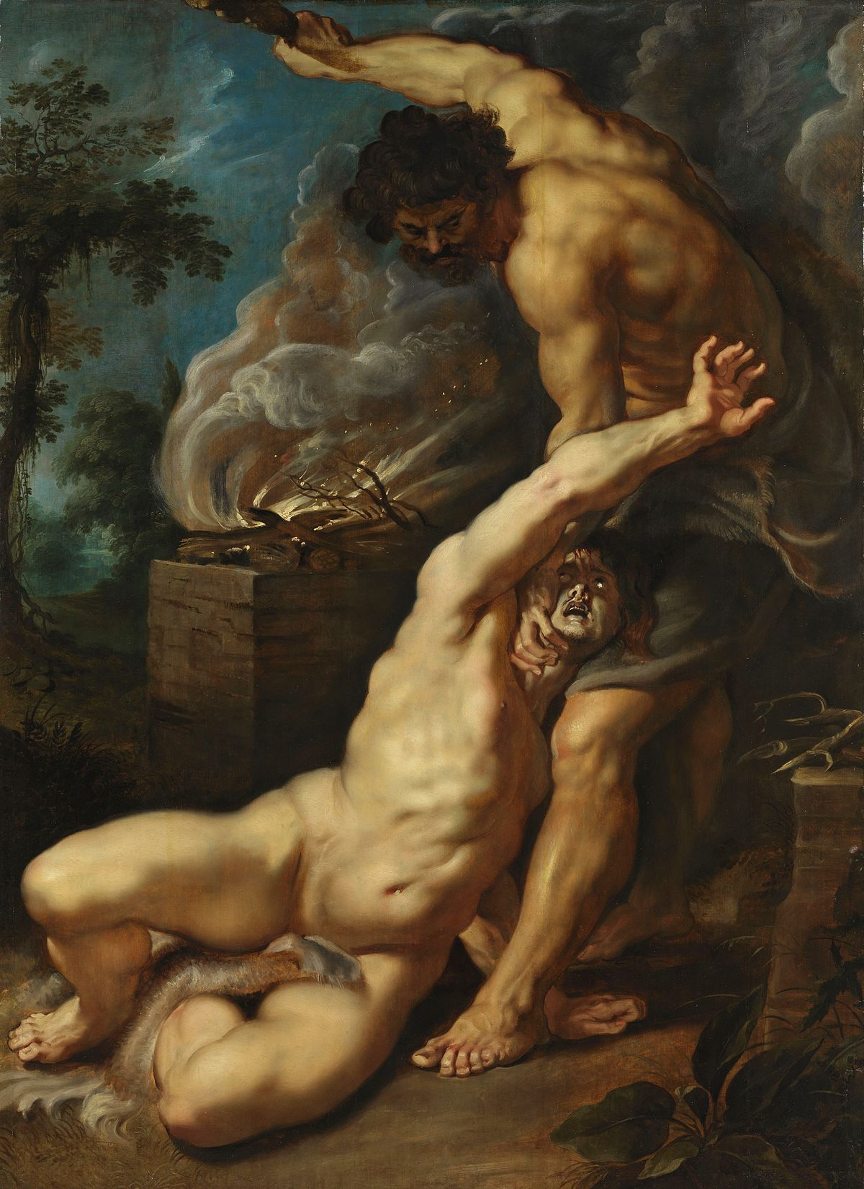
Cain slaying Abel
Peter Paul Rubens (1577–1640)

Slide 52
Adam and Eve: Starting From Now
בראשית פרק ד
(א) וְהָאָדָם יָדַע אֶת חַוָּה אִשְׁתּוֹ וַתַּהַר וַתֵּלֶד אֶת קַיִן וַתֹּאמֶר קָנִיתִי אִישׁ אֶת יְקֹוָק: (ב) וַתֹּסֶף לָלֶדֶת אֶת אָחִיו אֶת הָבֶל וַיְהִי הֶבֶל רֹעֵה צֹאן וְקַיִן הָיָה עֹבֵד אֲדָמָה: ... (ח) וַיֹּאמֶר קַיִן אֶל הֶבֶל אָחִיו וַיְהִי בִּהְיוֹתָם בַּשָּׂדֶה וַיָּקָם קַיִן אֶל הֶבֶל אָחִיו וַיַּהַרְגֵהוּ: (ט) וַיֹּאמֶר יְקֹוָק אֶל קַיִן אֵי הֶבֶל אָחִיךָ וַיֹּאמֶר לֹא יָדַעְתִּי הֲשֹׁמֵר אָחִי אָנֹכִי: (י) וַיֹּאמֶר מֶה עָשִׂיתָ קוֹל דְּמֵי אָחִיךָ צֹעֲקִים אֵלַי מִן הָאֲדָמָה: ... (כה) וַיֵּדַע אָדָם עוֹד אֶת אִשְׁתּוֹ וַתֵּלֶד בֵּן וַתִּקְרָא אֶת שְׁמוֹ שֵׁת כִּי שָׁת לִי אֱלֹהִים זֶרַע אַחֵר תַּחַת הֶבֶל כִּי הֲרָגוֹ קָיִן:
Genesis 4
1. Now the man knew his wife Eve, and she conceived and bore Cain, and she said, "I have acquired a man with the Lord." 2. And she continued to bear his brother Abel, and Abel was a shepherd of flocks, and Cain was a tiller of the soil. … 8. And Cain spoke to Abel his brother, and it came to pass when they were in the field, that Cain rose up against Abel his brother and slew him. 9. And the Lord said to Cain, "Where is Abel your brother?" And he said, "I do not know. Am I my brother's keeper?" 10. And He said, "What have you done? Behold! Your brother's blood cries out to Me from the earth. …
25. And Adam knew his wife again, and she bore a son, and she named him Seth, for God has given me other seed, instead of Abel, for Cain slew him.

Slide 53
Adam and Eve: Starting From Now
Elie Wiesel ‘Messengers of God’ pp. 28-29
Not content to live with the vestiges of the past, Adam and Eve planned their future. They built a house on the ruins of their shattered existence. Alone. Without outside help. They worked on fashioning their future, their own immortality. Eve bore Adam two sons, Cain and Abel. In the apocryphal “The Testament of Henoch” we find the following tale. One morning Eve tells her husband: I had a nightmare; I saw Cain kill his brother . . . The first nightmare in history. And like the others, it later came true.
The years went by. The couple had a third son, Seth. They loved him; he was their hope. One Midrash has it that Adam gave him a book and that this book was the Torah. He thus placed on Seth the responsibility of trans- mitting its teachings to his sons and their sons after them, to the end of all generations.

Slide 54
Adam and Eve: Starting From Now
Rabbi Dr. Isaac Bernstein זצ"ל in a public address on Teshuva
“Adam HaRishon comes home one day, and he finds that one son is murdered and the other son a murderer. What do parents do when [they are] confronted with a scene like that? … Did they throw in the towel? Did they give up in despair? Says Elie Wiesel – you know what they did? They had another son.
The koach [strength] of Adam of Rishon was not the ability to start a world because that had nothing to do with him. He was born into this world created by HaKadosh Baruch Hu as the first man. The koach of Adam of Rishon was not the ability to start a world, it was the ability to start again. To say despite what has gone on before, now is the time to make a new start, a new beginning. As the Chasid said, “Bereishis bara Elokim – Hashem created beginnings” … the ability to see in every year, in every day [Psalms 115:18] “וַאֲנַחְנוּ נְבָרֵךְ יָהּ מֵעַתָּה וְעַד עוֹלָם” [But we shall bless God from now and for evermore] - to start from now.”

Slide 55
Conclusions and Questions

Slide 56
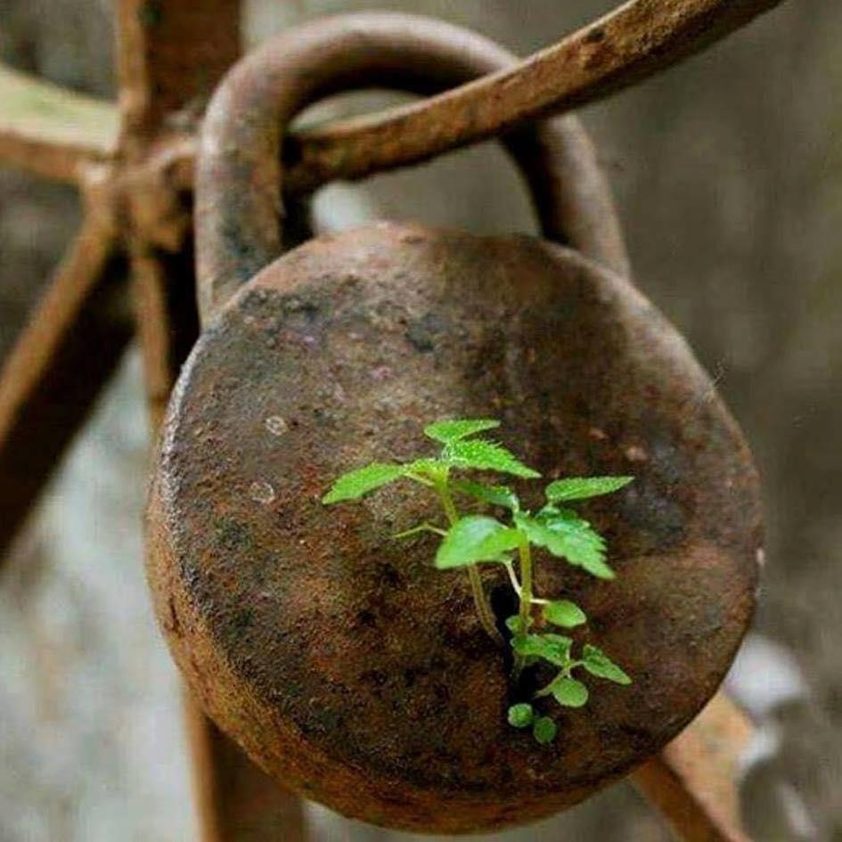

Slide 57
Thank You
rabbi@newwestend.org.uk
07531 326289
@moshefreedman

