Slide 1
COP26: The Jewish Perspective on Climate Change and the Environment
Rabbi Dr Moshe Freedman Jewish Chaplain – Canary Wharf Multifaith Chaplaincy
Rabbi, New West End Synagogue

Slide 2
Summary
The Jewish View of the Natural world
- L’ovdah u’leshomrah
The Imperative to Safeguard the Environment
- Rabbi Chaninah ben Dosa and the Carob tree
Kashrut
Vegetarianism and Veganism

Slide 3
Introduction

Slide 4
CLIMATE CHANGE

Slide 5
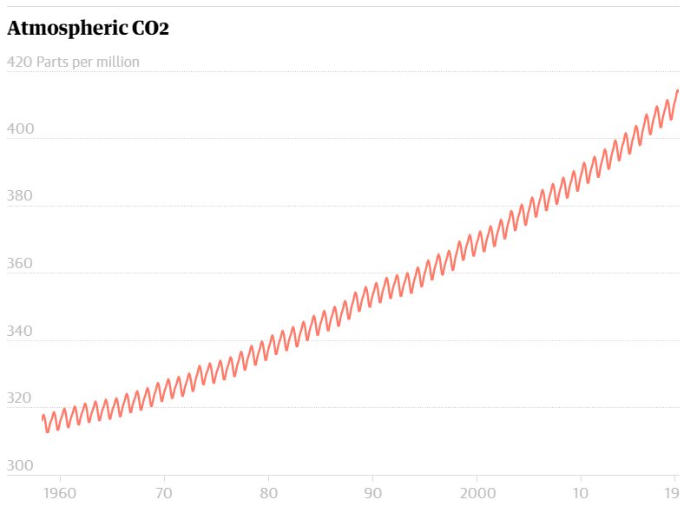
Global warming due to CO2 emissions — which according to the UN have increased by almost 50% since 1990 — is accelerating climate change and threatens the survival of millions of people, plants and animals by causing meteorological events like droughts, fires and floods, which are becoming increasingly frequent and more extreme.

Slide 6
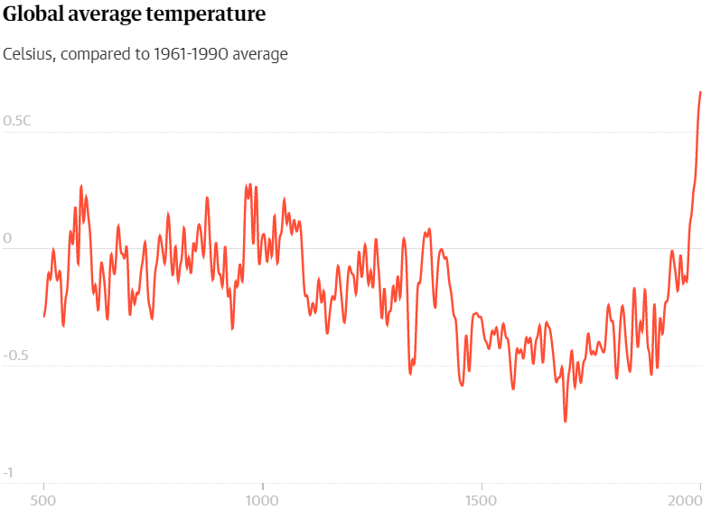
This means we need to take measures to mitigate its effects and adapt to its consequences which, even if we keep global warming under 2 ºC as required by the Paris Agreements, will last for centuries.

Slide 7
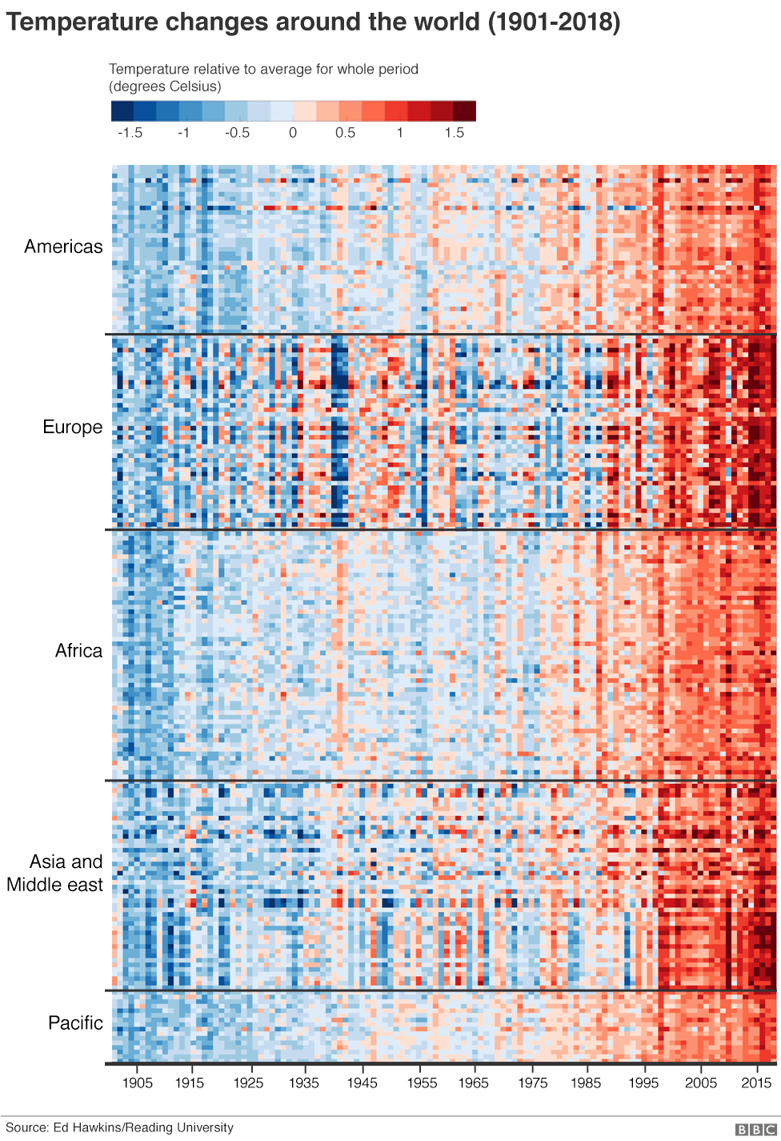
Americas
Europe
Africa
Asia and Middle East
Pacific
1905
1955
2015

Slide 8
POLLUTION

Slide 9
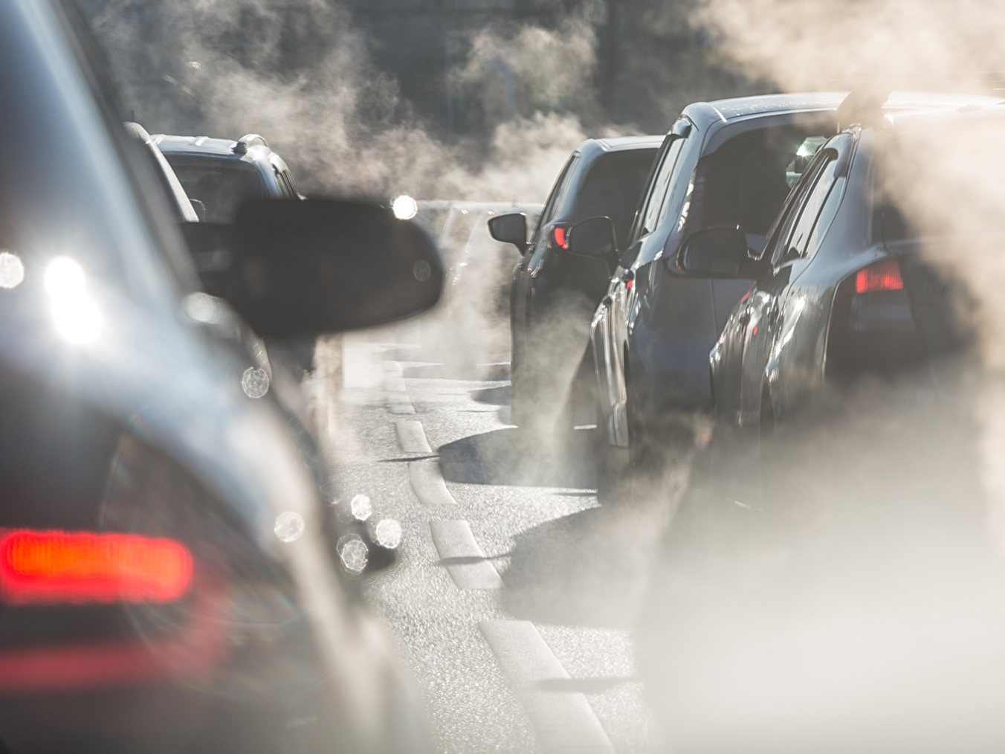
The World Health Organization (WHO) estimates that 90% of humanity breathes polluted air, so is calling for a reduction in air pollution to cut rates of respiratory illnesses, thus preventing seven million deaths a year. Contaminated water also causes major health problems and five million deaths a year according to Oxfam Intermón. The UN advocates eliminating dumping, minimising the use of chemicals and treating more wastewater, among other measures.

Slide 10
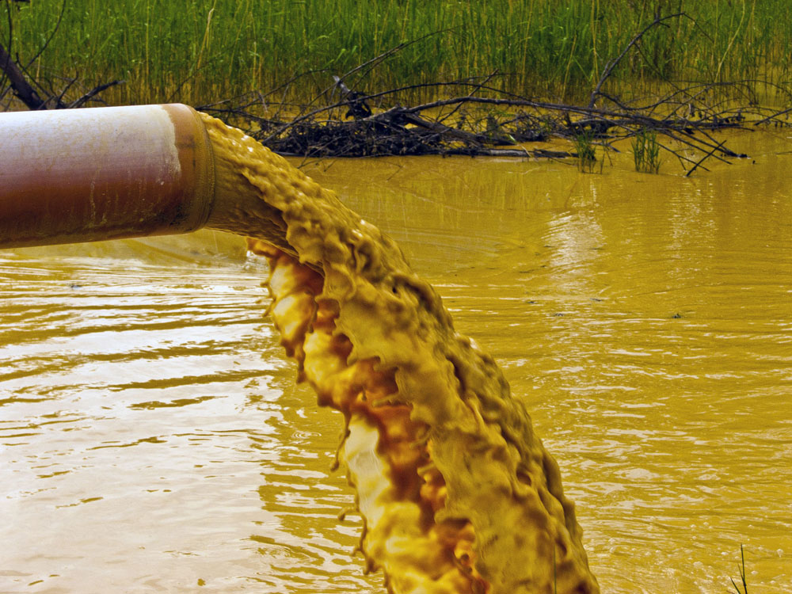

Slide 11
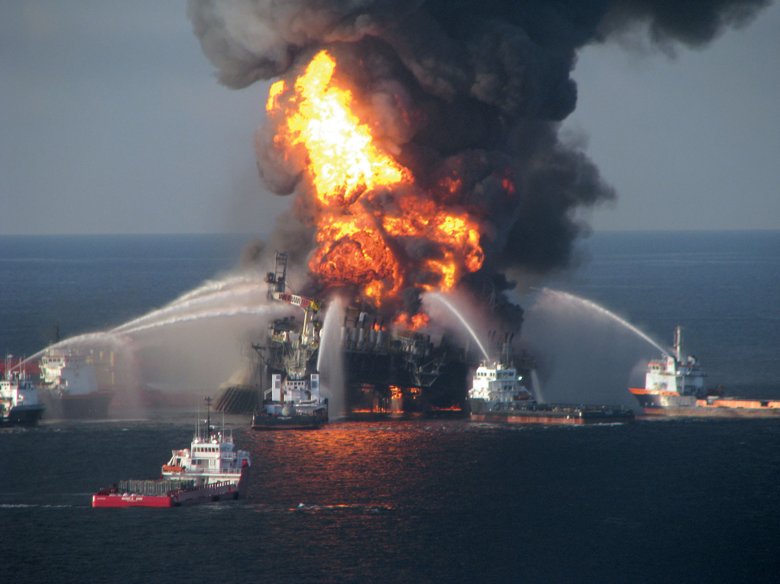

Slide 12
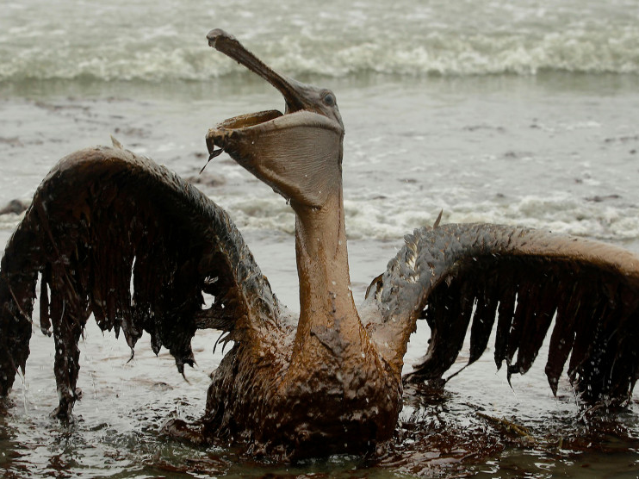

Slide 13
OCEANS

Slide 14
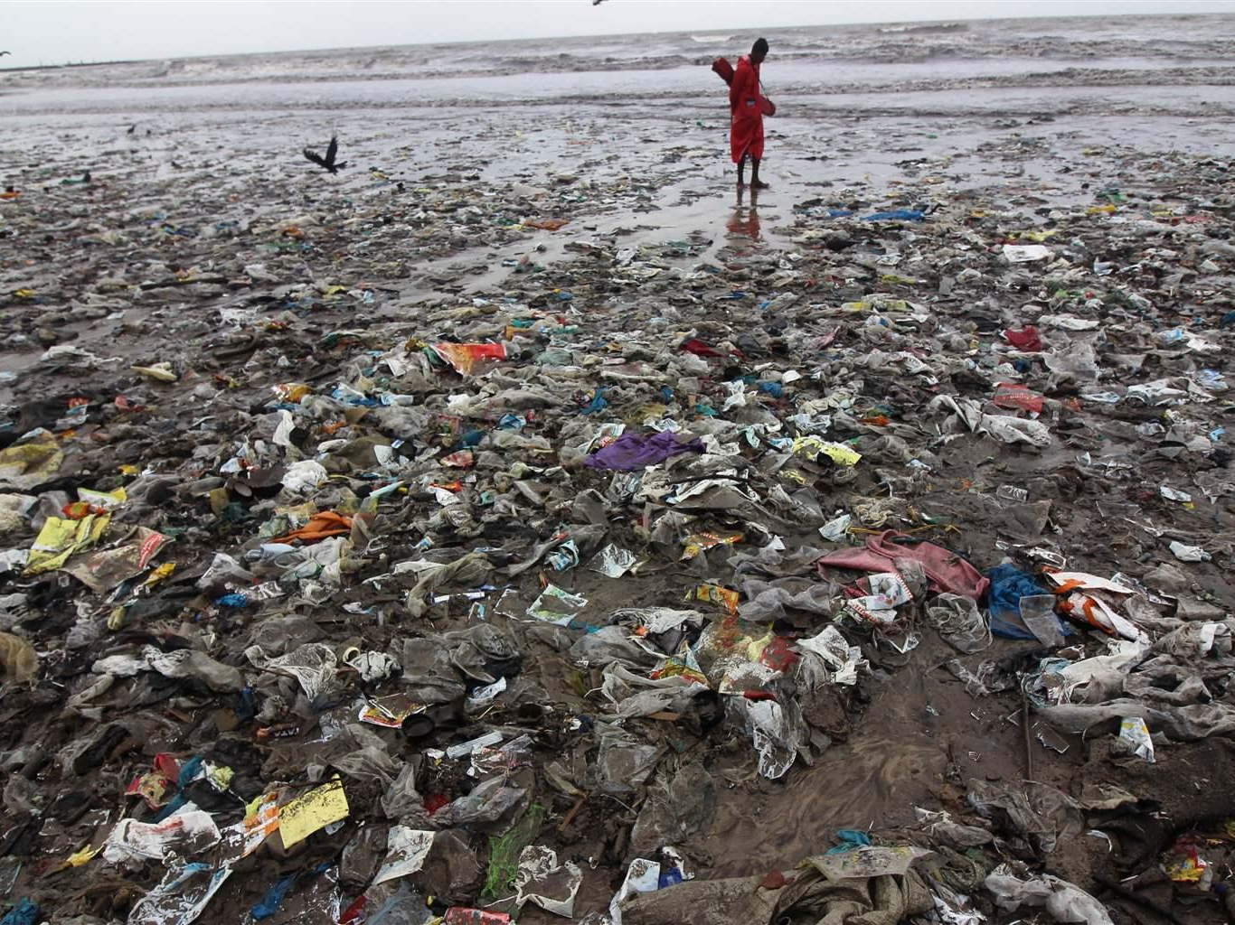
The oceans have become the giant waste dumps for plastic. What's more, there are other serious environmental problems related to the oceans such as damage to ecosystems due to global warming, dumping of pollutants, wastewater and fuel spills. The UN calls for improved management of protected areas, giving them sufficient resources, and reducing overfishing, pollution and acidification of the ocean caused by the increase in the earth's temperature.

Slide 15
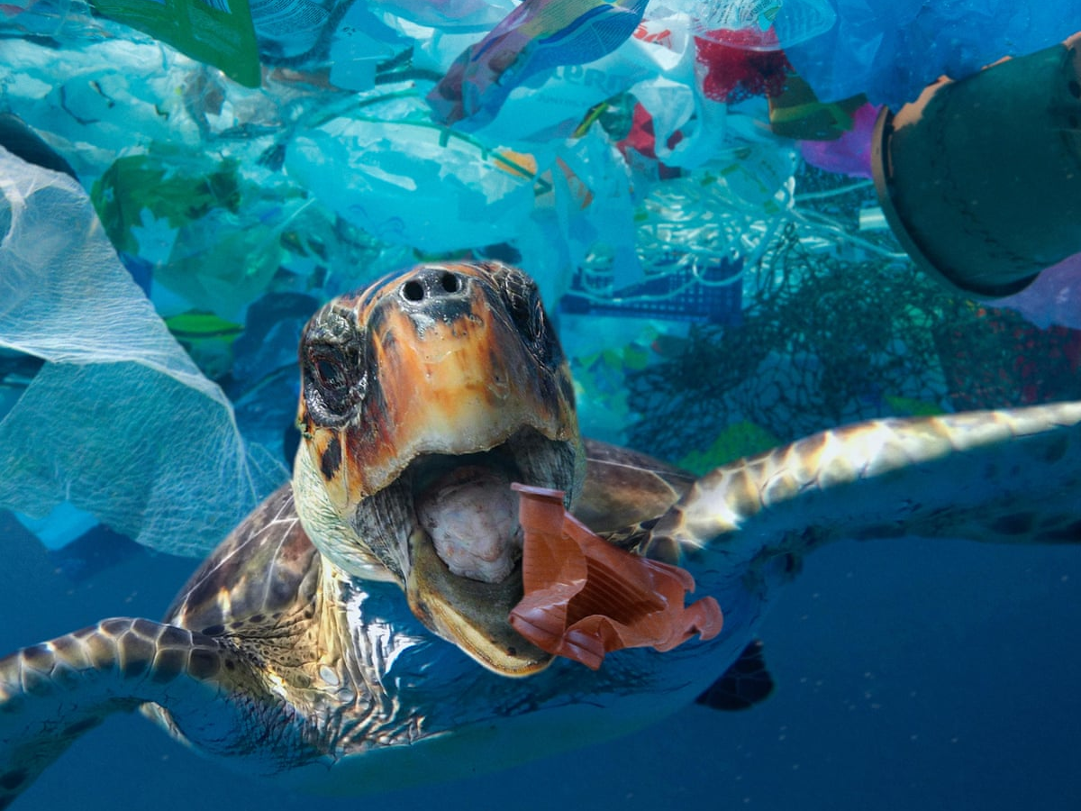

Slide 16
RENEWABLE ENERGY

Slide 17
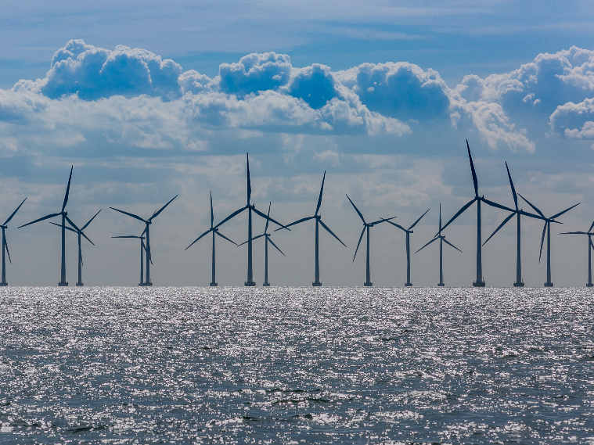
While energy accounts for 60% of global greenhouse gas (GHG) emissions, the UN calculates that 13% of the world population lacks access to electricity and that 3 billion people depend on fossil fuels for cooking. This situation requires an energy transition towards a cleaner, more accessible and efficient model based on the use of renewable energy sources to build communities that are more sustainable, inclusive and resistant to environmental problems like climate change.

Slide 18
SUSTAINABLE FOOD

Slide 19
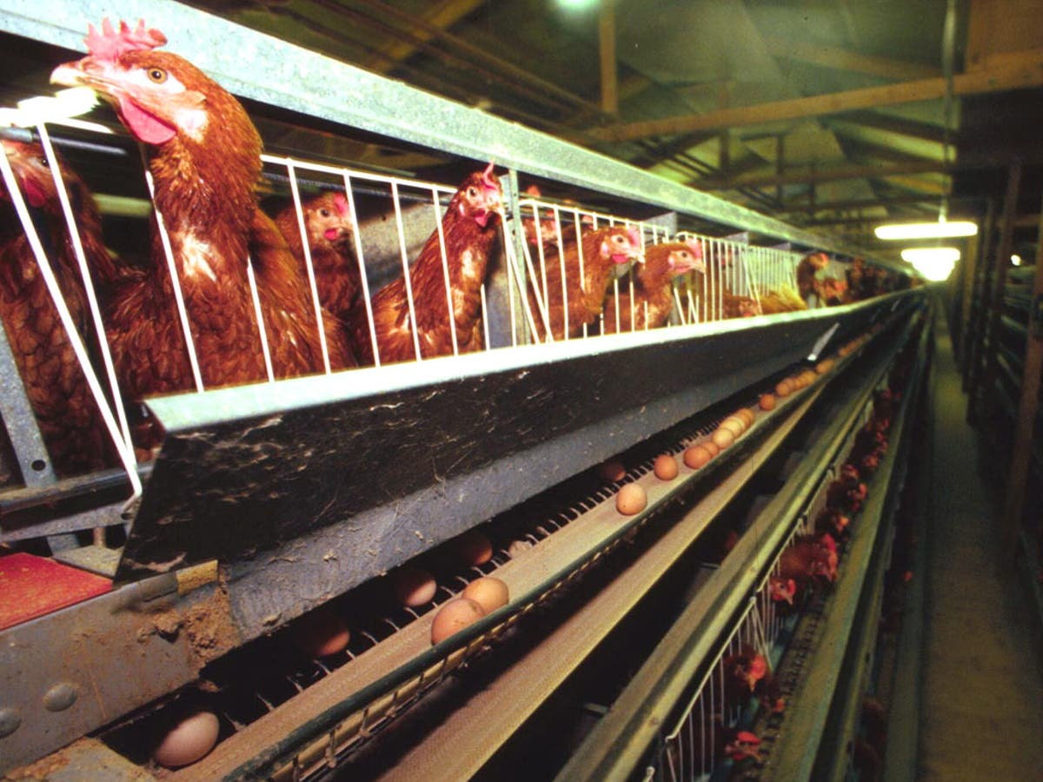
Intensive food production harms the environment by depleting the soil and damaging marine ecosystems. What's more, overexploitation of natural resources has put food safety and the availability of drinking water at risk. The UN considers it essential to change the food production model and our food habits, including a more plant-based diet featuring local ingredients to save energy and reduce CO2 emissions.

Slide 20
BIODIVERSITY

Slide 21
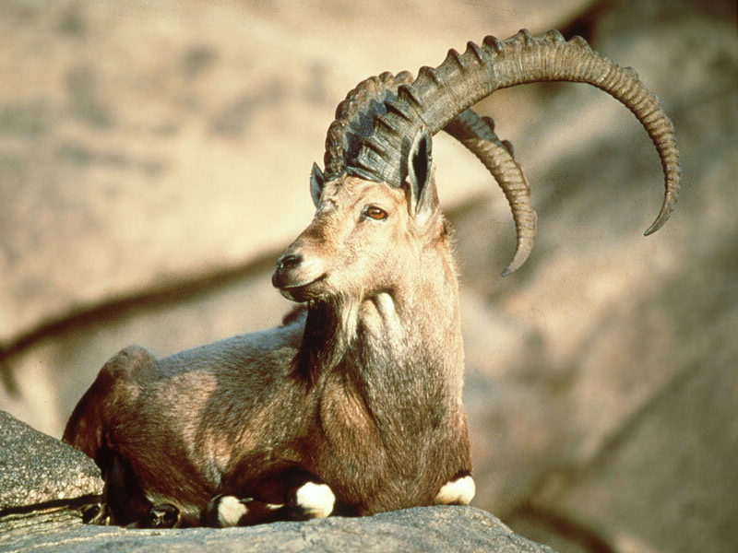
We have already lost 8% of known animal species and 22% are at risk of extinction due mainly to the destruction of their natural habitats, poaching and the introduction of invasive species. The UN has called for conclusive actions to put an end to these threats and conserve our natural heritage, including our increasingly threatened forests.

Slide 22
URBAN DEVELOPMENT

Slide 23
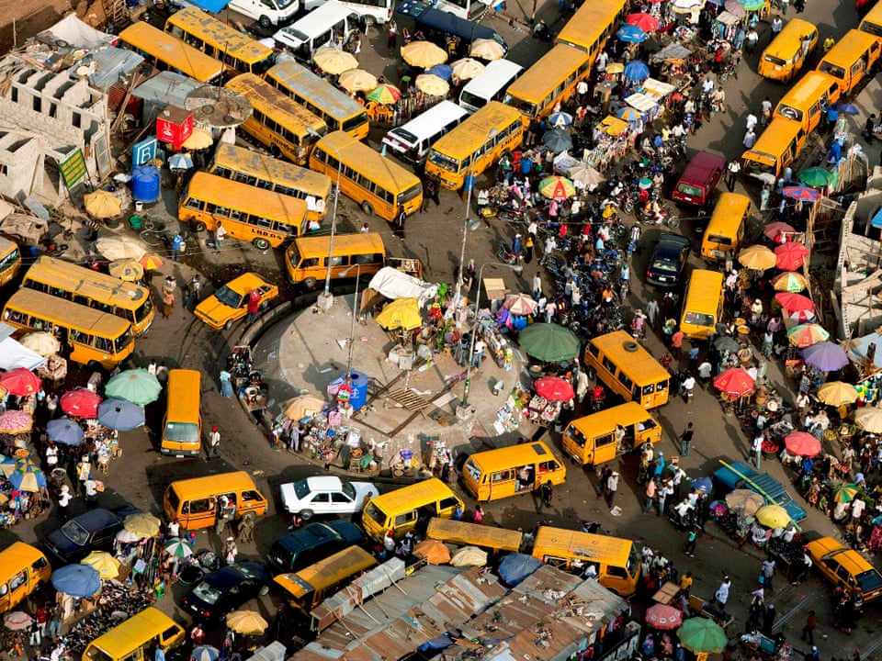
The growth of cities, which will need to accommodate around 5 billion people by 2030, will be another of the decade's big environmental challenges. The metropolises of the future will need to be compact, safe, inclusive, ecological and energy efficient, with more green spaces, more environmentally friendly buildings and more sustainable methods of transport which put the needs of pedestrians above those of traffic.

Slide 24
WATER

Slide 25
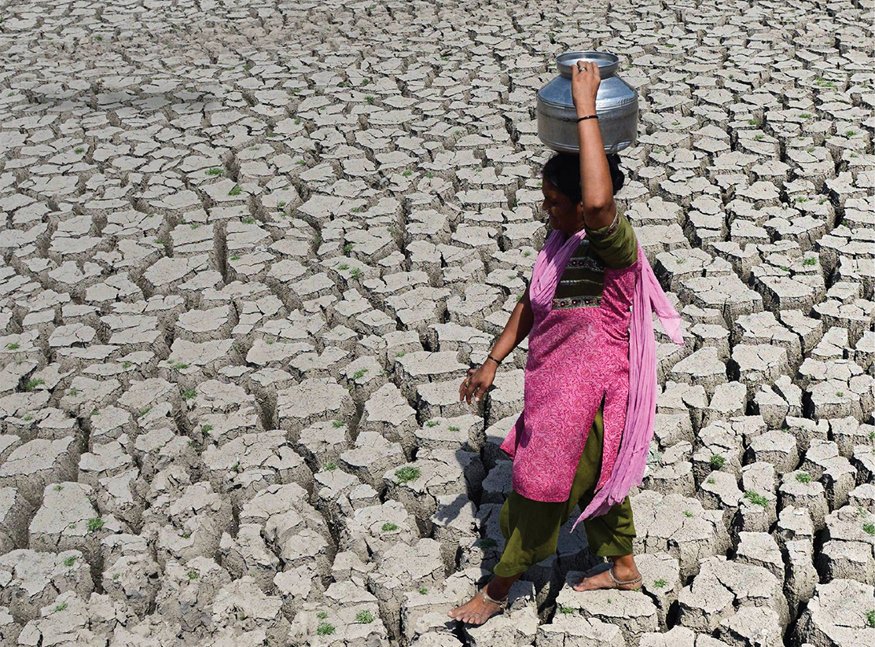
The lack water, vital to human, animal and plant survival, affects more than 40% of the world population, and according to the World Economic Forum, agriculture accounts for more than 70% of the water used in the planet's most arid countries. The responsible use of hydrological resources will improve food and energy production, as well as protecting the biodiversity of our water ecosystems and helping us slow climate change.

Slide 26
EXTREME WEATHER

Slide 27
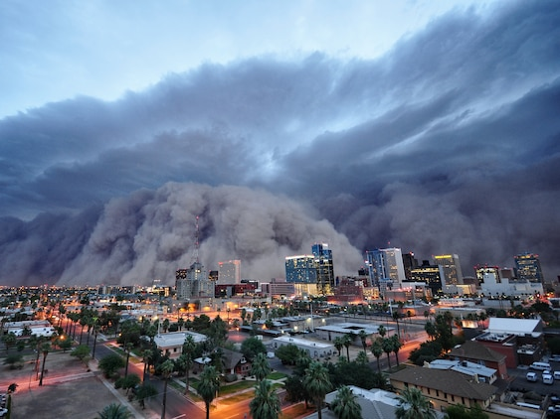
Global warming is causing increasingly frequent, intense and devastating droughts, hurricanes and heatwaves. Keeping temperatures stable, as has been championed in negotiations at the highest level, as well as improving our capacity to respond to climate emergencies, are the keys to minimising the number of these catastrophes, adapting to them, and defending ourselves from them.

Slide 28
OVERPOPULATION

Slide 29
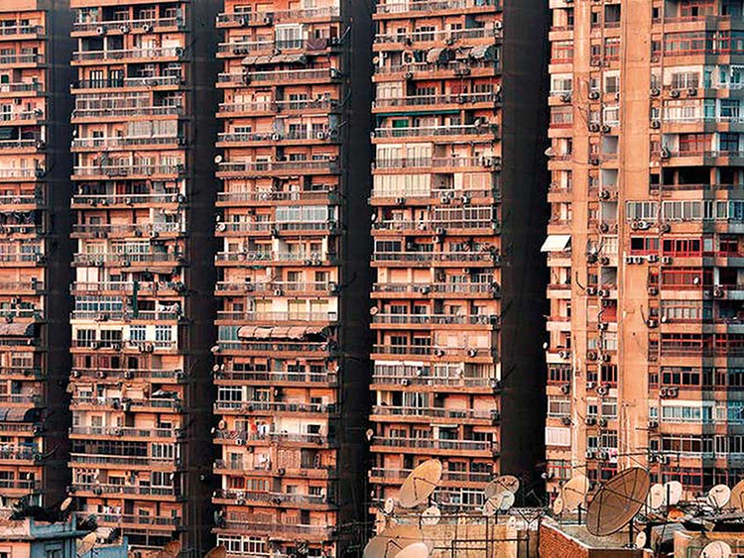
10. OVERPOPULATION AND WASTE MANAGEMENT
The UN expects the world population to exceed 8.5 billion by 2030, forcing us to considerably reduce the amount of waste we generate through prevention, reduction, reuse and recycling as part of the circular economy, with the aim of minimising the impact on health and on the environment.

Slide 30
The Natural World
in Jewish Thought

Slide 31
The Natural World in Jewish Thought
תהלים פרק קטו
(טז) הַשָּׁמַיִם שָׁמַיִם לַיקֹוָק וְהָאָרֶץ נָתַן לִבְנֵי אָדָם:
Psalms 115:16
The heavens are heavens of the Lord, but the earth He gave to the children of men.
בראשית פרק א פסוק כח
וַיְבָרֶךְ אֹתָם אֱלֹהִים וַיֹּאמֶר לָהֶם אֱלֹהִים פְּרוּ וּרְבוּ וּמִלְאוּ אֶת הָאָרֶץ וְכִבְשֻׁהָ וּרְדוּ בִּדְגַת הַיָּם וּבְעוֹף הַשָּׁמַיִם וּבְכָל חַיָּה הָרֹמֶשֶׂת עַל הָאָרֶץ:
Genesis 1:28
And God blessed them, and God said to them, “Be fruitful and multiply and fill the earth and subdue it, and rule over the fish of the sea and over the fowl of the sky and over all the beasts that tread upon the earth.”
בראשית פרק ב
(טו) וַיִּקַּח יְקֹוָק אֱלֹהִים אֶת הָאָדָם וַיַּנִּחֵהוּ בְגַן עֵדֶן לְעָבְדָהּ וּלְשָׁמְרָהּ:
Genesis 2:15
Now the Lord God took the man, and He placed him in the Garden of Eden to work it and to guard it.

Slide 32
The Natural World in Jewish Thought
Rabbi Shimshon Raphael Hirsch (d. 1888) on Genesis 2:15
Even if the earth is a paradise for man, he must do his work and perform his duty; the difference in Paradise is only that his labours are rewarded and his handiwork is blessed. … God placed him in a garden of delight and happiness, so that he should work for his happiness and preserve it with his own hands. By faithfully fulfilling his task, he will hold on to his happiness and even add to it. In any case, the עבודה and the שמירה of our verse do not refer only to the cultivation of the soil; rather, they include man’s whole moral conduct, in what he does and in what he refrains from doing. We have already indicated this above. Man’s moral conduct and his conscientious use of the bounties of nature advance nature toward its purpose and enable nature to continue flourishing: לעבדה ולשמרה. Our Sages, too, relate לעבדה ולשמרה to תורה ומצוות — i.e., to the totality of man’s purpose (see Bereshis Rabbah 16:5).

Slide 33
The Natural World in Jewish Thought
תהלים פרק כד פסוק א
לְדָוִד מִזְמוֹר לַיקֹוָק הָאָרֶץ וּמְלוֹאָהּ תֵּבֵל וְיֹשְׁבֵי בָהּ:
Psalms 24:1
Of David, a song. The land and the fullness thereof are the Lord's; the world and those who dwell therein.
בראשית פרק א פסוק כו
וַיֹּאמֶר אֱלֹהִים נַעֲשֶׂה אָדָם בְּצַלְמֵנוּ כִּדְמוּתֵנוּ וְיִרְדּוּ בִדְגַת הַיָּם וּבְעוֹף הַשָּׁמַיִם וּבַבְּהֵמָה וּבְכָל הָאָרֶץ וּבְכָל הָרֶמֶשׂ הָרֹמֵשׂ עַל הָאָרֶץ:
Genesis 1:26
And God said, “Let us make man in our image, after our likeness, and they shall rule over the fish of the sea and over the fowl of the heaven and over the animals and over all the earth and over all the creeping things that creep upon the earth.”
בראשית פרק ב
(יז) וּמֵעֵץ הַדַּעַת טוֹב וָרָע לֹא תֹאכַל מִמֶּנּוּ כִּי בְּיוֹם אֲכָלְךָ מִמֶּנּוּ מוֹת תָּמוּת:
Genesis 2:17
But of the Tree of Knowledge of good and evil you shall not eat of it, for on the day that you eat thereof, you shall surely die."

Slide 34
The Natural World in Jewish Thought
Rabbi Lord Jonathan Sacks (d. 2020) “The Stewardship Paradigm”
The mandate in Genesis 1 to exercise dominion is, therefore, not technical, but moral: humanity would control, within our means, the use of nature towards the service of God. Further, this mandate is limited by the requirement to serve and guard as seen in Genesis 2. The famous story of Genesis 2-3 - the eating of the forbidden fruit and Adam and Eve's subsequent exile from Eden - supports this point. Not everything is permitted. There are limits to how we interact with the earth. The Torah has commandments regarding how to sow crops, how to collect eggs, and how to preserve trees in a time of war, just to name a few. When we do not treat creation according to God's Will, disaster can follow.

Slide 35
The Natural World in Jewish Thought
קהלת רבה פרשה ז:יג
בְּשָׁעָה שֶׁבָּרָא הַקָּדוֹשׁ בָּרוּךְ הוּא אֶת אָדָם הָרִאשׁוֹן, נְטָלוֹ וְהֶחֱזִירוֹ עַל כָּל אִילָנֵי גַּן עֵדֶן, וְאָמַר לוֹ, רְאֵה מַעֲשַׂי כַּמָּה נָאִים וּמְשֻׁבָּחִין הֵן, וְכָל מַה שֶּׁבָּרָאתִי בִּשְׁבִילְךָ בָּרָאתִי, תֵּן דַּעְתְּךָ שֶׁלֹא תְקַלְקֵל וְתַחֲרִיב אֶת עוֹלָמִי, שֶׁאִם קִלְקַלְתָּ אֵין מִי שֶׁיְתַקֵּן אַחֲרֶיךָ.
Ecclesiaties Rabbah 7:13
When God created the first human beings, God led them around all the trees of the Garden of Eden and said: “Look at My works! See how beautiful they are—how excellent! For your sake I created them all. See to it that you do not spoil and destroy My world; for if you do, there will be no one else to repair it.”

Slide 36
Shechita and Vegetarianism

Slide 37
Shechita and Vegetarianism
בראשית פרק א
(כט) וַיֹּאמֶר אֱלֹהִים הִנֵּה נָתַתִּי לָכֶם אֶת כָּל עֵשֶׂב זֹרֵעַ זֶרַע אֲשֶׁר עַל פְּנֵי כָל הָאָרֶץ וְאֶת כָּל הָעֵץ אֲשֶׁר בּוֹ פְרִי עֵץ זֹרֵעַ זָרַע לָכֶם יִהְיֶה לְאָכְלָה: (ל) וּלְכָל חַיַּת הָאָרֶץ וּלְכָל עוֹף הַשָּׁמַיִם וּלְכֹל רוֹמֵשׂ עַל הָאָרֶץ אֲשֶׁר בּוֹ נֶפֶשׁ חַיָּה אֶת כָּל יֶרֶק עֵשֶׂב לְאָכְלָה וַיְהִי כֵן:
Genesis 1:29-30
29. And God said, "Behold, I have given you every seed-bearing herb, which is upon the surface of the entire earth, and every tree that has seed bearing fruit; it will be yours for food. 30. And to all the beasts of the earth and to all the fowl of the heavens, and to everything that moves upon the earth, in which there is a living spirit, every green herb to eat," and it was so.
בראשית פרק ט פסוק ג
כָּל רֶמֶשׂ אֲשֶׁר הוּא חַי לָכֶם יִהְיֶה לְאָכְלָה כְּיֶרֶק עֵשֶׂב נָתַתִּי לָכֶם אֶת כֹּל:
Genesis 9:3
Every moving thing that lives shall be yours to eat; like the green vegetation, I have given you everything.

Slide 38
Shechita and Vegetarianism
תלמוד בבלי מסכת סנהדרין דף נט עמוד ב
אמר רב יהודה אמר רב: אדם הראשון לא הותר לו בשר לאכילה, דכתיב (בראשית א') לכם יהיה לאכלה ולכל חית הארץ - ולא חית הארץ לכם.
Babylonian Talmud Tractate Sanhedrin 59b
Rav Yehuda says that Rav says: Meat was not permitted to Adam, the first man, for consumption, as it is written: “And God said: Behold, I have given you every herb that brings forth seed, which is upon the face of all the earth, and every tree, in which is the fruit of a tree that gives forth seed; for you it shall be for food, and for every animal of the earth, and for every fowl of the air, and for everything that creeps upon the earth, in which there is a living soul, every green herb for food. And it was so” (Genesis 1:29–30). It is derived God told Adam: Eating vegetation is permitted to people and animals but eating the animals of the earth is not permitted to you.

Slide 39
Shechita and Vegetarianism
וכשבאו בני נח התיר להם, שנאמר (בראשית ט') כירק עשב נתתי לכם את כל יכול לא יהא אבר מן החי נוהג בו ת"ל אך בשר בנפשו דמו לא תאכלו יכול אף לשרצים ת"ל אך.
But when the children of Noah came, God permitted them to eat meat; as it is stated: “Every moving thing that lives shall be for food for you; as the green herb I have given you all” (Genesis 9:3). One might have thought that accordingly, even the prohibition against eating a limb from a living animal does not apply to the descendants of Noah; therefore the verse states: “Only flesh with its life, which is its blood, you shall not eat” (Genesis 9:4). One might have thought that the prohibition against eating a limb from a living animal applies even to creeping animals; therefore the verse states “only,” a term used for exclusion, indicating that creeping animals are not included.

Slide 40
Shechita and Vegetarianism
הרב אברהם יצחק הכהן קוק, חזון הצמיחות והשלום - שחיטה אנושית
השחיטה עצמה צריכה להתקדש כתכונה מיוחדת דוקא "כאשר ציויתיך" )דברים יב( במיעוט צערו של החי, למען השריש עי"ז בלבו של אדם, כי הוא נגש לא להיות לו עסק עם דבר של הפקר, שאין בו אלא תנועה אבטומטית, כ"א גם בריה חיה ומרגשת, שצריך להתחשב עם חושיה, ואפילו עם רגשי לבה, עם רגש חיי המשפחה שלה וחמלתה על צאצאיה, באיסור אותו ואת בנו, מחוסר זמן ושילוח הקן.
Rav Kook (d. 1935) “A Vision of Vegetarianism and Peace” – Humane Slaughter
The act of slaughter (shechita) must be sanctified in a unique manner – “as I have commanded you” – with a minimum of pain to the animal. Thus, the person will take to heart the fact that this is a sentient being; he is not involved with a random object that moves about like an automaton, but with a living, feeling creature. He must become attuned to its senses, even to its emotions, to the feeling it has for the life of its family members, and to its compassion for its own offspring. Thus, it is biblically forbidden to kill the mother bird with her children on the same day or to slaughter a calf before it is eight days old; and it is a positive precept to send away the mother bird before taking her young.

Slide 41
Shechita and Vegetarianism
הרב אברהם יצחק הכהן קוק, חזון הצמיחות והשלום - הערת השכל וצמחונות
ע"כ ראתה ההסכמה האלהית, שרק היא יכולה לסול מסילות בקרב כליות ולב, לנתק את פתיל החבור בין האדם לבע"ח, למען יתרכז מרכז המוסרי האנושי בטובתו המיוחדת ואז, רק אז, יצליח להביא לו את אשרו בקץ הימים.
Rav Kook (d. 1935) “A Vision of Vegetarianism and Peace” – Enlightenment and Vegetarianism
When humanity reaches its goal of complete happiness and spiritual liberation, when it attains that lofty peak of perfection that is the pure knowledge of God and the full manifestation of the essential holiness of life, then the age of “motivation by virtue of enlightenment” will have arrived.

Slide 42
Shechita and Vegetarianism
ובבא האנושות למטרת אשרה וחופשה השלם, בבאה עד מרום פסגת ההשלמה של דעת אלהים צרופה, אל קדושת החיים המלאים בצביונם, אז יגיע תור "הערת השכל" שהוא בבנין נוסד על יסוד "הערת התורה" שקדמתה לכלל האנושיות, ויכיר אז האדם את יחשו אל חבריו ביצירה בעה"ח כולם, איך הוא ראוי להיות מצד המוסר הטהור שאיננו נזקק עוד לויתורים של דוחק, לצירוף של מדת הרחמים עם מדת הדין ביחש אליו הפרטי, לויתורים שלא דברה בהם תורה אלא כנגד יצה"ר.
This is like a structure built on the foundation of “motivation by virtue of the law,” which of necessity must precede [that of "motivation by virtue of enlightenment"] for all humanity. Then human beings will recognize their companions in Creation: all the animals. And they will understand how it is fitting from the standpoint of the purest ethical standard not to resort to moral concessions, to compromise the Divine attribute of justice with that of mercy [by permitting mankind's exploitation of animals]; for they will no longer need extenuating concessions, as in those matters of which the Talmud states: “The Torah speaks only of the evil inclination” (Kiddushin 31b).

Slide 43
Shechita and Vegetarianism
כ"א ללכת באורח טוב מוחלט, "וכרתי להם ברית ביום ההוא עם חית השדה ועוף השמים ורמש האדמה, וקשת וחרב ומלחמה אשבור מן הארץ" (הושע ב.)
Rather they will walk the path of absolute good - as the prophet declares: “I will make a covenant for them with the animals of the field, the birds of the air, and the creeping things of the ground; I also will banish the bow and sword, and war from the land [and I will cause them to rest in safety. I will betroth you to Me forever; and I will betroth you to Me with righteousness, with justice, with kindness, and with compassion; and I will betroth you to Me with faith, and you will know God]” (Hosea 2:20).

Slide 44
Population Growth

Slide 45
Population Growth
בראשית פרק א פסוק כח
וַיְבָרֶךְ אֹתָם אֱלֹהִים וַיֹּאמֶר לָהֶם אֱלֹהִים פְּרוּ וּרְבוּ וּמִלְאוּ אֶת הָאָרֶץ וְכִבְשֻׁהָ וּרְדוּ בִּדְגַת הַיָּם וּבְעוֹף הַשָּׁמַיִם וּבְכָל חַיָּה הָרֹמֶשֶׂת עַל הָאָרֶץ:
Genesis 1:28
And God blessed them, and God said to them, “Be fruitful and multiply and fill the earth and subdue it, and rule over the fish of the sea and over the fowl of the sky and over all the beasts that tread upon the earth.”
ישעיהו פרק מה פסוק יח
כִּי כֹה אָמַר יְקֹוָק בּוֹרֵא הַשָּׁמַיִם הוּא הָאֱלֹהִים יֹצֵר הָאָרֶץ וְעֹשָׂהּ הוּא כוֹנְנָהּ לֹא תֹהוּ בְרָאָהּ לָשֶׁבֶת יְצָרָהּ אֲנִי יְקֹוָק וְאֵין עוֹד:
Isaiah 45:18
For so said the Lord, the Creator of heaven, Who is God, Who formed the earth and made it, He established it; He did not create it for a waste, He formed it to be inhabited, "I am the Lord and there is no other.

Slide 46
Population Growth
תלמוד בבלי מסכת חגיגה דף ב עמוד א - ב
מי שחציו עבד וחציו בן חורין - עובד את רבו יום אחד ואת עצמו יום אחד, דברי בית הלל. אמרו להם בית שמאי: תלמוד בבלי תקנתם את רבו, ואת עצמו לא תקנתם; לישא שפחה - אינו יכול, בת חורין - אינו יכול.
Babylonian Talmud Tractate Chagigah 2a-b
One who is half-slave half-freeman serves his master one day and works for himself one day. This is the statement of Beit Hillel. Beit Shammai said to them: You have remedied the situation of his master, who benefits fully from all his rights to the slave, but his own situation you have not remedied. How so? He is unable to marry a maidservant, as half of him is already free, and a free Jew may not marry a Canaanite maidservant. He is likewise unable to marry a free woman, as half of him is still a slave.

Slide 47
Population Growth
ליבטיל? והלא לא נברא העולם אלא לפריה ורביה, שנאמר +ישעיהו מ"ה+ לא תהו בראה לשבת יצרה! אלא, מפני תיקון העולם כופין את רבו ועושה אותו בן חורין, וכותב לו שטר על חצי דמיו. וחזרו בית הלל להורות כדברי בית שמאי.
And if you say he should be idle and not marry, but isn’t it true that the world was created only for procreation, as it is stated: “He did not create it to be a waste; He formed it to be inhabited” (Isaiah 45:18)? Rather, for the betterment of the world we force his master to make him a freeman, and the slave writes a bill to his master accepting his responsibility to pay half his value to him. And Beit Hillel ultimately retracted their opinion, to rule in accordance with the statement of Beit Shammai that a half-slave must be set free.

Slide 48
Disposable Culture

Slide 49
Disposable Culture
בראשית פרק לב
(כה) וַיִּוָּתֵר יַעֲקֹב לְבַדּוֹ וַיֵּאָבֵק אִישׁ עִמּוֹ עַד עֲלוֹת הַשָּׁחַר:
Genesis 32:25
And Jacob was left alone, and a man wrestled with him until the break of dawn.
רש"י בראשית פרק לב פסוק כה
(כה) ויותר יעקב - שכח פכים קטנים וחזר עליהם:
Rashi on Genesis 32:25
And Jacob was left: He had forgotten small bottles and returned for them.

Slide 50
Safeguarding the Environment

Slide 51
Safeguarding the Environment
דברים פרק כ
(יט) כִּי תָצוּר אֶל עִיר יָמִים רַבִּים לְהִלָּחֵם עָלֶיהָ לְתָפְשָׂהּ לֹא תַשְׁחִית אֶת עֵצָהּ לִנְדֹּחַ עָלָיו גַּרְזֶן כִּי מִמֶּנּוּ תֹאכֵל וְאֹתוֹ לֹא תִכְרֹת כִּי הָאָדָם עֵץ הַשָּׂדֶה לָבֹא מִפָּנֶיךָ בַּמָּצוֹר: (כ) רַק עֵץ אֲשֶׁר תֵּדַע כִּי לֹא עֵץ מַאֲכָל הוּא אֹתוֹ תַשְׁחִית וְכָרָתָּ וּבָנִיתָ מָצוֹר עַל הָעִיר אֲשֶׁר הִוא עֹשָׂה עִמְּךָ מִלְחָמָה עַד רִדְתָּהּ:
Deuteronomy 20:19-20
19. When you besiege a city for many days to wage war against it to capture it, you shall not destroy its trees by wielding an ax against them, for you may eat from them, but you shall not cut them down. Is the tree of the field a man, to go into the siege before you? 20. However, a tree you know is not a food tree, you may destroy and cut down, and you shall build bulwarks against the city that makes war with you, until its submission.

Slide 52
Safeguarding the Environment
רמב"ם הלכות מלכים פרק ו הלכה י
ולא האילנות בלבד, אלא כל המשבר כלים, ג וקורע בגדים, והורס בנין, וסותם מעין, ומאבד מאכלות דרך השחתה, עובר בלא ד תשחית, ואינו לוקה אלא מכת מרדות מדבריהם.
Rambam Laws of Kings 6:10
This prohibition does not apply to trees alone. Rather, anyone who breaks utensils, tears garments, destroys buildings, stops up a spring, or ruins food with a destructive intent transgresses the command 'Do not destroy.' However, he is not lashed. Instead, he receives stripes for rebellious conduct as instituted by the Sages.

Slide 53
Safeguarding the Environment
Rabbi Lord Jonathan Sacks (d. 2020) “The Ecological Imperative”
First and foremost is the fact that the earth is not ours. It belongs to its Creator, to God Himself. That is the point of the first chapter of the Torah: “In the beginning, God created…” He made it; therefore, He is entitled to lay down the conditions within which we live in it as His guests.
Environmental responsibility seems to be one of the principles underlying the three great commands of periodic rest: Shabbat, the Sabbatical year, and the Jubilee year. On Shabbat all agricultural work is forbidden, “so that your ox and your donkey may rest” (Ex. 23:12). It sets a limit to our intervention in nature and the pursuit of economic growth. We remind ourselves that we are creations, not just creators. For six days the earth is handed over to us and our labours, but on the seventh we may perform no “work,” namely, any act that alters the state of something for human purposes. Shabbat is thus a weekly reminder of the integrity of nature and the limits of human striving.

Slide 54
Safeguarding the Environment
What Shabbat does for humans and animals, the Sabbatical and Jubilee years do for the land. The earth too is entitled to its periodic rest. The Torah warns that if the Israelites do not respect this, they will suffer exile: “Then shall the land make up for its Sabbatical years throughout the time that it is desolate and you are in the land of your enemies; then shall the land rest and make up for its Sabbath years” (Lev. 26:34). Behind this are two concerns. One is environmental.
As Maimonides points out, land which is overexploited eventually erodes and loses its fertility. The Israelites were therefore commanded to conserve the soil by giving it periodic fallow years, not pursuing short-term gain at the cost of long-term desolation. The second, no less significant, is theological: “The land,” says God, “is Mine; you are but strangers and temporary residents with Me” (Lev. 25:23). We are guests on earth.

Slide 55
Conclusions

Slide 56
Conclusions
תלמוד בבלי מסבת תענית כג.
יוֹמָא חַד הֲוָה אָזֵל בְּאוֹרְחָא חַזְיֵיהּ לְהָהוּא גַּבְרָא דַּהֲוָה נָטַע חָרוּבָא אֲמַר לֵיהּ הַאי עַד כַּמָּה שְׁנִין טָעֵין אֲמַר לֵיהּ עַד שִׁבְעִין שְׁנִין אֲמַר לֵיהּ פְּשִׁיטָא לָךְ דְּחָיֵית שִׁבְעִין שְׁנִין אֲמַר לֵיהּ הַאי גַּבְרָא עָלְמָא בְּחָרוּבָא אַשְׁכַּחְתֵּיהּ כִּי הֵיכִי דִּשְׁתַלוּ לִי אֲבָהָתִי שְׁתַלִי נָמֵי לִבְרָאִי
Babylonian Talmud Tractate Taanis 23a
One day, he was walking along the road when he saw a certain man planting a carob tree. Choni said to him: After how many years will this tree bear fruit? The man said to him: It will not produce fruit until seventy years have passed. Ḥoni said to him: Is it obvious to you that you will live seventy years, that you expect to benefit from this tree? He said to him: That man himself found a world full of carob trees. Just as my ancestors planted for me, I too am planting for my descendants.

Slide 57
Conclusions
Rabbi Lord Jonathan Sacks (d. 2020) “The Ecological Imperative”
Václav Havel [Former President of Czechoslovakia] made a fundamental point in The Art of the Impossible: “I believe that we have little chance of averting an environmental catastrophe unless we recognise that we are not the masters of Being, but only a part of Being.”
That is why a religious vision is so important, reminding us that we are not owners of our resources. They belong not to us but to the Eternal and eternity. Hence we may not needlessly destroy. If that applies even in war, how much more so in times of peace. “The earth is the Lord’s and all that is in it” (Ps. 24:1). We are its guardians, on behalf of its Creator, for the sake of future generations.

Slide 58
THE JEWISH APPROACH TO RESILIANCE
8PM ON
SUNDAY 11TH JULY
What the world can learn from the
Jewish experience of tragedy,
suffering and redemption.

Slide 59
Thank You
rabbi@newwestend.org.uk
07531 326289
@moshefreedman

